Slide 1
Sum and product of roots theorem
LO: To use the sum and product of roots theorem.

Slide 2


Sum and product of roots.
We have seen that for the quadratic equation
ax² + bx + c = 0
a, b, c ∈ ℝ and a ≠ 0
The sum of the roots x₁ + x₂ is
$$−\frac{b}{a}$$
$$\frac{c}{a}$$
And the product of the roots x₁ x₂ is
Find the zeros of this equations:
x² + 6x + 5 = 0
2x² – 3x + 4 = 0
x² – 4x + 5 = 0
Find the sum and the product of their roots

Slide 3
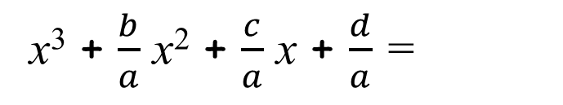
Polynomials of third degree.
Given a cubic equation
ax³ + bx² + cx + d = 0
a, b, c, d ∈ ℝ and a ≠ 0
and x₁, x₂ and x₃ are the solutions
We can factorise the cubic polynomial
f(x) = ax³ + bx² + cx + d =
a(x – x₁) (x – x₂) (x – x₃)
[
]
x³ + $\frac{b}{a}$ x² + $\frac{c}{a}$ x + $\frac{d}{a}$ =
(x – x₁) (x – x₂) (x – x₃)
Dividing by a
Expanding the right hand side of the equation
Expanding the first two brackets
[x² – x₂x
– x₁x + x₁x₂]
(x – x₃)
Multiplying out the third bracket
x³ – x₂x² – x₁x² + x₁x₂x
– x₃x² + x₂x₃x + x₁x₃x – x₁x₂ x₃)
Put the terms in order
[
]
[
]
x³ – x₁x² – x₂x² – x₃x² + x₁x₂x + x₁x₃x + x₂x₃x – x₁x₂ x₃
Grouping
x³
– (x₁ + x₂ + x₃)x²
+ (x₁x₂ + x₁x₃ + x₂x₃)x
– x₁x₂ x₃

Slide 4

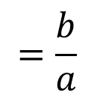
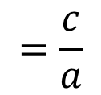
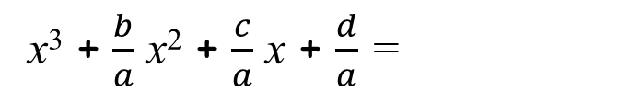

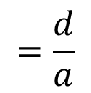
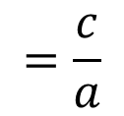
Polynomials of third grade.
x³ + $\frac{b}{a}$ x² + $\frac{c}{a}$ x + $\frac{d}{a}$ =
x³– (x₁+x₂+x₃)x² + (x₁x₂+x₁x₃+x₂x₃)x – x₁x₂ x₃
$$=\frac{b}{a}$$
$$=\text{–}\frac{b}{a}$$
– (x₁+x₂+x₃)
⇒
(x₁+x₂+x₃)
(x₁x₂+x₁x₃+x₂x₃)
$$=\frac{c}{a}$$
(x₁x₂+x₁x₃+x₂x₃)
$$=\frac{c}{a}$$
⇒
$$=\frac{d}{a}$$
$$=\text{–}\frac{d}{a}$$
– (x₁x₂ x₃)
(x₁x₂ x₃)
⇒
These are Viète’s formulae for cubic equations.
Find a similar formulae that satisfy the relationship between the zeros and the coefficients of a quartic polynomial.
ax⁴ + bx³ + cx² + dx + e = 0
a, b, c, d, e ∈ ℝ and a ≠ 0

Slide 5



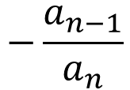

Polynomials of the nth degree.
Given a polynomial
f(x) = a_{n}x^{n} + a_{n-1}x^{n-1} + a_{n-2}x^{n-2} + … + a₂x² + a₁x + a₀
With real or complex coefficients (a_{n} ≠ 0 )
and zeros x₁, x₂ … x_{n} then
x₁+x₂+x₃+ … +x_{n}
$$=−\frac{a_{n−1}}{a_{n}}$$
(x₁x₂+x₁x₃+ … +x₁x_{n}+ x₂x₃+ x₂x₄+ … +x₂x_{n}+ … x_{n-1}x_{n}
$$=\frac{a_{n−2}}{a_{n}}$$
. . .
x₁x₂ x₃… x_{n}
$$={\left(−1\right)}^{n}\frac{a_{0}}{a_{n}}$$
The sum of all the roots x₁ + x₂+ … + x_{n} is
$$−\frac{a_{n−1}}{a_{n}}$$
$${\left(−1\right)}^{n}\frac{a_{0}}{a_{n}}$$
And the product of the roots x₁ x₂ … x_{n} is

Slide 6
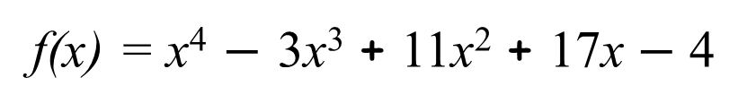
Polynomials of the nth degree.
Example 1:
Find the sum and product of the zeros of these polynomial.
f(x) = x⁴ $−$ 3x³ + 11x² + 17x $−$ 4
For a polynomial of degree n you need to use: a_{n}, a_{n-1} and a₀
n = 4
x₁+x₂+x₃+x₄
$$=−\frac{a_{n−1}}{a_{n}}$$
$$=−\frac{−3}{1}$$
= $3$
a_{n} = a₄ = 1
a_{n-1} = a₃ = $−$3
a₀ = $−$4
x₁x₂ x₃ x₄
$$={\left(−1\right)}^{n}\frac{a_{0}}{a_{n}}$$
$$={\left(−1\right)}^{4}\frac{− \text{4}}{1}$$
=$− \text{4}$

Slide 7
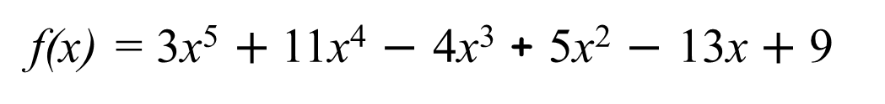
Polynomials of the nth degree.
Example 2:
Find the sum and product of the zeros of these polynomial.
f(x) = 3x⁵ $+$11x⁴ $−$ 4x³ + 5x² $−$ 13x $+$ 9
For a polynomial of degree n you need to use: a_{n}, a_{n-1} and a₀
n = 5
x₁+x₂+x₃+x₄+x₅
$$=−\frac{a_{n−1}}{a_{n}}$$
$$=−\frac{11}{3}$$
a_{n} = a₅ = 3
a_{n-1} = a₄ = $11$
a₀ = $9$
x₁x₂ x₃ x₄ x₅
$$={\left(−1\right)}^{n}\frac{a_{0}}{a_{n}}$$
$$={\left(−1\right)}^{5}\frac{9}{3}$$
=$− \text{3}$

Slide 8
Polynomials of the nth degree.
Example 3:
Find a quadratic whose roots are
3 + 2i and 3 $−$ 2i.
Let the desired quadratic be x² + bx + c, where we wish to find b and c. Then Viete's formula tells us
n = 2
x₁+x₂
$$=−\frac{a_{n−1}}{a_{n}}$$
$$=−\frac{b}{1}$$
=$− \text{b}$
= 3 + 2i
+
3 $−$ 2i
a_{n} = a₂ = 1
$$− \text{b}$$
=$6$
a_{n-1} = a₁ = $b$
$$\text{b}$$
=$−6$
a₀ = $c$
x₁x₂
$$={\left(−1\right)}^{n}\frac{a_{0}}{a_{n}}$$
$$={\left(−1\right)}^{2}\frac{c}{1}$$
=$\text{c}$
= (3 + 2i)
(3 $−$ 2i)
x₁ = 3 + 2i
x₂ = 3 $−$ 2i
$$\text{c}$$
=$\text{1}\text{3}$
So the desired quadratic is
x² $−6$x + $\text{1}\text{3}$

Slide 9
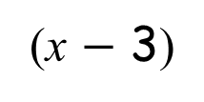
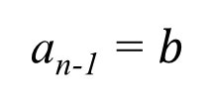
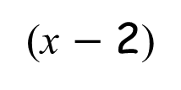
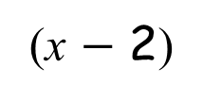
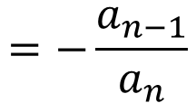

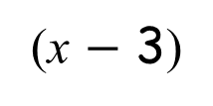
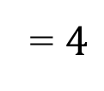
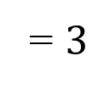
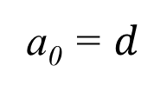
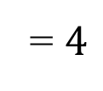
Polynomials of the nth degree.
Example 4:
Find a cubic polynomial with integer coefficients whose roots are -1, 2 and p, given that the sum of the roots is 4.
x₁ + x₂ + x₃
$$=−\frac{a_{n−1}}{a_{n}}$$
=$4$
n = 3
a_{n} = 1
⸫ -1
+ 2
+ p
=$4$
a_{n-1} = $b$
⸫ p
= $3$
The roots are: −1, 2, 3
a₀ = $d$
So, the polynomial is:
x₁ = -1
=
$$\text{a}$$
(x + 1)
(x $−$ 2)
(x $−$ 3)
x₂ = 2
Let’s choose a = 1 to get the simplest polynomial with integer coefficients:
x₃ = p
= (x + 1)
(x $−$ 2)
(x $−$ 3)
Now expand
So the desired cubic is
x³ – 4x² + x + 6

Slide 10
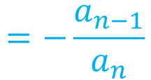
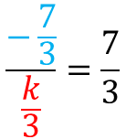
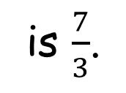
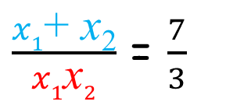

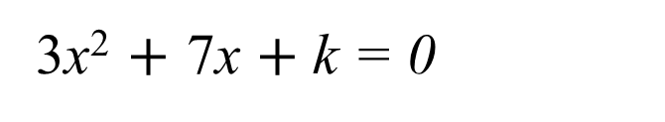

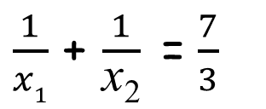
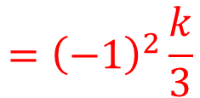
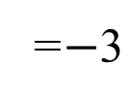
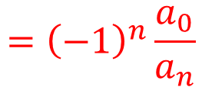
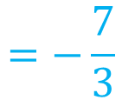

Polynomials of the nth degree.
Example 5:
If the sum of the reciprocals of the roots of the quadratic
is $\frac{7}{3}$.
3x² $+$ 7x $+$ k = 0
What is k?
x₁ and x₂ are the roots
$\frac{1}{x1}$ and $\frac{1}{\text{x}\text{2}}$ are the reciprocals of the roots
$\frac{1}{x1}$ + $\frac{1}{\text{x}\text{2}}$ is the sum of the reciprocals of the roots
$$\frac{−\frac{7}{3}}{\frac{k}{3}}=\frac{7}{3}$$
x₁+x₂
$$=−\frac{a_{n−1}}{a_{n}}$$
$$=−\frac{7}{3}$$
$\frac{1}{x1}$ + $\frac{1}{\text{x}\text{2}}$ =$\frac{7}{3}$
x₁x₂
$$={\left(−1\right)}^{n}\frac{a_{0}}{a_{n}}$$
$$={\left(−1\right)}^{2}\frac{k}{3}$$
$$=\frac{k}{3}$$
$\frac{x1\text{+} \text{x}\text{2}}{x1\text{x}2}$ = $\frac{7}{3}$
$$−\frac{21}{3k}=\frac{7}{3}$$
$$\text{k}$$
=$−\text{3}$

Slide 11

Thank you for using resources from
For more resources visit our website
https://www.mathssupport.org
If you have a special request, drop us an email
info@mathssupport.org

