Slide 1
Conjugate root theorem
LO: To apply the conjugate root theorem.

Slide 2
Conjugate root theorem.
“We know that some polynomials have complex solutions.
What might happen if those polynomials have real coefficients?
Can we predict pairs of roots?

Slide 3
Conjugate root theorem.
Given a polynomial
f(x) = a_{n}x^{n} + a_{n-1}x^{n-1} + a_{n-2}x^{n-2} + … + a₂x² + a₁x + a₀
where
a_{k} ∈ ℝ, k = 0, 1, 2, … n, and a_{n} ≠ 0
that has a complex zero z .
z = a + bi
f(z) = 0
then its conjugate z* is also a zero of the polynomial f.
z* = a – bi
f(z*) = 0

Slide 4
Conjugate root theorem.
If z is a zero
f(z) = 0
f(z) = a_{n}z^{n} + a_{n-1}z^{n-1} + … + a₂z² + a₁z + a₀
= 0
We have to prove that its conjugate z* is also a zero
f(z*) = 0
f(z*) = a_{n}(z*)^{n}+a_{n-1}(z*)^{n-1}+…+a₂(z*)² +a₁(z*)+a₀
= 0
Using the properties of conjugate numbers:
Conjugate of a power
f(z^{*)} = a_{n}(z^{n})* +a_{n-1}(z ^{n-1})*+…+a₂(z²)*+a₁(z)*+a₀
Conjugate of a product
f(z^{*)} = (a_{n}z^{n})* +(a_{n-1}z ^{n-1})*+…+(a₂z²)*+(a₁z)*+(a₀)*
= (f(z))*
Conjugate of a sum
f(z*) = (a_{n}z^{n} +a_{n-1}z ^{n-1}+…+a₂z² +a₁z+a₀)*
f(z*) =
(f(z))*
= 0*
= 0
QED

Slide 5










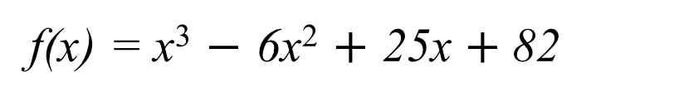








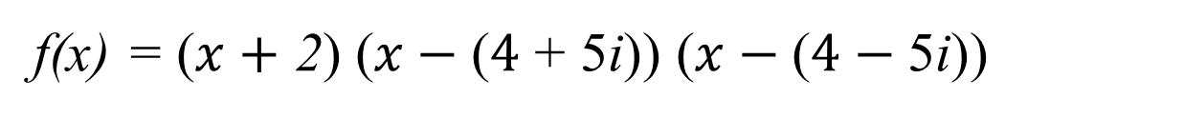
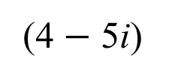








Conjugate root theorem.
Example 1:
Given that 4 + 5i is a complex zero of the polynomial.
f(x) = x³ $−$ 6x² $+$ 25x $+$ 82
Find all the remaining zeros.
Method 1:
Successively apply Horner’s algorithm to the complex numbers 4 + 5i and 4 – 5i.
$$1$$
$$−\text{6}$$
$$25$$
$$82$$
$$x1=$$
$$4+\text{5}\text{i}$$
$$\text{+}$$
$$\text{+}$$
$$\text{+}$$
(4 + 5i)
$$4\text{ + 5}\text{i}$$
$$−\text{33}\text{+ 10}\text{i}$$
$$−8\text{2}$$
The remaining zeros are:
$$1$$
$$−\text{2 + 5}\text{i}$$
$$−\text{8 + 10}\text{i}$$
$$0$$
$$\text{+}$$
$$\text{+}$$
$$x2=$$
$$4−\text{5}\text{i}$$
(4 $−$ 5i)
$$4−\text{5}\text{i}$$
$$8−\text{10}\text{i}$$
$$x3=$$
$$\text{2}$$
$$1$$
$$\text{2}$$
$$0$$
Fully factorise the polynomial
f(x) = ($x+$ 2) ($x−\text{(}4\text{ + 5}\text{i}\text{)}$) ($x−\text{(}4−\text{5}\text{i}\text{)}$)

Slide 6

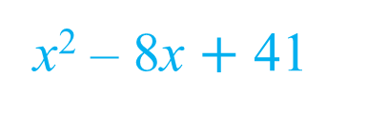

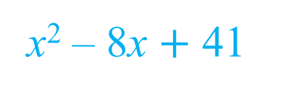
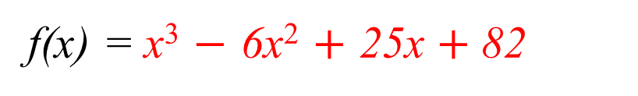

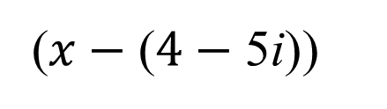

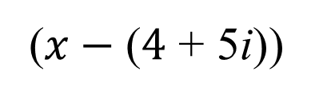


Conjugate root theorem.
Example 1:
Given that 4 + 5i is a complex zero of the polynomial.
f(x) = x³ $−$ 6x² $+$ 25x $+$ 82
Find all the remaining zeros.
Method 2:
Use the conjugate root theorem:
The first two factors are:
$$x1=$$
$$4+\text{5}\text{i}$$
Expanding brackets
($x−\text{(}4\text{ + 5}\text{i}\text{)}$)
($x−\text{(}4−\text{5}\text{i}\text{)}$)
x² – 8x $+$ 41
The remaining zeros are:
Using long division to find the last linear factor
x
+ 2
$$x2=$$
$$4−\text{5}\text{i}$$
x² – 8x $+$ 41
x³ – 6x² + 25x + 82
–
(
– 8x
)
x³
+ 41x
$$x3=$$
$$\text{2}$$
2x²
– 16x
+ 82
–
(
– 16x
)
2x²
+ 82
0
Fully factorised polynomial
f(x) = ($x+$ 2) ($x−\text{(}4\text{ + 5}\text{i}\text{)}$) ($x−\text{(}4−\text{5}\text{i}\text{)}$)

Slide 7









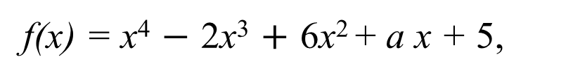








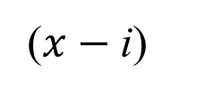




















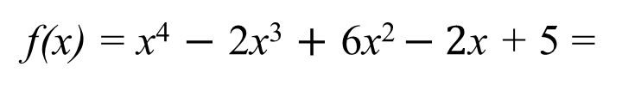


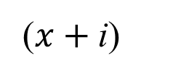


Conjugate root theorem.
Example 2:
Given that i is a complex zero of the polynomial.
f(x) = x⁴ $−$ 2x³ $+$ 6x² + a x + 5,
a ∈ ℝ, Find the value of a
Hence, find all the remaining zeros.
Apply Horner’s algorithm for $x1$ = i.
$$x1=$$
$$\text{i}$$
$$1$$
$$−\text{2}$$
$$6$$
$$a$$
$$5$$
$$x2=$$
$$–\text{i}$$
$$\text{+}$$
$$\text{+}$$
$$\text{+}$$
$$\text{+}$$
i
$$\text{i}$$
$$−\text{2}\text{i}−\text{1}$$
$$5\text{i}+2$$
$$2\text{i}+a\text{i}−\text{5}$$
If f(i) = 0
$$(2+a)\text{i}$$
$$=0$$
$$\text{5} −\text{2}\text{i}$$
$$\text{5}\text{i}$$
$$0$$
$$1$$
$$−\text{2 + }\text{i}$$
$$2+a+\text{5}\text{i}$$
$$(2+a)\text{i}$$
$$2+a$$
$$=0$$
$$\text{+}$$
$$\text{+}$$
$$\text{+}$$
$−$i
$$–\text{i}$$
$$2\text{i}$$
$$−\text{5}\text{i}$$
$$a$$
$$=−\text{2}$$
$$1$$
$$–\text{2}$$
$$\text{5}$$
$$0$$
f(x) = x⁴ $−$ 2x³ $+$ 6x² $− \text{2}$x + 5 =
($x−\text{i}\text{)}$
($x+\text{i}\text{)}$
(x² – 2x + 5)
We need two more zeros.

Slide 8


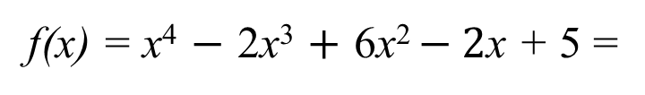





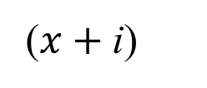

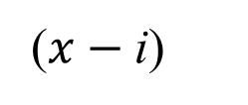




Conjugate root theorem.
Example 2:
Given that i is a complex zero of the polynomial.
f(x) = x⁴ $−$ 2x³ $+$ 6x² + a x + 5,
a ∈ ℝ, Find the value of a
Hence, find all the remaining zeros.
f(x) = x⁴ $−$ 2x³ $+$ 6x² $− \text{2}$x + 5 =
($x−\text{i}\text{)}$
($x+\text{i}\text{)}$
(x² – 2x + 5)
$$x1=$$
$$\text{i}$$
To find the remaining zeros we find the zeros of.
$$x2=$$
$$–\text{i}$$
$$=0$$
(x² – 2x + 5)
$$\text{– }\text{1}$$
$$=0$$
(x² – 2x ) + 5
$$+ 1$$
$$=0$$
(x – 1)² + 4
(x – 1)²
$$=\text{–4}$$
x – 1
$$=±\sqrt{−4}$$
x
$$=1±2i$$
$$x3=$$
$$1+2\text{i}$$
$$x4=$$
$$1–2\text{i}$$

Slide 9

Thank you for using resources from
For more resources visit our website
https://www.mathssupport.org
If you have a special request, drop us an email
info@mathssupport.org

