Slide 1
Graphing cubic functions
LO: To graph cubic functions

Slide 2
Cubic functions
Introductory Questions
What does the graph of a cubic function look like?
How can we tell what it will do just by looking at the equation?
What happens to f(x) = x³ as x → ∞ or x → -∞?
What is the effect of multiplying the function by a positive or negative constant?
What might change if we shift the function left, right, up, or down?

Slide 3

Cubic functions
The most basic cubic function is
y = x³
We graph the function for values of x between –3 and 3.
x
–3
–2
–1
0
1
2
3
y = x³
–27
– 8
– 1
0
1
8
27
y
y
Notice that:
40
The graph is horizontal at (0, 0)
30
As x gets very large and positive, y also gets very large and positive
20
10
We write: as x → ∞, y → ∞
–3
–2
–1
0
1
2
3
x
As x gets very small and negative, y also gets very small and negative
– 10
–20
We write: as x → –∞, y → –∞
–30

Slide 4
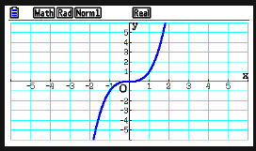
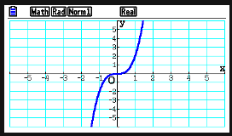
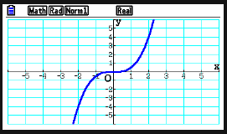
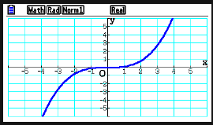
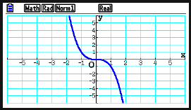
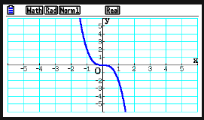
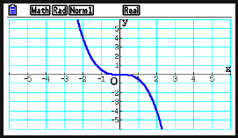
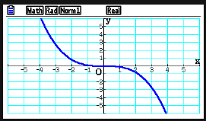




Using a GDC, transformations of the cubic function
We are going to investigate the effect of putting positive or a negative constant value (a) multiplying the function.
f(x) = x³
f(x) = 2x³
f(x) = $\frac{1}{2}x^{3}$
f(x) = $\frac{1}{10}x^{3}$
Look at your graphs. What can you say about the cubic function after multiplying the function by a positive constant value?
Vertical stretch
What is the effect of multiplying y by a positive constant a?
f(x) = –x³
f(x) = –2x³
f(x) =$−\frac{1}{2}x^{3}$
f(x) = $−\frac{1}{10}x^{3}$
What is the effect of multiplying y by a negative constant?
Vertical stretch and reflection over the x-axis
For the curve y = ax³, What is the geometrical significance of a?

Slide 5
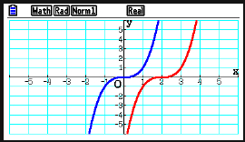
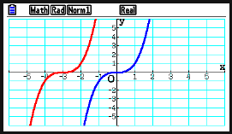
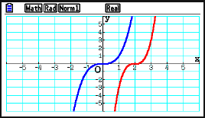
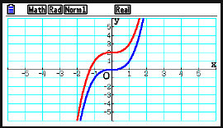
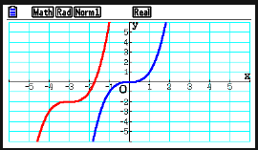
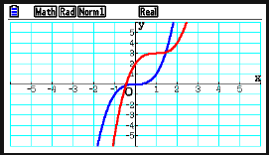
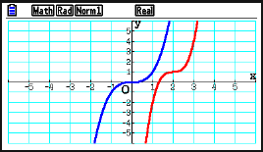


Using a GDC, transformations of the cubic function
We are going to investigate the effect of adding a positive or a negative constant value (b and c) to the function.
f(x) = x³
f(x) = (x – 2)³
f(x) = (x + 3)³
f(x) =3(x – 2)³
Look at your graphs. For the curve y = (x ± b)³
What is the geometrical significance of b?
f(x) = x³ + 2
f(x) = (x + 3)³ – 2
f(x) =$\text{(}\text{x} \text{–}\text{ 1}\text{)}\text{3} \text{+} \text{3}$
f(x) = 3(x – 2)³ $\text{+} \text{1}$
Look at your graphs. For the curve y = (x ± b)³ + c
What is the geometrical significance of c?
How the graph of y = a(x ± b)³ + c is obtained from the curve y = x³,

Slide 6
Cubic functions
Example 1:
On the same set of axes, sketch the graph of y = x³ and
y = (x – 2)³ – 1
y
y
y = x³
Sketch the graph of y = x³
8
6
All the points will be translated by two units to the right
4
2
x
And one unit downward
–3
–2
–1
0
1
2
3
–2
–4
–6
We sketch the new graph
y = (x – 2)³ – 1
–8

Slide 7
Graphs of cubic polynomials
Cubic polynomials in factorized form
Every real cubic polynomial can be categorized into one of four types
In each case a ∊ ℝ, a ≠ 0, and the constants α, β and γ corresponds to zeros
Type 1:
Three real, distinct zeros:
P(x) = a(x – α)(x – β)(x – γ)
Try sketching graphs, giving values to a , α, β and γ ∊ ℝ
Try positive and negative values for a.
α
γ
x
β
State the effect of changing both the size and sign of a.
What is the geometrical significance of α, β and γ ?
The graph has three distinct x-intercepts corresponding to the three distinct zeros α, β and γ ?

Slide 8
Graphs of cubic polynomials
Cubic polynomials in factorized form
Every real cubic polynomial can be categorized into one of four types
In each case a ∊ ℝ, a ≠ 0, and the constants α, β and γ corresponds to zeros
Type 2:
Two real zeros, one repeated:
P(x) = a(x – α)²(x – β)
Try sketching graphs, giving values to a , α and β ∊ ℝ
Try with positive and negative values for a.
α
β
x
What is the geometrical significance of the square factor ?
For a cubic of the form P(x) = a(x – α)²(x – β) where α, β ∊ ℝ the graph touches the x-axis at α and cut it at β

Slide 9
Graphs of cubic polynomials
Cubic polynomials in factorized form
Every real cubic polynomial can be categorized into one of four types
In each case a ∊ ℝ, a ≠ 0, and the constants α, β and γ corresponds to zeros
Type 3:
One real zero repeated three times:
P(x) = a(x – α)³
Try sketching graphs, giving values to a , α and β ∊ ℝ
Try with positive and negative values for a.
α
x
What is the geometrical significance of α?
For a cubic of the form P(x) = a(x – α)³ where α ∊ ℝ the graph has only one x-intercept at α

Slide 10
Graphs of cubic polynomials
Cubic polynomials in factorized form
Every real cubic polynomial can be categorized into one of four types
In each case a ∊ ℝ, a ≠ 0, and the constants α, β and γ corresponds to zeros
Type 4:
One real zero
P(x) = (x – α)(ax² + bx + c), Δ = b² – 4ac < 0
Try sketching graphs, giving values to a , α and β ∊ ℝ
Try with values for a, b and c that give Δ < 0
α
x
What is the significance of the quadratic factor which has no real zeros?
For a cubic of the form P(x) = (x – α)(ax² + bx + c), where Δ < 0
There is only one x-intercept, α

Slide 11
Using axis intercepts
Use the axes intercepts to sketch the graph of this function
f(x) = 2(x + 3)(x + 1)(x – 2)
x-intercepts occur when y = 0
(–3, 0)
(–1, 0)
(2, 0)
y-intercepts occur when x = 0
y
y
f(0) = 2(0 + 3)(0 + 1)(0 – 2)
f(0) = – 12
As a > 0 the graph has this shape
x
… and the points are then joined together with a smooth curve.
–3
–2
–1
0
1
2
3
The shape of this graph is characteristic of a cubic function.
–12

Slide 12
Using axis intercepts
Use the axes intercepts to sketch the graph of this function
f(x) = –x (x + 3)²
x-intercepts occur when y = 0
(0, 0)
(–3, 0)
y
y
y-intercepts occur when x = 0
f(0) = 0(0 + 3)²
f(0) = 0
x
As a < 0 the graph has this shape
–3
–2
–1
0
1
2
3
… and the points are then joined together with a smooth curve.

Slide 13
Finding a cubic function
Find the equation of the cubic function with this graph
The x-intercepts are –1, 2 , and 4
y
y
f(x) = a(x + 1)(x – 2)(x – 4)
When x = 0 y = –8
2
4
x
–8 = a(0 + 1)(0 – 2)(0 – 4)
–1
0
–8 = a(1)(2)(4)
–8 = 8a
–8
a = –1
So, f(x) = –(x + 1)(x – 2)(x – 4)

Slide 14
Finding a cubic function
Find the equation of the cubic function with this graph
The x-intercepts are -3, and touches at 1
y
y
f(x) = a(x + 3)(x – 1)²
When x = 0 y = 6
6
6 = a(0 + 3)(0 – 1)²
6 = a(3)(1)²
–3
0
1
x
6 = 3a
a = 2
So, f(x) = 2(x + 3)(x – 1)²

Slide 15
Finding a cubic function
Find the equation of the cubic function which has x-intercepts 1 and 3, y-intercept 9 and passes through (–1, 8)
The x-intercepts are 1 and 3, so (x – 1) and (x – 3) are linear factors
We suppose the third factor is (ax + b)
So, f(x) = (ax + b)(x – 1)(x – 3)
When f(0) = 9
When f(– 1) = 8
8 = (–1a + 3)(–1 – 1)(–1 – 3)
9 = (0a + b)(0 – 1)(0 – 3)
8 = (3 – a)(– 2)(– 4)
9 = b(-1)(-3)
8 = (3 – a)(8)
9 = 3b
1 = 3 – a
b = 3
a = 2
So, f(x) = (2x + 3)(x – 1)(x – 3)
f(x) = 2x³ – 5x² – 6x + 9

Slide 16

Thank you for using resources from
For more resources visit our website
https://www.mathssupport.org
If you have a special request, drop us an email
info@mathssupport.org

