Slide 1
Simple deductive proof
LO: To show that a statement is true using well-known mathematical principles.

Slide 2
Deductive proof
The word deduce means to establish facts through reasoning or make conclusions about a particular instance by referring to a general rule or principle.
Deduction is the noun associated with the verb deduce.
Proof by deduction is the demonstration that something is true by showing that it must be true for all instances that could be considered.
Hence, it is not sufficient to check that a statement is true for a few example numbers.
In Maths, proof by deduction usually requires the use of algebraic symbols to represent number, generalising the statements.

Slide 3
Deductive proof
The following are some very useful generalisations to prove a statement by deduction.
Use n to represent any integer.
Use n and m to represent any two integers.
Use n, n + 1 and n + 2 to represent 3consecutive numbers.
If n represents any integer 2n represents any even integer and 2n + 1 represents any odd integer.
It follows that 2n and 2n + 2 represent any two consecutive even integers and 2n – 1 and 2n + 1 represent any consecutive odd integers.
Furthermore, use n² and m² to represent any two square numbers.
Furthermore, use n² and (n + 1)² represent any two consecutive square numbers. And so on.

Slide 4
Some important results
More considerations to keep in mind when proving by deduction.
= means “is equal to”.
≠ means “is not equals to”.
≈ means “is approximately equal to”.
≡ means “is equivalent to”. It is called the identity symbol.
We also use logic symbols when proving by deduction.
“p ⇒ q” means “if p then q” or “p implies q”.
“p ⇔ q” means “p if and only if q” or “p implies q and q implies p”.
“if and only if” can be shorten as “iff”

Slide 5
Simple deductive proof
Proof is a fundamental part of mathematics.
Proof by deduction
Is a process of showing the truth or falsehood of a given statement by a straightforward combination of well-known established mathematical principles.
Proof notation
LHS
Left Hand Side of the statement
RHS
Right Hand Side of the statement
Q.E.D.
is an acronym for the Latin phrase quod erat demonstrandum, a fancy way to show that the statement is proved.

Slide 6
Simple deductive proof
Example 1
Consider three consecutive integers, n – 1, n and n + 1.
(a) Prove that the sum of these three integers is always divisible by 3.
(b) Prove that the sum of the squares of these three integers is never divisible by 3.
The sum of the three integers
= n – 1
+ n
+ n + 1
Simplifying
= 3n
Is multiple of 3
Q.E.D.

Slide 7
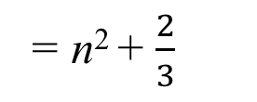
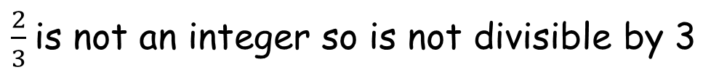
Simple deductive proof
Example 1
Consider three consecutive integers, n – 1, n and n + 1.
(a) Prove that the sum of these three integers is always divisible by 3.
(b) Prove that the sum of the squares of these three integers is never divisible by 3.
The sum of squares of the three integers
= (n – 1)²
+ n²
+ (n + 1)²
Expanding brackets
= n² – 2n + 1
+ n²
+ n² + 2n + 1
Simplifying
= 3n² + 2
Dividing by 3
= n² + $\frac{2}{3}$
Q.E.D.
$\frac{2}{3}$is not an integer so is not divisible by 3

Slide 8
Simple deductive proof
Example 2
Prove that the n² – 6n + 11 is positive for any integer.
= n² – 6n
)
– 9
(
+ 11
Completing the square
+ 9
= (n – 3)²
+ 2
(n – 3)² is always positive, since it is a square number.
Therefore, if we add 2 to the square number the result is still positive.
Hence, n² – 6n + 11 is positive for any integer.
Q.E.D.

Slide 9
Simple deductive proof
Example 3
Prove that (x – 2)² + 7 ≡ x² – 4x + 11
We can work any side to be expressed as the other side.
(x – 2)²
≡ x² – 4x
+ 11
Converting LHS into RHS
+ 7
LHS
RHS
x² – 4x + 4
+ 7
x² – 4x + 11
≡ x² – 4x
+ 11
Q.E.D.

Slide 10
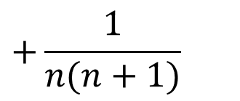

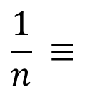
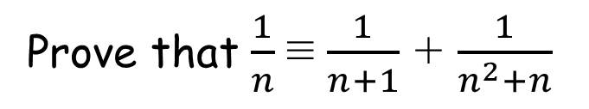

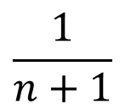
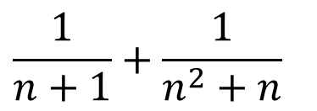
Simple deductive proof
Example 4
Prove that $\frac{1}{n}$≡ $\frac{1}{n+1}$+ $\frac{1}{n^{2}+n}$
We can work any side to be expressed as the other side.
$$\frac{1}{n}$$
$$\frac{1}{n+1}+\frac{1}{n^{2}+n}$$
Converting RHS into LHS
≡
LHS
RHS
$$\frac{1}{n+1}$$
$$+\frac{1}{n(n+1)}$$
Factorising the denominator
n
+ 1
Common denominator n(n + 1)
n(n + 1)
$$\frac{1}{n} ≡$$
$$\frac{1}{n}$$
Simplifying
Q.E.D.

Slide 11

Thank you for using resources from
For more resources visit our website
https://www.mathssupport.org
If you have a special request, drop us an email
info@mathssupport.org

