Slide 1
The derivative of e^{x}
LO: Find the derivative of the function f(x) = e^{x}

Slide 2
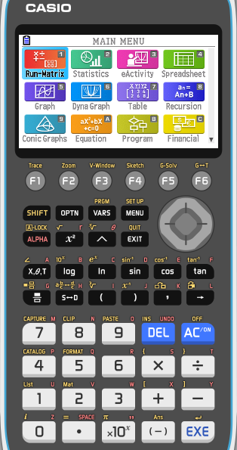
The derivative of e^{x}
We are going to sketch the graph f(x) = e^{x}
Turn on your calculator
Click on
5

Slide 3
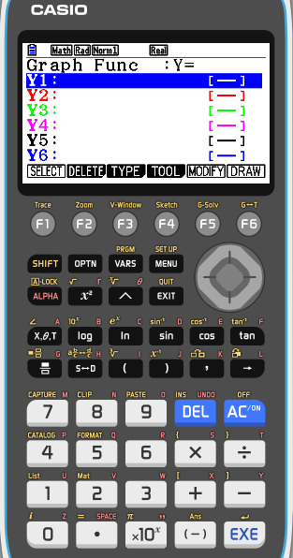
The derivative of e^{x}
We are going to sketch the graph f(x) = e^{x}
Turn on your calculator
Click on
5
SHIFT
MENU
(SET UP)

Slide 4
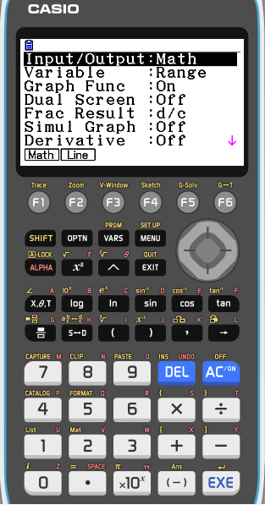
The derivative of e^{x}
We are going to sketch the graph f(x) = e^{x}
Turn on your calculator
Click on
5
SHIFT
MENU
(SET UP)
Scroll down to Derivative

Slide 5
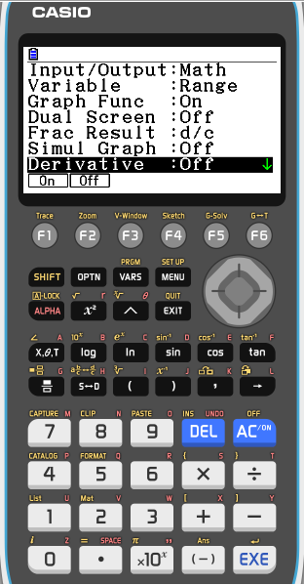
The derivative of e^{x}
We are going to sketch the graph f(x) = e^{x}
Turn on your calculator
Click on
5
SHIFT
MENU
(SET UP)
Scroll down to Derivative
F1 to turn it On

Slide 6
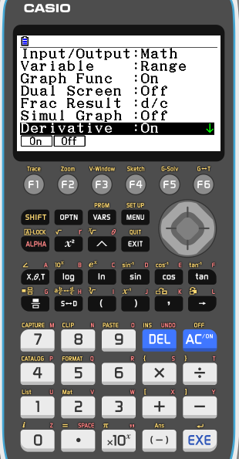
The derivative of e^{x}
We are going to sketch the graph f(x) = e^{x}
Turn on your calculator
Click on
5
SHIFT
MENU
(SET UP)
Scroll down to Derivative
F1 to turn it On
EXIT

Slide 7
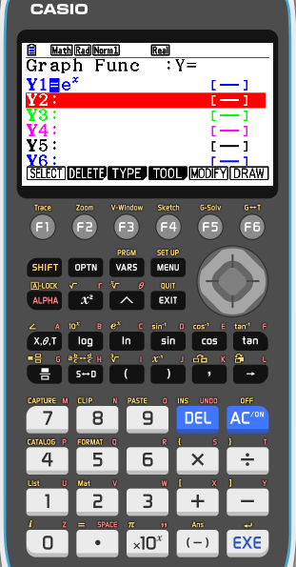
The derivative of e^{x}
We are going to sketch the graph f(x) = e^{x}
Turn on your calculator
Click on
5
SHIFT
MENU
(SET UP)
Scroll down to Derivative
F1 to turn it On
EXIT
In Y1 type e^{x}
EXE
F6
DRAW

Slide 8
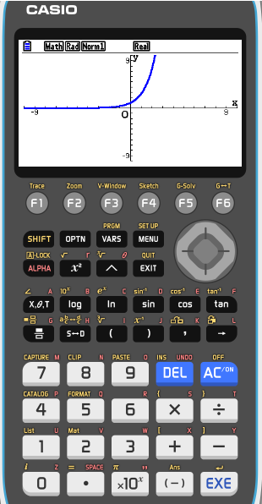
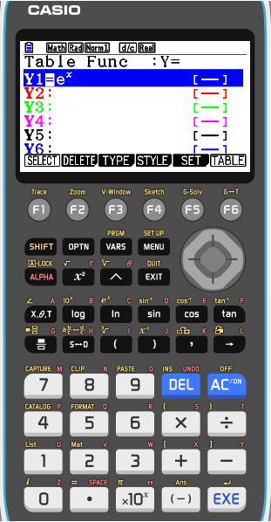
The derivative of e^{x}
We are going to sketch the graph f(x) = e^{x}
Turn on your calculator
Click on
5
SHIFT
MENU
(SET UP)
Scroll down to Derivative
F1 to turn it On
EXIT
In Y1 type e^{x}
EXE
F6
DRAW
MENU
7
F6 (TABL)
TABLE

Slide 9
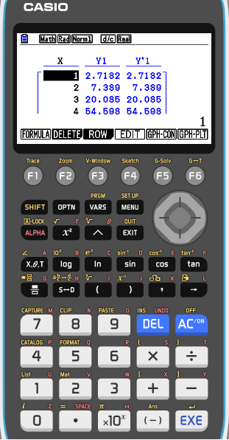
The derivative of e^{x}
We are going to sketch the graph f(x) = e^{x}
Turn on your calculator
Click on
5
SHIFT
MENU
(SET UP)
Scroll down to Derivative
F1 to turn it On
EXIT
In Y1 type e^{x}
EXE
F6
DRAW
MENU
7
F6 (TABL)
TABLE
Compare the values for the function and the derivative of the function
Make a conjecture about the derivative of f(x) = e^{x}

Slide 10
The derivative of e^{x}
From the table you can easily see that derivative of the function e^{x} is e^{x}
If f (x) = e^{x}, then f ’(x) = e^{x}
or
From this, it follows that
If f (x) = ke^{x}, then f ’(x) = ke^{x}
or
where k is a constant.
For example, if y = 4e^{x} – x³

Slide 11
Functions of the form e^{kx}
Suppose we are asked to differentiate a function of the form e^{kx}, where k is a constant. For example,
Differentiate y = e^{5x} with respect to x.
Let where u = 5x
Using the chain rule:
In practice, we wouldn’t need to include this much working.

Slide 12
Functions of the form e^{kx}
We would just remember that in general,
For example,
We can use the chain rule to extend this to any function of the form e^{f(x)}.

Slide 13
Functions of the form e^{f(x)}
If y = e^{f(x)} then we can let
Let where u = f(x)
then
Using the chain rule:
So in general,
In words, to differentiate an expression of the form y = e^{f(x)} we multiply it by the derivative of the exponent.
Notes:
Note that if e^{f(x)} is multiplied by a constant then its derivative will be multiplied by the same constant.

Slide 14
Functions of the form e^{f(x)}
For example,

Slide 15
Thank you for using resources from
For more resources visit our website
https://www.mathssupport.org
If you have a special request, drop us an email
info@mathssupport.org

