Slide 1
Normal probability calculations
LO: To calculate normal probabilities using GDC

Slide 2
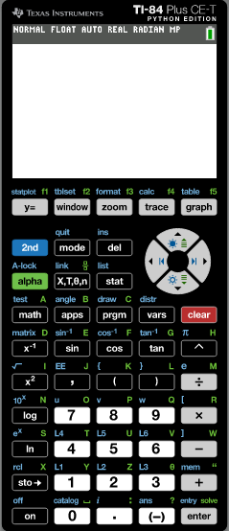
Example 1
You can use the GDC to calculate values that are not whole multiples of the standard deviation (or of course even if they are!)
Packets of coconut milk are advertised to contain 250ml. Akshat tests 75 packets. He finds that the contents are normally distributed with a mean volume of 255ml and a standard deviation of 8 ml.
Find the probability that a packet contains more than 250ml.
Use the GDC
First sketch a normal distribution diagram:
μ
255
Turn on
μ – σ
247
μ + σ
263
μ - 2σ
239
μ + 2σ
271
μ - 3σ
231
μ + 3σ
279

Slide 3
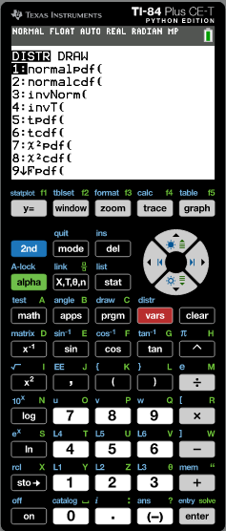
Example 1
You can use the GDC to calculate values that are not whole multiples of the standard deviation (or of course even if they are!)
Packets of coconut milk are advertised to contain 250ml. Akshat tests 75 packets. He finds that the contents are normally distributed with a mean volume of 255ml and a standard deviation of 8 ml.
Find the probability that a packet contains more than 250ml.
Use the GDC
First sketch a normal distribution diagram:
μ
255
Turn on
Click on 2
Normalcdf(
μ – σ
247
μ + σ
263
μ - 2σ
239
μ + 2σ
271
μ - 3σ
231
μ + 3σ
279

Slide 4
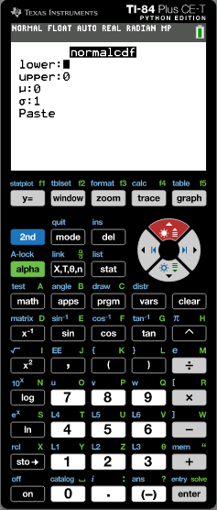
Example 1
You can use the GDC to calculate values that are not whole multiples of the standard deviation (or of course even if they are!)
Packets of coconut milk are advertised to contain 250ml. Akshat tests 75 packets. He finds that the contents are normally distributed with a mean volume of 255ml and a standard deviation of 8 ml.
Find the probability that a packet contains more than 250ml.
Use the GDC
First sketch a normal distribution diagram:
μ
255
Turn on
Click on 2
Normalcdf(
μ – σ
247
μ + σ
263
Enter the values:
μ - 2σ
239
μ + 2σ
271
Lower:
250
μ - 3σ
231
μ + 3σ
279
Upper:
10000
μ:
255
σ:
8
The value 10000 is a larger value that entered in the GDC is used in the place of ∞.

Slide 5
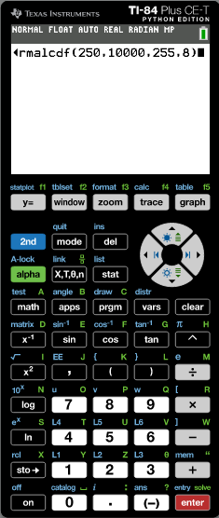
Example 1
You can use the GDC to calculate values that are not whole multiples of the standard deviation (or of course even if they are!)
Packets of coconut milk are advertised to contain 250ml. Akshat tests 75 packets. He finds that the contents are normally distributed with a mean volume of 255ml and a standard deviation of 8 ml.
Find the probability that a packet contains more than 250ml.
Use the GDC
First sketch a normal distribution diagram:
μ
255
Turn on
Click on 2
Normalcdf(
μ – σ
247
μ + σ
263
Enter the values:
μ - 2σ
239
μ + 2σ
271
Lower:
250
μ - 3σ
231
μ + 3σ
279
Upper:
10000
μ:
255
σ:
8
The value 10000 is a larger value that entered in the GDC is used in the place of ∞.

Slide 6
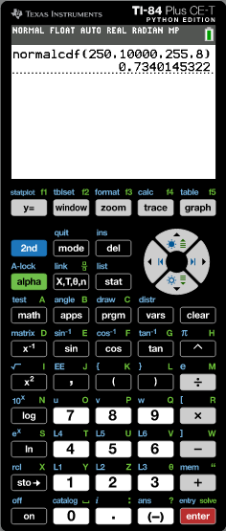
Example 1
You can use the GDC to calculate values that are not whole multiples of the standard deviation (or of course even if they are!)
Packets of coconut milk are advertised to contain 250ml. Akshat tests 75 packets. He finds that the contents are normally distributed with a mean volume of 255ml and a standard deviation of 8 ml.
Find the probability that a packet contains more than 250ml.
Use the GDC
First sketch a normal distribution diagram:
μ
255
Turn on
Click on 2
Normalcdf(
μ – σ
247
μ + σ
263
Enter the values:
μ - 2σ
239
μ + 2σ
271
Lower:
250
μ - 3σ
231
μ + 3σ
279
Upper:
10000
μ:
255
σ:
8
The solution on the calculator is 0.7340145322
So the probability that a packet contains more than 250ml is 0.734 or 73.4%

Slide 7
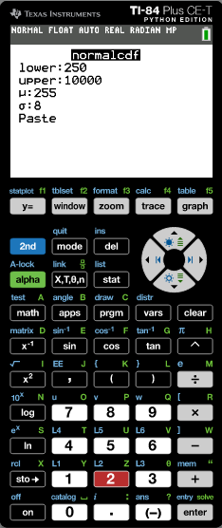
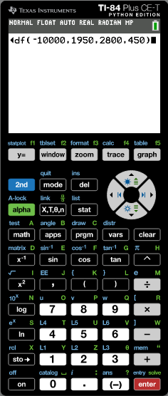
Example 2
The lifetime of a light bulb is normally distributed with a mean of 2800 hours and a standard deviation of 450 hours.
Find the percentage of light bulbs that have a lifetime of less than 1950 hours.
Find the percentage of light bulbs that have a lifetime of between 2300 and 3500 hours.
Find the percentage of light bulbs that have a lifetime of more than 3800 hours.
Sketching the normal distribution diagram gives a clear idea of what is happening.
Use the GDC
μ
2800
Enter the values:
μ – σ
2350
μ + σ
3250
Lower:
-10000
μ - 2σ
1900
μ + 2σ
3700
Upper:
1950
μ:
2800
μ - 3σ
1450
μ + 3σ
4150
σ:
450
1950
The value – 10000 is a smaller value that entered in the GDC is used in the place of – ∞.

Slide 8
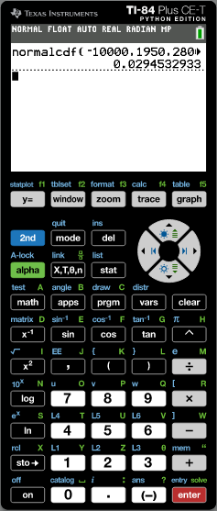
Example 2
The lifetime of a light bulb is normally distributed with a mean of 2800 hours and a standard deviation of 450 hours.
Find the percentage of light bulbs that have a lifetime of less than 1950 hours.
Find the percentage of light bulbs that have a lifetime of between 2300 and 3500 hours.
Find the percentage of light bulbs that have a lifetime of more than 3800 hours.
2.95%
Sketching the normal distribution diagram gives a clear idea of what is happening.
Use the GDC
μ
2800
Enter the values:
μ – σ
2350
μ + σ
3250
Lower:
-10000
μ - 2σ
1900
μ + 2σ
3700
Upper:
1950
μ:
2800
μ - 3σ
1450
μ + 3σ
4150
σ:
450
1950
The solution on the calculator is 0.0294532933
So the percentage of light bulbs that have a lifetime of less than 1950 hours is 2.95%
You can see from the sketch that indeed the answer should be a little more than 2.5%, because there would be 2.5% with a lifetime of less than 1900 hours.

Slide 9
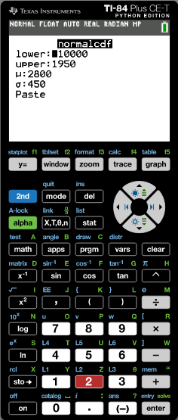

Example 2
The lifetime of a light bulb is normally distributed with a mean of 2800 hours and a standard deviation of 450 hours.
Find the percentage of light bulbs that have a lifetime of less than 1950 hours.
Find the percentage of light bulbs that have a lifetime of between 2300 and 3500 hours.
Find the percentage of light bulbs that have a lifetime of more than 3800 hours.
2.95%
Sketching in the normal distribution diagram gives a clear idea of what is happening.
Use the GDC
μ
2800
Enter the values:
μ – σ
2350
μ + σ
3250
Lower:
2300
Upper:
3500
μ - 2σ
1900
μ + 2σ
3700
μ:
2800
σ:
450
μ - 3σ
1450
μ + 3σ
4150
2300
3500

Slide 10
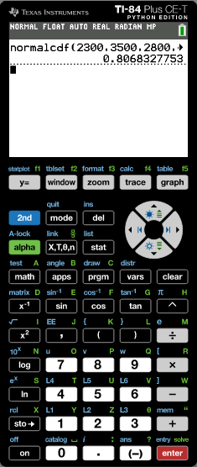
Example 2
The lifetime of a light bulb is normally distributed with a mean of 2800 hours and a standard deviation of 450 hours.
Find the percentage of light bulbs that have a lifetime of less than 1950 hours.
Find the percentage of light bulbs that have a lifetime of between 2300 and 3500 hours.
Find the percentage of light bulbs that have a lifetime of more than 3800 hours.
2.95%
80.7%
Sketching in the normal distribution diagram gives a clear idea of what is happening.
Use the GDC
μ
2800
Enter the values:
μ – σ
2350
μ + σ
3250
Lower:
2300
Upper:
3500
μ - 2σ
1900
μ + 2σ
3700
μ:
2800
σ:
450
μ - 3σ
1450
μ + 3σ
4150
2300
3500
The solution on the calculator is 0.80683283
So the percentage of light bulbs that have a lifetime of between 2300 and 3500 hours is 80.7%

Slide 11
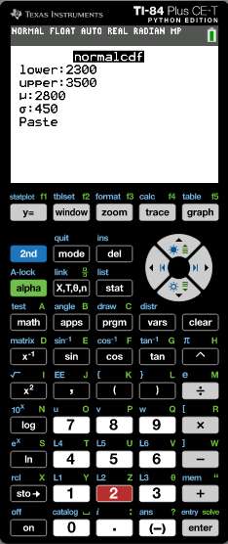
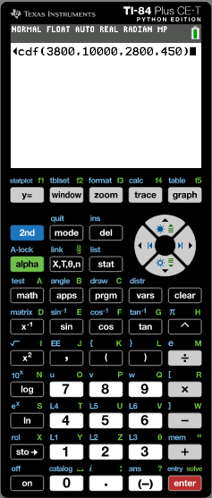
Example 2
The lifetime of a light bulb is normally distributed with a mean of 2800 hours and a standard deviation of 450 hours.
Find the percentage of light bulbs that have a lifetime of less than 1950 hours.
Find the percentage of light bulbs that have a lifetime of between 2300 and 3500 hours.
Find the percentage of light bulbs that have a lifetime of more than 3800 hours.
2.95%
80.7%
Sketching the normal distribution diagram gives a clear idea of what is happening.
Use the GDC
μ
2800
Enter the values:
μ – σ
2350
μ + σ
3250
Lower:
3800
Upper:
10000
μ - 2σ
1900
μ + 2σ
3700
μ:
2800
μ - 3σ
1450
μ + 3σ
4150
σ:
450
3800

Slide 12

Example 2
The lifetime of a light bulb is normally distributed with a mean of 2800 hours and a standard deviation of 450 hours.
Find the percentage of light bulbs that have a lifetime of less than 1950 hours.
Find the percentage of light bulbs that have a lifetime of between 2300 and 3500 hours.
Find the percentage of light bulbs that have a lifetime of more than 3800 hours.
2.95%
80.7%
1.31%
Sketching the normal distribution diagram gives a clear idea of what is happening.
Use the GDC
μ
2800
Enter the values:
μ – σ
2350
μ + σ
3250
Lower:
3800
Upper:
10000
μ - 2σ
1900
μ + 2σ
3700
μ:
2800
μ - 3σ
1450
μ + 3σ
4150
σ:
450
3800
The solution on the calculator is 0.0131341011
So the percentage of light bulbs that have a lifetime of more than 3800 hours is 1.31%

Slide 13
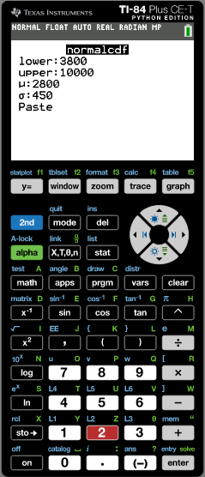

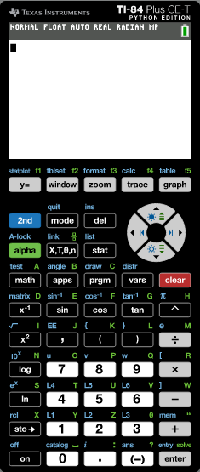
Example 2
The lifetime of a light bulb is normally distributed with a mean of 2800 hours and a standard deviation of 450 hours.
Find the percentage of light bulbs that have a lifetime of less than 1950 hours.
Find the percentage of light bulbs that have a lifetime of between 2300 and 3500 hours.
Find the percentage of light bulbs that have a lifetime of more than 3800 hours.
2.95%
80.7%
1.31%
120 light bulbs are tested.
d) Find the expected number of light bulbs with a lifetime of less than 2000 hours.
Use the GDC
μ
2800
Enter the values:
Lower:
-10000
μ – σ
2350
μ + σ
3250
Upper:
2000
μ:
2800
μ - 2σ
1900
μ + 2σ
3700
σ:
450
μ - 3σ
1450
μ + 3σ
4150
So we have to find the percentage of light bulbs that have a lifetime of less than 2000 hours.

Slide 14
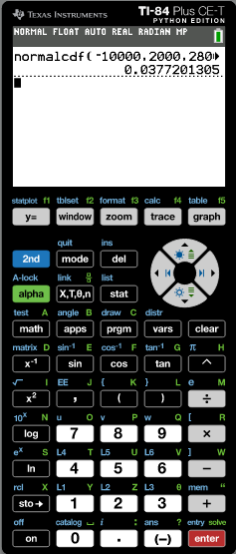
Example 2
The lifetime of a light bulb is normally distributed with a mean of 2800 hours and a standard deviation of 450 hours.
Find the percentage of light bulbs that have a lifetime of less than 1950 hours.
Find the percentage of light bulbs that have a lifetime of between 2300 and 3500 hours.
Find the percentage of light bulbs that have a lifetime of more than 3800 hours.
2.95%
80.7%
1.31%
120 light bulbs are tested.
d) Find the expected number of light bulbs with a lifetime of less than 2000 hours.
Use the GDC
μ
2800
Enter the values:
Lower:
-10000
μ – σ
2350
μ + σ
3250
Upper:
2000
μ:
2800
μ - 2σ
1900
μ + 2σ
3700
σ:
450
μ - 3σ
1450
μ + 3σ
4150
The solution on the calculator is 0.0377201305
So the percentage of light bulbs that have a lifetime of less than 2000 hours is 3.77%

Slide 15
Example 2
The lifetime of a light bulb is normally distributed with a mean of 2800 hours and a standard deviation of 450 hours.
Find the percentage of light bulbs that have a lifetime of less than 1950 hours.
Find the percentage of light bulbs that have a lifetime of between 2300 and 3500 hours.
Find the percentage of light bulbs that have a lifetime of more than 3800 hours.
2.95%
80.7%
1.31%
120 light bulbs are tested.
d) Find the expected number of light bulbs with a lifetime of less than 2000 hours.
Use the GDC
μ
2800
Enter the values:
Lower:
-10000
μ – σ
2350
μ + σ
3250
Upper:
2000
μ:
2800
μ - 2σ
1900
μ + 2σ
3700
σ:
450
μ - 3σ
1450
μ + 3σ
4150
So the percentage of light bulbs that have a lifetime of less than 2000 hours is 3.77%
120 x 0.0377 = 4.5264….
So you would expect 4 or 5 light bulbs

Slide 16

Thank you for using resources from
For more resources visit our website
https://www.mathssupport.org
If you have a special request, drop us an email
info@mathssupport.org

