Slide 1
The Normal Distribution
LO: To know the properties of the normal distribution.

Slide 2
The Normal Distribution
Is the most important distribution for a continuous random variable.
Many naturally occurring phenomena have a distribution that is normal, or approximately normal.
Examples of variables that have a Normal distribution
Physical attributes of a population such as:
Height
Weight
Arm length
Crop yields.
Scores for tests taken by a large population.
Once a normal model has been stablished, we can use it to calculate probabilities and make predictions.

Slide 3
The properties of a normal distribution:
It is a bell-shaped curve.
It is symmetrical about the mean, μ. (The mean, the mode and the median all have the same value).
The x-axis is an asymptote to the curve.
The total area under the curve is 1 (or 100%).
50% of the area is to the left of the mean, and 50% to the right.
100%
50%
50%
μ

Slide 4
The characteristics of any normal distribution
There is no single normal curve, but a family of curves, each one defined by its mean, μ, and standard deviation, σ.
If a random variable, X, has a normal distribution with mean μ and standard deviation σ, this is written X ~ N(μ, σ²)
μ and σ are called the parameters of the distribution.
The mean is the central point of the distribution
The standard deviation describes the spread of the distribution
The means are all the same and all the curves are centered around it but σ₁ < σ₂ < σ₃
X₁
Curve X₁ is narrower than X₂,
and X₂ is narrower than X₃
X₂
X₁ ~ N(5, 1²)
X₂ ~ N(5, 2²)
X₃
X₃ ~ N(5, 3²)
μ
5

Slide 5
The characteristics of any normal distribution
There is no single normal curve, but a family of curves, each one defined by its mean, μ, and standard deviation, σ.
If a random variable, X, has a normal distribution with mean μ and standard deviation σ, this is written X ~ N(μ, σ²)
μ and σ are called the parameters of the distribution.
The mean is the central point of the distribution
The standard deviation describes the spread of the distribution
The standard deviations are all the same, so the curves are all the same but μ₁ < μ₂ < μ₃
The curves may have different means and/or different standard deviations, but they all have the same characteristics
X₁
X₂
X₃
X₁ ~ N(5, 2²)
X₂ ~ N(10, 2²)
X₃ ~ N(15, 2²)
5
10
15

Slide 6
The standard normal distribution
The standard normal distribution is the normal distribution where
μ = 0
and σ = 1
The random variable is called Z.
It uses ‘z-values’ to describe the number of standard deviations any value is away from the mean.
The standard normal distribution is written Z ~ N(0, 1)
f(z)
σ
σ
σ
σ
σ
σ
-3
-2
-1
0
1
2
3

Slide 7
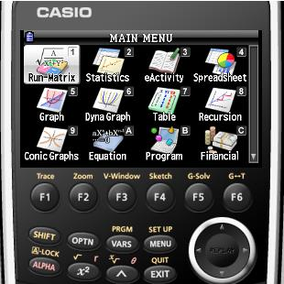
The standard normal distribution
The standard normal distribution is the normal distribution where μ = 0 and σ = 1
The random variable is called Z.
It uses ‘z-values’ to describe the number of standard deviations any value is away from the mean.
The standard normal distribution is written Z ~ N(0, 1)
Given that Z ~ N(0, 1) find P(-1 < Z < 1)
Using the GDC
f(z)
Turn on
Press 1
Run-Matrix
σ
σ
σ
σ
σ
σ
-3
-2
-1
0
1
2
3

Slide 8
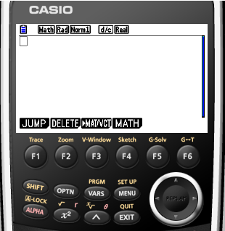
The standard normal distribution
The standard normal distribution is the normal distribution where μ = 0 and σ = 1
The random variable is called Z.
It uses ‘z-values’ to describe the number of standard deviations any value is away from the mean.
The standard normal distribution is written Z ~ N(0, 1)
Given that Z ~ N(0, 1) find P(-1 < Z < 1)
Using the GDC
f(z)
OPTN
σ
σ
σ
σ
σ
σ
-3
-2
-1
0
1
2
3

Slide 9
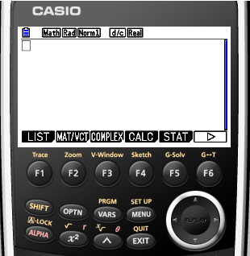
The standard normal distribution
The standard normal distribution is the normal distribution where μ = 0 and σ = 1
The random variable is called Z.
It uses ‘z-values’ to describe the number of standard deviations any value is away from the mean.
The standard normal distribution is written Z ~ N(0, 1)
Given that Z ~ N(0, 1) find P(-1 < Z < 1)
Using the GDC
f(z)
F5
STAT
σ
σ
σ
σ
σ
σ
-3
-2
-1
0
1
2
3

Slide 10
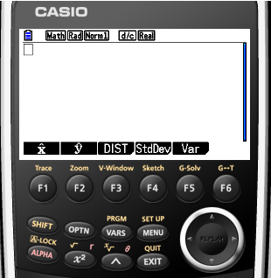
The standard normal distribution
The standard normal distribution is the normal distribution where μ = 0 and σ = 1
The random variable is called Z.
It uses ‘z-values’ to describe the number of standard deviations any value is away from the mean.
The standard normal distribution is written Z ~ N(0, 1)
Given that Z ~ N(0, 1) find P(-1 < Z < 1)
Using the GDC
f(z)
F3
DIST
σ
σ
σ
σ
σ
σ
-3
-2
-1
0
1
2
3

Slide 11
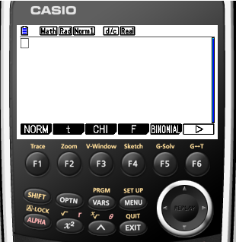
The standard normal distribution
The standard normal distribution is the normal distribution where μ = 0 and σ = 1
The random variable is called Z.
It uses ‘z-values’ to describe the number of standard deviations any value is away from the mean.
The standard normal distribution is written Z ~ N(0, 1)
Given that Z ~ N(0, 1) find P(-1 < Z < 1)
Using the GDC
f(z)
F1
NORM
σ
σ
σ
σ
σ
σ
-3
-2
-1
0
1
2
3

Slide 12
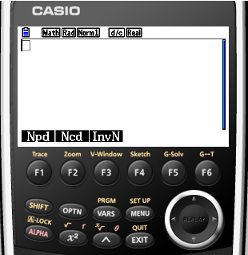
The standard normal distribution
The standard normal distribution is the normal distribution where μ = 0 and σ = 1
The random variable is called Z.
It uses ‘z-values’ to describe the number of standard deviations any value is away from the mean.
The standard normal distribution is written Z ~ N(0, 1)
Given that Z ~ N(0, 1) find P(-1 < Z < 1)
Using the GDC
f(z)
F2
Ncd
σ
σ
σ
σ
σ
σ
-3
-2
-1
0
1
2
3

Slide 13
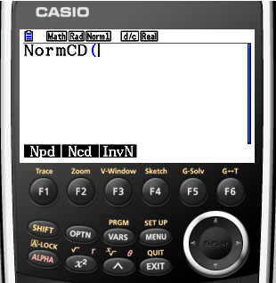
The standard normal distribution
The standard normal distribution is the normal distribution where μ = 0 and σ = 1
The random variable is called Z.
It uses ‘z-values’ to describe the number of standard deviations any value is away from the mean.
The standard normal distribution is written Z ~ N(0, 1)
Given that Z ~ N(0, 1) find P(-1 < Z < 1)
Using the GDC
f(z)
Enter the values in this order
,
Lower limit, -1
,
Upper limit, 1
Standard deviation, 1
,
)
Mean, 0
σ
σ
σ
σ
σ
σ
-3
-2
-1
0
1
2
3

Slide 14
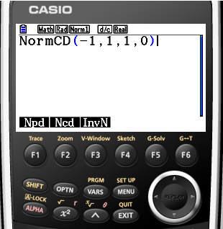
The standard normal distribution
The standard normal distribution is the normal distribution where μ = 0 and σ = 1
The random variable is called Z.
It uses ‘z-values’ to describe the number of standard deviations any value is away from the mean.
The standard normal distribution is written Z ~ N(0, 1)
Given that Z ~ N(0, 1) find P(-1 < Z < 1)
Using the GDC
f(z)
EXE
σ
σ
σ
σ
σ
σ
-3
-2
-1
0
1
2
3

Slide 15
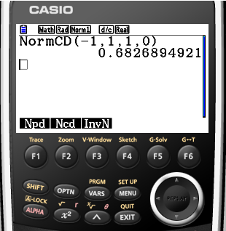
The standard normal distribution
The standard normal distribution is the normal distribution where μ = 0 and σ = 1
The random variable is called Z.
It uses ‘z-values’ to describe the number of standard deviations any value is away from the mean.
The standard normal distribution is written Z ~ N(0, 1)
Given that Z ~ N(0, 1) find P(-1 < Z < 1)
Using the GDC
f(z)
= 0.682689
= 68.27%
68.27%
σ
σ
σ
σ
σ
σ
-3
-2
-1
0
1
2
3

Slide 16
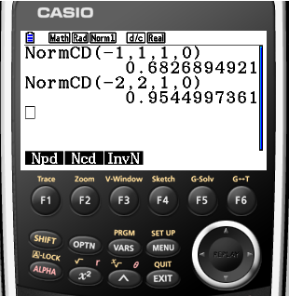
The standard normal distribution
The standard normal distribution is the normal distribution where μ = 0 and σ = 1
The random variable is called Z.
It uses ‘z-values’ to describe the number of standard deviations any value is away from the mean.
The standard normal distribution is written Z ~ N(0, 1)
Given that Z ~ N(0, 1) find P(-2 < Z < 2)
Using the GDC
f(z)
= 0.9544997361
= 95.45%
95.45%
σ
σ
σ
σ
σ
σ
-3
-2
-1
0
1
2
3

Slide 17
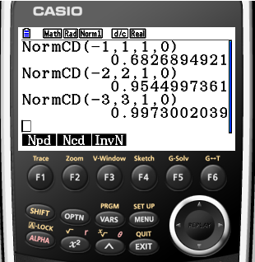
The standard normal distribution
The standard normal distribution is the normal distribution where μ = 0 and σ = 1
The random variable is called Z.
It uses ‘z-values’ to describe the number of standard deviations any value is away from the mean.
The standard normal distribution is written Z ~ N(0, 1)
Given that Z ~ N(0, 1) find P(-3 < Z < 3)
Using the GDC
f(z)
= 0.9973002039
= 99.73%
99.73%
σ
σ
σ
σ
σ
σ
-3
-2
-1
0
1
2
3

Slide 18
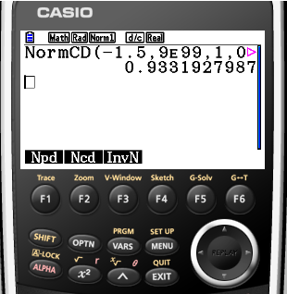
The standard normal distribution
The standard normal distribution is the normal distribution where μ = 0 and σ = 1
The random variable is called Z.
It uses ‘z-values’ to describe the number of standard deviations any value is away from the mean.
The standard normal distribution is written Z ~ N(0, 1)
Given that Z ~ N(0, 1) find P(Z > -1.5)
Using the GDC
f(z)
Enter upper limit as a very high number, 9 x 10⁹⁹
= 0.9331927987
= 93.32%
93.32%
σ
σ
σ
σ
σ
σ
-3
-2
-1
0
1
2
3

Slide 19
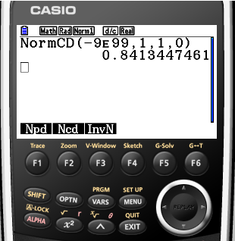
The standard normal distribution
The standard normal distribution is the normal distribution where μ = 0 and σ = 1
The random variable is called Z.
It uses ‘z-values’ to describe the number of standard deviations any value is away from the mean.
The standard normal distribution is written Z ~ N(0, 1)
Given that Z ~ N(0, 1) find P(Z < 1)
Using the GDC
f(z)
Enter lower limit as a very small negative number, -9 x 10⁹⁹
= 0.8413447461
= 84.13%
84.13%
σ
σ
σ
σ
σ
σ
-3
-2
-1
0
1
2
3

Slide 20
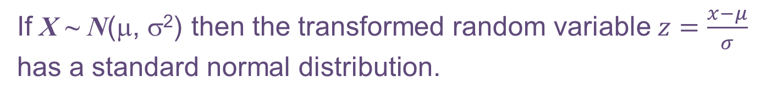
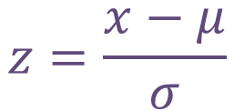
Probabilities for other normal distributions
Clearly, however, very few real-life variables are distributed like the standard normal distribution, with mean of 0 and a standard deviation of 1, but you can transform any normal distribution X ~ N(μ, σ²) to the standard normal distribution, because all normal distributions have the same basic shape but merely shifts in location and spread
To transform any given value of x on X ~ N(μ, σ²) to its equivalent z-value on Z ~ N(0, 1) use the formula
$$z=\frac{x−μ}{σ}$$
Then you can use the GDC to find the required probability.
If X ~ N(μ, σ²) then the transformed random variable $z=\frac{x−μ}{σ}$ has a standard normal distribution.

Slide 21
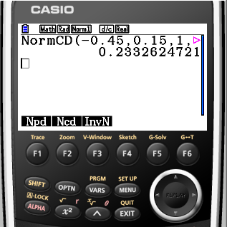
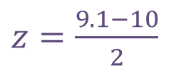
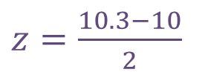
Probabilities for other normal distributions
Example 1:
The random variable X ~ N(10, 2²). Find P(9.1 < X < 10.3)
Step 1:
Sketch a standard normal curve and shade the required region
Step 2:
Convert x values to z using $z=\frac{x−μ}{σ}$
$z=\frac{9.1−10}{2}$
= -0.45
$z=\frac{10.3−10}{2}$
= 0.15
Step 3:
Enter the values into your GDC
P(9.1 < X < 10.3)
=
P(-0.45 < Z < 0.15)
= 0.233
10

Slide 22
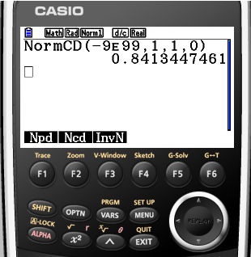
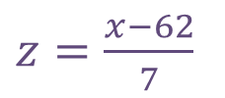
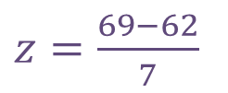
Probabilities for other normal distributions
Example 2:
The random variable X ~ N(62, 7²). Find P(X < 69)
Step 1:
Sketch a standard normal curve and shade the required region
Step 2:
Convert x values to z using $z=\frac{x−μ}{σ}$
$z=\frac{x−62}{7}$
= z
$z=\frac{69−62}{7}$
= 1
Step 3:
Enter the values into your GDC
P( X < 69)
=
P( Z < 1)
= 0.841
62

Slide 23
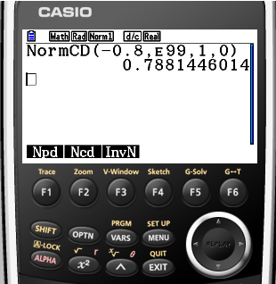
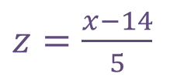
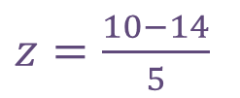
Probabilities for other normal distributions
Example 3:
The random variable X ~ N(14, 5²). Find P(X > 10)
Step 1:
Sketch a standard normal curve and shade the required region
Step 2:
Convert x values to z using $z=\frac{x−μ}{σ}$
$z=\frac{x−14}{5}$
= z
$z=\frac{10−14}{5}$
= -0.8
Step 3:
Enter the values into your GDC
P( X > 10)
=
P( Z > -0.8)
= 0.788
14

Slide 24
Probabilities for other normal distributions
You can also find these solutions directly using the GDC without using the standardisation formula, this is quickest and most efficient method of answering these questions
But is important to know the method of standardisation.
Tips:
If a normal distribution has mean μ and standard deviation σ.
To find P(x < a) or P(x ≤ a)
Use normalcdf(-E99, a, σ, μ)
To find P(x > a) or P(x ≥ a)
Use normalcdf(a, E99, σ, μ)
To find P(a < x < b) or P(a ≤ x ≤ a)
Use normalcdf(a, b, σ, μ)

Slide 25
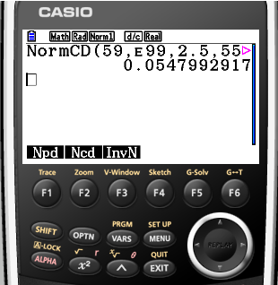
Probabilities for other normal distributions
Example 4:
Eggs laid by a chicken are known to have the mass normally distributed, with mean 55 g and standard deviation 2.5 g.
(a) An egg weighs more than 59 g?
What is the probability that
Solution:
The random variable W ~ N(55, 2.5²). Find P(W > 59)
Step 1:
Sketch a standard normal curve and shade the required region
Step 2:
Enter the values in your GDC
P( W > 59)
= 0.0548
Lower limit, 59
Upper limit, E99
Standard deviation, 2.5
Mean, 55
50
55
60

Slide 26
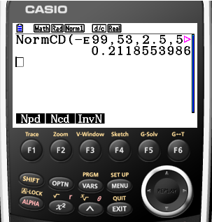
Probabilities for other normal distributions
Example 4:
Eggs laid by a chicken are known to have the mass normally distributed, with mean 55 g and standard deviation 2.5 g.
What is the probability that
(b) An egg weighs less than 53 g?
Solution:
The random variable W ~ N(55, 2.5²). Find P(W < 53)
Step 1:
Sketch a standard normal curve and shade the required region
Step 2:
Enter the values in your GDC
P( W < 53)
= 0.212
Lower limit, -E99
Upper limit, 53
Standard deviation, 2.5
Mean, 55
50
55
60

Slide 27
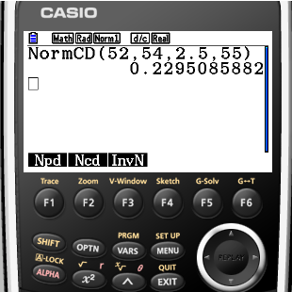
Probabilities for other normal distributions
Example 4:
Eggs laid by a chicken are known to have the mass normally distributed, with mean 55 g and standard deviation 2.5 g.
What is the probability that
(c) An egg is between 52 and 54 g?
Solution:
The random variable W ~ N(55, 2.5²). Find P(52 < W < 54)
Step 1:
Sketch a standard normal curve and shade the required region
Step 2:
Enter the values in your GDC
P(52 < W < 54)
= 0.230
Lower limit, 52
Upper limit, 54
Standard deviation, 2.5
Mean, 55
50
55
60

Slide 28

Thank you for using resources from
For more resources visit our website
https://www.mathssupport.org
If you have a special request, drop us an email
info@mathssupport.org

