Slide 1
Solving exponential equations using logarithms
LO: Solve exponential equations using logarithms.

Slide 2
Exponential Equations
Exponential equations are equations involving ‘unknowns’ as exponents.
For example 5^{x} = 25
x = 2

Slide 3
Exponential Equations
One way to solve exponential equations is to use the property that if 2 powers with the same base are equal, then their exponents are equal.
if b^{x} = b^{y}, then x = y
For b > 0 & b ≠ 1
Is not always easy to make the bases the same.
In this situations we can use logarithms.

Slide 4
Solve using logarithms
Example 1
Solve the equation
2^{3x} = 25
Give the exact answer
2^{3x} = 25
Taking the logarithm of each side
log 2^{3x}
=
log 25
Using the rule: log b^{n} = n log b
3x log 2
=
log 25
Dividing by log 2
log 2
log 2
log 25
=
3x
Dividing by 3
log 2
log 25
x
=
3 log 2

Slide 5
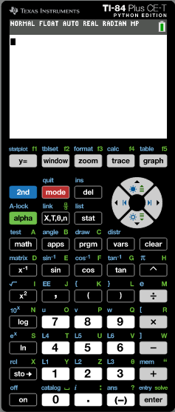
Solve using logarithms
Example 1
Solve the equation
2^{3x} = 25
Give the answer correct to 3 sf.
2^{3x} = 25
Now we will use the GDC to solve it.
Turn on the GDC
maths

Slide 6
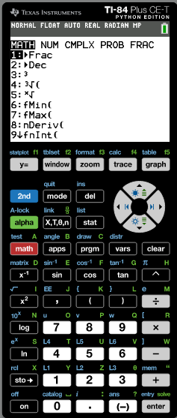
Solve using logarithms
Example 1
Solve the equation
2^{3x} = 25
Give the answer correct to 3 sf.
2^{3x} = 25
Now we will use the GDC to solve it.
Turn on the GDC
❐
maths

Slide 7
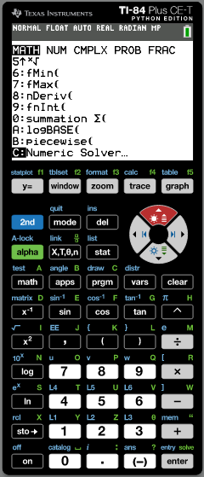
Solve using logarithms
Example 1
Solve the equation
2^{3x} = 25
Give the answer correct to 3 sf.
2^{3x} = 25
Now we will use the GDC to solve it.
Turn on the GDC
❐
enter
maths

Slide 8
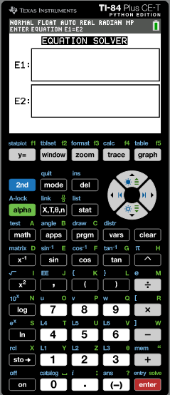
Solve using logarithms
Example 1
Solve the equation
2^{3x} = 25
Give the answer correct to 3 sf.
2^{3x} = 25
Now we will use the GDC to solve it.
Turn on the GDC
❐
enter
maths
Type in E1
2^{3x}
enter
Type in E2
25

Slide 9
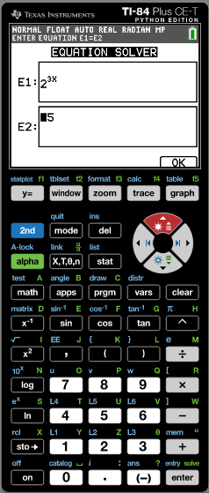
Solve using logarithms
Example 1
Solve the equation
2^{3x} = 25
Give the answer correct to 3 sf.
2^{3x} = 25
Now we will use the GDC to solve it.
Turn on the GDC
❐
enter
maths
Type in E1
2^{3x}
enter
Type in E2
25
enter

Slide 10
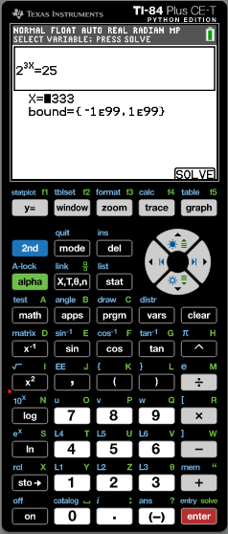
Solve using logarithms
Example 1
Solve the equation
2^{3x} = 25
Give the answer correct to 3 sf.
2^{3x} = 25
Now we will use the GDC to solve it.
Turn on the GDC
❐
enter
maths
Type in E1
2^{3x}
enter
Type in E2
25
enter
F5
SOLVE

Slide 11
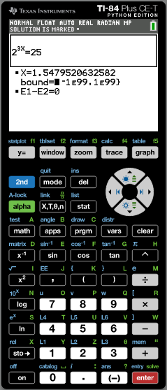
Solve using logarithms
Example 1
Solve the equation
2^{3x} = 25
Give the answer correct to 3 sf.
2^{3x} = 25
Now we will use the GDC to solve it.
Turn on the GDC
❐
enter
maths
Type in E1
2^{3x}
enter
Type in E2
25
enter
F5
SOLVE
The answer for x
1.54795206
Rounded to 3sf
x = 1.55

Slide 12
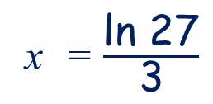
Solve using logarithms
Solve e^{3x} = 27 giving an exact answer.
e^{3x} = 27
Taking natural logs of both sides
ln e^{3x} = ln 27
Since ln e^{x} = x we cancel ln and e
3x = ln 27
x = $\frac{\text{l}\text{n}\text{ 27}}{\text{3}}$
Dividing by 3
Leave your answer in log form since an exact answer is required.

Slide 13


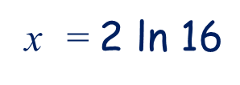



Solve using logarithms
Solve 2e = 32 giving an exact answer.
$$\frac{x}{2}$$
$$\frac{x}{2}$$
2e = 32
$$\frac{x}{2}$$
Dividing by 2
e = 16
Taking natural logs of both sides
ln e = ln 16
$$\frac{x}{2}$$
Since ln e^{x} = x we cancel ln and e
$$\frac{x}{2}$$
= ln 16
x = $\text{2 }\text{l}\text{n}\text{ 16}$
Multiplying by 2
Leave your answer in log form since an exact answer is required.

Slide 14
Solving equations of the form a^{x} = b
Find the exact points of intersection of y = e^{x} – 4 and y = 3 – 10e^{– x} giving an exact answer.
The functions meet where
e^{x} – 4
=
3 – 10e^{– x}
Equating to 0
e^{x} – 4 - 3 + 10e^{– x} = 0
Simplifying
e^{x} – 7 + 10e^{– x} = 0
Multiplying by e^{x}
e^{2x} – 7e^{x} + 10 = 0
Factorising
(e^{x} – 2)
(e^{x} – 5)
= 0
e^{x} = 2
or
e^{x} = 5
Solving for x
x = ln 2
or
x = ln 5
When x = ln 2
y = e^{ln 2} – 4
= -2
When x = ln 5
y = e^{ln 5} – 4
= 1
The functions meet at two points
(ln 2, -2)
and
(ln 5, 1)

Slide 15
Solving equations of the form a^{x} = b
Find the exact points of intersection of y = e^{x} – 4 and y = 3 – 10e^{– x}. Check the solution using technology.
The functions meet at two points
(ln 2, -2)
and
(ln 5, 1)
Use the GDC to check
Turn on the GDC
Y=

Slide 16
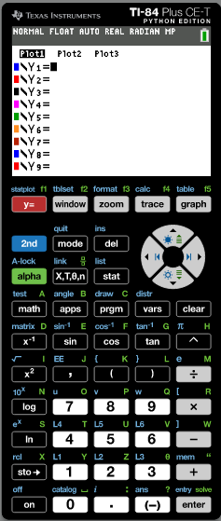
Solving equations of the form a^{x} = b
Find the exact points of intersection of y = e^{x} – 4 and y = 3 – 10e^{– x}. Check the solution using technology.
The functions meet at two points
(ln 2, -2)
and
(ln 5, 1)
Use the GDC to check
Turn on the GDC
Y=
e^{x} – 4
enter
Type in Y1

Slide 17
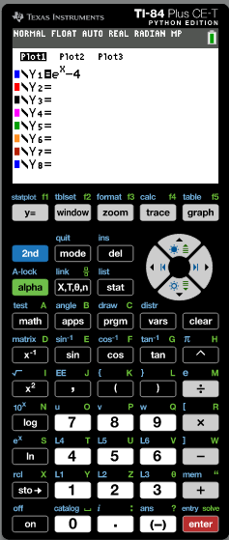
Solving equations of the form a^{x} = b
Find the exact points of intersection of y = e^{x} – 4 and y = 3 – 10e^{– x}. Check the solution using technology.
The functions meet at two points
(ln 2, -2)
and
(ln 5, 1)
Use the GDC to check
Turn on the GDC
Y=
e^{x} – 4
enter
Type in Y1
Type in Y2
3 – 10e^{– x}
enter

Slide 18
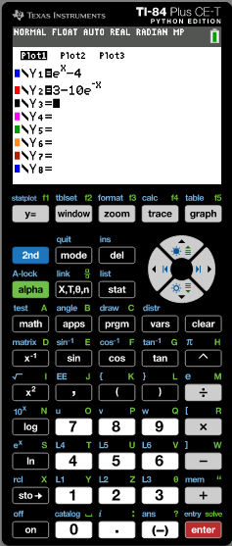
Solving equations of the form a^{x} = b
Find the exact points of intersection of y = e^{x} – 4 and y = 3 – 10e^{– x}. Check the solution using technology.
The functions meet at two points
(ln 2, -2)
and
(ln 5, 1)
Use the GDC to check
Turn on the GDC
Y=
e^{x} – 4
enter
Type in Y1
Type in Y2
3 – 10e^{– x}
enter
F5
Graph

Slide 19
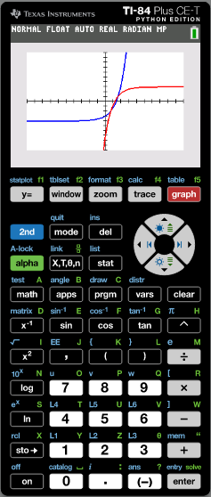
Solving equations of the form a^{x} = b
Find the exact points of intersection of y = e^{x} – 4 and y = 3 – 10e^{– x}. Check the solution using technology.
The functions meet at two points
(ln 2, -2)
and
(ln 5, 1)
Use the GDC to check
Turn on the GDC
Y=
e^{x} – 4
enter
Type in Y1
Type in Y2
3 – 10e^{– x}
enter
F5
Graph
2nd
F4
calc

Slide 20
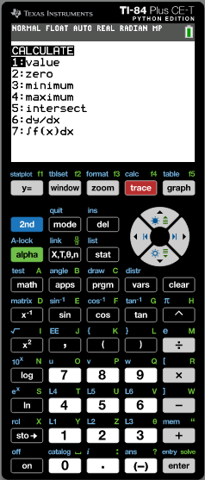
Solving equations of the form a^{x} = b
Find the exact points of intersection of y = e^{x} – 4 and y = 3 – 10e^{– x}. Check the solution using technology.
The functions meet at two points
(ln 2, -2)
and
(ln 5, 1)
Use the GDC to check
Turn on the GDC
Y=
e^{x} – 4
enter
Type in Y1
Type in Y2
3 – 10e^{– x}
enter
F5
Graph
2nd
F4
calc
5
INTSECT

Slide 21
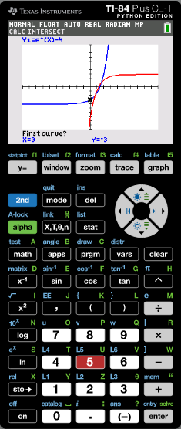
Solving equations of the form a^{x} = b
Find the exact points of intersection of y = e^{x} – 4 and y = 3 – 10e^{– x}. Check the solution using technology.
The functions meet at two points
(ln 2, -2)
and
(ln 5, 1)
Use the GDC to check
Turn on the GDC
Y=
e^{x} – 4
enter
Type in Y1
Type in Y2
3 – 10e^{– x}
enter
F5
Graph
2nd
F4
calc
enter
enter
5
INTSECT

Slide 22
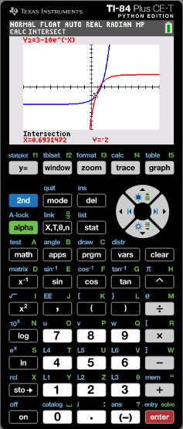
Solving equations of the form a^{x} = b
Find the exact points of intersection of y = e^{x} – 4 and y = 3 – 10e^{– x}. Check the solution using technology.
The functions meet at two points
(ln 2, -2)
and
(ln 5, 1)
Use the GDC to check
Turn on the GDC
Y=
e^{x} – 4
enter
Type in Y1
Type in Y2
3 – 10e^{– x}
enter
F5
Graph
2nd
F4
calc
enter
enter
5
INTSECT
We have the first point
(0.693147, -2)

Slide 23
Solving equations of the form a^{x} = b
Find the exact points of intersection of y = e^{x} – 4 and y = 3 – 10e^{– x}. Check the solution using technology.
The functions meet at two points
(ln 2, -2)
and
(ln 5, 1)
Use the GDC to check
Turn on the GDC
Y=
e^{x} – 4
enter
Type in Y1
Type in Y2
3 – 10e^{– x}
enter
F5
Graph
2nd
F4
calc
enter
enter
5
INTSECT
We have the first point
(0.693147, -2)
❐ Move the cursor to the next intersection
enter
enter

Slide 24
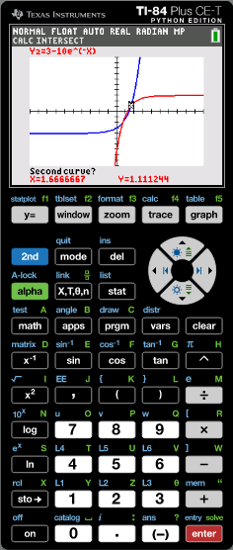
Solving equations of the form a^{x} = b
Find the exact points of intersection of y = e^{x} – 4 and y = 3 – 10e^{– x}. Check the solution using technology.
The functions meet at two points
(ln 2, -2)
and
(ln 5, 1)
Use the GDC to check
Turn on the GDC
Y=
e^{x} – 4
enter
Type in Y1
Type in Y2
3 – 10e^{– x}
enter
F5
Graph
2nd
F4
calc
enter
enter
5
INTSECT
We have the first point
(0.693147, -2)
❐ Move the cursor to the next intersection
enter
enter
(1.60943791, 1)
The second point

Slide 25
Exponential functions in Real life
Example 2: The population, P(t), in thousands, of a city is modelled by the function P(t) = 15e^{(–0.0145)t} where t is the number of years after 1 January 2015.
(a) What was the population of the city in 2015?
t is the number of years after 2015.
For 2015 t = 0
Substituting t = 0
P(0) = 15e ^{(–0.0145)0}
P(0) = 15e⁰
P(0) = 15
The population in 2015 was 15 000

Slide 26
Exponential functions in Real life
Example 2: The population, P(t), in thousands, of a city is modelled by the function P(t) = 15e^{(–0.0145)t} where t is the number of years after 1 January 2015.
(b) By what percentage is the population of the city changing each year?
Calculate the population one year after 2015.
t = 1
Substituting t = 1
P(1) = 15e^{(–0.0145) 1}
P(0) = 15
Calculate the rate of increase
15e^{(–0.0145)}
15
= e^{(–0.0145)}
= 0.986
To calculate percentage change
0.986 - 1
= -0.014
× 100%
The population is decreasing at the rate of 1.4% each year

Slide 27
Exponential functions in Real life
Example 2: The population, P(t), in thousands, of a city is modelled by the function P(t) = 15e^{(–0.0145)t} where t is the number of years after 1 January 2015.
(c) What will the population of the city be on 1 January 2035?
On 1 January 2035.
t = 20
Substituting t = 20
P(20) = 15e ^{(–0.0145)20}
= 15e^{–0.29}
= 11.22
In 2035 the population will be 11 220

Slide 28
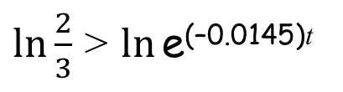
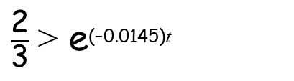
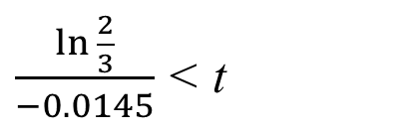
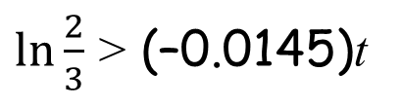
Exponential functions in Real life
Example 2: The population, P(t), in thousands, of a city is modelled by the function P(t) = 15e^{(–0.0145)t} where t is the number of years after 1 January 2015.
(d) When will the city’s population be less than 10 000?
When population is 10 000
P(t) = 10
Substituting P(t) = 10
10 > 15e^{(–0.0145)t}
$\frac{\text{2}}{\text{3}}$ > e^{(–0.0145)t}
Divide both sides by 15
$\ln{\frac{2}{3}}$ > $\ln{\text{e}\text{(–0.0145)}\text{t} }$
Take logarithms of both sides
$\ln{\frac{2}{3}}$ > (–0.0145)t
$\frac{\ln{\frac{2}{3}}}{−0.0145}$ < t
Divide both sides by –0.0145
t > 27.96
The population will be less than 10 000 in the year 28, that is, during 2043

Slide 29
Solving equations of the form a^{x} = b
We can use logarithms to solve equations of the form a^{x} = b. For example:
Find x to 3 significant figures if 5^{2x} = 30.
We can solve this by taking logs of both sides:
log 5^{2x} = log 30
2x log 5 = log 30
Using a calculator:
x = 1.06 (to 3 sig. figs.)

Slide 30
Solving equations of the form a^{x} = b
Find x to 3 significant figures if 4^{3x+1} = 7^{x+2}.
Taking logs of both sides:

Slide 31
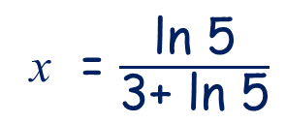
Solving equations of the form a^{x} = b
Solve e^{3x} = 5^{1 - x} giving an exact answer.
e^{3x} = 5^{1 - x}
Using natural logs since ln e^{x} = x
ln e^{3x} = ln 5^{1 - x}
So, bring down the exponents:
3x = (1 - x) ln 5
Expanding the brackets:
3x = ln 5 - x ln 5
Collecting x-terms together:
3x + x ln 5 = ln 5
Factorising:
x (3+ ln 5) = ln 5
x = $\frac{\text{l}\text{n}\text{ 5}}{\text{3+ }\text{ln}\text{ 5}}$
Leave your answer in log form since an exact answer is required.

Slide 32
Solving equations of the form a^{x} = b
Solve 3^{2x} –5(3^{x}) + 4 = 0 to 3 significant figures.
If we let y = 3^{x} we can write the equation as:
So:
If 3^{x} = 1 then x = 0.
Now, solving 3^{x} = 4 by taking logs of both sides:

Slide 33
Solving equations involving logarithms
We can use the laws of logarithms to solve equations.
For example:
Solve log₅ x + 2 = log₅ 10
To solve this equation we have to write the constant value 2 in logarithmic form:
2 = 2 log₅ 5 because log₅ 5 = 1
= log₅ 5²
= log₅ 25
The equation can now be written as:
log₅ x + log₅ 25 = log₅ 10
log₅ 25x = log₅ 10
25x = 10
x = 0.4

Slide 34

Thank you for using resources from
For more resources visit our website
https://www.mathssupport.org
If you have a special request, drop us an email
info@mathssupport.org

