Slide 1
Compound interest
LO: Use geometric series to work problems about compound interest.

Slide 2
COMPOUND INTEREST
Since this section involves what can happen to your money, it should be of INTEREST to you!
At some point in life, most people need either invest or borrow money.
When money is lent, the person lending the money is know as the lender, and the person receiving the money is known as the borrower.
The amount borrowed is called the principal

Slide 3
Types of Interest
The lender usually charges a fee called interest to the borrower.
This fee represents the cost of using the other person’s money.
The borrower must repay the principal borrowed as well as the interest charged for using that money.
The rate at which interest is charged is usually expressed as a percentage of the principal. This percentage is known as the interest rate, and it is an important factor when deciding where to invest your money and where to borrow money from.

Slide 4
Types of Interest
When money is deposited in a bank, the bank will usually pay interest to the owner of the account.
There are two ways to pay interest
Simple Interest
Interest paid (earned) on only the original amount, or principal, borrowed (lent).
Compound Interest
Interest paid (earned) on any previous interest earned, as well as on the principal borrowed (lent).
When money is deposited in a bank, it will usually earn compound interest.

Slide 5
Compound interest
Jack puts £500 into a savings account with an annual compound interest rate of 5%.
How much will he have in the account at the end of 4 years if he doesn’t add or withdraw any money?
At the end of each year interest is added to the total amount in the account. This means that each year 5% of an ever larger amount is added to the account.
Making calculations such as this are sometimes called compound interest problems.
There are two ways to solve such problems.
Method 1 Increase and add on.
Method 2 Use a multiplier

Slide 6
Compound interest
Method 1 Increase and add on
Calculate the amount of interest earned after each year and add it to the previous year’s total, as shown below.
After first year:
5% of £500 = £25, which gives Jack £500 + £25 = £525
After second year:
5% of £525 = £26.25, which gives Jack £525 + £26.25 = £551.25
After third year:
5% of £551.25 = £27.56, which gives Jack £551.25 + £27.56
= £578.81
After fourth year:
5% of £578.81 = £28.94, which gives Jack £578.81 + £28.94
= £607.75
(These amounts are written to the nearest penny.)
At the end of year 4 Jack has £607.75

Slide 7
Compound interest
Method 2 Use a multiplier
When dealing with percentage increase, the multiplier is found by adding the percentage increase expressed as a decimal to 1, which represents the original value.
So, in this case, the multiplier is given by 1 + 0.05 = 1.05
(When dealing with a percentage decrease, the multiplier is found by subtracting the decrease from 1, which gives a value for the multiplier of less than 1.)

Slide 8
Method 2 Use a multiplier
Compound interest
At the end of year 1 Jack has
£500 × 1.05 = £525
At the end of year 2 Jack has
£500 × 1.05 × 1.05 = £551.25
£500 × 1.05² = £551.25
At the end of year 3 Jack has
£ 500 × 1.05 × 1.05 × 1.05 = £578.81
£500 × 1.05³ = £578.81
At the end of year 4 Jack has
£500 × 1.05 × 1.05 × 1.05 × 1.05 = £607.75
£500 × 1.05⁴ = £607.75
If the money is left in your account for n years it will amount to
£500 × (1.05)^{n}
We have a geometric sequence with first term (u₁) 500, common ratio (r) 1.05 and time period (n)
u_{n} = u₁ (r)^{n}
where
r = (1 + i) and i is the interest rate
and
u₁ is the initial amount

Slide 9
The Compound interest formula
For interest compounding annually
(
^{n}
r
)
FV = PV ×
1 +
100
Where:
FV is the future value or final balance
PV is the present value or amount originally invested
r is the interest rate per year
n is the number of years

Slide 10
Compound interest
(
^{n}
r
)
1 +
FV = PV
100
$5 000 is invested for 4 years at 7% p.a. compound interest, compounded annually. What will it amount to at the end of this period? Give the answer to the nearest cent.
(
^{n}
r
)
PV =
5 000
FV = PV
1 +
100
r =
7
(
⁴
7
)
n =
4
FV = 5 000 ×
1 +
100
FV =
?
FV ≈
6 553.98
The investment amounts to $6 553.98
How much interest has been earned?
Interest earned =
FV
–
PV
=
6 553.98
–
5 000
=
$1 553.98

Slide 11
The Compound interest formula
Interest can be compounded more than once per year, Interest is commonly compounded:
half-yearly (2 times per year)
k = 2
quarterly (4 times per year)
k = 4
monthly (12 times per year)
k = 12
For interest compounding k times per year
(
^{kn}
r
)
FV = PV ×
1 +
100k

Slide 12
Compound interest
(
^{kn}
r
)
FV = PV ×
1 +
100k
$5 000 is invested for 4 years at 7% p.a. compound interest, compounded monthly. Calculate the final balance.
(
^{kn}
PV =
5 000
r
)
FV = PV ×
1 +
100k
r =
7
(
¹² ^{× 4}
7
)
n =
4
1 +
FV = 5000 ×
100 × 12
k =
12
(
⁴⁸
7
)
FV =
?
1 +
FV = 5000 ×
1200
FV ≈
6 610.27
The final balance is $6 610.27

Slide 13
Interest earned
(
^{kn}
r
)
1 +
FV = PV ×
100k
The interest earned is the difference between the original balance and the final balance
Interest = FV – PV
How much interest is earned if $8 000 is placed in an account that pays 4½% p.a. compounded quarterly for 3½ years.
(
^{kn}
PV =
8 000
r
)
FV = PV ×
1 +
4.5
100k
r =
n =
3.5
(
⁴ ^{× 3.5}
4.5
)
1 +
FV = 8000 ×
k =
4
100 × 4
FV =
?
(
¹⁴
7
)
1 +
FV = 8000 ×
FV ≈
9 356.41
Interest =
?
400
Interest = FV – PV
Interest = 9356.41 – 8000
Interest = $1356.41
The interest earned is $1356.41

Slide 14
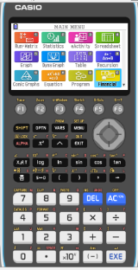
Using a GDC for Compound Interest
There is a financial program that can be used in you calculator
We are going to use a Graphing display calculator to solve problems about Compound Interest
CASIO

Slide 15
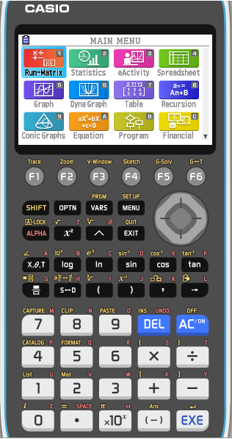
Using a GDC for compound interest - Casio
There is a financial program that can be used in you calculator
From the Main Menu select Financial

Slide 16
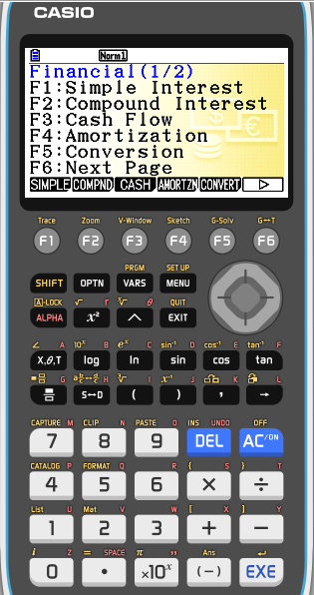
Using a GDC for compound interest - Casio
There is a financial program that can be used in you calculator
From the Main Menu select Financial
Select F2: Compound interest

Slide 17
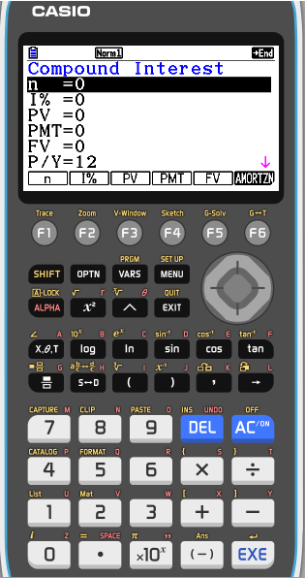
Using a GDC for compound interest - Casio
There is a financial program that can be used in you calculator
From the Main Menu select Financial
Select F2: Compound interest
The following abbreviations are used:
n: represents the number of time periods
I%: represents the interest rate per year
PV: represents the present value
PMT: represents the payment each time period
FV: represents the future value
P/Y: is the number of payments per year
C/Y: is the number of compounding periods per year

Slide 18
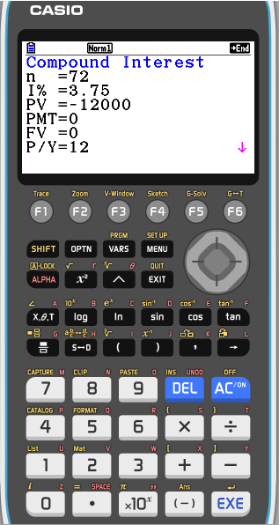
Using a GDC for compound interest - Casio
Connie invest €12 000 in an account that pays 3.75% p.a. compounded monthly. How much is her investment worth after 6 years?
Set up the TVM screen
Since it is compounded monthly there are 6 × 12 = 72 month periods, so, n = 72
EXE
I% =
3.75%
EXE
The initial investment (PV) is considered as an outgoing and is entered as a negative value
PV =
EXE
–12 000
PMT =
No needed, leave 0

FV =

It is our unknown
P/Y =
12
EXE
C/Y =
12
EXE
Press F5

Slide 19
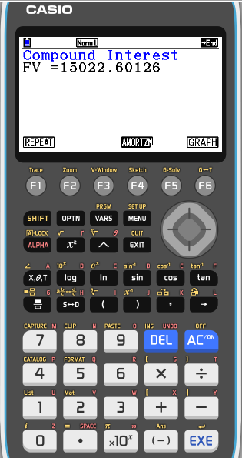
Using a GDC for compound interest - Casio
Connie invest €12 000 in an account that pays 3.75% p.a. compounded monthly. How much is her investment worth after 6 years?
Set up the TVM screen
Since it is compounded monthly there are 6 × 12 = 72 month periods, so, n = 72
EXE
I% =
3.75%
EXE
The initial investment (PV) is considered as an outgoing and is entered as a negative value
PV =
EXE
–12 000
PMT =
No needed, leave 0

FV =

It is our unknown
P/Y =
12
EXE
C/Y =
12
EXE
Press F5
Connie’s investment is worth €15 022.60 after 6 years

Slide 20
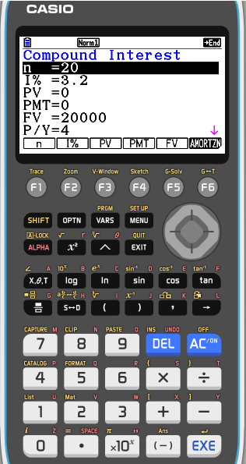
Using a GDC for compound interest - Casio
How much does Alfred need to deposit into an account to collect 20 000 OMR at the end of 5 years if the account is paying 3.2% p.a. compounded quarterly?
Set up the TVM screen
Since it is compounded quarterly there are 5 × 4 = 20 month periods, so, n = 20
EXE
I% =
3.2%
EXE
PV =
It is our unknown

PMT =
No needed, leave 0

The Final value should be a positive value
FV =
20 000
EXE
P/Y =
4
EXE
C/Y =
4
EXE
Press F3

Slide 21
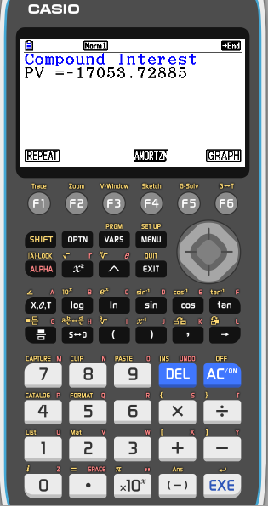
Using a GDC for compound interest - Casio
How much does Alfred need to deposit into an account to collect 20 000 OMR at the end of 5 years if the account is paying 3.2% p.a. compounded quarterly?
Set up the TVM screen
Since it is compounded quarterly there are 5 × 4 = 20 month periods, so, n = 20
EXE
I% =
3.2%
EXE
PV =
It is our unknown

PMT =
No needed, leave 0

The Final value should be a positive value
FV =
20 000
EXE
P/Y =
4
EXE
C/Y =
4
EXE
Press F3
Alfred needs to deposit 17 053.729 OMR

Slide 22
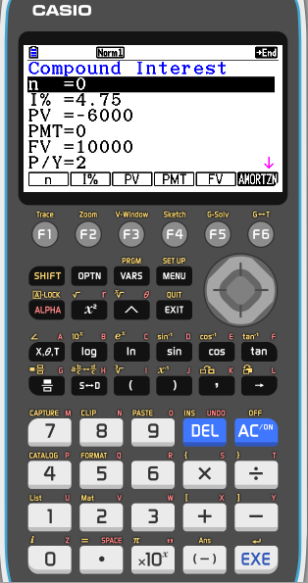
Using a GDC for compound interest - Casio
For how long must Kapil invest £6 000 at 4.75% p.a. compounded half-yearly for it to amount £10 000?
Set up the TVM screen
We need to find n, the number of periods required, so, n = 0
EXE
I% =
4.75%
EXE
PV =
-6000
EXE
PMT =
No needed, leave 0

The Final value should be a positive value
FV =
10 000
EXE
P/Y =
2
EXE
C/Y =
2
EXE
Press F1

Slide 23
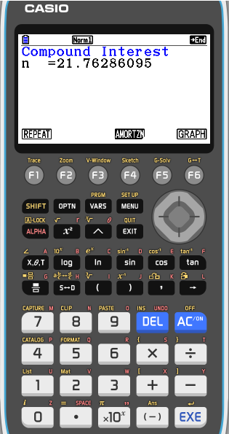
Using a GDC for compound interest - Casio
For how long must Kapil invest £6 000 at 4.75% p.a. compounded half-yearly for it to amount £10 000?
Set up the TVM screen
We need to find n, the number of periods required, so, n = 0
EXE
I% =
4.75%
EXE
PV =
-6000
EXE
PMT =
No needed, leave 0

The Final value should be a positive value
FV =
10 000
EXE
P/Y =
2
EXE
C/Y =
2
EXE
Press F1
n = 21.8, so 22 half-years are required, or 11 years

Slide 24
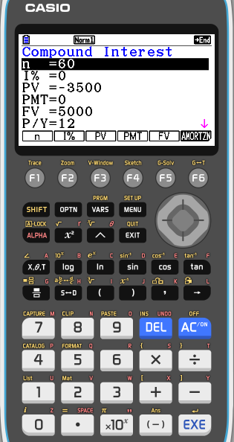
Using a GDC for compound interest - Casio
Marwan deposits €3 500 in an account that compounds interest monthly 5 years later the account totals €5 000. What annual rate of interest was paid?
Set up the TVM screen
Since it is compounded monthly there are 5 × 12 = 60 month periods, so, n = 60
EXE
I% =
It is our unknown

PV =
-3500
EXE
PMT =
No needed, leave 0

The Final value should be a positive value
FV =
5000
EXE
P/Y =
12
EXE
C/Y =
12
EXE
Press F2

Slide 25
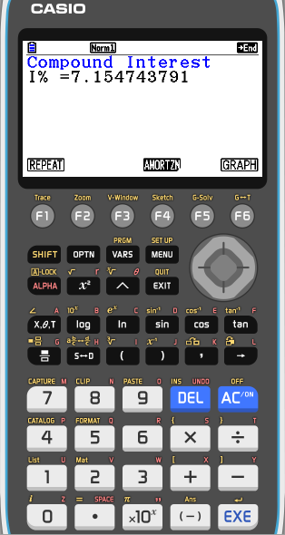
Using a GDC for compound interest - Casio
Marwan deposits €3 500 in an account that compounds interest monthly 5 years later the account totals €5 000. What annual rate of interest was paid?
Set up the TVM screen
Since it is compounded monthly there are 5 × 12 = 60 month periods, so, n = 60
EXE
I% =
It is our unknown

PV =
-3500
EXE
PMT =
No needed, leave 0

The Final value should be a positive value
FV =
5000
EXE
P/Y =
12
EXE
C/Y =
12
EXE
Press F2
An annual interest rate of 7.15% p.a. is required

Slide 26
Thank you for using resources from
For more resources visit our website
https://www.mathssupport.org
If you have a special request, drop us an email
info@mathssupport.org

