Slide 1
Applications of geometric patterns
LO: Solve problems involving geometric patterns.

Slide 2
Geometric sequences
In real-life situations we can see examples of geometric patterns.
Compound interest:
If a person deposits $1 000 in a saving account which pays interest at a rate of 5% annually, and makes no other deposits or withdrawals.
How much will be in the account after 10 years?
At the beginning there will be:
$1 000
= u₁
After one year there will be:
$1 000 × 1.05
= $1 050
= u₂
After two years there will be:
$1 050 × 1.05
= $1 102.50
= u₃
After three years there will be:
$1 102.50 × 1.05
= $1 157.63
= u₄
What type of sequences is 1000, 1050, 1102.5, 1157.63…?

Slide 3
Geometric sequences
What type of sequences is 1000, 1050, 1102.5, 1157.63…?
Geometric sequence
With u₁ = 1000
r = 1.05
How do you calculate the amount of money (A) after t years given the interest rate (r) and the initial amount of money (The Principal) (P)?
A = P (1 + r)^{t}
A =
The amount of money in the account
P =
The principal (initial amount of money)
r =
The interest rate (a percentage, written as a decimal)
t =
Number of years

Slide 4
Geometric sequences
What happens if the interest is compounded more than once each year?
Let say that the interest is compounded n times each year
A =
The amount of money in the account
P =
The principal (initial amount of money)
r =
The interest rate (a percentage, written as a decimal)
t =
Number of years
n =
Number of times per year that interest is compounded
r
A = P (1 + )^{nt}
n

Slide 5
Geometric sequences
The initial population of rabbits on a farm was 50. The population increase by 7% each week.
a) How many rabbits were present after 15 weeks?
There is a fixed percentage increase each week, so the population forms a geometric sequence.
In this geometric sequence
r = 1.07
u₁ =
50
w = 0
One week later
u₂ =
50 × 1.07
w = 1
The general term of this sequence is u_{w + 1} = u₁ × r^{w}.
If w = 15
u₁₅ ₊ ₁ = 50 × (1.07)¹⁵
u₁₆ ≈ 137.95
There were 138 rabbits after 15 weeks

Slide 6
Geometric sequences
The initial population of rabbits on a farm was 50. The population increase by 7% each week.
b) How many rabbits were present after 30 weeks?
The general term of this sequence is u_{w + 1} = u₁ × r^{w}.
If w = 30
u₃₀ ₊ ₁ = 50 × (1.07)³⁰
u₃₁ ≈ 380.61
There were 381 rabbits after 30 weeks

Slide 7
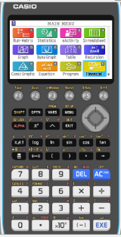
Geometric sequences
The initial population of rabbits on a farm was 50. The population increase by 7% each week.
c) How long would it take for population to reach 500?
The general term of this sequence is
u_{w + 1} = u₁ × r^{w}
after w weeks there will be 500
500 = 50 × (1.07)^{w}
CASIO
To solve this equation we are going to use the GDC

Slide 8
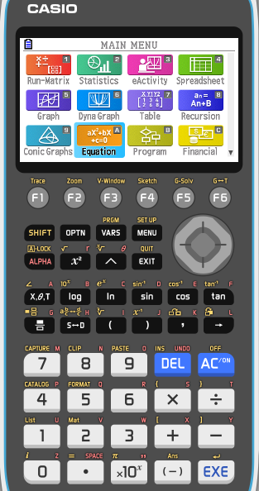
Using the GDC: Casio
500 = 50 × (1.07)^{w}
We need to find w
Select Equation from the main MENU

Slide 9
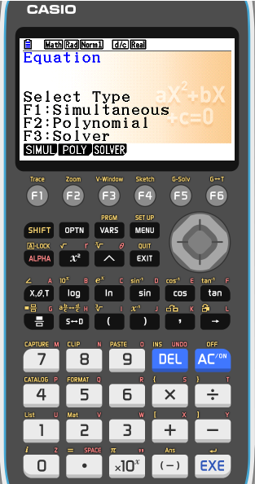
Using the GDC: Casio
500 = 50 × (1.07)^{w}
We need to find w
Select Equation from the main MENU
Press F3: Solver

Slide 10
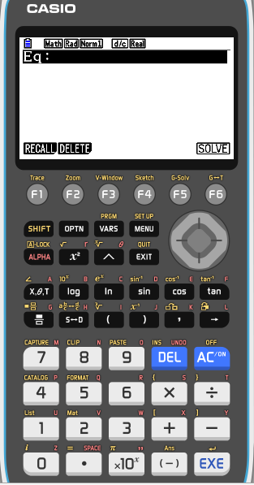
Using the GDC: Casio
500 = 50 × (1.07)^{w}
We need to find w
Select Equation from the main MENU
Press F3: Solver
Type 500 = 50 (1.07)^X

Slide 11
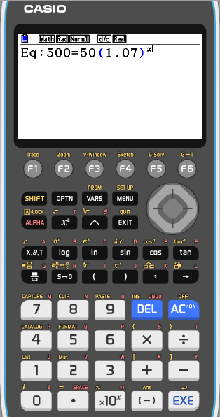
Using the GDC: Casio
500 = 50 × (1.07)^{w}
We need to find w
Select Equation from the main MENU
Press F3: Solver
Type 500 = 50 (1.07)^X
EXE

Slide 12
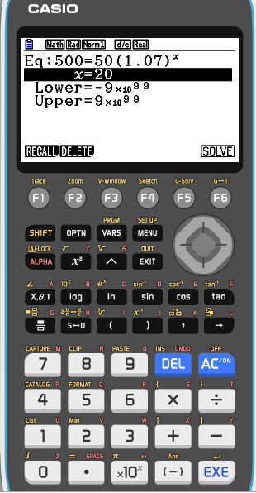
Using the GDC: Casio
500 = 50 × (1.07)^{w}
We need to find w
Select Equation from the main MENU
Press F3: Solver
Type 500 = 50 (1.07)^X
EXE
EXE

Slide 13
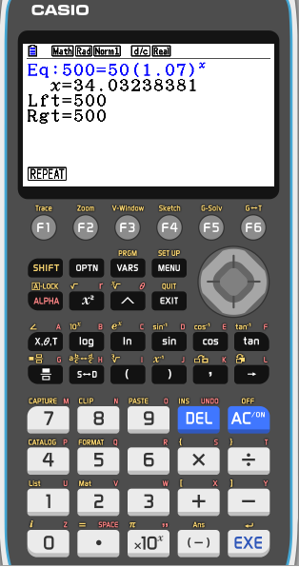
Using the GDC: Casio
500 = 50 × (1.07)^{w}
We need to find w
Select Equation from the main MENU
Press F3: Solver
Type 500 = 50 (1.07)^X
EXE
EXE
So, x = 34.0323, it will take approximately 34 weeks

Slide 14
Thank you for using resources from
For more resources visit our website
https://www.mathssupport.org
If you have a special request, drop us an email
info@mathssupport.org

