Slide 1
Using sigma (Σ) notation
(Geometric series)
LO: Write geometric series using sigma notation and use the GDC to evaluate them.

Slide 2

Using sigma (Σ) notation
When working with series, the Greek symbol Σ (the capital letter sigma) is used to mean ‘the sum of’.
For example:
… and this is the last value of i.
$$\sum_{i=1}^{n}{u_{i}}$$
This is the first value of i …
represents a finite series containing n terms:
You read this ‘the sum of all the terms u_{i} from i = 1 to i = n’
u₁ + u₂ + u₃ + … + u_{n}
The terms in the series are obtained by substituting 1, 2, 3, …, n in turn for i in u_{i}.

Slide 3
Using Σ notation
For example, suppose we want to write in sigma notation the sum of the first 6 terms of the series whose n^{th} term is of the form 2^{n} .
We can write:
Σ
6
(2^{n})
n = 1
2¹ + 2² + 2³ + 2⁴ + 2⁵ + 2⁶
= 126

Slide 4
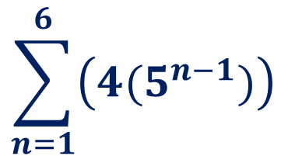
Using Σ notation
Write the series 4 + 20 + 100 + 500 + 2500 + 12500 using sigma notation
the terms are a geometric progression with u₁ = 4 and r = 5
u_{n} = u₁ r^{n–1}
First we have to find the general term u_{n} .
u_{n} = 4
(5)
^{n–1}
This series is the first six terms of the geometric progression
Using sigma notation we write:
$$\sum_{n=1}^{6}{\left(4(5^{n−1})\right)}$$

Slide 5
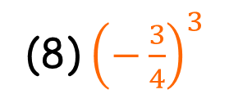
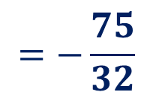
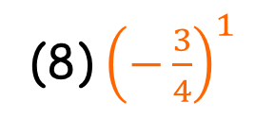
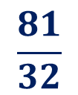
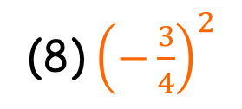
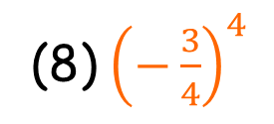

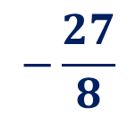


Using Σ notation
$$\sum_{n=1}^{4}{{8\left(−\frac{3}{4}\right)}^{n}}$$
Evaluate
Substituting n = 1, 2, 3, 4 into ${8\left(−\frac{3}{4}\right)}^{n}$
(8) ${\left(−\frac{3}{4}\right)}^{1}$
(8) ${\left(−\frac{3}{4}\right)}^{2}$
(8) ${\left(−\frac{3}{4}\right)}^{3}$
(8) ${\left(−\frac{3}{4}\right)}^{4}$
+
+
+
$$\frac{9}{2}$$
$$−\frac{27}{8}$$
$$\frac{81}{32}$$
-6
+
+
+
$$=−\frac{75}{32}$$

Slide 6
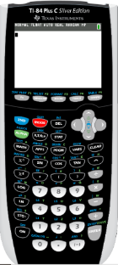

Using sigma (Σ) notation
Using GDC to evaluate a geometric series
$$\sum_{n=1}^{6}{\left(4(5^{n−1})\right)}$$
Evaluate
We are going to use a Graphing display calculator to solve the problem
Texas Instruments

Slide 7
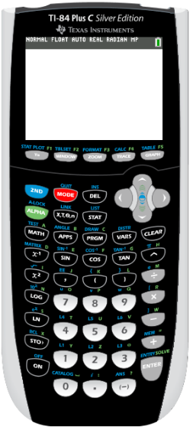
Σ notation - Using GDC Texas Instruments
Using GDC to evaluate a a geometric series
$$\sum_{n=1}^{6}{\left(4(5^{n−1})\right)}$$
Evaluate
Turn on the GDC
Press
MATH

Slide 8
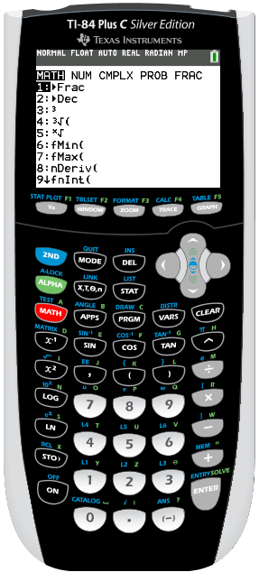
Σ notation - Using GDC Texas Instruments
Using GDC to evaluate a a geometric series
$$\sum_{n=1}^{6}{\left(4(5^{n−1})\right)}$$
Evaluate
Turn on the GDC
Press
MATH
Scroll up to
0: summation Σ(

Slide 9
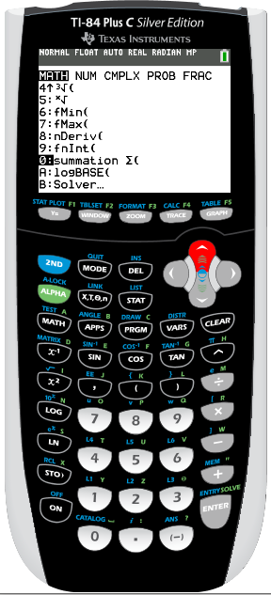
Σ notation - Using GDC Texas Instruments
Using GDC to evaluate a a geometric series
$$\sum_{n=1}^{6}{\left(4(5^{n−1})\right)}$$
Evaluate
Turn on the GDC
Press
MATH
Scroll up to
0: summation Σ(
ENTER

Slide 10
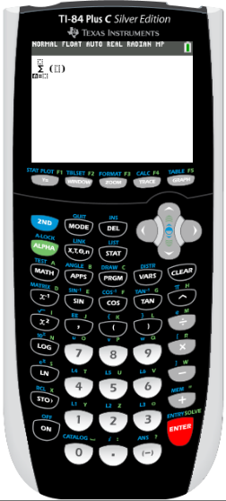
Σ notation - Using GDC Texas Instruments
Using GDC to evaluate a a geometric series
$$\sum_{n=1}^{6}{\left(4(5^{n−1})\right)}$$
Evaluate
Turn on the GDC
Press
MATH
Scroll up to
0: summation Σ(
ENTER
x
Type
1


(
x
–
)
6
4
5
^
1


Slide 11
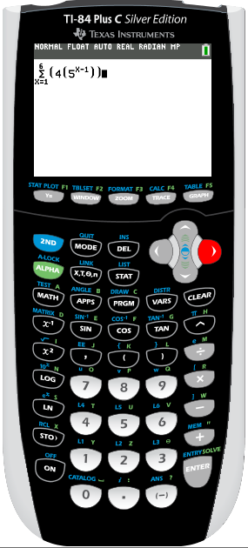
Σ notation - Using GDC Texas Instruments
Using GDC to evaluate a a geometric series
$$\sum_{n=1}^{6}{\left(4(5^{n−1})\right)}$$
Evaluate
Turn on the GDC
Press
MATH
Scroll up to
0: summation Σ(
ENTER
x
Type
1


(
x
–
)
6
4
5
1

ENTER

Slide 12
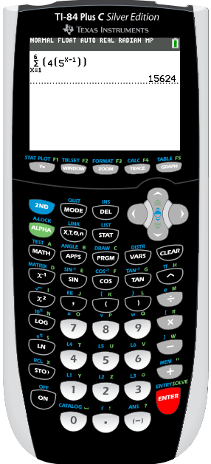
Σ notation - Using GDC Texas Instruments
Using GDC to evaluate a a geometric series
$$\sum_{n=1}^{6}{\left(4(5^{n−1})\right)}$$
Evaluate
Turn on the GDC
Press
MATH
Scroll up to
0: summation Σ(
ENTER
x

x
–
Type
1

15
4
2
ENTER
= 15 624

Slide 13

Thank you for using resources from
For more resources visit our website
https://www.mathssupport.org
If you have a special request, drop us an email
info@mathssupport.org

