Slide 1
Using sigma (Σ) notation
(Arithmetic series)
LO: Write arithmetic series using sigma notation and use the GDC to evaluate them.

Slide 2
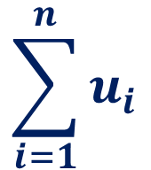
Using sigma (Σ) notation
When working with series, the Greek symbol Σ (the capital letter sigma) is used to mean ‘the sum of’.
u₁ + u₂ + u₃ + … + u_{n} can be written more compactly using sigma notation.
For example:
… and this is the last value of i.
$$\sum_{i=1}^{n}{u_{i}}$$
This is the first value of i …
represents a finite series containing n terms:
You read this ‘the sum of all the terms u_{i} from i = 1 to i = n’
u₁ + u₂ + u₃ + … + u_{n}
The terms in the series are obtained by substituting 1, 2, 3, …, n in turn for i in u_{i}.

Slide 3
Using Σ notation
For example, suppose we want to find the sum of the first 4 terms of the series whose n^{th} term is of the form 3n – 1.
We can write:
(3 × 1 – 1) + (3 × 2 – 1) + (3 × 3 – 1) + (3 × 4 – 1)
= 2 + 5 + 8 + 11
= 26

Slide 4
Using Σ notation
The initial value of n doesn’t have to be 1. For example:
Σ
8
(4n + 3)
n = 3
= (4×3+3)
+ (4×4+3)
+ (4×5+3)
+ (4×6+3)
+ (4×7+3)
+ (4×8+3)
= 15
+ 19
+ 23
+ 27
+ 31
+ 35
= 150

Slide 5
Using Σ notation
Write the series 4 + 7 + 10 + … to 50 terms using sigma notation
the terms are an arithmetic progression with u₁ = 4 and d = 3
First, we have to find the general term u_{n} .
u_{n} = u₁ + (n – 1)d
u_{n} = 4
+
(n – 1)
3
u_{n} = 3
n + 1
This series is the first fifty terms of the arithmetic progression
Using sigma notation we write:
Σ
50
(3n + 1)
n = 1

Slide 6

Using Σ notation
$$\sum_{n=3}^{8}{\left(3n −5\right)}$$
Evaluate
Substituting n = 3, 4, 5, 6, 7, 8 into 3n – 5
+
+
+
+
+
3(8) – 5
3(3) – 5
3(4) – 5
3(5) – 5
3(6) – 5
3(7) – 5
4
+
7
+
10
+
13
+
16
+
19
= 69

Slide 7

Using Σ notation
$$\sum_{n=1}^{3}{2n−n^{2}}$$
Evaluate
Substituting n = 1, 2, 3 into 2n – n²
+
2(2) – 2²
+
2(1) – 1²
2(3) – 3²
1
+
0
+
(-3)
= -2

Slide 8
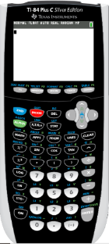

Σ notation - Using GDC
Using GDC to evaluate an arithmetic series
$$\sum_{n=1}^{15}{(4n−2)}$$
Evaluate
We are going to use Graphing display calculator to solve the problem
Texas Instruments

Slide 9
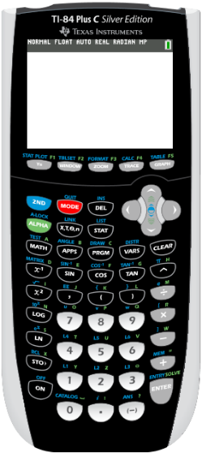
Σ notation - Using GDC Texas Instruments
Using GDC to evaluate an arithmetic series
$$\sum_{n=1}^{15}{(4n−2)}$$
Evaluate
Turn on the GDC
Press
MATH

Slide 10
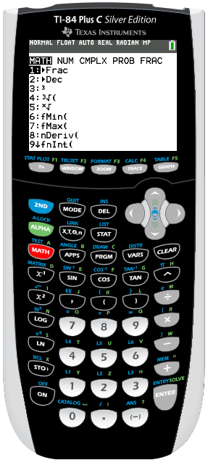
Σ notation - Using GDC Texas Instruments
Using GDC to evaluate an arithmetic series
$$\sum_{n=1}^{15}{(4n−2)}$$
Evaluate
Turn on the GDC
Press
MATH
Scroll up to
0: summation Σ(

Slide 11
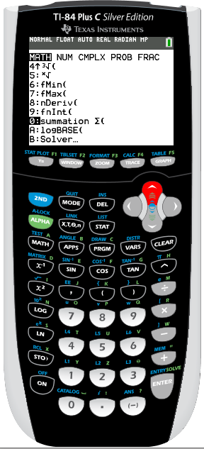
Σ notation - Using GDC Texas Instruments
Using GDC to evaluate an arithmetic series
$$\sum_{n=1}^{15}{(4n−2)}$$
Evaluate
Turn on the GDC
Press
MATH
Scroll up to
0: summation Σ(
ENTER

Slide 12
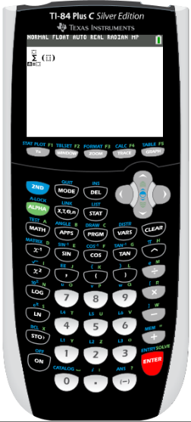
Σ notation - Using GDC Texas Instruments
Using GDC to evaluate an arithmetic series
$$\sum_{n=1}^{15}{(4n−2)}$$
Evaluate
Turn on the GDC
Press
MATH
Scroll up to
0: summation Σ(
ENTER
x

x
–
Type
1

15
4
2

Slide 13
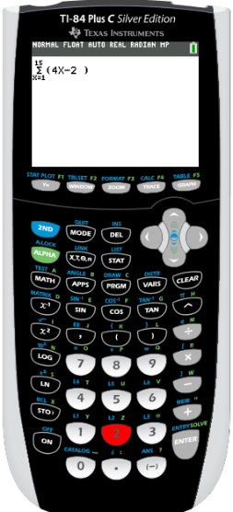
Σ notation - Using GDC Texas Instruments
Using GDC to evaluate an arithmetic series
$$\sum_{n=1}^{15}{(4n−2)}$$
Evaluate
Turn on the GDC
Press
MATH
Scroll up to
0: summation Σ(
ENTER
x

x
–
Type
1

15
4
2
ENTER

Slide 14
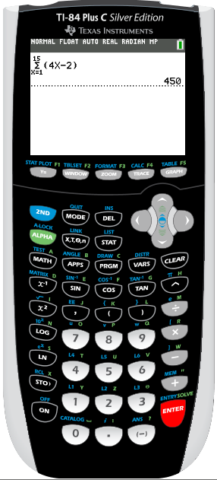
Σ notation - Using GDC Texas Instruments
Using GDC to evaluate an arithmetic series
$$\sum_{n=1}^{15}{(4n−2)}$$
Evaluate
Turn on the GDC
Press
MATH
Scroll up to
0: summation Σ(
ENTER
x

x
–
Type
1

15
4
2
ENTER
= 450

Slide 15

Thank you for using resources from
For more resources visit our website
https://www.mathssupport.org
If you have a special request, drop us an email
info@mathssupport.org

