Slide 1
Problem solving by integration
LO: Solve problems using integral calculus.

Slide 2
Measure the change in a quantity from its rate of change
When we studied differential calculus, we saw how to find the rate of change of a function by differentiation.
Since integration is the reverse process of differentiation, integration can be used to measure the change in a quantity from its rate of change.
When we introduce integration, we separated the area under a curve into rectangles.
y
The area of each rectangle is the rate of change of the quantity times the subinterval width, which tells the change in the quantity corresponding to that subinterval .
So, the area under a rate function for a particular interval tells us the overall change in the quantity over that interval.
R3
R4
R8
R5
R6
R2
R7
R1
0
x

Slide 3
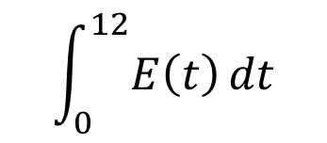
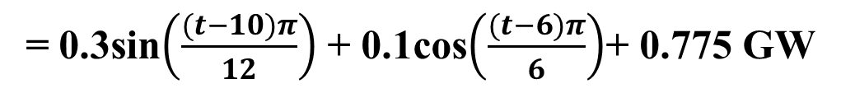
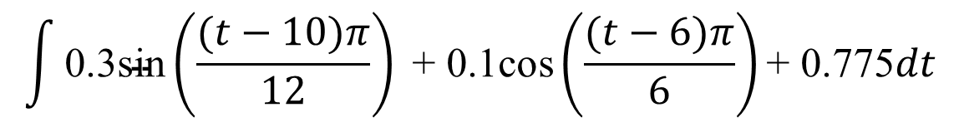
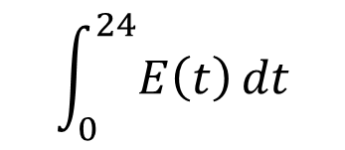
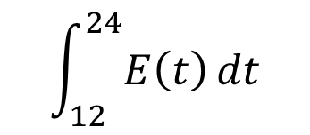
Problem solving
The rate of power consumption by the city of Bristol can be modelled by the function.
E(t)
= 0.3sin$\left(\frac{(t−10)π}{12}\right)$ + 0.1cos$\left(\frac{(t−6)π}{6}\right)$+ 0.775 GW
Where t is the number of hours after midnight each day.
0 ≤ t ≤ 24
Find the following quantities and explain what they represent
$$\int_{0}^{12}{E\left(t\right)dt}$$
$$\int_{12}^{24}{E\left(t\right)dt}$$
$$\int_{0}^{24}{E\left(t\right)dt}$$
(a)
(b)
(c)
First, we need the integral of the function E(t)
$$\int{\text{0.3}\text{sin}\left(\frac{(t−10)π}{12}\right)\text{ + 0.1}\text{cos}\left(\frac{(t−6)π}{6}\right)\text{+ 0.775}dt}$$

Slide 4
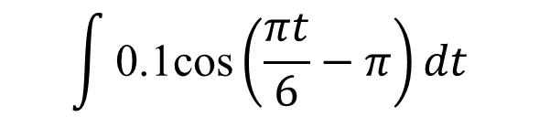
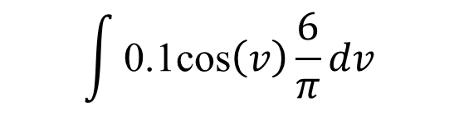
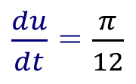
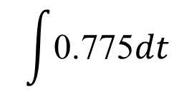
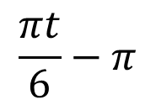
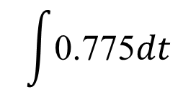
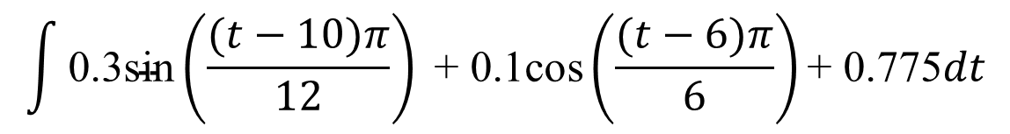
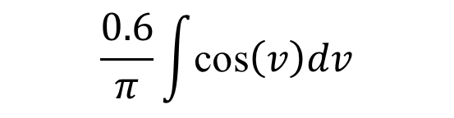
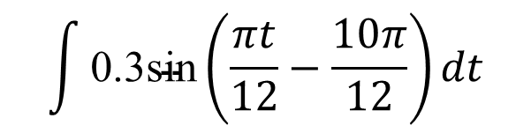
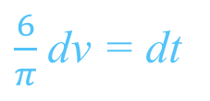
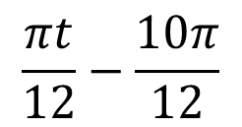
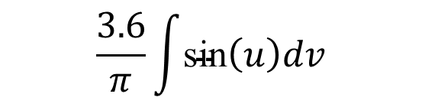
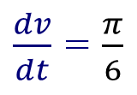
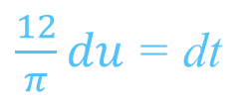
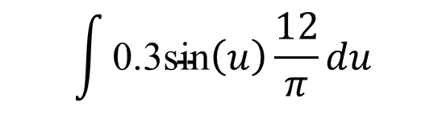
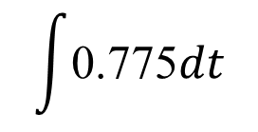
Problem solving
First, we need the integral of the function E(t)
$$\int{\text{0.3}\text{sin}\left(\frac{(t−10)π}{12}\right)\text{ + 0.1}\text{cos}\left(\frac{(t−6)π}{6}\right)\text{+ 0.775}dt}$$
$$\int{\text{0.3}\text{sin}\left(\frac{πt}{12}−\frac{10π}{12}\right)dt}$$
$$\int{\text{0.1}\text{cos}\left(\frac{πt}{6}−π\right)dt}$$
$$\int{\text{0.775}dt}$$
+
+
$$\frac{πt}{12}−\frac{10π}{12}$$
$$\frac{πt}{6}−π$$
Let
u =
Let
v =
$\frac{du}{dt}$ = $\frac{π}{12}$
⇒
$\frac{12}{π}du$ = dt
$\frac{dv}{dt}$ = $\frac{π}{6}$
⇒
$\frac{6}{π}$dv = dt
$$\int{\text{0.775}dt}$$
$$\int{\text{0.3}\text{sin}\left(u\right)\frac{12}{π}du}$$
$$\int{\text{0.1}\text{cos}\left(v\right)\frac{6}{π}dv}$$
+
+
$$\frac{3.6}{π}\int{\text{sin}\left(u\right)dv}$$
$$\frac{0.6}{π}\int{\text{cos}\left(v\right)dv}$$
$$\int{\text{0.775}dt}$$
+
+

Slide 5


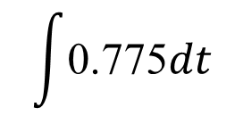
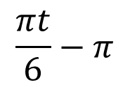
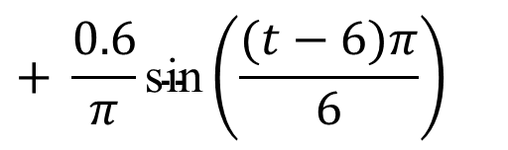
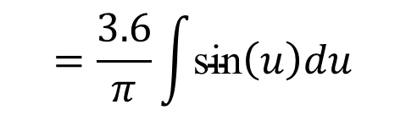
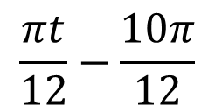

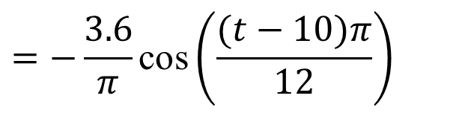
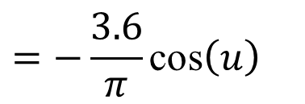
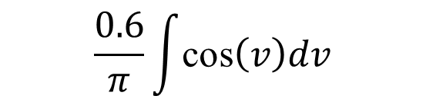
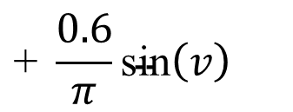

Problem solving
$$\frac{πt}{6}−π$$
$$\frac{πt}{12}−\frac{10π}{12}$$
u =
v =
$$=\frac{3.6}{π}\int{\text{sin}\left(u\right)du}$$
$$\frac{0.6}{π}\int{\text{cos}\left(v\right)dv}$$
$$\int{\text{0.775}dt}$$
+
+
Integrating
$$=−\frac{3.6}{π}\text{cos}\left(u\right)$$
$$\text{+ }\frac{0.6}{π}\text{s}\text{in}\left(v\right)$$
$$\text{+ 0.775}\text{t}$$
$$\text{+ }\text{C}$$
Replacing u and v
$$=−\frac{3.6}{π}\text{cos}\left(\frac{(t−10)π}{12}\right)$$
$$+ \frac{0.6}{π}\text{s}\text{in}\left(\frac{(t−6)π}{6}\right)$$
$$\text{+ 0.775}\text{t}$$
$$\text{+ }\text{C}$$
Using this indefinite integral to answer the questions

Slide 6
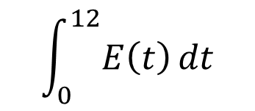
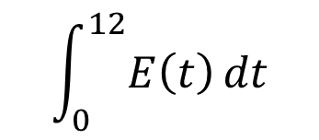
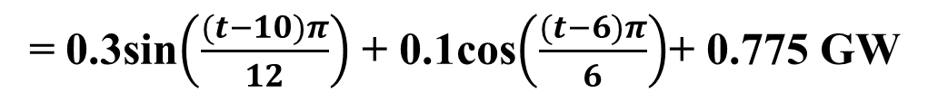
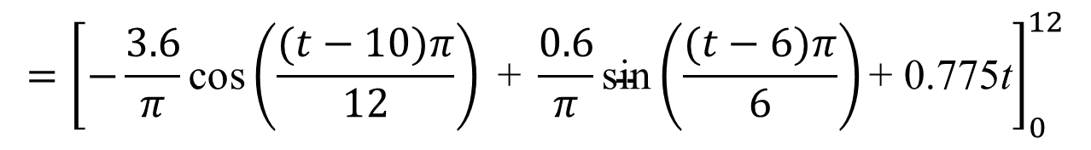
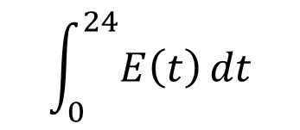
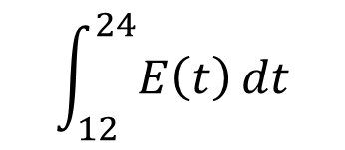
Problem solving
The rate of power consumption by the city of Bristol can be modelled by the function.
E(t)
= 0.3sin$\left(\frac{(t−10)π}{12}\right)$ + 0.1cos$\left(\frac{(t−6)π}{6}\right)$+ 0.775 GW
Where t is the number of hours after midnight each day.
0 ≤ t ≤ 24
Find the following quantities and explain what they represent
$$\int_{0}^{12}{E\left(t\right)dt}$$
$$\int_{12}^{24}{E\left(t\right)dt}$$
$$\int_{0}^{24}{E\left(t\right)dt}$$
(a)
(b)
(c)
$$\int_{0}^{12}{E\left(t\right)dt}$$
Finding the definite integral
$$={\left[−\frac{3.6}{π}\text{cos}\left(\frac{(t−10)π}{12}\right)\text{ + }\frac{0.6}{π}\text{sin}\left(\frac{(t−6)π}{6}\right)\text{+ 0.775}\text{t}\right]}_{0}^{12}$$
$=$ $\left[−\frac{3.6}{π}\text{cos}\left(\frac{π}{6}\right)\text{ + }\frac{0.6}{π}\text{sin}\left(π\right)\text{+ 9.3}\right]−\left[−\frac{3.6}{π}\text{cos}\left(\frac{−5π}{6}\right)\text{ + }\frac{0.6}{π}\text{sin}\left(−π\right)\text{+ }\text{0}\right]$
≈ 7.315 GWh
The morning power consumption of Bristol is about 7.32 GWh

Slide 7
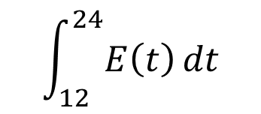
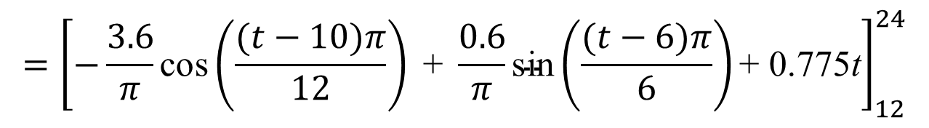
Problem solving
The rate of power consumption by the city of Bristol can be modelled by the function.
E(t)
= 0.3sin$\left(\frac{(t−10)π}{12}\right)$ + 0.1cos$\left(\frac{(t−6)π}{6}\right)$+ 0.775 GW
Where t is the number of hours after midnight each day.
0 ≤ t ≤ 24
Find the following quantities and explain what they represent
$$\int_{0}^{12}{E\left(t\right)dt}$$
$$\int_{12}^{24}{E\left(t\right)dt}$$
$$\int_{0}^{24}{E\left(t\right)dt}$$
(a)
(b)
(c)
$$\int_{12}^{24}{E\left(t\right)dt}$$
Finding the definite integral
$$={\left[−\frac{3.6}{π}\text{cos}\left(\frac{(t−10)π}{12}\right)\text{ + }\frac{0.6}{π}\text{sin}\left(\frac{(t−6)π}{6}\right)\text{+ 0.775}\text{t}\right]}_{12}^{24}$$
$=$ $\left[−\frac{3.6}{π}\text{cos}\left(\frac{7π}{6}\right)\text{ + }\frac{0.6}{π}\text{sin}\left(3π\right)\text{+ }18.6\right]−\left[−\frac{3.6}{π}\text{cos}\left(\frac{π}{6}\right)\text{ + }\frac{0.6}{π}\text{sin}\left(π\right)\text{+ }\text{9.3}\right]$
≈ 11.285 GWh
The afternoon power consumption of Bristol is about 11.29 GWh

Slide 8
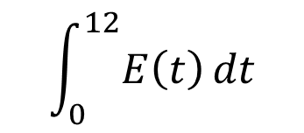
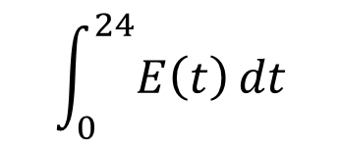
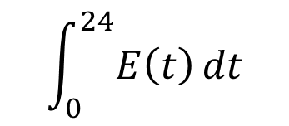
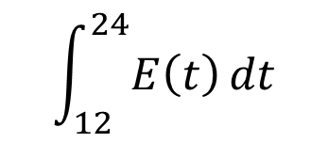
Problem solving
The rate of power consumption by the city of Bristol can be modelled by the function.
E(t)
= 0.3sin$\left(\frac{(t−10)π}{12}\right)$ + 0.1cos$\left(\frac{(t−6)π}{6}\right)$+ 0.775 GW
Where t is the number of hours after midnight each day.
0 ≤ t ≤ 24
Find the following quantities and explain what they represent
$$\int_{0}^{12}{E\left(t\right)dt}$$
$$\int_{12}^{24}{E\left(t\right)dt}$$
$$\int_{0}^{24}{E\left(t\right)dt}$$
(a)
(b)
(c)
$$\int_{0}^{24}{E\left(t\right)dt}$$
Finding the definite integral
$$\int_{0}^{24}{E\left(t\right)dt}$$
$$\int_{0}^{12}{E\left(t\right)dt}$$
$$\int_{12}^{24}{E\left(t\right)dt}$$
=
+
≈ 7.315 GWh
+ 11.285 GWh
≈ 18.6 GWh
The total daily power consumption of Bristol is about 18.6 GWh

Slide 9

Thank you for using resources from
For more resources visit our website
https://www.mathssupport.org
If you have a special request, drop us an email
info@mathssupport.org

