Slide 1
Differentiation,
The quotient rule
LO: Find the derivative of the quotient of functions.

Slide 2
The quotient rule
To find the derivative of a quotient of functions you use the quotient rule.
The derivative of a quotient of functions is not equal the quotient of the derivatives of the functions.
For example:
g(x)
x³
g(x) = x³
h(x) = x
f(x) =
=
f(x) = x²
h(x)
x
f ’ (x) = 2x
g’ (x) = 3x²
h’ (x) = 1
g’ (x)
g’ (x)
3x²
f ’ (x) ≠
=
= 3x²
h’ (x)
h’ (x)
1
2x ≠
3x²

Slide 3
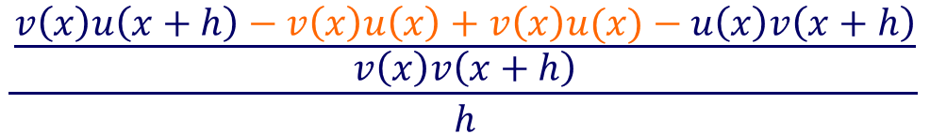



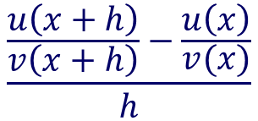
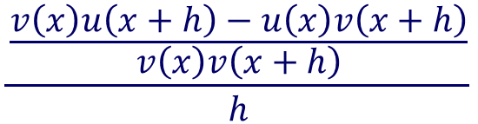





The quotient rule
To find the derivative of a quotient of functions you have to use the quotient rule.
You can derive the quotient rule from first principles.
Given that
u(x)
and
v(x)
Are differentiable functions
u(x)
$$\frac{\frac{u\left(x+h\right)}{v\left(x+h\right)}−\frac{u\left(x\right)}{v(x)}}{h}$$
Let
f(x) =
Then:
f '(x) =
$$\lim_{h→0}{}$$
v(x)
Subtracting fractions
$$\frac{\frac{v\left(x\right)u\left(x+h\right)−u\left(x\right)v\left(x+h\right)}{v\left(x\right)v\left(x+h\right)}}{h}$$
m'(x) =
$$\lim_{h→0}{}$$
Adding and subtracting v(x)u(x)
$$\frac{\frac{v\left(x\right)u\left(x+h\right)−v\left(x\right)u\left(x\right)+v\left(x\right)u(x)−u\left(x\right)v\left(x+h\right)}{v\left(x\right)v\left(x+h\right)}}{h}$$
$$=\lim_{h→0}{}$$
Separating the two fractions and switching the denominator
$$\frac{v\left(x\right)u\left(x+h\right)−v\left(x\right)u\left(x\right)}{h}$$
$$−$$
$$\frac{u\left(x\right)v\left(x+h\right)−v\left(x\right)u(x)}{h}$$
$$=\lim_{h→0}{}$$
$$v\left(x\right)v\left(x+h\right)$$

Slide 4








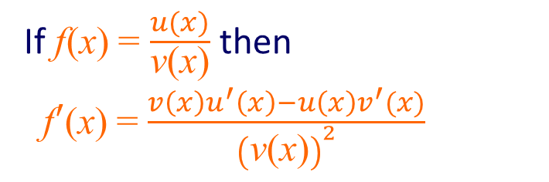


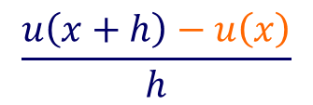











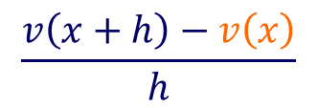
The quotient rule
$$\frac{v\left(x\right)u\left(x+h\right)−v\left(x\right)u\left(x\right)}{h}$$
$$−$$
$$\frac{u\left(x\right)v\left(x+h\right)−v\left(x\right)u(x)}{h}$$
$$=\lim_{h→0}{}$$
$$v\left(x\right)v\left(x+h\right)$$
Factorising
$$v\left(x\right)\frac{u\left(x+h\right)−u\left(x\right)}{h}$$
$$−$$
$$u\left(x\right)\frac{v\left(x+h\right)−v\left(x\right)}{h}$$
$$=\lim_{h→0}{}$$
$$v\left(x\right)v\left(x+h\right)$$
Taking the limits in both numerator and denominator
$$v\left(x\right)$$
$$\frac{u\left(x+h\right)−u\left(x\right)}{h}$$
$$u\left(x\right)$$
$$\frac{v\left(x+h\right)−v\left(x\right)}{h}$$
$$\lim_{h→0}{}$$
$$\lim_{h→0}{}$$
$$−$$
$$\lim_{h→0}{}$$
$$\lim_{h→0}{}$$
=
$$\left[v\left(x\right)v\left(x+h\right)\right]$$
$$\lim_{h→0}{}$$
Evaluating for h → 0
$$−$$
u(x)
v′ (x)
u′(x)
$$−$$
u(x)
v′(x)
u′(x)
v(x)
v(x)
⇒
f '(x) =
f '(x) =
v(x)
v(x)
[v(x)]²
Which is the quotient rule.
If f(x) = $\frac{u(x)}{\text{v}\text{(}\text{x}\text{)}}$ then
f$′$(x) = $\frac{v\left(x\right)u^{′}\left(x\right)−u\left(x\right)v^{′}(x)}{{\left(\text{v}\text{(}\text{x}\text{)}\right)}^{2}}$

Slide 5




The quotient rule
u(x)
If
f(x) =
Where
v(x) ≠ 0
v(x)
u(x)
are differentiable functions
and
v(x)
and
$$−$$
v’(x)
u’(x)
u(x)
v(x)
Then:
f '(x) =
[v(x)]²
Another way of writing this is:
u
If
y =
v
u
v
Where
and
are differentiable functions of x
$$v\frac{du}{dx}$$
$$−u\frac{dv}{dx}$$
Then:
$$\frac{dy}{dx}=$$
v²

Slide 6



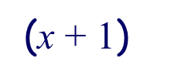


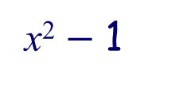

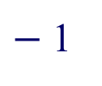




The quotient rule
Example 1:
(x² + 1)
Find f '(x) if f (x) =
x ≠ $−$1
(x + 1)
Let u(x) = x² + 1
and
v(x) =
$$\text{x}\text{ + 1}$$
Define u and v
So
u’(x) = 2x
v’(x) = 1
Find u’(x) and v’(x)
$$−$$
v’(x)
v(x)
u’(x)
u(x)
f '(x) =
Use the quotient rule
[v(x)]²
$$−$$
(x² + 1)
2x
($\text{x}\text{ + 1}$)
1
Expand brackets
f '(x) =
($\text{x}\text{ + 1}$)²
$$\text{+ }\text{2}\text{x}$$
2x²
$$−$$
x² $−$ 1
f '(x) =
Simplify
($\text{x}\text{ + 1}$)²
$$\text{+} \text{2}\text{x}$$
$−$ 1
f '(x) =
x²
($\text{x}\text{ + 1}$)²

Slide 7






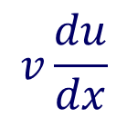


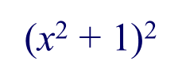

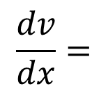




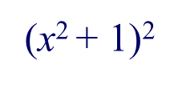

The quotient rule
Example 2:
4x
Differentiate y =
With respect to x
x² + 1
Let u = 4x
and
v =
$$\text{x}\text{2}\text{ + 1 }$$
Define u and v
$$\frac{du}{dx}=4$$
$$\frac{dv}{dx}=$$
So
2x
Find u’(x) and v’(x)
$$v\frac{du}{dx}$$
$$−u\frac{dv}{dx}$$
$$\frac{dy}{dx}=$$
Use the quotient rule
v²
$$−$$
(4x)
$$\frac{dy}{dx}=$$
($\text{x}\text{2}\text{ + 1}$)
2x
4
Expand brackets
($\text{x}\text{2}\text{ + 1}$)²
$$\frac{dy}{dx}=$$
4x²
$$−$$
8x²
$$\text{+ }\text{4}$$
Simplify
($\text{x}\text{2} \text{+ 1}$)²
$$\frac{dy}{dx}=$$
$$\text{4}$$
$−$ 4x²
($\text{x}\text{2}\text{ +} \text{1}$)²

Slide 8





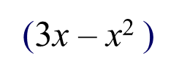
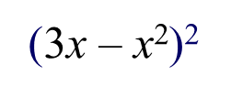

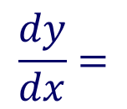



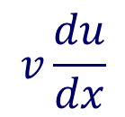




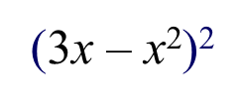
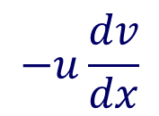

The quotient rule
Example 3:
x² – 3
Differentiate y =
With respect to x
3x – x²
Let u = x² – 3
and
v =
$$\text{3}\text{x}\text{ – }\text{x}\text{2}$$
Define u and v
$$\frac{du}{dx}=2x$$
$$\frac{dv}{dx}=$$
So
3 – 2x
Find u’(x) and v’(x)
$$v\frac{du}{dx}$$
$$−u\frac{dv}{dx}$$
$$\frac{dy}{dx}=$$
Use the quotient rule
v²
$$\frac{dy}{dx}=$$
($\text{3}\text{x}\text{ – }\text{x}\text{2}$)
(2x)
$$−$$
(x² – 3 )
(3 – 2x)
Expand brackets
($\text{3}\text{x}\text{ – }\text{x}\text{2}$)²
$$–$$
$$+ \text{2}\text{x}\text{3}$$
$$+$$
9
$$\frac{dy}{dx}=$$
6x²
3x²
$$–\text{ 6}\text{x}$$
$$–\text{2}\text{x}\text{3}$$
Simplify
($\text{3}\text{x}\text{ – }\text{x}\text{2}$)²
$$\frac{dy}{dx}=$$
3x²
$$+$$
$$–\text{ 6}\text{x}$$
9
($\text{3}\text{x}\text{ – }\text{x}\text{2}$)²

Slide 9




Summary
The quotient rule
u(x)
u
If
f(x) =
Where
v(x) ≠ 0
If
y =
v(x)
v
$$−$$
v' (x)
$$v\frac{du}{dx}$$
$$−u\frac{dv}{dx}$$
u' (x)
u(x)
v(x)
f '(x) =
$$\frac{dy}{dx}=$$
[v(x)]²
v²

Slide 10

Thank you for using resources from
For more resources visit our website
https://www.mathssupport.org
If you have a special request, drop us an email
info@mathssupport.org

