Slide 1
The derivative of ln x
LO: Find the derivative of the function f(x) = ln x.

Slide 2
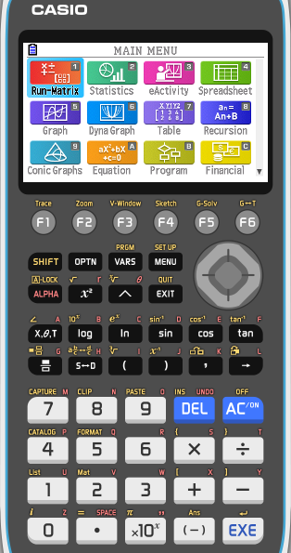
The derivative of ln x
We are going to sketch the graph f(x) = ln x
Turn on your calculator
Click on
5

Slide 3
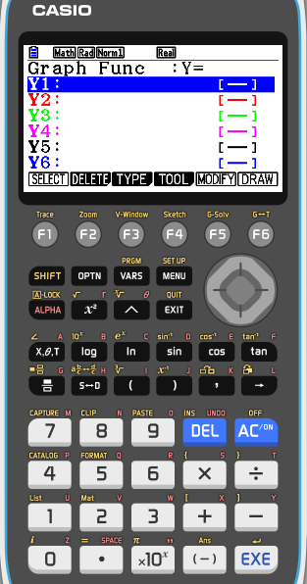
The derivative of ln x
We are going to sketch the graph f(x) = ln x
Turn on your calculator
Click on
5
SHIFT
MENU
(SET UP)

Slide 4
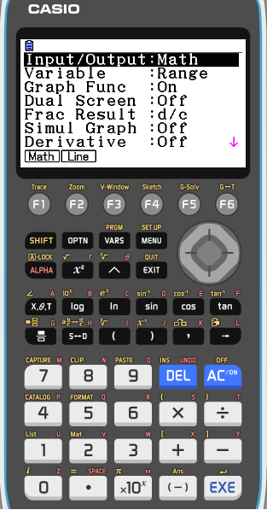
The derivative of ln x
We are going to sketch the graph f(x) = ln x
Turn on your calculator
Click on
5
SHIFT
MENU
(SET UP)
Scroll down to Derivative

Slide 5
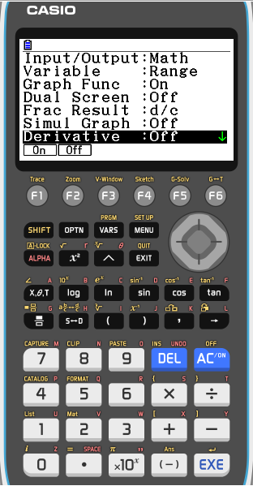
The derivative of ln x
We are going to sketch the graph f(x) = ln x
Turn on your calculator
Click on
5
SHIFT
MENU
(SET UP)
Scroll down to Derivative
F1 to turn it On

Slide 6
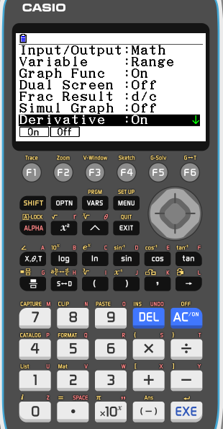
The derivative of ln x
We are going to sketch the graph f(x) = ln x
Turn on your calculator
Click on
5
SHIFT
MENU
(SET UP)
Scroll down to Derivative
F1 to turn it On
EXIT

Slide 7
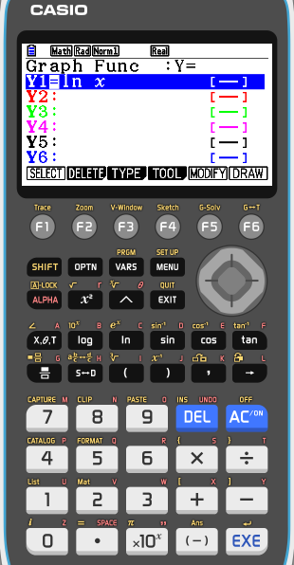
The derivative of ln x
Now we are going to sketch the graph f(x) = ln x and the derivative of f(x) = ln x
Turn on your calculator
Click on MENU
5 (Graph)
Make sure that Derivative is on
in the settings
In Y1 type ln x
EXE
F6
DRAW

Slide 8
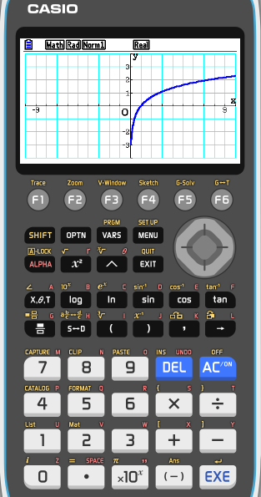
The derivative of ln x
Now we are going to sketch the graph f(x) = ln x and the derivative of f(x) = ln x
Turn on your calculator
Click on MENU
5 (Graph)
Make sure that Derivative is on
in the settings
In Y1 type ln x
EXE
F6
DRAW
Now we want to sketch the derivative
EXIT
Scroll down to Y2
OPTN
F2 (Calc)
F1 (d/dx)

Slide 9
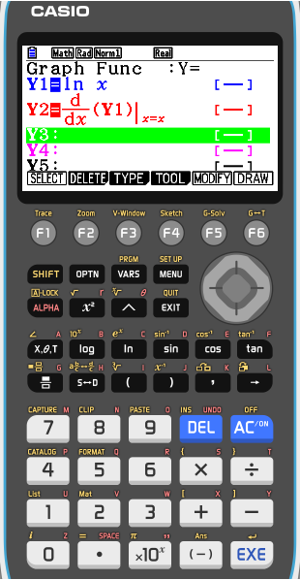
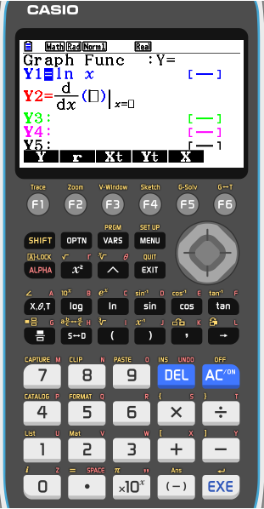
The derivative of ln x
Now we are going to sketch the graph f(x) = ln x and the derivative of f(x) = ln x
Turn on your calculator
Click on MENU
5 (Graph)
Make sure that Derivative is on
in the settings
In Y1 type ln x
EXE
F6
DRAW
Now we want to sketch the derivative
EXIT
Scroll down to Y2
OPTN
F2 (Calc)
F1 (d/dx)
F1 (Y)
1
EXE
F6
DRAW

Slide 10
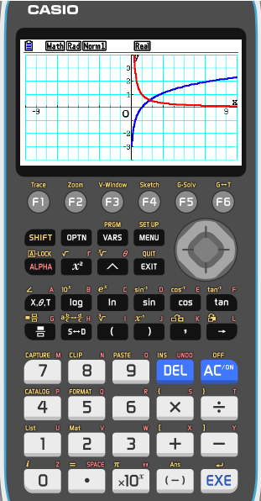
The derivative of ln x
Now we are going to sketch the graph f(x) = ln x and the derivative of f(x) = ln x
Turn on your calculator
Click on MENU
5 (Graph)
Make sure that Derivative is on
in the settings
In Y1 type ln x
EXE
F6
DRAW
Now we want to sketch the derivative
EXIT
Scroll down to Y2
OPTN
F2 (Calc)
F1 (d/dx)
F1 (Y)
1
EXE
F6
DRAW
( )
You can identify the function and the derivative . Now let's make the table of values
( )
MENU
7
Select both
F6 (tabl)

Slide 11
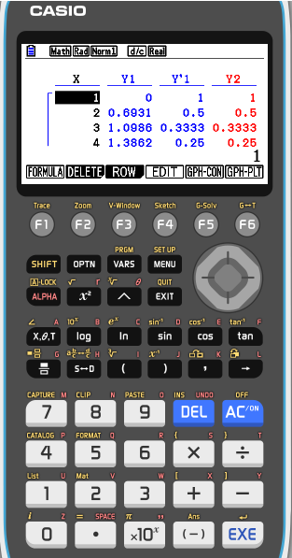
The derivative of ln x
Now we are going to sketch the graph f(x) = ln x and the derivative of f(x) = ln x
Turn on your calculator
Click on MENU
5 (Graph)
Make sure that Derivative is on in the settings
In Y1 type ln x
EXE
F6
DRAW
Now we want to sketch the derivative
EXIT
Scroll down to Y2
OPTN
F2 (Calc)
F1 (d/dx)
1
EXE
EXE
F1 (Y)
F4 (Styl)
F2 ( )
You can identify the function and the derivative. Now lets make the table of values
MENU
7
Select both
F6 (tabl)
Make a conjecture about the derivative of f(x) = ln x

Slide 12
The derivative of ln x
From the graph and the table you can easily see that derivative of the function ln x is $\frac{1}{x}$
If f (x) = ln x, then f ’(x) = $\frac{1}{x}$
or
If y = ln x, then y ’ = $\frac{1}{x}$

Slide 13
The derivative of ln x
Find the derivative of
$$g\left(x\right)=\ln{x}$$
$$\frac{1}{\text{f}\text{ ′ }\text{(}\text{g}\text{(}\text{x}\text{))}}$$
Using the inverse function theorem
$$\left(g\right)′(x)=$$
If g(x) = $\ln{x}$
then
f(x) =
g^{–1} (x) =
$$ex$$
Define g(x) and f(x)
So
f ′(x) =
$$ex$$
1
Apply the inverse function theorem
g '(x) =
e
^{ln x}
Using the property of logarithms
x =
e ^{ln x}
1
g '(x) =
x
$$\frac{d}{dx}\text{(}\text{ln} \text{x}\text{ )}$$
$$\frac{1}{x}$$
=

Slide 14
The derivative of ln x
Summarising
$$\frac{d}{dx}\text{(}\text{ln} \text{x}\text{ )}$$
$$=\frac{1}{x}$$
The laws of logarithms can help us to differentiate some logarithmic functions more easily:
$$\text{ln} \text{(}\text{ab}\text{)}\text{ = }\text{ln} \text{a}\text{ + }\text{ln} \text{b}$$
$$\text{ln} \left(\frac{a}{b}\right)\text{ = }\text{ln} \text{a} ‒ \text{ln} \text{b}$$
$$\text{ln} \text{(}\text{a}\text{)}\text{n}\text{ = }\text{n}\text{ln} \text{a}$$

Slide 15
The derivative of ln x
Remember, ln x is the inverse of e^{x}.
So, if y = ln x
means
log_{e} x = y
then x = e^{y}
Differentiating with respect to y gives:
However, for y = ln x we want $\frac{dy}{dx}$not $\frac{dx}{dy}$.
$\frac{dy}{dx}$behaves like a fraction, so,
But e^{y} = x so,

Slide 16
The derivative of ln x
Differentiate f (x) = x² + ln x with respect to x.
f (x) = x² + ln x
Find the derivative of each term
f ′(x) = 2x + $\frac{1}{x}$
$\frac{2x^{2}+ 1}{x}$
or
f ′(x) =

Slide 17
The derivative of ln x
Differentiate f (x) = ln e^{3x} with respect to x.
f (x) = ln e^{3x}
Use the fact that the functions are inverses to simplify first
f (x) = 3x
Find the derivative
f ’(x) = 3

Slide 18
The derivative of ln x
Differentiate f (x) = ln (1 – 3x) with respect to x.
Using chain rule
Let
u = 1 – 3x
and
y = ln u
u’ = – 3
y’ = $\frac{1}{u}$
y’ = $\frac{1}{1−3x}$
$$\left(\frac{1}{1−3x}\right)$$
– 3
f ′(x) =
$$\left(\frac{−3}{1−3x}\right)$$
f ′(x) =
$$\left(\frac{3}{3x−1}\right)$$
f ′(x) =

Slide 19
The derivative of ln x
Differentiate f (x) = x³ln x with respect to x.
Using product rule
Let
u = x³
and
v = ln x
u’ = 3x²
v’ = $\frac{1}{x}$
$$\left(\frac{1}{x}\right)$$
f ′(x) =
x³
+
3x²
ln x
f ′(x) =
x²
+
3x²
ln x
f ′(x) =
x²
(1
+
ln x)
3

Slide 20
Thank you for using resources from
For more resources visit our website
https://www.mathssupport.org
If you have a special request, drop us an email
info@mathssupport.org

