Slide 1
Anti-differentiation with boundary condition
LO: To antidifferentiate a function with a boundary condition.

Slide 2

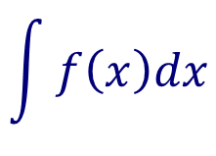
Reversing the process of differentiation
Antidifferentiation is also known as indefinite integration
$$\int{dx}$$
And is denoted with an integral symbol,
$$\int{f\left(x\right)dx=F\left(x\right)+C}$$
If F ’(x) = f(x), we write
integrand
Constant of integration
$$\int{f\left(x\right)dx}$$
Variable of integration
Is read as:
“The antiderivative of f with respect to x”
“The integral of f with respect to x”

Slide 3
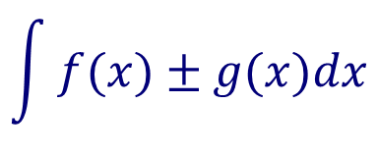
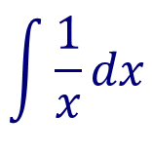
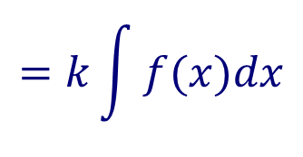
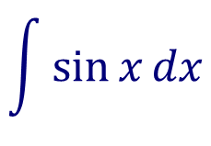
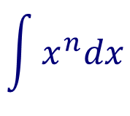
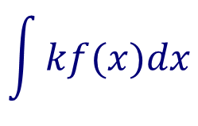
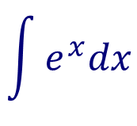
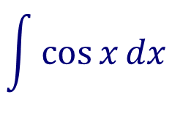
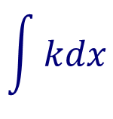
Rules to find the indefinite integrals
Power rule
$$\int{x^{n}dx}$$
$$=\frac{1}{n+1}x^{n+1}+C, n≠−1$$
Constant rule
$$\int{e^{x}dx}$$
$$=e^{x}+C$$
$$\int{kdx}$$
$$=kx+C,$$
$$\int{\frac{1}{x}dx}$$
Constant multiple rule
$$=\ln\left|x\right|+C$$
$$\int{kf(x)dx}$$
$$=k\int{f(x)dx}$$
$$\int{\cos{x}dx}$$
$$=\sin{x}+C$$
$$\int{\sin{x}dx}$$
Sum or difference rule
$$=−cos{x}+C$$
$$\int{f(x)±g(x)dx}$$
$$=\int{f\left(x\right)dx±\int{g\left(x\right)dx}}$$

Slide 4
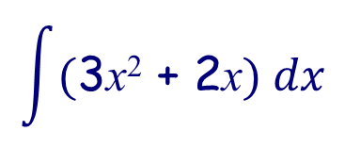
Indefinite integrals
If f’(x) = 3x² + 2x and f(2) = -3, Find f(x)
f’(x) = 3x² + 2x
$$f(x)=\int{(\text{3}\text{x}\text{2}\text{ + 2}\text{x}) dx}$$
$$f\left(x\right)=x^{3}+x^{2}+C$$
$$\int{(\text{3}\text{x}\text{2}\text{ + 2}\text{x}) dx}$$
This is the general solution for
Use the fact that f(2) = -3 to find C
$$f(2)=2^{3}+2^{2}+C$$
$$\text{−3}=8+4+C$$
$$−15=C$$
$$f\left(x\right)=x^{3}+x^{2}−15$$

Slide 5
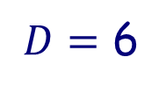
Indefinite integrals
If $f^{′′}$(x) = 12x² ‒ 4; $f^{′}$(0) = ‒1 and f(1) = 4, Find f(x)
f ”(x) = 12x² ‒ 4
$$f′(x)=\int{(\text{12}\text{x}\text{2} ‒ \text{4}) dx}$$
$$f^{′}(x)=\frac{{12x}^{3}}{3}−4x+C$$
$$f^{′}(x)=4x^{3}−4x+C$$
Use the fact that $f^{′}$(0) = $\text{‒}\text{1}$ to find C
$$so, C=−1$$
Thus
$$f^{′}(x)=4x^{3}−4x−1$$
But$f$(1) = $4$
$$f(x)=\int{(4x^{3}−4x−1) dx}$$
so$4$ = $1−2−1+D$
$$f\left(x\right)=\frac{{4x}^{4}}{4}−\frac{{4x}^{2}}{2}−x+D$$
$D=$ 6
$$f\left(x\right)=x^{4}−2x^{2}−x+6$$
$$f\left(x\right)=x^{4}−2x^{2}−x+D$$

Slide 6
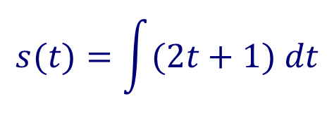
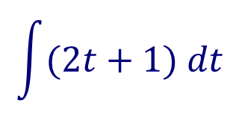

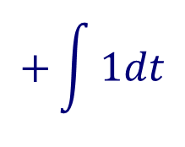
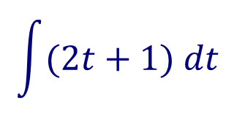
Indefinite integrals
The velocity of a moving object is given by v(t) = 2t + 1
Find an expression for the displacement in terms of t
$$s(t)=\int{(2t+1) dt}$$
$$=2\int{tdt}$$
$$+\int{1dt}$$
$$s(t)=t^{2}+t+C$$
$$\int{(2t+1) dt}$$
This is called the general solution for
If the position of the object at time t = 1 is 6 we can find C
$$s(1)=1^{2}+1+C$$
$$6=1^{2}+1+C$$
$$4=C$$
The fact that the position at time t = 1 is 6 is called a boundary condition
$$\int{(2t+1) dt}$$
$s(t)=t^{2}+t+4$ is a particular solution of

Slide 7


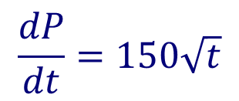


Indefinite integrals
The rate of growth of a population of fish is given by $\frac{dP}{dt}=150\sqrt{t}$for 0 ≤ t ≤ 5 years. The initial population was 200 fish. Find the number of fish at t = 4 years.
$$\frac{dP}{dt}=150\sqrt{t}$$
$$P(t)=\int{150\sqrt{t} dt}$$
⇒
The initial population was 200 means that at time t = 0, $P(0)=$200
$$=\int{150t^{\frac{1}{2}} dt}$$
Rewrite with rational exponents
$$=150\int{t^{\frac{1}{2}} dt}$$
$$P(0)={100(0)}^{\frac{3}{2}}+C$$
$$200={100(0)}^{\frac{3}{2}}+C$$
$$P(t)={100t}^{\frac{3}{2}}+C$$
General solution
$$P(t)={100t}^{\frac{3}{2}}+200$$
$$200=C$$
Particular solution
$$P(4)={100(4)}^{\frac{3}{2}}+200$$
Find P when t =4
$$P(4)=1000$$
There are 1000 fish when t = 4 years

Slide 8
Thank you for using resources from
For more resources visit our website
https://www.mathssupport.org
If you have a special request, drop us an email
info@mathssupport.org

