Slide 1
The fundamental Theorem of Calculus
LO: To evaluate definite integrals analytically and using the GDC.

Slide 2
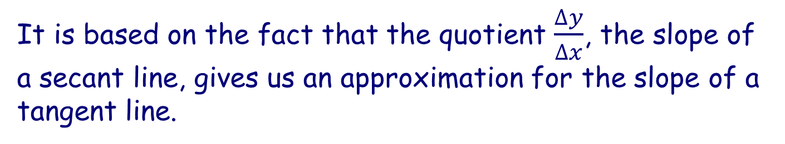
Fundamental theorem of calculus
Isaac Newton and Gottfried Leibniz independently came to realize that differential calculus and the definite integral are linked together.
This link is called the Fundamental theorem of calculus.
The beauty of this theorem is that it enables us to evaluate complicated summations.
It is based on the fact that the quotient $\frac{∆y}{∆x}$, the slope of a secant line, gives us an approximation for the slope of a tangent line.
The product (Δy)(Δx), the area of a rectangle, gives us an approximation for the area under a curve.

Slide 3


Fundamental theorem of calculus
This fact is established in the following theorem.
Fundamental theorem of calculus
If f is a continuous function on the interval a ≤ x ≤ b and F is an antiderivative of f on a ≤ x ≤ b, then
$$\int_{a}^{b}{f\left(x\right)ⅆx}$$
$=$ $\left[F(x)\right]\begin{matrix}b \\ a\end{matrix}$
= F(b) – F(a)
The notation $\left[F(x)\right]\begin{matrix}b \\ a\end{matrix}$ means F(b) – F(a)

Slide 4
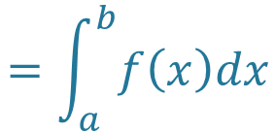
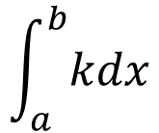
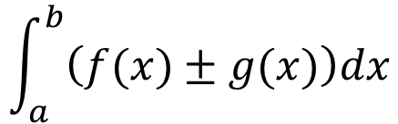
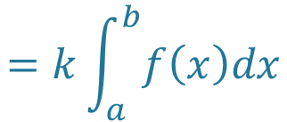
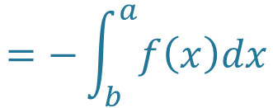
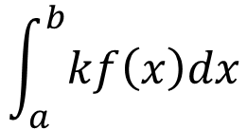
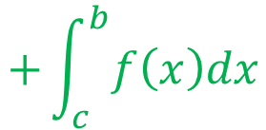
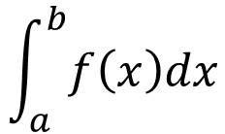
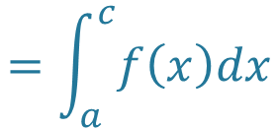
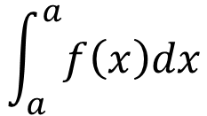
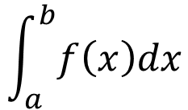
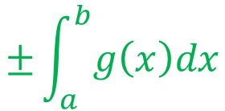
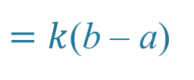
Properties of the definite integral
The following properties of the definite integral can all be deduced from the Fundamental theorem of calculus.
$$\int_{a}^{a}{f\left(x\right)dx}$$
= 0
$$\int_{a}^{b}{f\left(x\right)dx}$$
$$=−\int_{b}^{a}{f\left(x\right)dx}$$
$$\int_{a}^{b}{kf\left(x\right)dx}$$
$$=k\int_{a}^{b}{f\left(x\right)dx}$$
$$\int_{a}^{b}{\left(f(x)±g(x)\right)dx}$$
$$=\int_{a}^{b}{f\left(x\right)dx}$$
$$±\int_{a}^{b}{g\left(x\right)dx}$$
$$\int_{a}^{b}{f\left(x\right)dx}$$
$$=\int_{a}^{c}{f\left(x\right)dx}$$
$$+\int_{c}^{b}{f\left(x\right)dx}$$
$$\int_{a}^{b}{kdx}$$
$=k$(b – a)

Slide 5
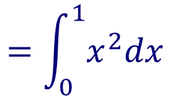
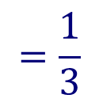
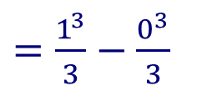
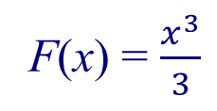

Fundamental theorem of calculus
Use the fundamental theorem of calculus to find the area:
between the x-axis and y = x² from x = 0 to x = 1
f(x) = x²
has antiderivative
y = $x^{2}$
F(x) = $\frac{x^{3}}{3}$
Is the antiderivative
So the area
$$=\int_{0}^{1}{x^{2}dx}$$
0
1
x
= F(1) – F(0)
$=\frac{1^{3}}{3}−\frac{0^{3}}{3}$
$$=\frac{1}{3}$$

Slide 6
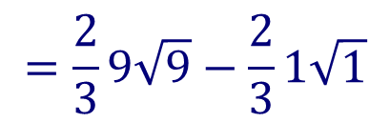
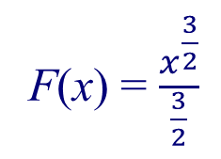
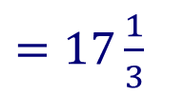

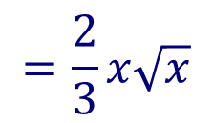
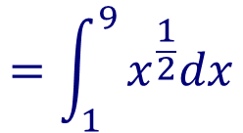

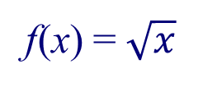
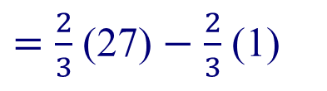
Fundamental theorem of calculus
Use the fundamental theorem of calculus to find the area:
between the x-axis and y = $\sqrt{x}$ from x = 1 to x = 9
f(x) = $\sqrt{x}$
$$=x^{\frac{1}{2}}$$
has antiderivative
y =$\sqrt{x}$
F(x) = $\frac{x^{\frac{3}{2}}}{\frac{3}{2}}$
$$=\frac{2}{3}x\sqrt{x}$$
Is the antiderivative
So the area
$$=\int_{1}^{9}{x^{\frac{1}{2}}dx}$$
1
9
x
= F(9) – F(1)
$$=\frac{2}{3}9\sqrt{9}−\frac{2}{3}1\sqrt{1}$$
$=\frac{2}{3}$ (27) $−$ $\frac{2}{3}$ (1)
$=17\frac{1}{3}$

Slide 7





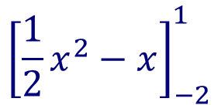
Fundamental theorem of calculus
$$\int_{−2}^{1}{\left(x−1\right)dx}$$
Evaluate the definite integral
$${\left[\frac{1}{2}x^{2}−x\right]}_{−2}^{1}$$
Find the simplest antiderivative of x - 1
Evaluate the antiderivative at x = 1 and x = -2, then find the difference
$=\left[\frac{1}{2}{(1}^{2})−1\right]−\left(\frac{1}{2}{(−2)}^{2}−(−2)\right)$
$=\left[\frac{1}{2}−1\right]−\left(2+2\right)$
$=\left[−\frac{1}{2}\right]−4$
$=−\frac{9}{2}$

Slide 8
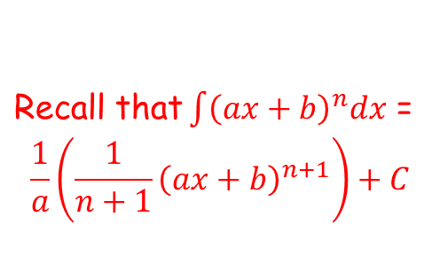
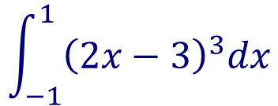



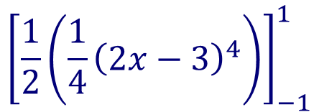
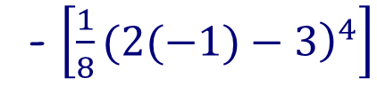
Fundamental theorem of calculus
$$\int_{−1}^{1}{{\left(2x−3\right)}^{3}dx}$$
Evaluate the definite integral
$\text{Recall} \text{that}\int{{\left(ax+b\right)}^{n}dx}$ =
$$\frac{1}{a}\left(\frac{1}{n+1}{\left(ax+b\right)}^{n+1}\right)+C$$
$${\left[\frac{1}{2}\left(\frac{1}{4}{\left(2x−3\right)}^{4}\right)\right]}_{−1}^{1}$$
Evaluate the antiderivative at x = 1 and x = -1, then find the difference
$=\left[\frac{1}{8}(2(1)−{\left.3\right)}^{4}\right]$
- $\left[\frac{1}{8}(2(−1)−{\left.3\right)}^{4}\right]$
$=\left[\frac{1}{8}−\frac{625}{8}\right]$
$=−78$

Slide 9
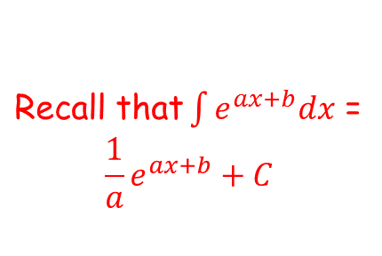
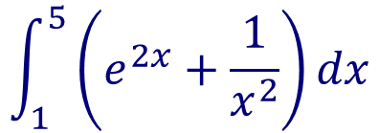



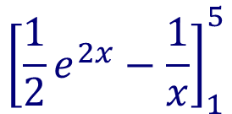
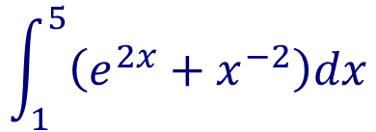
Fundamental theorem of calculus
$$\int_{1}^{5}{\left(e^{2x}+\frac{1}{x^{2}}\right)dx}$$
Evaluate the definite integral
$$\int_{1}^{5}{\left(e^{2x}+x^{−2}\right)dx}$$
$\text{Recall} \text{that}\int{e^{ax+b}dx}$ =
$$\frac{1}{a}e^{ax+b}+C$$
$${\left[\frac{1}{2}e^{2x}−\frac{1}{x}\right]}_{1}^{5}$$
Evaluate the antiderivative at x = 5 and x = 1, then find the difference
$=\left[\frac{1}{2}(e^{2(5)}−\frac{1}{5}\right]−\left(\frac{1}{2}(e^{2(1)}−\frac{1}{1}\right)$
$=$ $\frac{1}{2}e^{10}−\frac{1}{2}e^{2}+\frac{4}{5}$
$=\frac{5e^{10}−5e^{2}+8}{10}$

Slide 10
Evaluating definite integrals using GDC

Slide 11
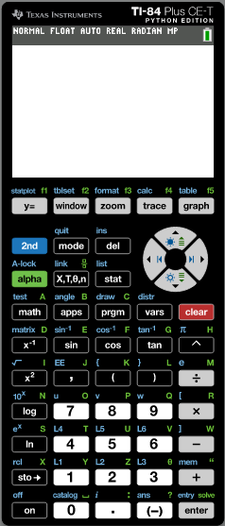

Fundamental theorem of calculus
$$\int_{1}^{4}{\left(\frac{1−\sqrt{x}}{\sqrt{x}}\right)dx}$$
Use a GDC to evaluate the definite integral
Turn on the GDC
Press the math button

Slide 12
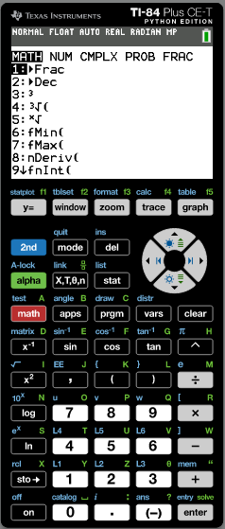
Fundamental theorem of calculus
$$\int_{1}^{4}{\left(\frac{1−\sqrt{x}}{\sqrt{x}}\right)dx}$$
Use a GDC to evaluate the definite integral
Turn on the GDC
Press the math button
Press 9

Slide 13
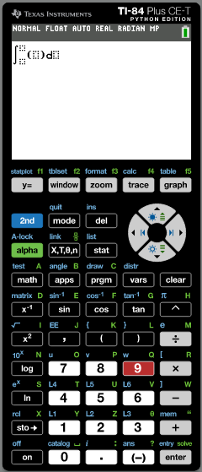

Fundamental theorem of calculus
$$\int_{1}^{4}{\left(\frac{1−\sqrt{x}}{\sqrt{x}}\right)dx}$$
Use a GDC to evaluate the definite integral
Turn on the GDC
Press the math button
Press 9
Press

Slide 14
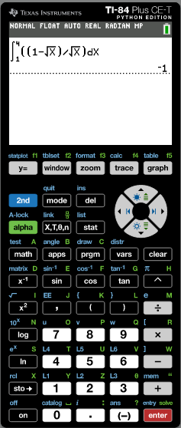
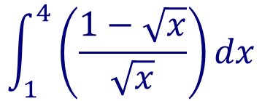
Fundamental theorem of calculus
$$\int_{1}^{4}{\left(\frac{1−\sqrt{x}}{\sqrt{x}}\right)dx}$$
Use a GDC to evaluate the definite integral
Turn on the GDC
Press the math button
Press 9
Press
$$\int_{1}^{4}{\left(\frac{1−\sqrt{x}}{\sqrt{x}}\right)dx}$$
= –1

Slide 15

Thank you for using resources from
For more resources visit our website
https://www.mathssupport.org
If you have a special request, drop us an email
info@mathssupport.org

