Slide 1
Introduction to Limits
LO: To understand the concept of limit.

Slide 2
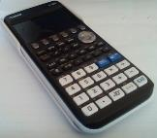
Creating a sequence
a rectangular sheet of paper,
Work with a partner. You will need
a pair of scissors
, a copy of this table
and a calculator.
Round number | Portion of the paper you have at the end of the round
 | Fraction | Decimal
1
2
3
4
5
6

Slide 3
Creating a sequence
a rectangular sheet of paper,
Work with a partner. You will need
a pair of scissors
, a copy of this table.
and a calculator.
Round number | Portion of the paper you have at the end of the round
 | Fraction | Decimal
1
2
3
4
5
6
Round 1:
Cut the rectangular sheet into three pieces of roughly equal size.
Take one piece each, leaving one spare piece on the table.

Slide 4

Creating a sequence
a rectangular sheet of paper,
Work with a partner. You will need
a pair of scissors
, a copy of this table.
and a calculator.
Fred
Leslie
Spare
Round number | Portion of the paper you have at the end of the round
 | Fraction | Decimal
1
2
3
4
5
6
$$\frac{1}{3}$$
0.333
$$\frac{1}{3}$$
$$\frac{1}{3}$$
$$\frac{1}{3}$$
Round 1:
Cut the rectangular sheet into three pieces of roughly equal size.
Take one piece each, leaving one spare piece on the table.
Calculate and record the portion of the original rectangle you now have as both a fraction and a decimal (to three significant figures).

Slide 5

Creating a sequence
a rectangular sheet of paper,
Work with a partner. You will need
a pair of scissors
, a copy of this table.
and a calculator.
Fred
Leslie
Spare
Round number | Portion of the paper you have at the end of the round
 | Fraction | Decimal
1
2
3
4
5
6
$$\frac{1}{3}$$
0.333
$$\frac{1}{3}$$
$$\frac{1}{3}$$
Round 2:
Cut the spare piece of paper into three pieces of equal size.

Slide 6



Creating a sequence
a rectangular sheet of paper,
Work with a partner. You will need
a pair of scissors
, a copy of this table.
and a calculator.
Fred
Leslie
Spare
Round number | Portion of the paper you have at the end of the round
 | Fraction | Decimal
1
2
3
4
5
6
$$\frac{1}{9}$$
$$\frac{1}{9}$$
$$\frac{1}{9}$$
$$\frac{1}{3}$$
0.333
$$\frac{4}{9}$$
0.444
$$\frac{1}{3}$$
+
$$=\frac{4}{9}$$
$$\frac{1}{3}$$
+
$$=\frac{4}{9}$$
Round 2:
Cut the spare piece of paper into three pieces of equal size.
Each of you add one piece of this to your portion.
Calculate and record the total portion of the original rectangle you now have in the same way as before.

Slide 7
Creating a sequence
Work with a partner. You will need
a rectangular sheet of paper,
a pair of scissors
and a copy of this table.
Fred
Leslie
Spare
Round number | Portion of the paper you have at the end of the round
 | Fraction | Decimal
1
2
3
4
5
6
$$\frac{1}{3}$$
0.333
$$\frac{4}{9}$$
0.444
$$\frac{4}{9}$$
$$\frac{4}{9}$$
Round 3:
Cut the spare piece of paper into three pieces of equal size.

Slide 8





Creating a sequence
Work with a partner. You will need
a rectangular sheet of paper,
a pair of scissors
and a copy of this table.
Fred
Leslie
Round number | Portion of the paper you have at the end of the round
 | Fraction | Decimal
1
2
3
4
5
6
$$\frac{1}{3}$$
0.333
$$\frac{1}{27}$$
$$\frac{1}{27}$$
$$\frac{4}{9}$$
0.444
$$\frac{13}{27}$$
0.481
$$\frac{4}{9}$$
+
$$=\frac{13}{27}$$
$$\frac{4}{9}$$
+
$$=\frac{13}{27}$$
Round 3:
Cut the spare piece of paper into three pieces of equal size.
Each of you add one piece of this to your portion.
Calculate and record the total portion of the original rectangle you now have in the same way as before.

Slide 9







Creating a sequence
Work with a partner. You will need
a rectangular sheet of paper,
a pair of scissors
, a copy of this table.
and a calculator.
Fred
Leslie
Round number | Portion of the paper you have at the end of the round
 | Fraction | Decimal
1
2
3
4
5
6
$$\frac{1}{3}$$
0.333
$$\frac{4}{9}$$
0.444
$$\frac{13}{27}$$
0.481
$$\frac{40}{81}$$
$$\frac{40}{81}$$
0.494
$$\frac{13}{27}$$
$$\frac{13}{27}$$
$$\frac{40}{81}$$
Round 4:
Repeat the process for three more rounds.

Slide 10






Creating a sequence
Work with a partner. You will need
a rectangular sheet of paper,
a pair of scissors
, a copy of this table.
and a calculator.
Fred
Leslie
Round number | Portion of the paper you have at the end of the round
 | Fraction | Decimal
1
2
3
4
5
6
$$\frac{1}{3}$$
0.333
$$\frac{4}{9}$$
0.444
$$\frac{13}{27}$$
0.481
$$\frac{364}{729}$$
$$\frac{121}{243}$$
$$\frac{40}{81}$$
0.494
$$\frac{121}{243}$$
$$\frac{40}{81}$$
$$\frac{40}{81}$$
$$\frac{364}{729}$$
$$\frac{121}{243}$$
0.498
Round 4:
$$\frac{364}{729}$$
0.499
Repeat the process for three more rounds.
As you complete more and more rounds of this activity, what can you say about the portion of the original rectangle you have?.

Slide 11

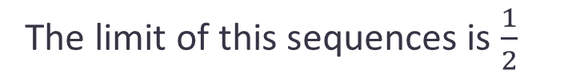


Limits of series
The data collected form a series, where S₁ is the portion of the rectangle you have after round 1, S₂ the portion you have after round 2, and so on.
Round number | Portion of the paper you have at the end of the round
 | Fraction | Decimal
1
2
3
4
5
6
Series like this are called convergent because as the term number in the series increases, the of the series approach a fixed value known as the limit, L of the series.
$$\frac{1}{3}$$
0.333
$$\frac{4}{9}$$
0.444
$$\frac{13}{27}$$
0.481
$$\frac{40}{81}$$
0.494
We can write this as:
$$\lim_{n→∞}{S_{n}=L}$$
$$\frac{121}{243}$$
0.498
$$\frac{364}{729}$$
0.499
This notation is read as: ‘the limit as n approaches infinity of S_{n} equals L’
Series that are not convergent are divergent
The limit of this sequences is $\frac{1}{2}$

Slide 12
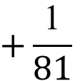


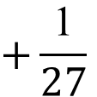

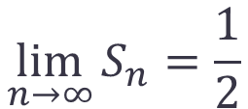


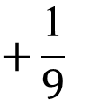


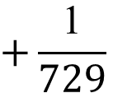
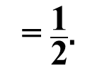
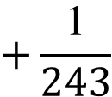

Limits of series
Let’s graph the series
$$\frac{\text{1}}{\text{3}}$$
$$+\frac{\text{1}}{\text{9}}$$
$$+\frac{\text{1}}{27}$$
$$+\frac{\text{1}}{\text{81}}$$
$$+\frac{\text{1}}{\text{243}}$$
$$+\frac{\text{1}}{\text{729}}$$
$\text{...}$
= $\frac{\text{1}}{\text{2}}\text{.}$
Even though there are an infinite number of terms, this series converges to $\frac{\text{1}}{\text{2}}$.
Round number | Portion of the paper you have at the end of the round
 | Fraction | Decimal
1
2
3
4
5
6
0.5
0.4
Sum, S_{n}
$$\frac{1}{3}$$
0.333
0.3
$$\frac{4}{9}$$
0.444
0.2
$$\frac{13}{27}$$
0.481
0.1
$$\frac{40}{81}$$
0.494
1
2
3
4
5
6
$$\frac{121}{243}$$
0.498
Number of terms, n
$$\frac{364}{729}$$
0.499
$$\lim_{n→∞}{S_{n}=\frac{1}{2}}$$

Slide 13

Limits of functions
You can think of a limit as a way of describing the output of a function as the input gets closer to a certain value
$$\lim_{x→c}{f(x)=L}$$
Means that as the value of x becomes closer to c (from either side), the function, f(x), becomes close to a fixed value L
If f(x) does not become close to a fixed value L we say that the limit does not exist
You can use a GDC to help find the limit of a function.
Graphically: You can graph the function and examine the values of f(x) when x is near c.
Numerically: You can make a table of values and examine the values of f(x) when x is near c.

Slide 14
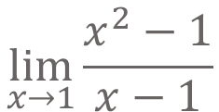
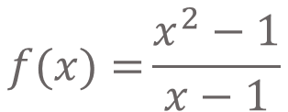
Limits of functions
A limit allows us to examine the tendency of a function around a given point even when the function is not defined at the point. Let us look at the function below.
$$f(x)={\frac{x^{2}−1}{x−1}}$$
Since its denominator is zero when x = 1, f(1) is undefined; however, its limit at x = 1 exists
$$\lim_{x→1}{\frac{x^{2}−1}{x−1}}$$
We read: The limit as x is approaching to 1 of the function

Slide 15
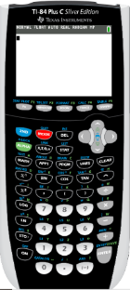
Using a GDC for Logarithms in base 10
We are going to use Graphing display calculator to find the limits of a function numerically and graphically.
Click on the calculator you are using
Texas Instruments

Slide 16
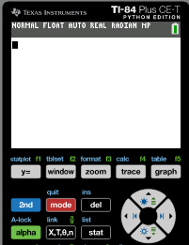
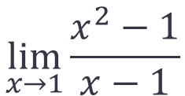


Limits of functions, Numerically
$$\lim_{x→1}{\frac{x^{2}−1}{x−1}}$$
Use your GDC to find
Now, with your GDC, complete the table of values for the function:
$$f(x)=\frac{x^{2}−1}{x−1}$$
x
0.8
0.9
0.99
0.999
1
1.001
1.01
1.1
1.2
$$y=\frac{x^{2}−1}{x−1}$$
We want to see the value of the function as x approaches 1
Turn on the GDC
Press Y =

Slide 17
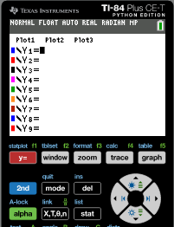


Limits of functions, Numerically
$$\lim_{x→1}{\frac{x^{2}−1}{x−1}}$$
Use your GDC to find
Now, with your GDC, complete the table of values for the function:
$$f(x)=\frac{x^{2}−1}{x−1}$$
x
0.8
0.9
0.99
0.999
1
1.001
1.01
1.1
1.2
$$y=\frac{x^{2}−1}{x−1}$$
We want to see the value of the function as x approaches 1
Turn on the GDC
Press Y =
Type
(x² – 1)/(x – 1)

Slide 18
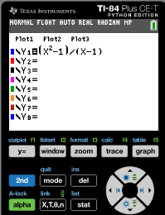
Limits of functions, Numerically
$$\lim_{x→1}{\frac{x^{2}−1}{x−1}}$$
Use your GDC to find
Now, with your GDC, complete the table of values for the function:
$$f(x)=\frac{x^{2}−1}{x−1}$$
x
0.8
0.9
0.99
0.999
1
1.001
1.01
1.1
1.2
$$y=\frac{x^{2}−1}{x−1}$$
We want to see the value of the function as x approaches 1
Turn on the GDC
Press Y =
Type
(x² – 1)/(x – 1)
Press
2nd tblset

Slide 19
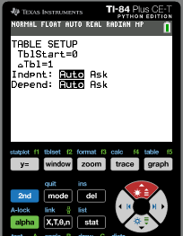
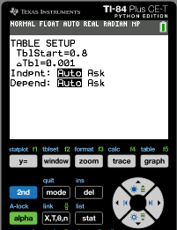
Limits of functions, Numerically
$$\lim_{x→1}{\frac{x^{2}−1}{x−1}}$$
Use your GDC to find
Now, with your GDC, complete the table of values for the function:
$$f(x)=\frac{x^{2}−1}{x−1}$$
x
0.8
0.9
0.99
0.999
1
1.001
1.01
1.1
1.2
$$y=\frac{x^{2}−1}{x−1}$$
We want to see the value of the function as x approaches 1
Turn on the GDC
Press Y =
Type
(x² – 1)/(x – 1)
Press
2nd tblset
Type
tblStart= 0.8
enter
2nd
æTbl: 0.001
enter
table

Slide 20
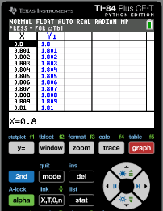
Limits of functions, Numerically
$$\lim_{x→1}{\frac{x^{2}−1}{x−1}}$$
Use your GDC to find
Now, with your GDC, complete the table of values for the function:
$$f(x)=\frac{x^{2}−1}{x−1}$$
approaching x=1 from the left
approaching x=1 from the right
x
0.8
0.9
0.99
0.999
1
1.001
1.01
1.1
1.2
$$y=\frac{x^{2}−1}{x−1}$$
1.8
1.9
1.99
1.999
undef.
2.001
2.01
2.1
2.2
We want to see the value of the function as x approaches 1
Turn on the GDC
Type
(x² – 1)/(x – 1)
Press
2nd tblset
Type
tblStart: 0.8
enter
2nd
æTbl: 0.001
enter
table

Slide 21
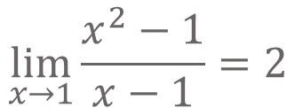
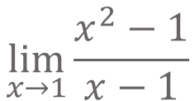


Limits of functions, Numerically
Find
$$\lim_{x→1}{\frac{x^{2}−1}{x−1}}$$
Now, using your calculator, complete the table of values for the function:
$$f(x)=\frac{x^{2}−1}{x−1}$$
approaching x = 1 from the left
approaching x = 1 from the right
x
0.8
0.9
0.99
0.999
1
1.001
1.01
1.1
1.2
$$y=\frac{x^{2}−1}{x−1}$$
1.8
1.9
1.99
1.999
undef.
2.001
2.01
2.1
2.2
We want to see the value of the function as x approaches 1
There is discontinuity at x = 1
You have seen that the value of the function as x approaches 1 is approaching to 2 from both sides.
You can write this result using this notation:
$$\lim_{x→1}{\frac{x^{2}−1}{x−1}}=2$$

Slide 22
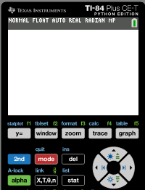
Limits of functions, Graphically
Now, with your GDC, trace along the graph of this function:
$$y=\frac{x^{2}−1}{x−1}$$
, x ≠ 1
Using this method we can graphically find the limit of the function
Press
GRAPH

Slide 23
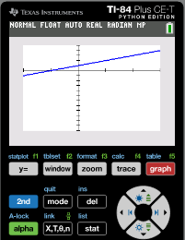
Limits of functions, Graphically
Now, with your GDC, trace along the graph of this function:
$$y=\frac{x^{2}−1}{x−1}$$
, x ≠ 1
Using this method we can graphically find the limit of the function
Press
GRAPH
Press
trace

Slide 24
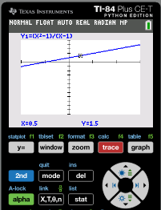
Limits of functions, Graphically
Now, with your GDC, trace along the graph of this function:
$$y=\frac{x^{2}−1}{x−1}$$
, x ≠ 1
Using this method we can graphically find the limit of the function
Press
GRAPH
Press
trace
Trace along the graph from the left. You will notice that as x gets closer to 1, the value of the function gets closer to 2

Slide 25
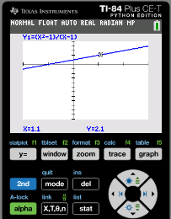
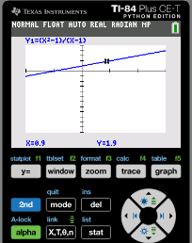
Limits of functions, Graphically
Now, with your GDC, trace along the graph of this function:
$$y=\frac{x^{2}−1}{x−1}$$
, x ≠ 1
Using this method we can graphically find the limit of the function
Press
GRAPH
Press
trace
Trace along the graph from the left. You will notice that as x gets closer to 1, the value of the function gets closer to 2
Trace along the graph from the right and notice that the value of the function likewise gets closer to 2

Slide 26

Limits of functions, Graphically
Now, with your GDC, trace along the graph of this function:
$$y=\frac{x^{2}−1}{x−1}$$
, x ≠ 1
Using this method we can graphically find the limit of the function
Press
GRAPH
Press
trace
This means that the limit of the functions as x approaches to 1 both from the left and from the right is 2
Trace along the graph from the left. You will notice that as x gets closer to 1, the value of the function gets closer to 2
Trace along the graph from the right and notice that the value of the function likewise gets closer to 2

Slide 27
Limits of functions, Analytically
Case 1
Point: When approaching a point defined or not (Closed or Open) the limit is the y coordinate of the point you are approaching.
Case 2
Vertical Asymptote: When approaching a vertical asymptote, the limit is infinity if you are heading up and negative infinity if you are heading downwards.

Slide 28
Limits of functions, Analytically
To find the limit of a function we follow these steps:
STEPS
Step 1:
Plug in the value of x.
If undefined go to step 2
Step 2:
Factor, rationalize or rewrite the function then simplify if possible and plug in the given value of x
If undefined go to step 3
Step 3:
Use another method to confirm non-existence of the limit if possible and plug in the given value of x

Slide 29
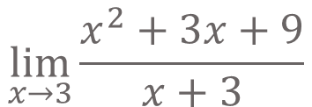
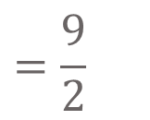
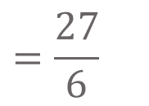
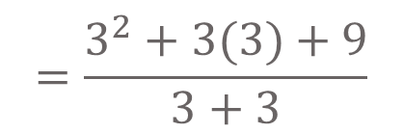
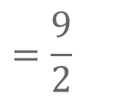
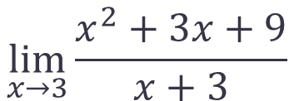
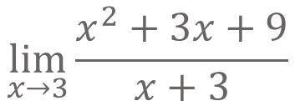
Limits of functions, Analytically
Example 1:
$$\lim_{x→3}{\frac{x^{2}+3x+9}{x+3}}$$
Find
Step 1:
Plug in the value of x.
$$\lim_{x→3}{\frac{x^{2}+3x+9}{x+3}}$$
$$=\frac{3^{2}+3(3)+9}{3+3}$$
$$=\frac{27}{6}$$
$$=\frac{9}{2}$$
$$\lim_{x→3}{\frac{x^{2}+3x+9}{x+3}}$$
$$=\frac{9}{2}$$

Slide 30






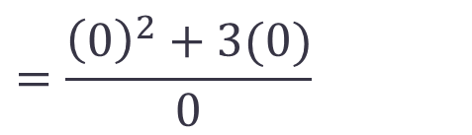
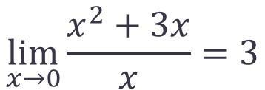
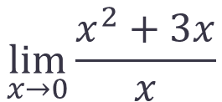
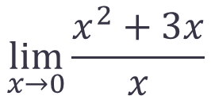
Limits of functions, Analytically
Example 2:
$$\lim_{x→0}{\frac{x^{2}+3x}{x}}$$
Find
Step 1:
Plug in the value of x.
If undefined go to step 2
$$=\frac{{\left(0\right)}^{2}+3(0)}{0}$$
$$\lim_{x→0}{\frac{x^{2}+3x}{x}}$$
$$=\frac{0}{0}$$
It is undefined
Step 2:
Factor, rationalize or rewrite the function then simplify if possible and plug in the given value of x
x
$$\lim_{x→0}$$
(x + 3)
Factorising the numerator
=
x
=
$$\lim_{x→0}$$
$$x+3$$
Simplifying
Substituting x
$=$ $0+3$
= 3
$\text{Since} x ≠$ $0$
$$\lim_{x→0}{\frac{x^{2}+3x}{x}=3}$$
∴

Slide 31





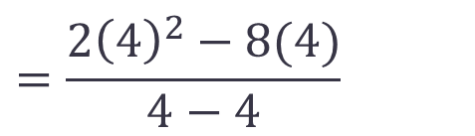
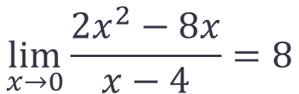
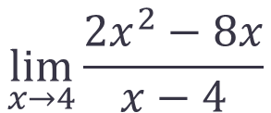
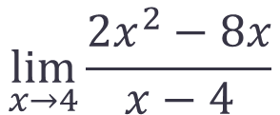
Limits of functions, Analytically
Example 3:
$$\lim_{x→4}{\frac{{2x}^{2}−8x}{x−4}}$$
Find
Step 1:
Plug in the value of x.
If undefined go to step 2
$$=\frac{{2\left(4\right)}^{2}−8(4)}{4−4}$$
$$\lim_{x→4}{\frac{{2x}^{2}−8x}{x−4}}$$
$$=\frac{0}{0}$$
It is undefined
Step 2:
Factor, rationalize or rewrite the function then simplify if possible and plug in the given value of x
$$\lim_{x→4}$$
2x
(x – 4)
Factorising the numerator
=
x – 4
=
$$\lim_{x→4}$$
$$2x$$
Simplifying
Substituting x
$=$ $2(4)$
= 8
$\text{Since} x ≠$ $4$
$$\lim_{x→0}{\frac{{2x}^{2}−8x}{x−4}=8}$$
∴

Slide 32
Round number | Portion of the paper you have at the end of the round
 | Fraction | Decimal
1
2
3
4
5
6
Round number | Portion of the paper you have at the end of the round
 | Fraction | Decimal
1
2
3
4
5
6
Round number | Portion of the paper you have at the end of the round
 | Fraction | Decimal
1
2
3
4
5
6
Round number | Portion of the paper you have at the end of the round
 | Fraction | Decimal
1
2
3
4
5
6

Slide 33

Thank you for using resources from
For more resources visit our website
https://www.mathssupport.org
If you have a special request, drop us an email
info@mathssupport.org

