Slide 1
Properties of logarithms
LO: Know and use properties of logarithms to change between exponential and logarithmic forms.

Slide 2
Logarithms in base 10
10 ^{x} = a
If
This can be written in logarithmic form as:
log₁₀ a = x
For logarithms base 10 is not necessary to write the base
This expression can be written simply as
log a = x
Examples:
log₁₀ 100 = 2
Can be written as
log 100 = 2

Slide 3
Logarithms in base 10
Our decimal number system is based on powers of ten.
We can write powers of ten using logarithmic notation.
10⁵ =
100 000
log 100 000 = 5
10⁴ =
10 000
log 10 000 = 4
10³ =
1 000
log 1000 = 3
10² =
100
log 100 = 2
10¹=
10
log 10 = 1
10⁰ =
1
log 1 = 0
10⁻¹ =
0.1
log 0.1 = -1
10⁻² =
0.01
log 0.01 = -2
10⁻³ =
0.001
log 0.001 = -3
What about other numbers? For example, what is log 125.
We know is a number between log 100 and log 1000.

Slide 4
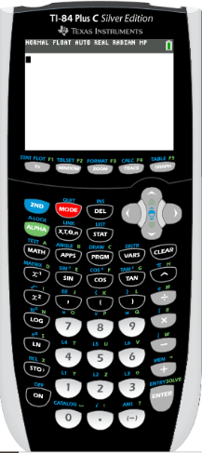
Using a GDC for Logarithms in base 10
We are going to use Graphing display calculator to find the logarithm base 10
Texas Instruments

Slide 5
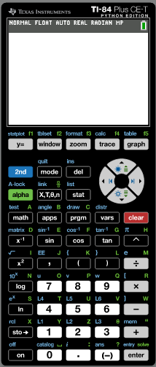
Logarithms in base 10
Example 1:
We use a calculator to find log 125.
Turn on
Click
LOG
125
)
ENTER

Slide 6
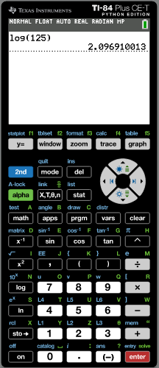
Logarithms in base 10
Example 1:
We use a calculator to find log 125.
Turn on
Click
Log
125
)
ENTER
log 125
= 2.0969
4dp

Slide 7
Logarithms in base 10
Example 2:
We use a calculator to find log 0.85.
Turn on
Click
LOG
)
0.85
ENTER

Slide 8
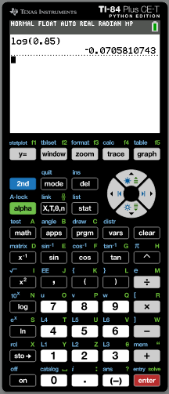
Logarithms in base 10
Example 2:
We use a calculator to find log 0.85.
Turn on
Click
LOG
)
0.85
ENTER
log 125
= –0.0706
4dp

Slide 9
Thank you for using resources from
For more resources visit our website
https://www.mathssupport.org
If you have a special request, drop us an email
info@mathssupport.org

