Slide 1
Annual depreciation and inflation
LO: Use the formula for geometric series to calculate depreciation and inflation.

Slide 2
Depreciation and inflation
  Prices of goods and commodities change, usually upwards.
  The money in your pocket is likely to have less buying power in two years’ time than it does now.
  This effect is called
Inflation
Governments tend to keep measures of inflation because the level affects peoples’ happiness and hence their choice of government
  The measure is commonly called the consumer price index (CPI). The CPI is a percentage increase for prices over a given time period.

Slide 3
Depreciation and inflation
Inflation
  To calculate inflation, you can use the formula for compound interest
(
^{n}
r
)
FV = PV ×
1 +
100

Slide 4
Inflation
When calculating inflation, the annual multiplier is
(
^{n}
r
)
1 +
Where r is the annual inflation rate as percentage.
100
The inflation formula is:
(
^{n}
r
)
FV = PV ×
1 +
100
Where:
FV is the future value after n years
PV is the original value
r is the inflation rate as percentage, per year
n is the number of years

Slide 5
Inflation
From December 2012 to December 2013 the Australian Bureau of Statistics recorded a CPI of 2.7%.
If one kg of local cheese cost 9.65 AUD in December 2012, how much did it cost in
(a) Dec. 2013 (b) Dec. 2014 (c) Dec 2016
The original value is 9.65 AUD and inflation ratio 2.7%
(
)
2.7
¹
(a)
After 1 year, the value is:
FV = 9.65 ×
1 +
100
9.65 × 1.027
= 9.91
(
)
2.7
²
(b)
After 2 years, the value is:
1 +
FV = 9.65 ×
100
9.65 × 1.027 ²
= 10.18
(
)
2.7
⁴
(c)
After 4 years, the value is:
1 +
FV = 9.65 ×
100
9.65 × 1.027 ⁴
= 10.73

Slide 6
Inflation
Georgia would like to purchase a painting that is currently worth $5000. She makes monthly deposits into an investment account, so that she can purchase the painting in 3 years’ time.
If inflation averages 2.5% per year, calculate the value of the painting indexed for inflation for 3 years.
To index the value of the painting for inflation, we increase it by 2.5% each year for 3 years
(
2.5
)
³
Indexed value is:
1 +
= 5000 ×
100
= 5 000 × 1.025³
= 5384.45

Slide 7
Depreciation and inflation
Depreciation
  is the loss in value of an asset over time.
  Assets such as computers, cars, and furniture depreciate for two reasons:
Wear and tear
  For example, an auto will decrease in value because of the mileage, wear on tires, and other factors related to the use of the vehicle.
Obsolescence.
Assets also decrease in value as they are replaced by newer models. Last year's car model is less valuable because there is a newer model in the marketplace..

Slide 8
Depreciation and inflation
Depreciation
  To calculate depreciation, you can use the formula for compound interest but the rate will be negative instead
(
^{n}
r
)
FV = PV ×
1 -
100

Slide 9
Depreciation
When calculating depreciation, the annual multiplier is
(
^{n}
r
)
1 -
Where r is the annual depreciation rate as percentage.
100
The depreciation formula is:
(
^{n}
r
)
FV = PV ×
1 -
100
Where:
FV is the future value after n time periods
PV is the original value
r is the depreciation rate per period
n is the number of periods

Slide 10
Depreciation
A car is bought for €25 000, and depreciates at 15% each year.
Find its value after
(a) 1 year (b) 2 years (c) n years
We have that the initial value is €25 000 and depreciation ratio is 15%
(
)
15
¹
(a)
After 1 year, the value is:
FV = 25000 ×
1 -
100
25 000 × 0.85
= €21 250.00
(
)
15
²
(b)
After 2 years, the value is:
FV = 25000 ×
1 -
100
25 000 × 0.85²
= 18 062.50
(c)
After n years, the value is:
25 000 × 0.85^{n}

Slide 11
(
^{n}
r
)
Depreciation
1 +
FV = PV ×
100
An excavator was purchased for € 12 000 and depreciated at 18% each year.
Find its values after 7 years.
By how much it depreciate?
(
^{n}
r
)
PV =
12 000
FV = PV ×
1 +
100
r =
-18
(
)
18
⁷
FV = 12 000 ×
1 –
n =
7
100
FV =
?
FV ≈
2 991.43
So, after 7 years the value is € 2 991.43
Depreciation =
12 000.00
– 2 991.43
= 9 008.57
So, depreciation is € 9 008.57

Slide 12
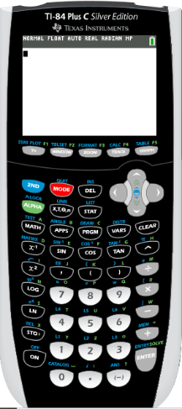
Using a GDC for depreciation
Leslie paid $ 32 000 for a new car. The car depreciates at a rate of 12% per annum.
Find its values after 5 years.
We are going to use Graphing display calculator to solve the problem
Texas Instruments

Slide 13
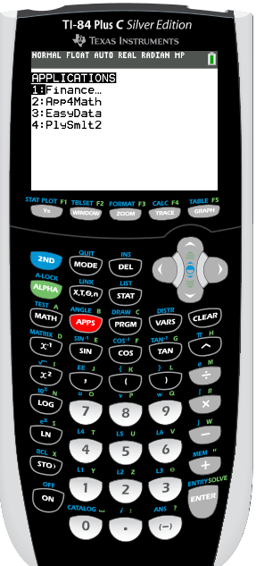
Using a GDC for depreciation (TI-84 Plus)
Leslie paid $ 32 000 for a new car. The car depreciates at a rate of 12% per annum.
Find its values after 5 years.
We are going to use TVM solver
Tap on APPS
1: Finance

Slide 14
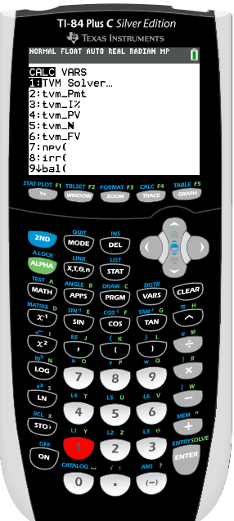
Using a GDC for depreciation (TI-84 Plus)
Leslie paid $ 32 000 for a new car. The car depreciates at a rate of 12% per annum.
Find its values after 5 years.
We are going to use TVM solver
1: Finance
1: TVM Solver
Tap on APPS

Slide 15
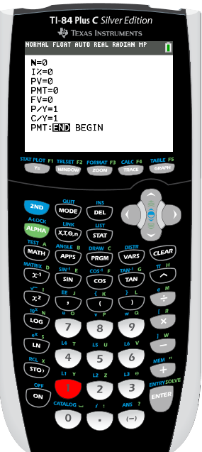
Using a GDC for depreciation
Leslie paid $ 32 000 for a new car. The car depreciates at a rate of 12% per annum.
Find its values after 5 years.
We are going to use TVM solver
Tap on APPS
1: Finance
1: TVM Solver
N: represents the number of time periods
5
ENTER
I%: represents the interest rate per year
PV: represents the present value
PMT: represents the payment each time period
FV: represents the future value
P/Y: is the number of payments per year
C/Y: is the number of compounding periods per year

Slide 16
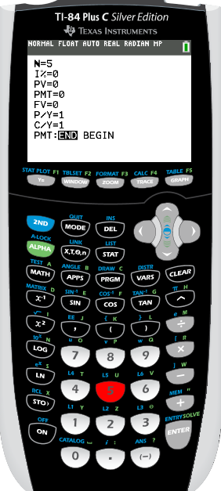
Using a GDC for depreciation
Leslie paid $ 32 000 for a new car. The car depreciates at a rate of 12% per annum.
Find its values after 5 years.
We are going to use TVM solver
Tap on APPS
1: Finance
1: TVM Solver
N: represents the number of time periods
5
ENTER
I%: represents the interest rate per year
-12
ENTER
PV: represents the present value
PMT: represents the payment each time period
FV: represents the future value
P/Y: is the number of payments per year
C/Y: is the number of compounding periods per year

Slide 17
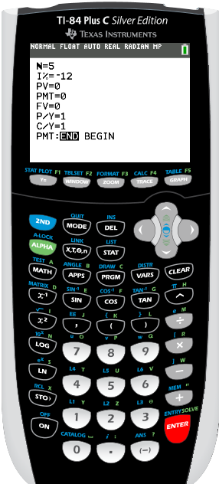
Using a GDC for depreciation
Leslie paid $ 32 000 for a new car. The car depreciates at a rate of 12% per annum.
Find its values after 5 years.
We are going to use TVM solver
Tap on APPS
1: Finance
1: TVM Solver
N: represents the number of time periods
5
ENTER
I%: represents the interest rate per year
-12
ENTER
-32 000
ENTER
PV: represents the present value
PMT: represents the payment each time period
FV: represents the future value
P/Y: is the number of payments per year
C/Y: is the number of compounding periods per year

Slide 18
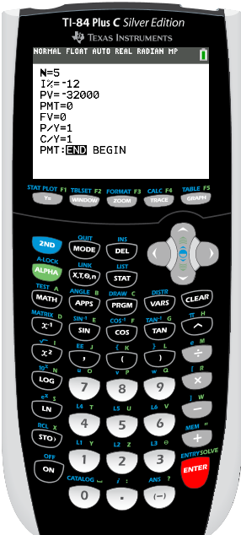
Using a GDC for depreciation
Leslie paid $ 32 000 for a new car. The car depreciates at a rate of 12% per annum.
Find its values after 5 years.
We are going to use TVM solver
Tap on APPS
1: Finance
1: TVM Solver
N: represents the number of time periods
5
ENTER
I%: represents the interest rate per year
-12
ENTER
-32 000
ENTER
PV: represents the present value
0
PMT: represents the payment each time period
ENTER
FV: represents the future value
0
ENTER
P/Y: is the number of payments per year
1
ENTER
1
C/Y: is the number of compounding periods per year
ENTER
With the arrow  move the cursor up to FV

Slide 19
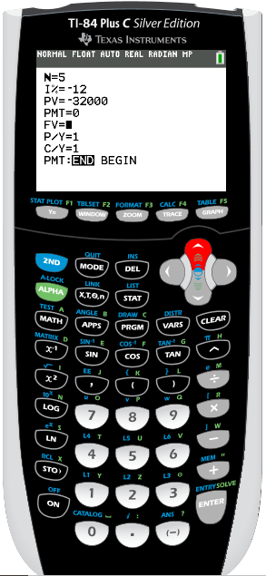
Using a GDC for depreciation
Leslie paid $ 32 000 for a new car. The car depreciates at a rate of 12% per annum.
Find its values after 5 years.
We are going to use TVM solver
Tap on APPS
1: Finance
1: TVM Solver
N: represents the number of time periods
ENTER
I%: represents the interest rate per year
-12
ENTER
-32 000
ENTER
PV: represents the present value
0
PMT: represents the payment each time period
ENTER
FV: represents the future value
0
ENTER
P/Y: is the number of payments per year
1
ENTER
1
C/Y: is the number of compounding periods per year
ENTER
With the arrow  move the cursor up to FV
Press ALPHA
ENTER

Slide 20
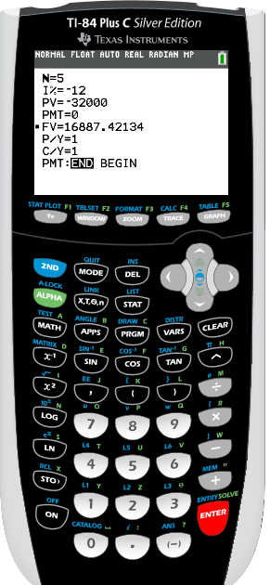
Using a GDC for depreciation
Leslie paid $ 32 000 for a new car. The car depreciates at a rate of 12% per annum.
Find its values after 5 years.
The value after 5 years is:
$16 887.42

Slide 21

Thank you for using resources from
For more resources visit our website
https://www.mathssupport.org
If you have a special request, drop us an email
info@mathssupport.org

