Slide 1
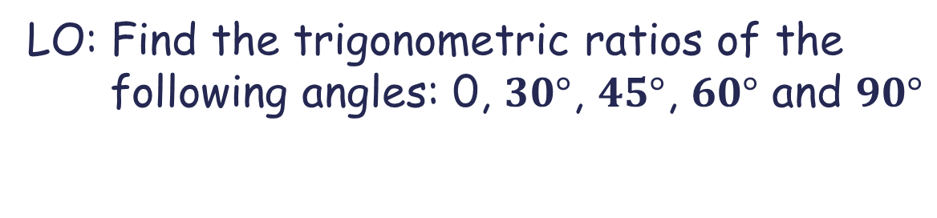
Trigonometric ratios for special angles.
LO: Find the trigonometric ratios of the following angles: 0, $30°$, $45°$, $60°$ and $90°$

Slide 2




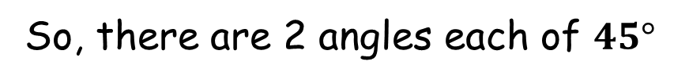
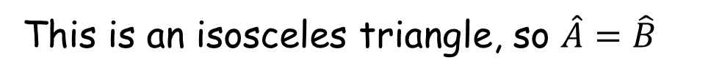
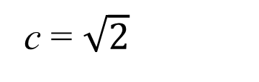
Angles $45°$
Look at this isosceles right-angled triangle.
We let the equal sides have length 1.
A
Using Pythagoras’ theorem, the 3rd side is
$$\frac{π}{4}$$
1
c
$$\sqrt{2}$$
c² = 1² + 1²
c² = 2
$$\frac{π}{4}$$
c = $\sqrt{2}$
C
1
B
This is an isosceles triangle, so $\hat{A}=\hat{B}$
So, there are 2 angles each of $45°$

Slide 3
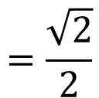

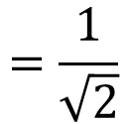


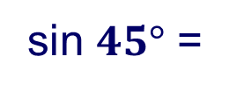
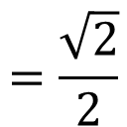
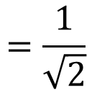

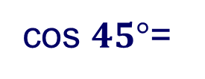

Angles $45°$
Now look at the trigonometric ratios for this triangle
Take any angle, say B.
A
Label the sides
$$\frac{π}{4}$$
h
opposite
$$=\frac{\sqrt{2}}{2}$$
1
$$=\frac{1}{\sqrt{2}}$$
$$\sqrt{2}$$
sin $45°$ =
o
hypotenuse
$$\frac{π}{4}$$
adjacent
$$=\frac{\sqrt{2}}{2}$$
cos $45°$=
$$=\frac{1}{\sqrt{2}}$$
C
1
a
B
hypotenuse
opposite
$$=\frac{1}{1}$$
tan $45°$ =
$$=1$$
adjacent

Slide 4






Angles $60°$and $30°$
Look at this equilateral triangle.
Trig ratios don’t depend on the size of the triangle, so we can let the sides be any convenient length.
B
$$30°$$
$$30°$$
$$60°$$
Let the sides be 2 cm.
2
2
You will see why 2 is a convenient length.
$$60°$$
$$60°$$
A
1
2
1
C
Divide the triangle into 2 equal right angled triangles.
We will take only one triangle to work

Slide 5


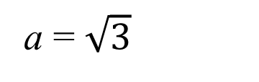


Angles $60°$and $30°$
Now look at this right-angled triangle, which is half the equilateral triangle.
B
Using Pythagoras’ theorem, the 3rd side is
$$30°$$
2² = a² + 1²
2
$$\sqrt{3}$$
a
a² = 2² - 1²
$$60°$$
a² = 3
A
1
a = $\sqrt{3}$
So, we can calculate the trigonometric ratios for the angles $\frac{π}{3}$ and $\frac{π}{6}$

Slide 6
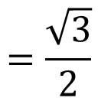


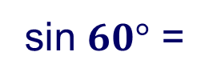
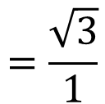


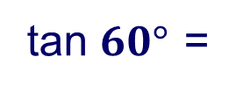


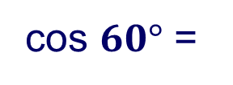
Angles $60°$and $30°$
Now look at the trigonometric ratios for this triangle
We start with the angle A, $60°$.
B
Label the sides for this angle
h
$$30°$$
$$=\frac{\sqrt{3}}{2}$$
opposite
2
sin $60°$ =
$$\sqrt{3}$$
hypotenuse
o
$$60°$$
A
a
1
adjacent
$$=\frac{1}{2}$$
cos $60°$ =
hypotenuse
opposite
$$=\frac{\sqrt{3}}{1}$$
tan $60°$ =
$$=\sqrt{3}$$
adjacent

Slide 7
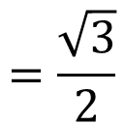
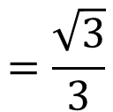

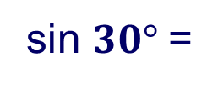
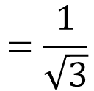


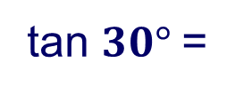

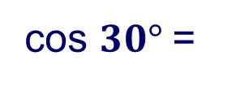
Angles $60°$and $30°$
Now look at the trigonometric ratios for this triangle
Now we take the angle B, $30°$.
B
Label the sides for this angle
h
$$30°$$
opposite
$$=\frac{1}{2}$$
2
sin $30°$=
$$\sqrt{3}$$
hypotenuse
a
$$60°$$
A
adjacent
$$=\frac{\sqrt{3}}{2}$$
o
1
cos $30°$=
hypotenuse
opposite
$$=\frac{1}{\sqrt{3}}$$
$$=\frac{\sqrt{3}}{3}$$
tan $30°$=
adjacent

Slide 8





























Trigonometric ratios for special angles
Summary
$$0$$
$$1$$
$$2$$
$$3$$
$$4$$
0
$$30°$$
$$45°$$
$$60°$$
$$90°$$
$$\frac{\sqrt{0}}{2}$$
$$\frac{\sqrt{1}}{2}$$
$$\frac{\sqrt{2}}{2}$$
$$\frac{\sqrt{3}}{2}$$
$$\frac{\sqrt{4}}{2}$$
sin
$$\frac{1}{2}$$
$$0$$
$$1$$
$$\frac{\sqrt{3}}{2}$$
$$\frac{\sqrt{2}}{2}$$
$$\frac{1}{2}$$
cos
$$1$$
$$0$$
$$\frac{\sqrt{3}}{3}$$
$$\frac{1}{\sqrt{3}}$$
$$\sqrt{3}$$
$$undefined$$
tan
$$0$$
$$1$$
$$2$$
On top of the angles write down the numbers 0 - 4
Write for cosine the same values but in inverse order
Square root the number on top and divide by 2 for sine
For tangent, divide the value of sine by cosine
Write down the angles 0, $30°$ , $45°$ , $60°$, $90°$.

Slide 9

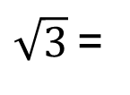
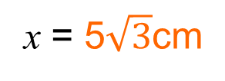
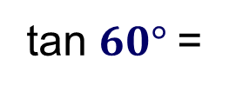
Trigonometric ratios for special angles
S O H
C A H
T O A
Find the exact value of x in this triangle
First label the sides
We are given the side adjacent to the angle and we want to find the length of the opposite side, so we use:
opposite
tan θ =
adjacent
h
x
o
tan $60°$=
x
5
x
$\sqrt{3}$=
5
$$60°$$
a
x = 5$\sqrt{3}$cm
5 m

Slide 10

Thank you for using resources from
For more resources visit our website
https://www.mathssupport.org
If you have a special request, drop us an email
info@mathssupport.org

