Slide 1
Creating the sketch of a function
LO: To create the sketch of a function from information given or transferring a graph from screen to paper.

Slide 2
Sketching the graph of a function
Every function has a particular behaviour and is identified by a specific shape.
There are two ways to represent the graph of a function.
Drawing its graph.
Sketching its graph.
In this lesson we will be working on Sketching the graph of a function
If you are asked to sketch the graph of a function is to represent by means of a diagram or graph (labelled as appropriate).
The sketch should give a general idea of the required shape or relationship and should include relevant features.

Slide 3
Sketching the graph of a function
Details to keep in mind when sketching a function.
All axes should be labelled.
Features that should be labelled:
Any maximum value
Any minimum value
Axis intercepts
Axis of symmetry
Zeros of functions or roots of equations
Equations of vertical and horizontal asymptotes
Identify starting and ending points

Slide 4
Sketching the graph of a function
Sketch the graph of the function y = x² + 3x – 10.
The graph is a parabola
We need some points to sketch the graph
y
From the equation we have the y-intercept.
7
6
5
4
y-intercept (0, –10).
3
2
We can find the zeros of the function by factorizing the equation and these are the x-intercepts.
(–5, 0).
1
(2, 0)
-10
0
1
2
3
4
5
6
7
9
x
-9
-8
-7
-6
-5
-4
-3
-2
-1
8
10
-1
-2
-3
-4
0 = x² + 3x – 10.
-5
0 =
(x + 5)
(x – 2)
-6
-7
(x + 5)
(x – 2)
= 0
= 0
-8
-9
x = –5
x = 2
-10
(0, –10).
These are the zeros of the function
-11
-12
x-intercepts
(– 5, 0)
(2, 0)
-13

Slide 5
Sketching the graph of a function
Sketch the graph of the function y = x² + 3x – 10.
The graph is a parabola
We need some points to sketch the graph
7
y
Now we can calculate the equation of the line of symmetry.
x = -1.5
6
5
4
3
The line of symmetry is halfway between the x-intercepts.
2
(–5, 0).
1
(2, 0)
-10
0
1
2
3
4
5
6
7
9
x
-9
-8
-7
-6
-5
-4
-3
-2
-1
8
10
-1
-2
Equation of the axis of symmetry
-3
p + q
-5 + 2
-4
x =
=
=
-1.5
-5
2
2
-6
This is the x-coordinate of the vertex
-7
Finding the y-coordinate
-8
-9
y = (-1.5)² + 3(-1.5) – 10
-10
(0, –10).
y = -12.25
-11
(–1.25, –12.25).
-12
Vertex
(-1.5, -12.25)
-13

Slide 6
Sketching the graph of a function
Sketch the graph of the function y = –2(x + 3)(x – 1).
–2
3
– 1
The graph is a parabola
We need some points to sketch the graph
y
From the equation we have the y-intercept.
8
7
(0, 6).
6
( )
( )
5
4
y-intercept (0, 6).
3
2
We can find the zeros of the function by equating to zero the equation and these are the x-intercepts.
(–3, 0).
1
(1 , 0)
x
-10
-9
-8
-7
-6
-5
-4
-3
-2
-1
0
1
2
3
4
5
6
7
8
9
10
-2
-3
-4
(x – 1)
-5
0 =
–2(x + 3)
-6
(x + 3)
(x – 1)
= 0
-7
= 0
-8
x = –3
x = 1
-9
-10
-11
x-intercepts
(1, 0)
-12
(–3, 0)
-13

Slide 7
Sketching the graph of a function
Sketch the graph of the function y = -2(x + 3)(x – 1).
The graph is a parabola
We need some points to sketch the graph
y
8
Now we can calculate the equation of the line of symmetry.
7
(0, 6).
6
5
4
The line of symmetry is halfway between the x-intercepts.
3
2
(–3, 0).
1
(1 , 0)
x
-10
-9
-8
-7
-6
-5
-4
-3
-2
-1
0
1
2
3
4
5
6
7
8
9
10
-2
Equation of the axis of symmetry
-3
p + q
-3 + 1
-4
x =
=
=
-1
-5
2
2
-6
This is the x-coordinate of the vertex
-7
Finding the y-coordinate
-8
-9
y = -2(-1+3)(-1 -1)
-10
x = -1
-11
y = 8
-12
Vertex
(-1, 8)
-13

Slide 8
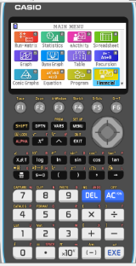
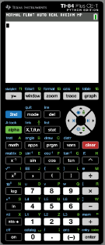
The graph of a function
Transferring a graph from screen of the GDC to paper.
We are going to explain step by step how to transfer a graph from the screen of your Graphing display calculator to paper. Select the Calculator you are using.
CASIO
Texas Instruments

Slide 9
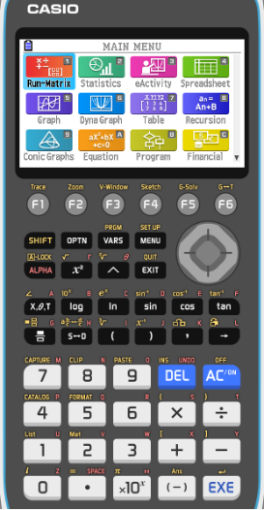
Sketching the graph of a function
Use the GDC to sketch the graph of the function
y = x³ – x² – 7x – 1 for the domain –2 ≤ x ≤ 3
5
y
Turn on the GDC
4
Press 5
Graph
3
2
1
x
–3 –2 –1
1 2 3
-1
-2
-3
-4
-5
⁻-6
-7
-8
-9
-10
-11

Slide 10
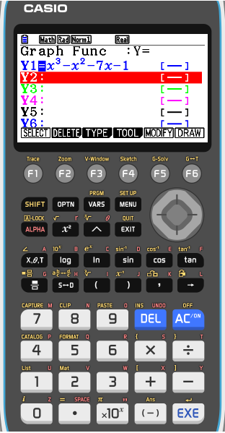
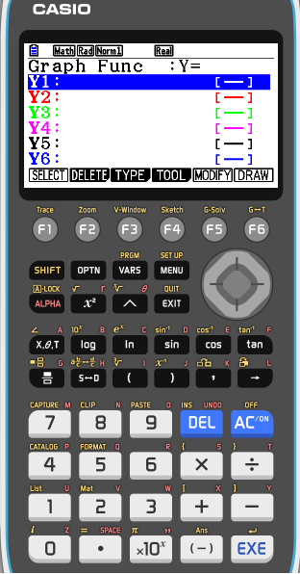
Sketching the graph of a function
Use the GDC to sketch the graph of the function
y = x³ – x² – 7x – 1 for the domain –2 ≤ x ≤ 3
5
y
Turn on the GDC
4
Press 5
Graph
3
Type in the function
2
y = x³ – x² – 7x – 1
1
x
EXE
–3 –2 –1
1 2 3
-1
Press F6
Draw
-2
-3
-4
-5
⁻-6
-7
-8
-9
-10
-11

Slide 11
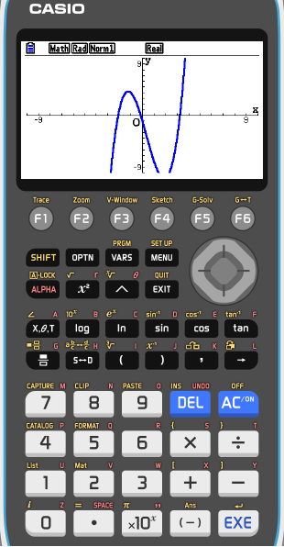
Sketching the graph of a function
Use the GDC to sketch the graph of the function
y = x³ – x² – 7x – 1 for the domain –2 ≤ x ≤ 3
5
y
Turn on the GDC
4
Press 5
Graph
3
Type in the function
2
y = x³ – x² – 7x – 1
1
x
EXE
–3 –2 –1
1 2 3
-1
Press F6
Draw
-2
Press F3
V-Window
-3
-4
-5
⁻-6
-7
-8
-9
-10
-11

Slide 12
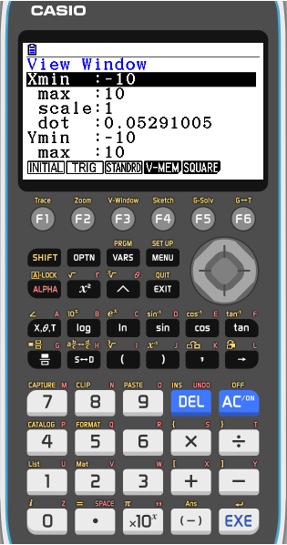
Sketching the graph of a function
Use the GDC to sketch the graph of the function
y = x³ – x² – 7x – 1 for the domain –2 ≤ x ≤ 3
5
y
Turn on the GDC
4
Press 5
Graph
3
Type in the function
2
y = x³ – x² – 7x – 1
1
x
EXE
–3 –2 –1
1 2 3
-1
Press F6
Draw
-2
Press F3
V-Window
-3
Set the domain
-4
Xmin: –2
EXE
-5
max: 3
EXE
⁻-6
Set the range
EXE
-7
Ymin: –12
EXE
-8
max: 5
-9
Press F6
Draw
-10
-11

Slide 13
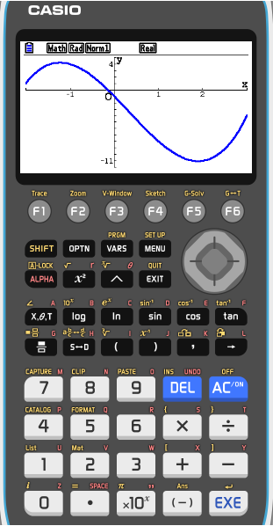
Sketching the graph of a function
Use the GDC to sketch the graph of the function
y = x³ – x² – 7x – 1 for the domain –2 ≤ x ≤ 3
5
y
We need some points to sketch the graph
(-1.2, 4.2)
4
3
Press F5
G-Solv
2
1
x
Press F2
MAX
Maximum point: (-1.2, 4.2)
–3 –2 –1
1 2 3
-1
-2
(0, -1)
Press F5
G-Solv
-3
Press F3
MIN
-4
Minimum point:
(1.9, -11.1)
-5
⁻-6
Press F5
G-Solv
-7
Press F4
Y-ICEPT
-8
Y-intercept:
(0, -1)
-9
-10
-11
(1.9, -11.1)

Slide 14
Sketching the graph of a function
Use the GDC to sketch the graph of the function
y = x³ – x² – 7x – 1 for the domain –2 ≤ x ≤ 3
5
y
Press F5
G-Solv
(-1.2, 4.2)
4
Press F1
ROOT
X-intercept: (-0.15, 0)
3
For the starting point:
2
(-2, 1)
1
x
(-0.15, 0)
Press F5
G-Solv
–3 –2 –1
1 2 3
-1
Press F6
⬥
(0, -1)
Press F1
Y-CAL
-2
-3
Enter x-value X: -2
-4
EXE
-5
Starting point: (-2, 1)
⁻-6
-7
-8
-9
-10
-11
(1.9, -11.1)

Slide 15
Sketching the graph of a function
Use the GDC to sketch the graph of the function
y = x³ – x² – 7x – 1 for the domain –2 ≤ x ≤ 3
5
y
For the ending point:
(-1.2, 4.2)
4
3
Press F5
G-Solv
2
Press F6
⬥
(-2, 1)
1
x
(-0.15, 0)
Press F1
Y-CAL
–3 –2 –1
-1
1 2 3
Enter x-value X: 3
(0, -1)
-2
EXE
-3
Ending point: (3, -4)
-4
(3, -4)
-5
Join the points with a smooth curve
⁻-6
-7
-8
-9
Click to end
-10
-11
(1.9, -11.1)

Slide 16
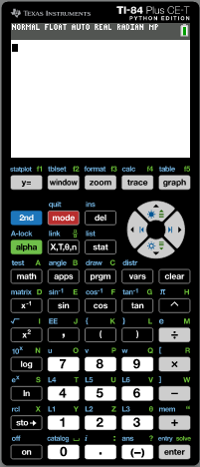
Sketching the graph of a function
Use the GDC to sketch the graph of the function
y = x³ – x² – 7x – 1 for the domain –2 ≤ x ≤ 3
5
y
Turn on the GDC
4
Press Y=
3
2
1
x
–3 –2 –1
1 2 3
-1
-2
-3
-4
-5
⁻-6
-7
-8
-9
-10
-11

Slide 17
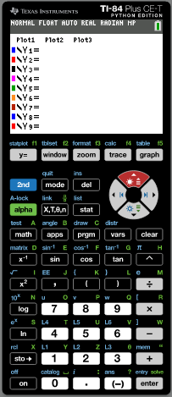
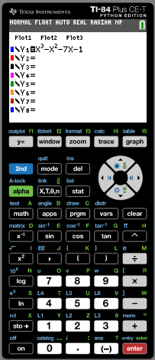
Sketching the graph of a function
Use the GDC to sketch the graph of the function
y = x³ – x² – 7x – 1 for the domain –2 ≤ x ≤ 3
5
y
Turn on the GDC
4
Press Y=
3
Type in the function
2
y = x³ – x² – 7x – 1
1
x
enter
–3 –2 –1
1 2 3
-1
Press
Graph
-2
-3
-4
-5
⁻-6
-7
-8
-9
-10
-11

Slide 18
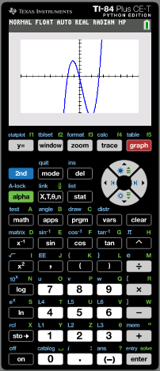
Sketching the graph of a function
Use the GDC to sketch the graph of the function
y = x³ – x² – 7x – 1 for the domain –2 ≤ x ≤ 3
5
y
Turn on the GDC
4
Press 5
Graph
3
Type in the function
2
y = x³ – x² – 7x – 1
1
x
enter
–3 –2 –1
1 2 3
-1
Press
Graph
-2
Press
Window
-3
-4
-5
⁻-6
-7
-8
-9
-10
-11

Slide 19
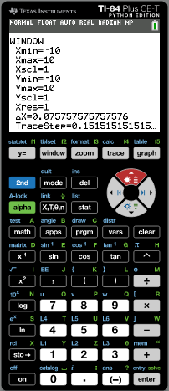
Sketching the graph of a function
Use the GDC to sketch the graph of the function
y = x³ – x² – 7x – 1 for the domain –2 ≤ x ≤ 3
5
y
Turn on the GDC
4
Press 5
Graph
3
Type in the function
2
y = x³ – x² – 7x – 1
1
x
enter
–3 –2 –1
1 2 3
-1
Press
Graph
-2
Press
Window
-3
Set the domain
-4
Xmin: –2
enter
-5
Xmax: 3
enter
⁻-6
Set the range
-7
Ymin: –12
enter
Ymax: 5
enter
-8
-9
Press
graph
-10
-11

Slide 20
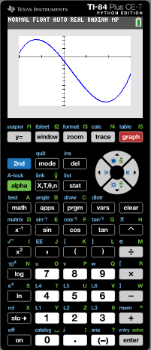
Sketching the graph of a function
Use the GDC to sketch the graph of the function
y = x³ – x² – 7x – 1 for the domain –2 ≤ x ≤ 3
5
y
We need some points to sketch the graph
(-1.2, 4.2)
4
3
Press 2nd
Calc
2
1
x
Press 4
maximum
Drag the cursor to the left of a maximum
–3 –2 –1
1 2 3
-1
enter
-2
Drag the cursor to the right of a maximum
-3
-4
enter
enter
-5
Maximum point: (-1.2, 4.2)
⁻-6
-7
Press 2nd
Calc
-8
-9
-10
-11

Slide 21
Sketching the graph of a function
Use the GDC to sketch the graph of the function
y = x³ – x² – 7x – 1 for the domain –2 ≤ x ≤ 3
5
y
We need some points to sketch the graph
(-1.2, 4.2)
4
3
2
Press 3
minimum
1
x
Drag the cursor to the left of a minimum
–3 –2 –1
1 2 3
enter
-1
Drag the cursor to the right of a minimum
-2
-3
enter
enter
-4
Minimum point:
(1.9, -11.1)
-5
⁻-6
Press 2nd
Calc
-7
-8
-9
-10
-11
(1.9, -11.1)

Slide 22
Sketching the graph of a function
Use the GDC to sketch the graph of the function
y = x³ – x² – 7x – 1 for the domain –2 ≤ x ≤ 3
For the x-intercept:
5
y
Press 2:
zero
(-1.2, 4.2)
4
Drag the cursor to the left of a zero
3
2
enter
(-2, 1)
1
x
Drag the cursor to the right of a zero
(-0.15, 0)
–3 –2 –1
1 2 3
enter
enter
-1
-2
X-intercept: (-0.15, 0)
-3
Press 2nd
Calc
-4
For the starting point:
-5
⁻-6
Press 1:
value
-7
enter
x:
–2
Starting point: (-2, 1)
-8
-9
Press 2nd
Calc
-10
-11
(1.9, -11.1)

Slide 23
Sketching the graph of a function
Use the GDC to sketch the graph of the function
y = x³ – x² – 7x – 1 for the domain –2 ≤ x ≤ 3
5
y
For the ending point:
(-1.2, 4.2)
4
Press 1:
value
3
enter
2
x:
3
Ending point: (3, -4)
(-2, 1)
1
x
(-0.15, 0)
Press 2nd
Calc
–3 –2 –1
1 2 3
-1
For the y-intercept:
(0, -1)
Press 1:
value
-2
enter
-3
x:
0
-4
(3, -4)
Y-intercept: (0, -1)
-5
Join the points with a smooth curve
⁻-6
-7
-8
-9
-10
-11
(1.9, -11.1)

Slide 24

Thank you for using resources from
For more resources visit our website
https://www.mathssupport.org
If you have a special request, drop us an email
info@mathssupport.org

