Slide 1
Graphical solution of equations
LO: To use the GDC to solve equations, including those which may be unfamiliar.

Slide 2
Graphical Solution of Equations
We can use the GDC to solve equations graphically
To solve equations graphically follow these steps:
Step 1:
Turn on the GDC and select the Graph option from the menu.
Step 2:
Type in the left hand side of the equation on Y1.
Step 3:
Type in the right hand side of the equation on Y2.
Step 4:
Draw the graph on the screen
Step 5:
Find the x-value of any intersection of the two graphs.

Slide 3
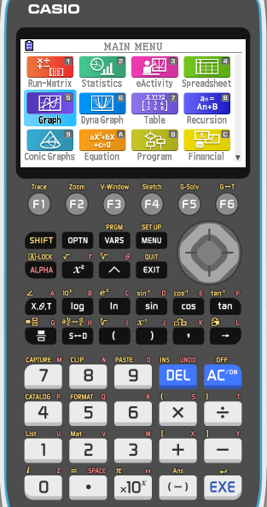
Graphical Solution of Equations
2x – 8 = x – 1
Example 1
Solve
Step 1:
Turn on the GDC and select the Graph option from the menu.
Step 2:
Type in the left hand side of the equation on Y1.
2x – 8

Slide 4
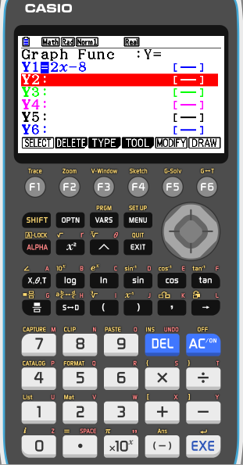
Graphical Solution of Equations
2x – 8 = x – 1
Example 1
Solve
Step 1:
Turn on the GDC and select the Graph option from the menu.
Step 2:
Type in the left hand side of the equation on Y1.
2x – 8
Step 3:
Type in the right hand side of the equation on Y2.
x – 1

Slide 5
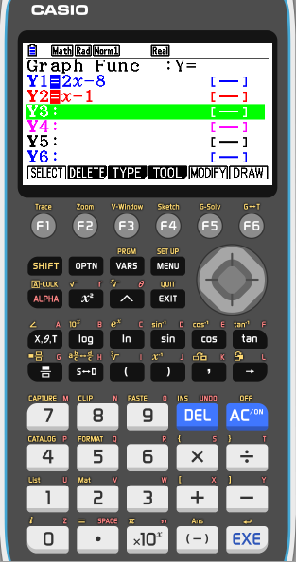
Graphical Solution of Equations
2x – 8 = x – 1
Example 1
Solve
Step 1:
Turn on the GDC and select the Graph option from the menu.
Step 2:
Type in the left hand side of the equation on Y1.
2x – 8
Step 3:
Type in the right hand side of the equation on Y2.
x – 1
Step 4:
Draw the graph on the screen
F6
Draw

Slide 6
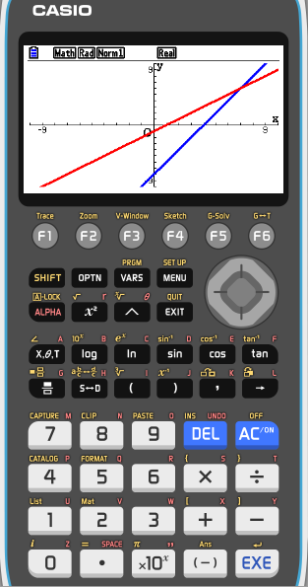
Graphical Solution of Equations
2x – 8 = x – 1
Example 1
Solve
Step 1:
Turn on the GDC and select the Graph option from the menu.
Step 2:
Type in the left hand side of the equation on Y1.
2x – 8
Step 3:
Type in the right hand side of the equation on Y2.
x – 1
Step 4:
Draw the graph on the screen
F6
Draw
Step 5:
Find the x-value of any intersection of the two graphs.
F5
G-Solv
F5
INTSECT

Slide 7
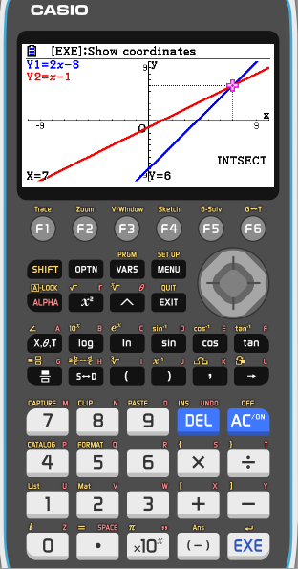
Graphical Solution of Equations
2x – 8 = x – 1
Example 1
Solve
Step 1:
Turn on the GDC and select the Graph option from the menu.
Step 2:
Type in the left hand side of the equation on Y1.
2x – 8
Step 3:
Type in the right hand side of the equation on Y2.
x – 1
Step 4:
Draw the graph on the screen
F6
Draw
Step 5:
Find the x-value of any intersection of the two graphs.
F5
G-Solv
F5
INTSECT
Solution:
x = 7

Slide 8
Graphical Solution of Equations
2x³ – 4x² – x = x² + x – 2
Example 2
Solve
Step 1:
Turn on the GDC and select the Graph option from the menu.
Step 2:
Type in the left hand side of the equation on Y1.
2x³ – 4x² – x

Slide 9
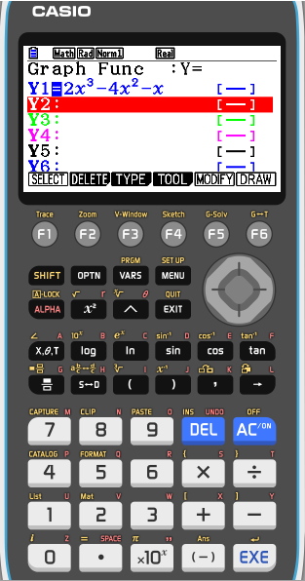
Graphical Solution of Equations
2x³ – 4x² – x = x² + x – 2
Example 2
Solve
Step 1:
Turn on the GDC and select the Graph option from the menu.
Step 2:
Type in the left hand side of the equation on Y1.
2x³ – 4x² – x
Step 3:
Type in the right hand side of the equation on Y2.
x² + x – 2

Slide 10
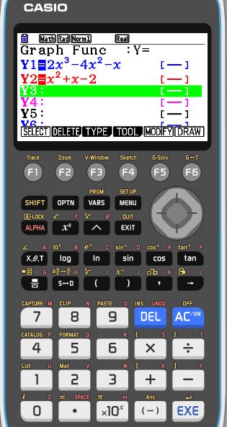
Graphical Solution of Equations
2x³ – 4x² – x = x² + x – 2
Example 2
Solve
Step 1:
Turn on the GDC and select the Graph option from the menu.
Step 2:
Type in the left hand side of the equation on Y1.
2x³ – 4x² – x
Step 3:
Type in the right hand side of the equation on Y2.
x² + x – 2
Step 4:
Draw the graph on the screen
F6
Draw

Slide 11
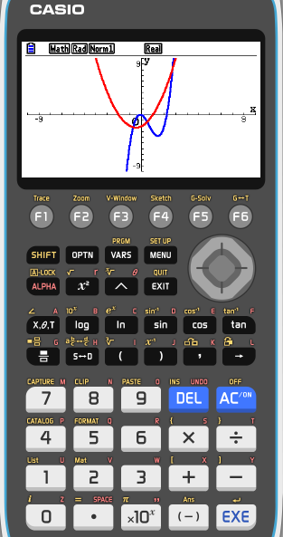
Graphical Solution of Equations
2x³ – 4x² – x = x² + x – 2
Example 2
Solve
Step 1:
Turn on the GDC and select the Graph option from the menu.
Step 2:
Type in the left hand side of the equation on Y1.
2x³ – 4x² – x
Step 3:
Type in the right hand side of the equation on Y2.
x² + x – 2
Step 4:
Draw the graph on the screen
F6
Draw
Step 5:
Find the x-value of any intersection of the two graphs.
F5
G-Solv
F5
INTSECT

Slide 12
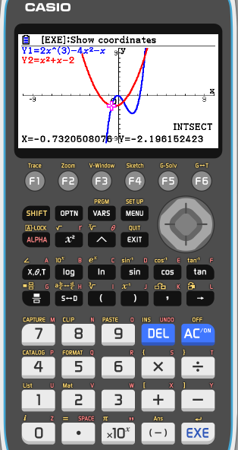
Graphical Solution of Equations
2x³ – 4x² – x = x² + x – 2
Example 2
Solve
Step 1:
Turn on the GDC and select the Graph option from the menu.
Step 2:
Type in the left hand side of the equation on Y1.
2x³ – 4x² – x
Step 3:
Type in the right hand side of the equation on Y2.
x² + x – 2
Step 4:
Draw the graph on the screen
F6
Draw
Step 5:
Find the x-value of any intersection of the two graphs.
F5
G-Solv
F5
INTSECT
Solution:
x ≈ -0.732


Slide 13
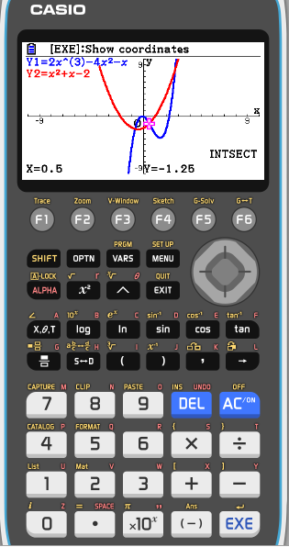
Graphical Solution of Equations
2x³ – 4x² – x = x² + x – 2
Example 2
Solve
Step 1:
Turn on the GDC and select the Graph option from the menu.
Step 2:
Type in the left hand side of the equation on Y1.
2x³ – 4x² – x
Step 3:
Type in the right hand side of the equation on Y2.
x² + x – 2
Step 4:
Draw the graph on the screen
F6
Draw
Step 5:
Find the x-value of any intersection of the two graphs.
F5
G-Solv
F5
INTSECT

Solution:
x ≈ -0.732

x = 0.5

Slide 14
Graphical Solution of Equations
2x³ – 4x² – x = x² + x – 2
Example 2
Solve
Step 1:
Turn on the GDC and select the Graph option from the menu.
Step 2:
Type in the left hand side of the equation on Y1.
2x³ – 4x² – x
Step 3:
Type in the right hand side of the equation on Y2.
x² + x – 2
Step 4:
Draw the graph on the screen
F6
Draw
Step 5:
Find the x-value of any intersection of the two graphs.
F5
G-Solv
F5
INTSECT
Solution:
x ≈ -0.732

x = 0.5

x ≈ 2.732

Slide 15
Graphical Solution of Equations
2^{x} = 5 – x
Example 3
Solve
Step 1:
Turn on the GDC and select the Graph option from the menu.
Step 2:
Type in the left hand side of the equation on Y1.
2^{x}

Slide 16
Graphical Solution of Equations
2^{x} = 5 – x
Example 3
Solve
Step 1:
Turn on the GDC and select the Graph option from the menu.
Step 2:
Type in the left hand side of the equation on Y1.
2^{x}
Step 3:
Type in the right hand side of the equation on Y2.
5 – x

Slide 17
Graphical Solution of Equations
2^{x} = 5 – x
Example 3
Solve
Step 1:
Turn on the GDC and select the Graph option from the menu.
Step 2:
Type in the left hand side of the equation on Y1.
2^{x}
Step 3:
Type in the right hand side of the equation on Y2.
5 – x
Step 4:
Draw the graph on the screen
F6
Draw

Slide 18
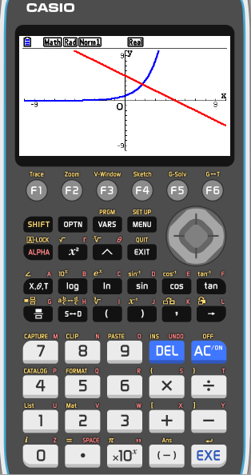
Graphical Solution of Equations
2^{x} = 5 – x
Example 3
Solve
Step 1:
Turn on the GDC and select the Graph option from the menu.
Step 2:
Type in the left hand side of the equation on Y1.
2^{x}
Step 3:
Type in the right hand side of the equation on Y2.
5 – x
Step 4:
Draw the graph on the screen
F6
Draw
Step 5:
Find the x-value of any intersection of the two graphs.
F5
G-Solv
F5
INTSECT

Slide 19
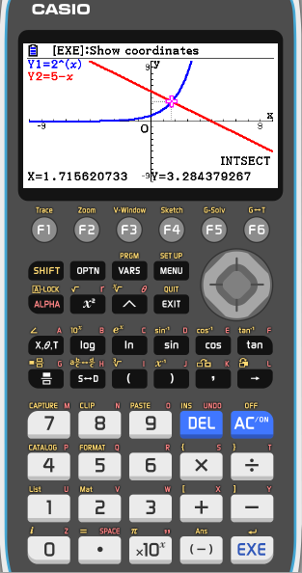
Graphical Solution of Equations
2^{x} = 5 – x
Example 3
Solve
Step 1:
Turn on the GDC and select the Graph option from the menu.
Step 2:
Type in the left hand side of the equation on Y1.
2^{x}
Step 3:
Type in the right hand side of the equation on Y2.
5 – x
Step 4:
Draw the graph on the screen
F6
Draw
Step 5:
Find the x-value of any intersection of the two graphs.
F5
G-Solv
F5
INTSECT
Solution:
x ≈ 1.72

Slide 20
Thank you for using resources from
For more resources visit our website
https://www.mathssupport.org
If you have a special request, drop us an email
info@mathssupport.org

