Slide 1
HCF and LCM
LO: To find the Highest common factor and the Lowest common multiple of numbers

Slide 2
Common multiples
Multiples of 3
6
9
36
39
3
12
33
63…
42
10
15
20
25
30
35
40
45
50
55
60
5
15
30
45
60
65 …
Multiples of 5
27
48
57
18
21
24
51
54
What do you conclude from this lists?
Which one is the Lowest Common Multiple?
15

Slide 3
The lowest common multiple
The lowest common multiple (or LCM) of two numbers is the smallest number that is a multiple of both the numbers.
We can find this by writing down the first few multiples for both numbers until we find a number that is in both lists.
For example,
Multiples of 20 are :
20,
40,
60,
80,
100,
120, . . .
Multiples of 25 are :
25,
50,
75,
100,
125, . . .
The LCM of 20 and 25 is
100.

Slide 4
The lowest common multiple
What is the lowest common multiple (LCM) of 8 and 10?
The first ten multiples of 8 are:
8
16
24
32
40
48
56
64
72
80
…
The first ten multiples of 10 are:
10
20
30
40
50
60
70
80
90
100
…
The lowest common multiple (LCM) of 8 and 10 is
40.

Slide 5
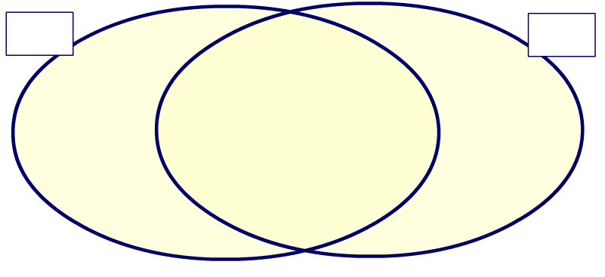
Common Factors
Factors of 18:
1
18
2
9
18
24
24
3
6
9
1
3
12
Factors of 24:
6
8
18
2
1
24
4
2
12
3
8
What do you say about these numbers?
4
6
They are all common factors of 18 and 24
6
Which one is the Highest Common Factor?

Slide 6
The highest common factor
The highest common factor (or HCF) of two numbers is the highest number that is a factor of both numbers.
We can find the highest common factor of two numbers by writing down all their factors and finding the largest factor in both lists.
For example,
Factors of 36 are :
1,
2,
3,
4,
6,
9,
12,
18,
36.
Factors of 45 are :
1,
3,
5,
9,
15,
45.
The HCF of 36 and 45 is
9.

Slide 7
The highest common factor
What is the highest common factor (HCF) of 24 and 30?
The factors of 24 are:
1
2
3
4
6
8
12
24
The factors of 30 are:
1
2
3
5
6
10
15
30
The highest common factor (HCF) of 24 and 30 is
6.

Slide 8

Thank you for using resources from
For more resources visit our website
https://www.mathssupport.org
If you have a special request, drop us an email
info@mathssupport.org

