Slide 1
Creating Pie charts
LO: To use a scaling method to draw pie charts.

Slide 2
Draw Pie charts
The circle represents everyone in a classroom.
How you would show on the pie chart that half the class are boys and half are girls
Boys
Girls

Slide 3
Draw Pie charts
The circle represents everyone in a classroom.
How you would show that one quarter of the class wear glasses and the rest do not wear glasses.
Glasses
No Glasses

Slide 4
Draw Pie charts
I want a pie chart about 36 people.
36
How big each angle needs to be for the pie Chart?
8
12
16
80°
120°
160°
How many degrees per person?
10°
360° ÷ 36
=

Slide 5
Draw Pie charts
I want a pie chart about 48 people.
48
How big each angle needs to be for the pie Chart?
10
18
20
75°
135°
150°
7.5°
How many degrees per person?
360° ÷ 48
=

Slide 6
Draw Pie charts
I want a pie chart about 24 people.
24
How big each angle needs to be for the pie Chart?
6
8
10
90°
120°
150°
How many degrees per person?
15°
360° ÷ 24
=

Slide 7
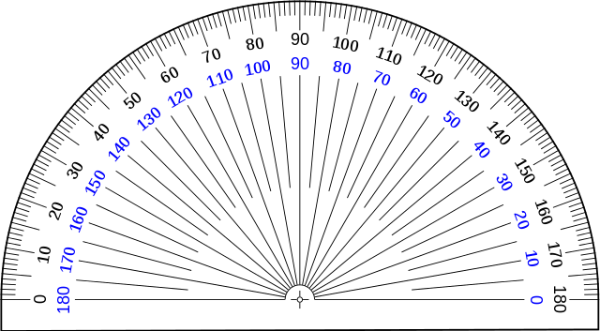



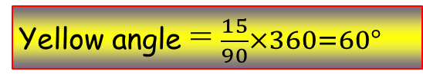

Draw Pie charts
In a survey, people were asked to indicate which one is their favourite colour. The information is given in the table. Display the information in a pie chart.
Favourite
color
Freq.
Blue
35
Purple
10
Yellow
15
Pink
5
Green
25
Total
90
Blue angle = $\frac{35}{90}×360=140°$
Purple angle = $\frac{10}{90}×360=40°$
Yellow angle = $\frac{15}{90}×360=60°$
Pink angle = $\frac{5}{90}×360=20°$
Green angle = $\frac{25}{90}×360=100°$

Slide 8
Draw Pie charts
In a survey, people were asked to indicate which one is their favourite colour. The information is given in the table. Display the information in a pie chart.
Favourite
color
Freq.
Blue
35
Purple
10
Yellow
15
Pink
5
Green
25
Total
90
Blue angle = $\frac{35}{90}×360=140°$
Blue
Purple angle = $\frac{10}{90}×360=40°$
Yellow angle = $\frac{15}{90}×360=60°$
Pink angle = $\frac{5}{90}×360=20°$
Green angle = $\frac{25}{90}×360=100°$

Slide 9
Draw Pie charts
In a survey, people were asked to indicate which one is their favourite colour. The information is given in the table. Display the information in a pie chart.
Favourite
color
Freq.
Blue
35
Purple
10
Yellow
15
Pink
5
Green
25
Total
90
Blue angle = $\frac{35}{90}×360=140°$
Blue
Purple angle = $\frac{10}{90}×360=40°$
Yellow angle = $\frac{15}{90}×360=60°$
Pink angle = $\frac{5}{90}×360=20°$
Green angle = $\frac{25}{90}×360=100°$

Slide 10
Draw Pie charts
In a survey, people were asked to indicate which one is their favourite colour. The information is given in the table. Display the information in a pie chart.
Favourite
color
Freq.
In a survey, people were asked to indicate which one is their favourite colour. The information is given in the table. Display the information in a pie chart.
Blue
35
Purple
10
Yellow
15
Pink
5
Green
25
Total
90
Blue angle = $\frac{35}{90}×360=140°$
Blue
Purple angle = $\frac{10}{90}×360=40°$
Purple
Yellow angle = $\frac{15}{90}×360=60°$
Pink angle = $\frac{5}{90}×360=20°$
Green angle = $\frac{25}{90}×360=100°$

Slide 11
Draw Pie charts
In a survey, people were asked to indicate which one is their favourite colour. The information is given in the table. Display the information in a pie chart.
Favourite
color
Freq.
Blue
35
Purple
10
Yellow
15
Pink
5
Green
25
Total
90
Blue angle = $\frac{35}{90}×360=140°$
Blue
Purple angle = $\frac{10}{90}×360=40°$
Purple
Yellow angle = $\frac{15}{90}×360=60°$
Pink angle = $\frac{5}{90}×360=20°$
Green angle = $\frac{25}{90}×360=100°$

Slide 12
Draw Pie charts
In a survey, people were asked to indicate which one is their favourite colour. The information is given in the table. Display the information in a pie chart.
Favourite
color
Freq.
Blue
35
Purple
10
Yellow
15
Pink
5
Green
25
Total
90
Blue angle = $\frac{35}{90}×360=140°$
Blue
Yellow
Purple angle = $\frac{10}{90}×360=40°$
Purple
Yellow angle = $\frac{15}{90}×360=60°$
Pink angle = $\frac{5}{90}×360=20°$
Green angle = $\frac{25}{90}×360=100°$

Slide 13
Draw Pie charts
In a survey, people were asked to indicate which one is their favourite colour. The information is given in the table. Display the information in a pie chart.
Favourite
color
Freq.
Blue
35
Purple
10
Yellow
15
Pink
5
Green
25
Total
90
Blue angle = $\frac{35}{90}×360=140°$
Blue
Yellow
Purple angle = $\frac{10}{90}×360=40°$
Purple
Yellow angle = $\frac{15}{90}×360=60°$
Pink angle = $\frac{5}{90}×360=20°$
Green angle = $\frac{25}{90}×360=100°$

Slide 14
Draw Pie charts
In a survey, people were asked to indicate which one is their favourite colour. The information is given in the table. Display the information in a pie chart.
Favourite
color
Freq.
Blue
35
Purple
10
Yellow
15
Pink
5
Green
25
Total
90
Blue angle = $\frac{35}{90}×360=140°$
Green
Blue
Yellow
Purple angle = $\frac{10}{90}×360=40°$
Purple
Pink
Yellow angle = $\frac{15}{90}×360=60°$
Pink angle = $\frac{5}{90}×360=20°$
Green angle = $\frac{25}{90}×360=100°$

Slide 15



Using Pie charts
The pie chart is showing how a group of people travel to work.
Altogether there were 240 people
How many travel by car?
$$\frac{126}{360}$$
× 240
= 84
Car
How many travel by bus?
126°
Walk
$$\frac{78}{360}$$
36°
× 240
= 52
Bus
78°
48°
How many travel by train?
Cycle
72°
Train
$$\frac{72}{360}$$
× 240
= 48

Slide 16


Using Pie charts
The pie chart is showing how a group of people travel to work.
Altogether there were 240 people
How many travel by cycle?
Car
$$\frac{48}{360}$$
× 240
= 32
126°
Walk
36°
Bus
78°
48°
72°
Cycle
How many walk?
Train
$$\frac{36}{360}$$
× 240
= 24
walk

Slide 17

Thank you for using resources from
For more resources visit our website
https://www.mathssupport.org
If you have a special request, drop us an email
info@mathssupport.org

