Slide 1
Definite integral using technology
LO: Use the GDC to find the definite integral.

Slide 2

Definite integrals using GDC
Using GDC to evaluate a definite integral
$$\int_{1}^{5}{\frac{1}{4x}dx}$$
Evaluate the definite integral
We are going to use Graphing display calculator to solve this question

Slide 3
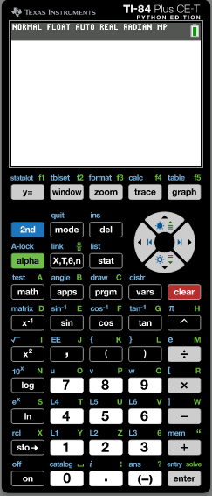

Definite integrals using GDC
$$\int_{1}^{5}{\frac{1}{4x}dx}$$
Evaluate the definite integral
Turn on the GDC
Press MATH

Slide 4
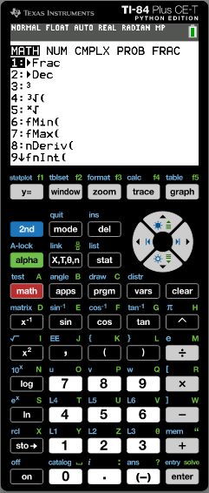
Definite integrals using GDC
$$\int_{1}^{5}{\frac{1}{4x}dx}$$
Evaluate the definite integral
Turn on the GDC
Press MATH
Press 9 fnINT

Slide 5
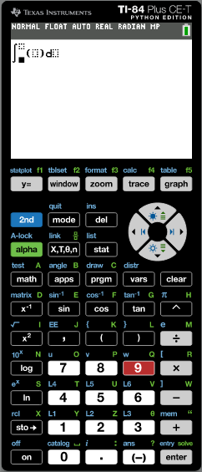
Definite integrals using GDC
$$\int_{1}^{5}{\frac{1}{4x}dx}$$
Evaluate the definite integral
Turn on the GDC
Press MATH
Press 9 fnINT
1

5
1

÷
(
4
x
)
Type in
)

x


Slide 6
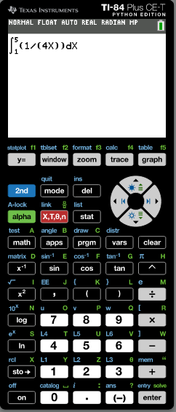
Definite integrals using GDC
$$\int_{1}^{5}{\frac{1}{4x}dx}$$
Evaluate the definite integral
Turn on the GDC
Press MATH
Press 9 fnINT
1

5
1

÷
(
4
x
)
Type in
)

x
Enter

Slide 7
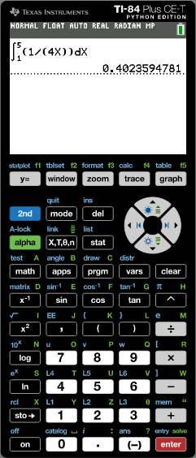
Definite integrals using GDC
$$\int_{1}^{5}{\frac{1}{4x}dx}$$
Evaluate the definite integral
Turn on the GDC
Press MATH
Press 9 fnINT
1

5
1

÷
(
4
x
)
Type in
)

x
Enter
$$\int_{1}^{5}{\frac{1}{4x}dx}$$
$$=0.402$$
3sf

Slide 8
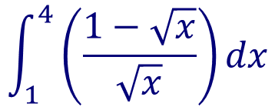
Definite integrals using GDC
$$\int_{1}^{4}{\left(\frac{1−\sqrt{x}}{\sqrt{x}}\right)dx}$$
Evaluate the definite integral
Press clear
Press MATH

Slide 9

Definite integrals using GDC
$$\int_{1}^{4}{\left(\frac{1−\sqrt{x}}{\sqrt{x}}\right)dx}$$
Evaluate the definite integral
Turn on the GDC
Press MATH
Press 9 fnINT

Slide 10

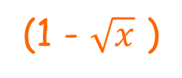
Definite integrals using GDC
$$\int_{1}^{4}{\left(\frac{1−\sqrt{x}}{\sqrt{x}}\right)dx}$$
Evaluate the definite integral
Turn on the GDC
Press MATH
Press 9 fnINT
1


(1 - $\sqrt{x}$ )
÷
$$\sqrt{x}$$
4

Type in

x

Slide 11
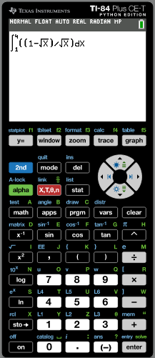
Definite integrals using GDC
$$\int_{1}^{4}{\left(\frac{1−\sqrt{x}}{\sqrt{x}}\right)dx}$$
Evaluate the definite integral
Turn on the GDC
Press MATH
Press 9 fnINT
1


(1 - $\sqrt{x}$ )
÷
$$\sqrt{x}$$
4

Type in

x
Enter

Slide 12
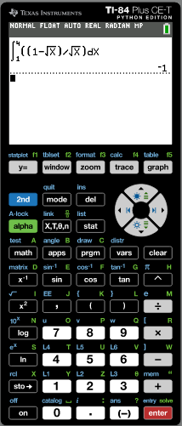
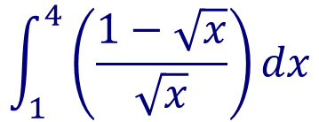
Definite integrals using GDC
$$\int_{1}^{4}{\left(\frac{1−\sqrt{x}}{\sqrt{x}}\right)dx}$$
Evaluate the definite integral
Turn on the GDC
Press MATH
Press 9 fnINT
1


(1 - $\sqrt{x}$ )
÷
$$\sqrt{x}$$
Type in
4

x
Enter
$$\int_{1}^{4}{\left(\frac{1−\sqrt{x}}{\sqrt{x}}\right)dx}$$
= –1

Slide 13
Thank you for using resources from
For more resources visit our website
https://www.mathssupport.org
If you have a special request, drop us an email
info@mathssupport.org

