Slide 1
Definite integral using technology
LO: Use the GDC to find the definite integral.

Slide 2
Definite integrals using GDC
Using GDC to evaluate a definite integral
$$\int_{1}^{5}{\frac{1}{4x}dx}$$
Evaluate the definite integral
We are going to use Graphing display calculator to solve this question

Slide 3
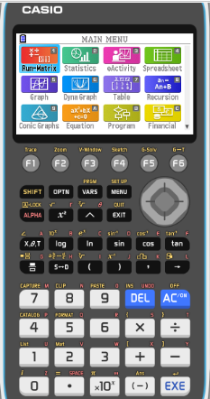
Definite integrals using GDC
$$\int_{1}^{5}{\frac{1}{4x}dx}$$
Evaluate the definite integral
Turn on the GDC
1
Run-Matrix

Slide 4
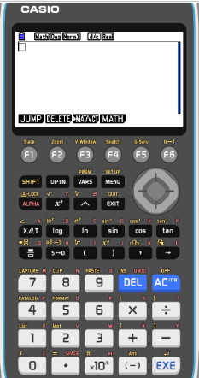
Definite integrals using GDC
$$\int_{1}^{5}{\frac{1}{4x}dx}$$
Evaluate the definite integral
Turn on the GDC
1
Run-Matrix
F4
MATH

Slide 5
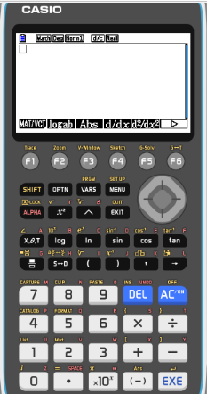
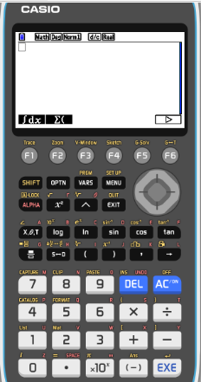
Definite integrals using GDC
$$\int_{1}^{5}{\frac{1}{4x}dx}$$
Evaluate the definite integral
Turn on the GDC
1
Run-Matrix
F4
MATH
F6


F1
∫dx

Slide 6
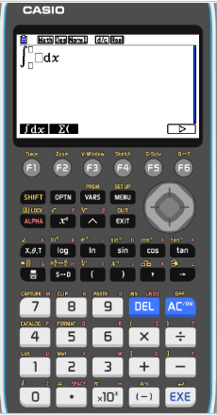
Definite integrals using GDC
$$\int_{1}^{5}{\frac{1}{4x}dx}$$
Evaluate the definite integral
Turn on the GDC
1
Run-Matrix
F4
MATH
F6


F1
∫dx
Type in
1

4
x

Slide 7
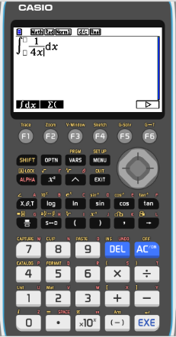
Definite integrals using GDC
$$\int_{1}^{5}{\frac{1}{4x}dx}$$
Evaluate the definite integral
Turn on the GDC
1
Run-Matrix
F4
MATH
F6


F1
∫dx
Type in
1

4
x


1

5

Slide 8
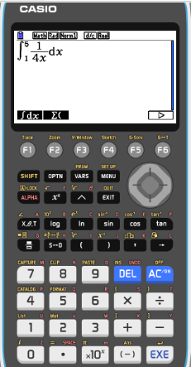
Definite integrals using GDC
$$\int_{1}^{5}{\frac{1}{4x}dx}$$
Evaluate the definite integral
Turn on the GDC
1
Run-Matrix
F4
MATH
F6

F1
∫dx
Type in
1

4
x


1

5
EXE

Slide 9
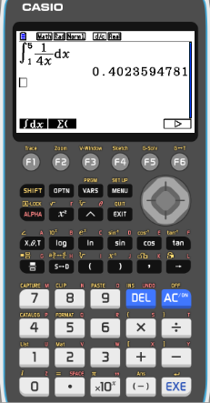
Definite integrals using GDC
$$\int_{1}^{5}{\frac{1}{4x}dx}$$
Evaluate the definite integral
Turn on the GDC
1
Run-Matrix
F4
MATH
F6

F1
∫dx
Type in
1

4
x


1

5
EXE
$$\int_{1}^{5}{\frac{1}{4x}dx}$$
$$=0.402$$
3sf

Slide 10
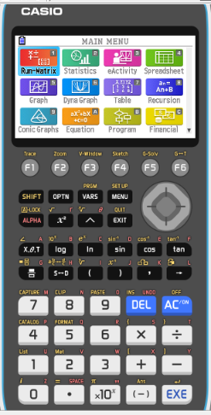
Fundamental theorem of calculus
$$\int_{1}^{4}{\left(\frac{1−\sqrt{x}}{\sqrt{x}}\right)dx}$$
Use a GDC to evaluate the definite integral
Turn on the GDC
1
Run-Matrix

Slide 11
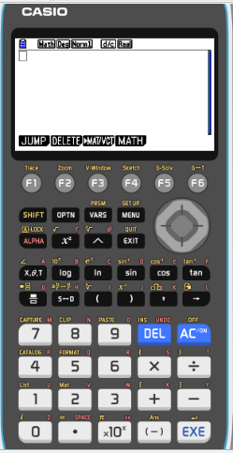
Fundamental theorem of calculus
$$\int_{1}^{4}{\left(\frac{1−\sqrt{x}}{\sqrt{x}}\right)dx}$$
Use a GDC to evaluate the definite integral
Turn on the GDC
1
Run-Matrix
OPTN

Slide 12
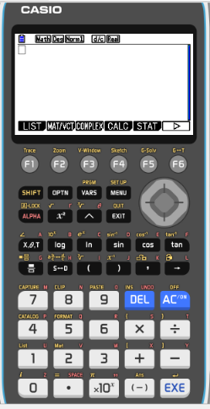
Fundamental theorem of calculus
$$\int_{1}^{4}{\left(\frac{1−\sqrt{x}}{\sqrt{x}}\right)dx}$$
Use a GDC to evaluate the definite integral
Turn on the GDC
1
Run-Matrix
OPTN
F4
CALC

Slide 13
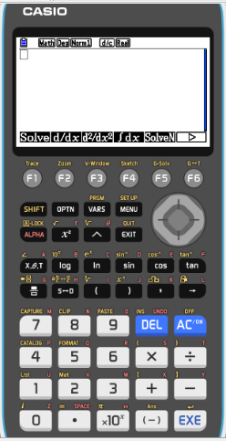
Fundamental theorem of calculus
$$\int_{1}^{4}{\left(\frac{1−\sqrt{x}}{\sqrt{x}}\right)dx}$$
Use a GDC to evaluate the definite integral
Turn on the GDC
1
Run-Matrix
OPTN
F4
CALC
F4
∫dx

Slide 14
Fundamental theorem of calculus
$$\int_{1}^{4}{\left(\frac{1−\sqrt{x}}{\sqrt{x}}\right)dx}$$
Use a GDC to evaluate the definite integral
Turn on the GDC
1
Run-Matrix
OPTN
F4
CALC
F4
∫dx
Type
1- $\sqrt{x}$

$$\sqrt{x}$$


Slide 15
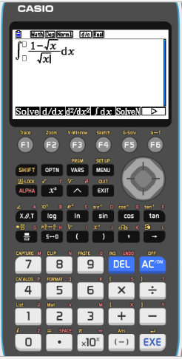
Fundamental theorem of calculus
$$\int_{1}^{4}{\left(\frac{1−\sqrt{x}}{\sqrt{x}}\right)dx}$$
Use a GDC to evaluate the definite integral
Turn on the GDC
1
Run-Matrix
OPTN
F4
CALC
F4
∫dx

Type
1- $\sqrt{x}$

$$\sqrt{x}$$



1

4

Slide 16
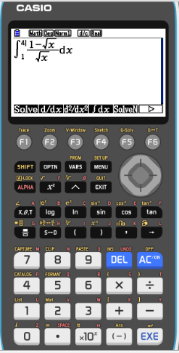
Fundamental theorem of calculus
$$\int_{1}^{4}{\left(\frac{1−\sqrt{x}}{\sqrt{x}}\right)dx}$$
Use a GDC to evaluate the definite integral
Turn on the GDC
1
Run-Matrix
OPTN
F4
CALC
F4
∫dx
Type
1- $\sqrt{x}$

$$\sqrt{x}$$



1

4
EXE

Slide 17
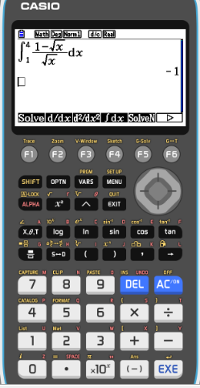
Fundamental theorem of calculus
$$\int_{1}^{4}{\left(\frac{1−\sqrt{x}}{\sqrt{x}}\right)dx}$$
Use a GDC to evaluate the definite integral
Turn on the GDC
1
Run-Matrix
OPTN
F4
CALC
F4
∫dx
Type
1- $\sqrt{x}$

$$\sqrt{x}$$



1

4
EXE
$$\int_{1}^{4}{\left(\frac{1−\sqrt{x}}{\sqrt{x}}\right)dx}$$
= –1

Slide 18
Thank you for using resources from
For more resources visit our website
https://www.mathssupport.org
If you have a special request, drop us an email
info@mathssupport.org

