Slide 1
Equations of Tangent and normal lines
LO: Find the equation of the tangent at a point.
Find the equation of the normal line at a point.

Slide 2
Tangents and normals
Remember, the tangent to a curve at any point P is a straight line that just touches the curve at that point P with gradient equal to the gradient of the curve at P.
tangent
y
f(x)
P
x
normal
Here is a curve y = f(x),
Here is the point P on the curve
This is the tangent to the curve at P
The normal to a curve at a point is a straight line that passes through P and is perpendicular to the tangent at that point.

Slide 3
Tangents and normals
Remember, the tangent to a curve at any point P is a straight line that just touches the curve at that point P with gradient equal to the gradient of the curve at P.
tangent
y
f(x)
P
(a, b)
x
normal
The tangent and the curve are closely related because, at P
The x-coordinate of the tangent is equal to the x-coordinate of the curve
The y-coordinate of the tangent is equal to the y-coordinate of the curve
The gradient of the tangent is equal to the gradient of the curve.
You can use differentiation to find the equation of the tangent to any curve at a point P(a, b), provided that you know both the equation of the curve and the x-coordinate, a, of the point P.

Slide 4
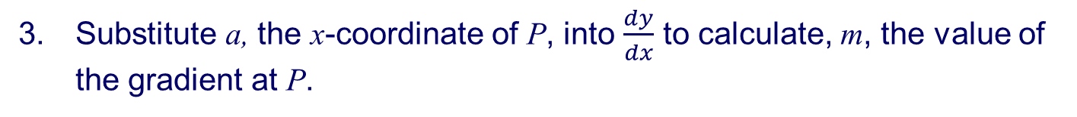
tangent
y
f(x)
P
(a, b)
x
normal
To find the equation of the tangent to the curve at P(a, b):
Calculate b, the y-coordinate of P, using the equation of the curve.
Find the gradient function $\frac{dy}{dx}$.
Substitute a, the x-coordinate of P, into $\frac{dy}{dx}$ to calculate, m, the value of the gradient at P.
Use the equation of a straight line (y – b) = m(x – a).

Slide 5
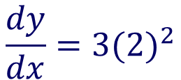
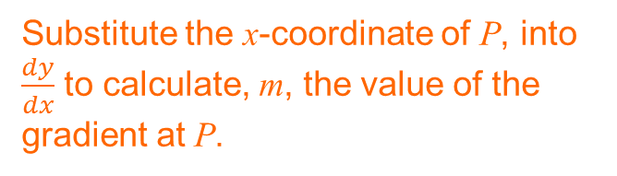
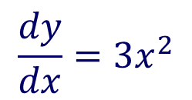

Tangents and normals
Point P has an x-coordinate 2. Find the equation of the tangent to the curve f(x) = x³ – 3 at the point P.
Give your answer in the form y = mx + c
Example 1
P(2, b)
P(2, 5)
Calculate b, the y-coordinate of P, using the equation of the curve.
y = x³ – 3
At x = 2
y = 2³ – 3
y = 5
$$\frac{dy}{dx}=3x^{2}$$
Find the gradient function $\frac{dy}{dx}$
Substitute the x-coordinate of P, into $\frac{dy}{dx}$ to calculate, m, the value of the gradient at P.
$$\frac{dy}{dx}={3(2)}^{2}$$
= 12
Use the equation of a straight line (y – b) = m(x – a).
y – 5 = 12(x – 2)
y – 5 = 12x – 24
Equation of the tangent
y = 12x – 19

Slide 6
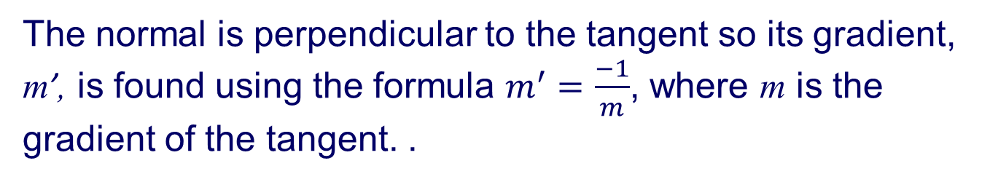
tangent
y
f(x)
P
(a, b)
x
normal
To find the equation of the normal to a curve at a given point P(a, b), you need to do one extra step.
The normal is perpendicular to the tangent so its gradient, m’, is found using the formula $m^{′}=\frac{−1}{m}$, where m is the gradient of the tangent. .

Slide 7
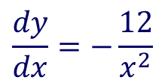
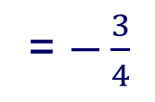

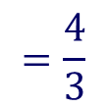
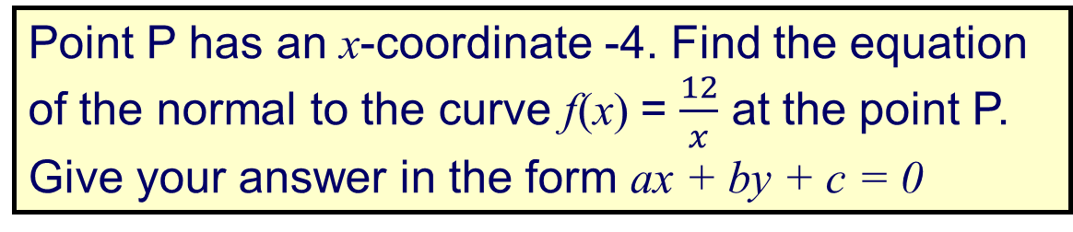
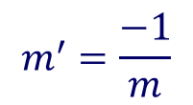
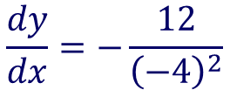
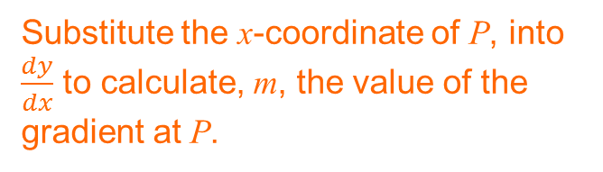
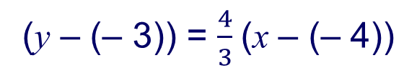
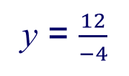
Tangents and normals
Point P has an x-coordinate -4. Find the equation of the normal to the curve f(x) = $\frac{12}{x}$ at the point P.
Give your answer in the form ax + by + c = 0
Example 2
P(-4, b)
P(-4, -3)
Calculate b, the y-coordinate of P, using the equation of the curve.
y = 12x⁻¹
At x = – 4
y = $\frac{12}{−4}$
y = – 3
Find the gradient function $\frac{dy}{dx}$
$$\frac{dy}{dx}=−\frac{12}{x^{2}}$$
Substitute the x-coordinate of P, into $\frac{dy}{dx}$ to calculate, m, the value of the gradient at P.
$$\frac{dy}{dx}=−\frac{12}{{\left(−4\right)}^{2}}$$
= $−\frac{3}{4}$
Gradient of the tangent, m.
$$m^{′}=\frac{−1}{m}$$
$$=\frac{4}{3}$$
Gradient of the normal
Use the equation of a straight line (y – b) = m(x – a).
(y – (– 3)) = $\frac{4}{3}$(x – (– 4))
3(y + 3) = 4(x + 4)
3y + 9 = 4x + 16
Equation of the normal
4x – 3y + 7 = 0

Slide 8
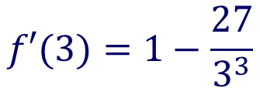
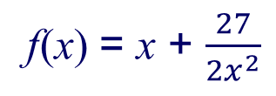
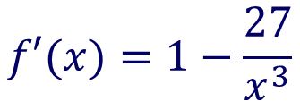
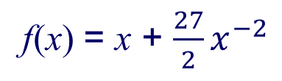
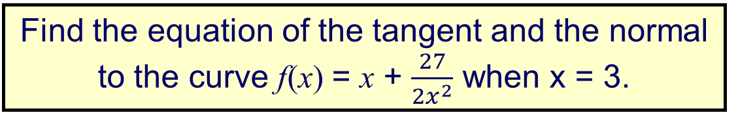
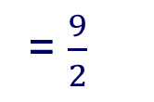
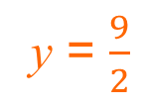
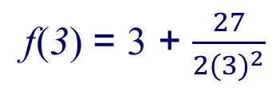
Tangents and normals
Find the equation of the tangent and the normal to the curve f(x) = x + $\frac{27}{2x^{2}}$ when x = 3.
Example 3
Rewrite the function using negative exponent
f(x) = x + $\frac{27}{2x^{2}}$
⇒
f(x) = x + $\frac{27}{2}x^{−2}$
Find the derivative of f
$$f′(x)=1−\frac{27}{x^{3}}$$
Evaluate f’ when x = 3
$$f′(3)=1−\frac{27}{3^{3}}$$
= 0
= m_{tangent}
Since the gradient is 0, the tangent line is horizontal, so the normal line must be vertical, passing through the point (3, b)
The equation of the normal line is therefore:
x = 3
The equation of the tangent line is y = b
f(3) = 3 + $\frac{27}{2{(3)}^{2}}$
= $\frac{9}{2}$
To find b, evaluate f when x = 3
y = $\frac{9}{2}$
Equation of the tangent

Slide 9

Thank you for using resources from
For more resources visit our website
https://www.mathssupport.org
If you have a special request, drop us an email
info@mathssupport.org

