Slide 1
Gradient of the tangent line and the derivative
LO: Interpret the derivative as the gradient function.

Slide 2
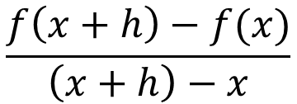
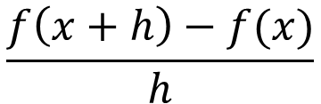
Gradient of the secant line
Consider the graph y = f(x)
We draw a secant line AB.
The gradient of secant line AB is:
y=f(x)
f(x+h)
B(x + h, f(x + h))
$$\frac{f\left(x+h\right)−f(x)}{\left(x+h\right)−x}$$
Simplifying:
f(x)
A(x, f(x))
h
$$\frac{f\left(x+h\right)−f(x)}{h}$$
x
x+h
This expression is known as the difference quotient
Notes:
This result tells us that the gradient of any point on the curve y = x² is 2 times the x-coordinate.

Slide 3
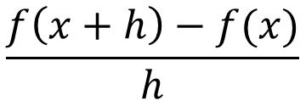
Gradient of the secant line
Consider the graph y = f(x)
The gradient of secant line AB is:
$$\frac{f\left(x+h\right)−f(x)}{h}$$
f(x+h)
Suppose that the point B slides down the curve and approaches point A:
B(x + h, f(x + h))
f(x+h)
B(x + h, f(x + h))
The secant line AB will get closer to the tangent line at the point A:
f(x)
A(x, f(x))
h
As B gets closer to A, h becomes smaller.
x
x+h
x+h
Notes:
This result tells us that the gradient of any point on the curve y = x² is 2 times the x-coordinate.

Slide 4
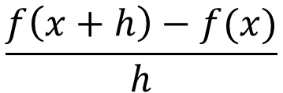

Gradient of the tangent line
Consider the graph y = f(x)
As B gets closer to A, h gets closer to 0.
We can take the limit as h approaches to 0 of the gradient of the secant line to get the gradient of the tangent line
f(x+h)
B(x + h, f(x + h))
$$\lim_{h→0}{}$$
$$\frac{f\left(x+h\right)−f(x)}{h}$$
f(x+h)
B(x + h, f(x + h))
f(x)
A(x, f(x))
This is not a constant. It is a function that gives the gradient of f at x
h
x
x+h
x+h
Notes:
This result tells us that the gradient of any point on the curve y = x² is 2 times the x-coordinate.

Slide 5

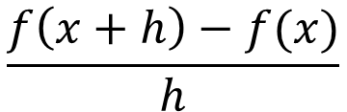
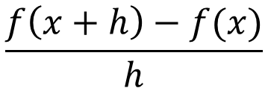

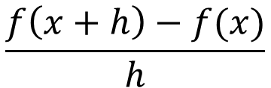


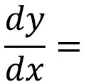
Gradient of the tangent line
$$\lim_{h→0}{}$$
$$\frac{f\left(x+h\right)−f(x)}{h}$$
The function defined by:
Is known as the derivative of f.
The derivative is defined by:
$$\lim_{h→0}{}$$
$$\frac{f\left(x+h\right)−f(x)}{h}$$
f '(x) =
f '(x) is read as the derivative of f, or f prime of x
f(x+h)
B(x + h, f(x + h))
f(x)
A(x, f(x))
Or is defined by:
h
x
x+h
$$\frac{dy}{dx}=$$
$$\lim_{h→0}{}$$
$$\frac{f\left(x+h\right)−f(x)}{h}$$
$$\frac{dy}{dx}$$
is read as the derivative of y with respect to x or dy dx
Notes:
This result tells us that the gradient of any point on the curve y = x² is 2 times the x-coordinate.

Slide 6
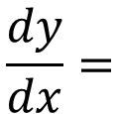



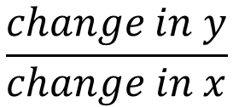

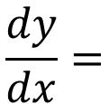

Gradient of the tangent line
$$\frac{dy}{dx}=$$
$$\frac{f\left(x+h\right)−f(x)}{h}$$
The derivative is defined by:
$$\lim_{h→0}{}$$
Remember that gradient is
$$\frac{change in y}{change in x}$$
Can be expressed as:
$$\frac{∆y}{∆x}$$
f(x+h)
B(x + h, f(x + h))
$$∆y$$
f(x)
A(x, f(x))
$$\frac{∆y}{∆x}$$
$$\frac{dy}{dx}=$$
$$\lim_{∆x→0}{}$$
$$∆x$$
x
x+h
Notes:
This result tells us that the gradient of any point on the curve y = x² is 2 times the x-coordinate.

Slide 7
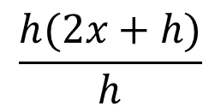

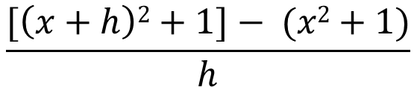
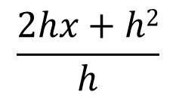


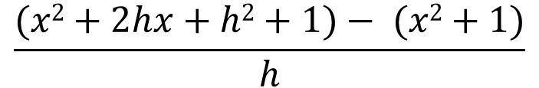







Gradient of the tangent line
$$\lim_{h→0}{}$$
$$\frac{f\left(x+h\right)−f(x)}{h}$$
$$f′(x)=$$
Example 1
Find the derivative of f(x) = x² + 1, and hence find the gradient of the tangent line when x = 3
Solution:
$$\frac{[\left(x+h\right)2+1]− (x2+1)}{h}$$
$$f′(x)=$$
$$\lim_{h→0}{}$$
Expanding (x + h)²
=
$$\lim_{h→0}{}$$
$$\frac{(x2+2hx+h2+1)− (x2+1)}{h}$$
$$\lim_{h→0}{}$$
$$\frac{2hx+h2}{h}$$
Simplifying like terms
=
Factorising
$$\frac{h(2x+h)}{h}$$
=
$$\lim_{h→0}{}$$
= 2x + h
= 2x + 0
Simplifying
The gradient function is:
$$f′(x)=$$
2x
So, the gradient of the tangent line when x = 3 is 6
= 6
Evaluating for x = 3
$$f′(3)=$$
2(3)
Notes:
This result tells us that the gradient of any point on the curve y = x² is 2 times the x-coordinate.

Slide 8
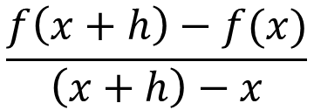
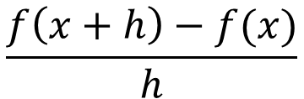
The derivative of f(x) = x^{n}
Using the definition of derivative, find the derivative of f(x) = x²
Solution:
$$\frac{f\left(x+h\right)−f(x)}{h}$$
$$f′(x)=$$
$$\lim_{h→0}{}$$
$$f′(x)=$$
$$\lim_{h→0}{}$$
$$\frac{[\left(x+h\right)2]− (x2)}{h}$$
Expanding (x + h)²
=
$$\lim_{h→0}{}$$
$$\frac{(x2+2hx+h2)− (x2)}{h}$$
$$\lim_{h→0}{}$$
$$\frac{2hx+h2}{h}$$
=
Simplifying like terms
Factorising
$$\frac{h(2x+h)}{h}$$
=
$$\lim_{h→0}{}$$
= 2x + h
= 2x + 0
Simplifying
f(x) = x²
$$f′(x)=$$
2x
The gradient function of is:
Notes:
This result tells us that the gradient of any point on the curve y = x² is 2 times the x-coordinate.

Slide 9
The derivative of f(x) = x^{n}
Using the definition of derivative, find the derivative of f(x) = x³
Solution:
$$\frac{f\left(x+h\right)−f(x)}{h}$$
$$f′(x)=$$
$$\lim_{h→0}{}$$
$$f′(x)=$$
$$\lim_{h→0}{}$$
$$\frac{[\left(x+h\right)3]− (x3)}{h}$$
Expanding (x + h)³
=
$$\lim_{h→0}{}$$
$$\frac{(x3+3x^{2}h+3xh^{2}+h3)− (x3)}{h}$$
$$\lim_{h→0}{}$$
$$\frac{3x^{2}h+3xh^{2}+h3}{h}$$
=
Simplifying like terms
0
0
Factorising
$$\frac{h(3x^{2}+3xh+h2)}{h}$$
=
$$\lim_{h→0}{}$$
Simplifying
f(x) = x³
$$f′(x)=$$
3x²
The gradient function of is:
Notes:
This result tells us that the gradient of any point on the curve y = x² is 2 times the x-coordinate.

Slide 10
The derivative of f(x) = x^{n}
Using the definition of derivative, find the derivative of f(x) = x⁴
Solution:
$$\frac{f\left(x+h\right)−f(x)}{h}$$
$$f′(x)=$$
$$\lim_{h→0}{}$$
$$f′(x)=$$
$$\lim_{h→0}{}$$
$$\frac{[\left(x+h\right)4]− (x4)}{h}$$
Expanding (x + h)³
=
$$\lim_{h→0}{}$$
$$\frac{(x4+4x^{3}h+6x^{2}h^{2}+4xh^{3}+h4)− (x4)}{h}$$
$$\lim_{h→0}{}$$
$$\frac{4x^{3}h+6x^{2}h^{2}+4xh^{3}+h4}{h}$$
=
Simplifying like terms
0
0
0
Factorising
$$\frac{h(4x^{3}+6x^{2}h+4xh^{2}+h3)}{h}$$
=
$$\lim_{h→0}{}$$
Simplifying
f(x) = x⁴
$$f′(x)=$$
4x³
The gradient function of is:
Notes:
This result tells us that the gradient of any point on the curve y = x² is 2 times the x-coordinate.

Slide 11

Thank you for using resources from
For more resources visit our website
https://www.mathssupport.org
If you have a special request, drop us an email
info@mathssupport.org

