Slide 1
The binomial distribution
LO: To know the properties of the binomial distribution.
To solve problems involving binomial distribution.

Slide 2
Binomial experiment.
DEFINITION OF BINOMIAL EXPERIMENT.
A binomial experiment is an experiment in which there are two outcomes.
EXAMPLE: We roll a die.
There are 6 possible results ( outcomes ): 1, 2, 3, 4, 5 or 6.
However, if we are interested in getting a 6, we could say the trial has only 2 outcomes: a 6 or not a 6. Now it is a Binomial experiment
Lots of experiments can be thought of as having 2 outcomes.
e.g. A seed is sown and the flower is either yellow or not yellow.
e.g. A computer chip is taken off a production line and it either works or it doesn’t.

Slide 3
Binomial experiment.
The 2 possible outcomes of these experiments are called success and failure. We will label the probability of success as p and failure as q.
What can you say about p + q ?
p + q = 1 since no other outcomes are possible.
Suppose that we repeat a trial several times and the probability of success doesn’t change from one trial to the next.
Suppose also that each result has no effect on the result of the other trials.
The trials are independent.
With these conditions all satisfied, we can use the binomial model to estimate the probability of success and to estimate the mean.

Slide 4
Binomial experiment.
The Binomial distribution can be used to model a situation if all of the following conditions are met:
Each trial has only two possible outcomes, success and failure.
The trial is repeated n times.
The probability of success in one trial is p and p is constant from trial to trial.
The trials are independent of each other.
The binomial distribution describes the behavior of a discrete variable X if the conditions above apply
The parameters that define a unique binomial distribution are the values of n and p. Any binomial distribution is represented as X ~ B(n, p)

Slide 5
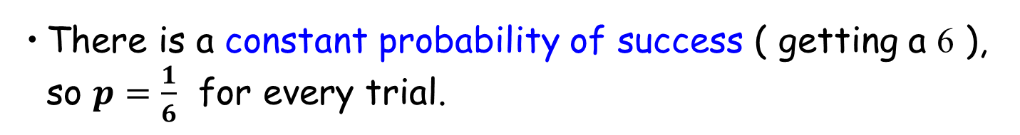
Binomial experiment.
EXAMPLE.
We roll a fair die 4 times and we count the number of sixes.
Determine if the experiment satisfies the conditions to be considered binomial.
There are 4 trials
There are 2 outcomes to each trial. ( Success is getting a 6 and failure is not getting a 6 ).
There is a constant probability of success ( getting a 6 ), so $p=\frac{1}{6}$ for every trial.
The trials are independent.
This experiment satisfies the conditions for the binomial model.

Slide 6
Setting up a Binomial Distribution
A probability distribution gives the probabilities for all possible values of a variable.
We are now going to find these probabilities using an example. It will result in a formula to calculate this probability and is very easy to use.
Consider the experiment of rolling the die 5 times.
Suppose we need to find the probability of getting 3 sixes.

Slide 7
Find the probability of getting three sixes.
We need to do two things:
Find the probability of getting 6, 6, 6, 6’, 6’ (in that order ) where 6’ is “not a six” and
Find the number of ways of getting 3 sixes (in any order ).
We know the probability of getting a 6 if we roll the die once is given by
If we roll the die again the outcome is independent of the 1st outcome, so we can use the formula
if A and B are independent
giving

Slide 8
Find the probability of getting three sixes.
Then, P(6, 6, 6) =
Now we have the probability of 3 sixes, we want the last 2 rolls to give anything except a six.
The probability of not getting a six is given by:
So,
And finally,

Slide 9
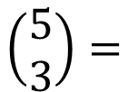
Find the probability of getting three sixes.
So,
Now we need
the number of ways of getting 3 sixes.
6 6 6 6’ 6’
6 6 6’ 6 6’
6 6 6’ 6’ 6
6 6’ 6 6 6’
6 6’ 6 6’ 6
6 6’ 6’ 6 6
6’ 6 6 6 6’
6’ 6 6 6’ 6
6’ 6 6’ 6 6
6’ 6’ 6 6 6
Fortunately we don’t have to do this all the time!
If we think of it as choosing the 3 positions for the sixes after rolling the dice 5 times, we realise that we have
$$\left(\begin{matrix}5 \\ 3\end{matrix}\right)=$$
10

Slide 10
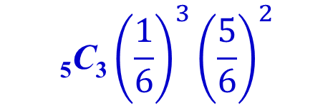
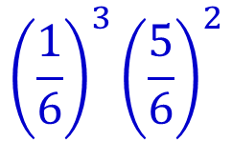
Find the probability of getting three sixes.
We now have that after rolling the dice 5 times
the probability of getting 6, 6, 6, 6’, 6’ ( in any order ) is
$${\left(\frac{1}{6}\right)}^{3}{\left(\frac{5}{6}\right)}^{2}$$
the number of ways of getting 3 sixes in any order is
₅C₃
So the probability of 3 sixes ( in any order ) is
$$\text{5}\text{C}\text{3}{\left(\frac{1}{6}\right)}^{3}{\left(\frac{5}{6}\right)}^{2}$$

Slide 11
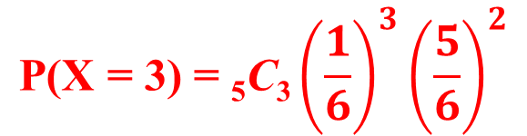
Find the probability of getting three sixes.
If X is the random variable “the number of sixes when a die is rolled 5 times” then X has a binomial distribution and
$$\text{P}\text{(}\text{X}\text{ = 3) = }\text{5}\text{C}\text{3}{\left(\frac{1}{6}\right)}^{3}{\left(\frac{5}{6}\right)}^{2}$$
Tip: For any binomial probability, these numbers . . .
are equal

Slide 12
Find the probability of getting three sixes.
If X is the random variable “the number of sixes when a die is rolled 5 times” then X has a binomial distribution and
$$\text{P}\text{(}\text{X}\text{ = 3) = }\text{5}\text{C}\text{3}{\left(\frac{1}{6}\right)}^{3}{\left(\frac{5}{6}\right)}^{2}$$
and this . . .
is the sum of these

Slide 13
Find the probability of getting three sixes.
We can simplify the expression using a calculator:
( 4 d.p. )
We can find the probabilities of getting 0, 1, 2, 4 and 5 sixes in the same way.
Tip: It saves some fiddling on the calculator if you remember that
Can you find the probabilities that X = 2 and X = 4 and X = 5 ?
( Give the answers correct to 4 d.p. )
It’s useful to remember that

Slide 14
The probabilities are:
Since the sum of the probabilities is 1, I added the others and subtracted from 1.
P(X = 5)
= 0.000128
= 0.0001
The probability correct to 4 d.p.

Slide 15
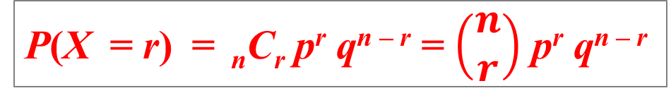
Binomial distribution function.
In general, if X is a random variable binomially distributed, then we write
where n is the number of trials and
p is the probability of success in one trial.
The probability of obtaining r successes out of n independent trials, when p is the probability of success for each trial, is
P(X = r) = _{n}C_{r} p^{r} q^{n – r} = $\left(\begin{matrix}n \\ r\end{matrix}\right)$ p^{r} q^{n – r}
where q = 1 − p
(The Binomial distribution is just a special case of a discrete probability distribution)

Slide 16
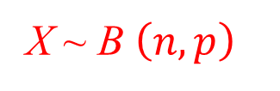
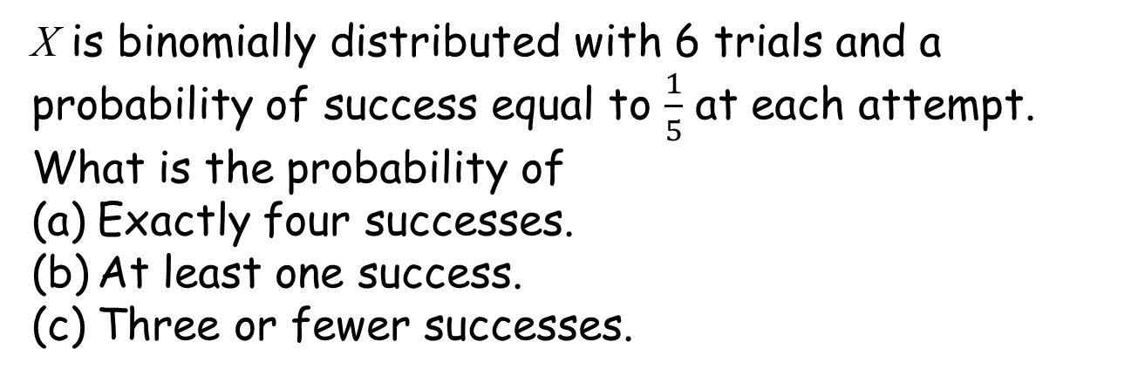
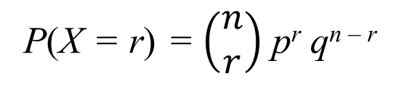
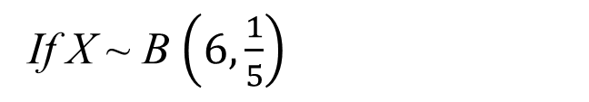
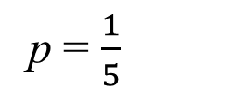
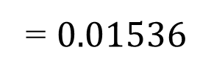
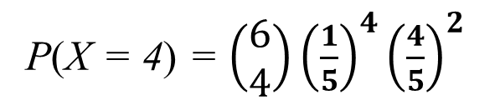
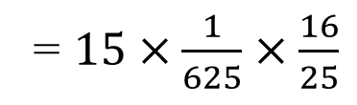
Binomial distribution problems.
Example 1
X is binomially distributed with 6 trials and a probability of success equal to $\frac{1}{5}$ at each attempt. What is the probability of
Exactly four successes.
At least one success.
Three or fewer successes.
Solution:
Using this notation
X ~ B $\left(n,p\right)$
n = 6
You can rewrite the question as
If X ~ B $\left(6,\frac{1}{5}\right)$
p = $\frac{1}{5}$
(a) P(X = 4)
Using this formula
P(X = r) = $\left(\begin{matrix}n \\ r\end{matrix}\right)$ p^{r} q^{n – r}
r = 4
P(X = 4) = $\left(\begin{matrix}6 \\ 4\end{matrix}\right){\left(\frac{1}{5}\right)}^{4}{\left(\frac{4}{5}\right)}^{2}$
= $15×\frac{1}{625}×\frac{16}{25}$
= $0.01536$

Slide 17

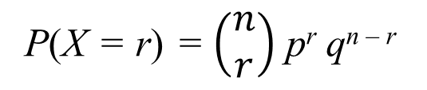
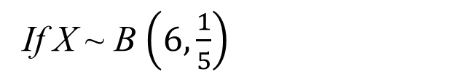
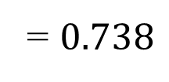
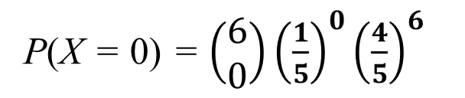
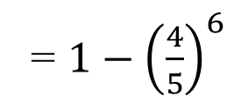
Binomial distribution problems.
Example 1
X is binomially distributed with 6 trials and a probability of success equal to $\frac{1}{5}$ at each attempt. What is the probability of
Exactly four successes.
At least one success.
Three or fewer successes.
Solution:
Using this notation
X ~ B $\left(n,p\right)$
You can rewrite the question as
n = 6
If X ~ B $\left(6,\frac{1}{5}\right)$
p = $\frac{1}{5}$
P(X = r) = $\left(\begin{matrix}n \\ r\end{matrix}\right)$ p^{r} q^{n – r}
(b) P(X ≥ 1)
r = 0
It is quicker to calculate 1 – P(X = 0)
P(X = 0) = $\left(\begin{matrix}6 \\ 0\end{matrix}\right){\left(\frac{1}{5}\right)}^{0}{\left(\frac{4}{5}\right)}^{6}$
= $1−{\left(\frac{4}{5}\right)}^{6}$
= $0.738$

Slide 18

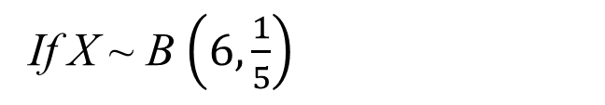
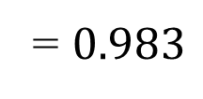
Binomial distribution problems.
Example 1
X is binomially distributed with 6 trials and a probability of success equal to $\frac{1}{5}$ at each attempt. What is the probability of
Exactly four successes.
At least one success.
Three or fewer successes.
Solution:
Using this notation
X ~ B $\left(n,p\right)$
n = 6
You can rewrite the question as
If X ~ B $\left(6,\frac{1}{5}\right)$
p = $\frac{1}{5}$
(c) P(X ≤ 3) =
P(X = 0) + P(X = 1) + P(X = 2) + P(X = 3)
P(X ≤ 3) = $\left(\begin{matrix}6 \\ 0\end{matrix}\right){\left(\frac{1}{5}\right)}^{0}{\left(\frac{4}{5}\right)}^{6}$+ $\left(\begin{matrix}6 \\ 1\end{matrix}\right){\left(\frac{1}{5}\right)}^{1}{\left(\frac{4}{5}\right)}^{5}$+ $\left(\begin{matrix}6 \\ 2\end{matrix}\right){\left(\frac{1}{5}\right)}^{2}{\left(\frac{4}{5}\right)}^{4}$ + $\left(\begin{matrix}6 \\ 3\end{matrix}\right){\left(\frac{1}{5}\right)}^{3}{\left(\frac{4}{5}\right)}^{3}$
= ${\left(\frac{4}{5}\right)}^{6}\text{+}\text{6}×{\left(\frac{1}{5}\right)}^{1}×{\left(\frac{4}{5}\right)}^{5}{\text{+}15×\left(\frac{1}{5}\right)}^{2}×{\left(\frac{4}{5}\right)}^{4}{\text{+}2\text{0}×\left(\frac{1}{5}\right)}^{3}×{\left(\frac{4}{5}\right)}^{3}$
= $0.983$

Slide 19
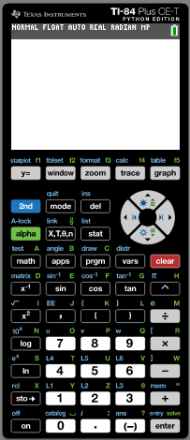

Using GDC for Binomial distribution problems.
Example 2
X is a discrete random variable and X ~ B(20, 0.45) Calculate the probability that
(a) X is less than or equal to 10.
(b) X lies between 5 and 10 inclusive.
(c) X is greater than 11.
Solution:
Using this notation
X ~ B $\left(n,p\right)$
= 0
Lower bound
Upper bound
= 10
Number of trials
= 20
Probability
= 0.45
Turn on the calculator
Click 2nd
distr

Slide 20
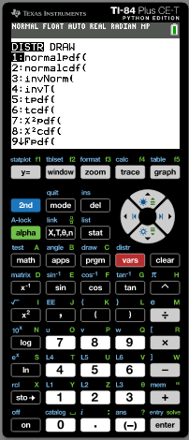
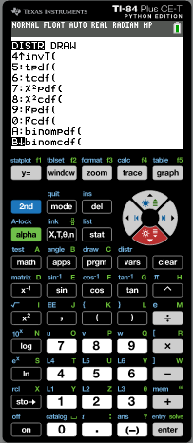
Using GDC for Binomial distribution problems.
Example 2
X is a discrete random variable and X ~ B(20, 0.45) Calculate the probability that
(a) X is less than or equal to 10.
(b) X lies between 5 and 10 inclusive.
(c) X is greater than 11.
Solution:
Using this notation
X ~ B $\left(n,p\right)$
Lower bound = 0
Upper bound = 10
Number of trials = 20
Probability = 0.45
Scroll to B↓binomcdf
enter

Slide 21
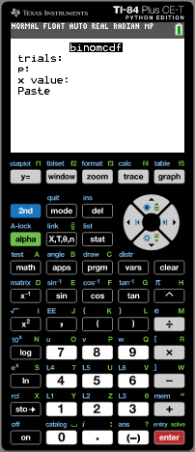
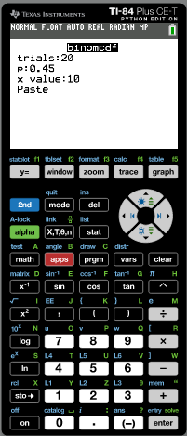
Using GDC for Binomial distribution problems.
Example 2
X is a discrete random variable and X ~ B(20, 0.45) Calculate the probability that
(a) X is less than or equal to 10.
(b) X lies between 5 and 10 inclusive.
(c) X is greater than 11.
Solution:
Using this notation
X ~ B $\left(n,p\right)$
Lower bound = 0
Trials = 20
Upper bound = 10
p = 0.45
Number of trials = 20
x value = 10
Probability = 0.45
enter
enter

Slide 22
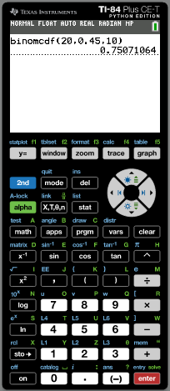
Using GDC for Binomial distribution problems.
Example 2
X is a discrete random variable and X ~ B(20, 0.45) Calculate the probability that
(a) X is less than or equal to 10.
(b) X lies between 5 and 10 inclusive.
(c) X is greater than 11.
Solution:
Using this notation
X ~ B $\left(n,p\right)$
P(X ≤ 10) ≈ 0.751
Rounded to 3sf

Slide 23
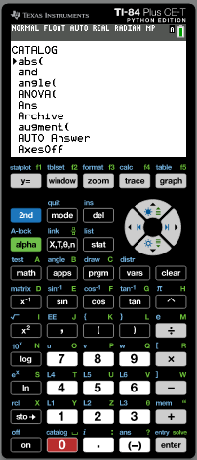
Using GDC for Binomial distribution problems.
Example 2
X is a discrete random variable and X ~ B(20, 0.45) Calculate the probability that
(a) X is less than or equal to 10.
(b) X lies between 5 and 10 inclusive.
(c) X is greater than 11.
Solution:
Using this notation
X ~ B $\left(n,p\right)$
We need the sum of these probabilities
P(5) + P(6) + P(7) + P(8) + P(9) + P(10)
Click 2nd
catalog
Scroll to sum

Slide 24
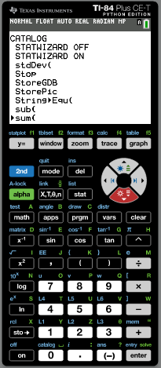
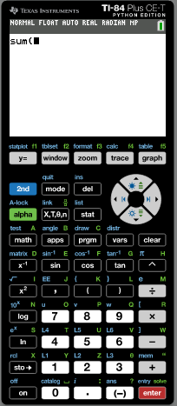

Using GDC for Binomial distribution problems.
Example 2
X is a discrete random variable and X ~ B(20, 0.45) Calculate the probability that
(a) X is less than or equal to 10.
(b) X lies between 5 and 10 inclusive.
(c) X is greater than 11.
Solution:
Using this notation
X ~ B $\left(n,p\right)$
We need the sum of these probabilities
P(5) + P(6) + P(7) + P(8) + P(9) + P(10)
Click 2nd
catalog
Scroll to sum
enter
Click 2nd
distr

Slide 25
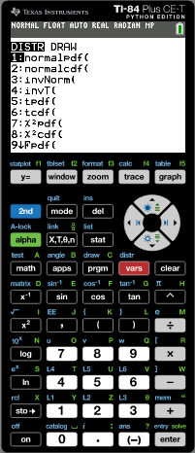
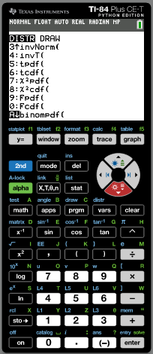
Using GDC for Binomial distribution problems.
Example 2
X is a discrete random variable and X ~ B(20, 0.45) Calculate the probability that
(a) X is less than or equal to 10.
(b) X lies between 5 and 10 inclusive.
(c) X is greater than 11.
Solution:
Using this notation
X ~ B $\left(n,p\right)$
We need the sum of these probabilities
P(5) + P(6) + P(7) + P(8) + P(9) + P(10)
Click 2nd
catalog
Scroll to sum
enter
Click 2nd
distr
Scroll to A↓binompdf
enter

Slide 26

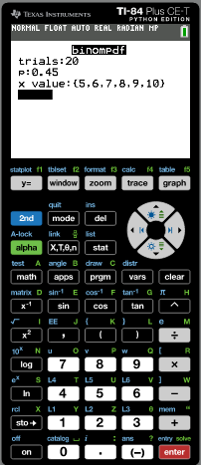
Using GDC for Binomial distribution problems.
Example 2
X is a discrete random variable and X ~ B(20, 0.45) Calculate the probability that
(a) X is less than or equal to 10.
(b) X lies between 5 and 10 inclusive.
(c) X is greater than 11.
Solution:
Using this notation
X ~ B $\left(n,p\right)$
We need the sum of these probabilities
P(5) + P(6) + P(7) + P(8) + P(9) + P(10)
Type in the following:
Trials:
20
p:
0.45
x value:
{5, 6, 7, 8, 9, 10}
enter
enter

Slide 27
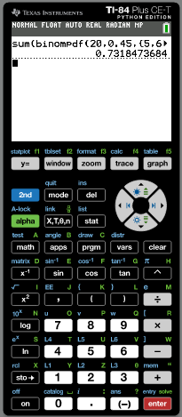
Using GDC for Binomial distribution problems.
Example 2
X is a discrete random variable and X ~ B(20, 0.45) Calculate the probability that
(a) X is less than or equal to 10.
(b) X lies between 5 and 10 inclusive.
(c) X is greater than 11.
Solution:
Using this notation
X ~ B $\left(n,p\right)$
P(5 ≤ X ≤ 10) ≈ 0.732
Rounded to 3sf

Slide 28
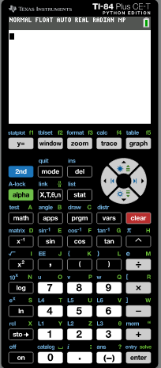
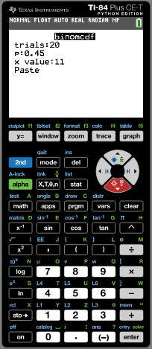
Using GDC for Binomial distribution problems.
Example 2
X is a discrete random variable and X ~ B(20, 0.45) Calculate the probability that
(a) X is less than or equal to 10.
(b) X lies between 5 and 10 inclusive.
(c) X is greater than 11.
Solution:
Using this notation
X ~ B $\left(n,p\right)$
We are going to calculate 1 – P(x ≤ 11)
Click clear
Type 1 -
Click 2nd
distr
Scroll to B↓binomcdf
enter
Type this values
Trials = 20
p = 0.45
x value = 11
enter
enter

Slide 29
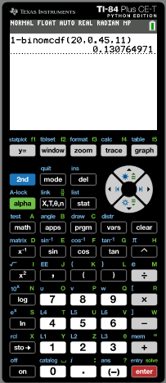
Using GDC for Binomial distribution problems.
Example 2
X is a discrete random variable and X ~ B(20, 0.45) Calculate the probability that
(a) X is less than or equal to 10.
(b) X lies between 5 and 10 inclusive.
(c) X is greater than 11.
Solution:
Using this notation
X ~ B $\left(n,p\right)$
P(X ≥ 11) ≈ 0.131
Rounded to 3sf

Slide 30

Thank you for using resources from
For more resources visit our website
https://www.mathssupport.org
If you have a special request, drop us an email
info@mathssupport.org

