Slide 1
Equation of the regression line.
LO: How to calculate a least squares regression line using the formula and the GDC.

Slide 2
The least squares regression line
Before you have learned that a line of best fit is drawn to describe correlation which was a bit of a guessing game a bit hit and miss.
But now you will learn a slightly more accurate method ‘the method of least squares’ to calculate the line of regression.
Linear Least Square Regression is a method of fitting an affine line to a set of data points.

Slide 3

We construct the scatter diagram to illustrate the data,
Find the mean point
Mean Point (8.6, 79.6)
Size
5
12
7
10
10
9
8
11
6
8
Mass
65
97
68
92
78
78
76
88
74
80
And draw the line of best fit.
100
95
Inaccuracies occur because we only have one point to draw the line through and the line of best fit is then drawn ‘by eye’ .
90
85
80
Mass (kg)
75
70
65
There is another way to improve our line, involving residuals
60
4
5
6
7
8
9
10
11
12
13
Shoe Size

Slide 4
Residuals
A residual is the vertical distance between observed y-value and the predicted y-value using the line of regression.
Residuals are shown by a vertical line from the line of regression.
y
Positive Residual
If the point is above the graph
Zero Residual
Actual data point
If the graph pass through the data point
(x_{i}, y_{i})
Negative Residual
Residual
If the point is below the graph
y_{i} - y_{p}
Predicted data point
(x_{p}, y_{p})
x

Slide 5
The equation of the Regression line of y on x
The least squares regression line is the one that has the smallest possible value for the sum of the squares of the residuals.
In the diagram we aim to make
a² + b² + c² + d² + e² + f² + g² + h² + i² + j² + k² + l².
As close to zero as possible
y
f
l
e
k
d
j
c
i
b
h
a
g
x

Slide 6
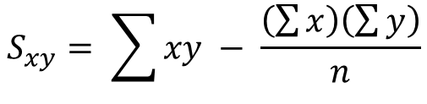


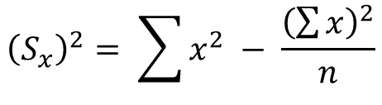
The equation of the Regression line of y on x
The derivation of the formula for the Linear Least Square Regression Line is a classic optimization problem, but its derivation is not part of this course.
A rather complicated formula emerges:
The formula for finding the gradient (m) of the regression line is:
$$m= \frac{S_{xy}}{{\left(S_{x}\right)}^{2}}$$
, where
$$S_{xy}= \sum{xy} − \frac{\left(\sum{x}\right)\left(\sum{y}\right)}{n}$$
$${\left(S_{x}\right)}^{2}= \sum{x^{2} − \frac{{\left(\sum{x}\right)}^{2}}{n}}$$
The equation of the regression line is:
$y − \overline{y}= \frac{S_{xy}}{{\left(S_{x}\right)}^{2}}\left(x − \overline{x}\right)$

Slide 7


Use the least square regression formula to find the equation of the regression line
$y − \overline{y}= \frac{S_{xy}}{{\left(S_{x}\right)}^{2}}\left(x − \overline{x}\right)$
Size
5
12
7
10
10
9
8
11
6
8
Mass
65
97
68
92
78
78
76
88
74
80
We need to find $\overline{x}$, $\overline{y}$, Σxy and Σx²
x | y | xy | x²
100
5
65
25
325
95
12
97
1164
144
90
7
68
476
49
85
10
92
100
920
80
10
78
780
100
Mass (kg)
75
9
78
702
81
70
8
76
608
64
65
11
88
968
121
60
6
74
444
36
8
80
640
64
4
5
6
7
8
9
10
11
12
13
Shoe Size
86
796
7027
784

Slide 8
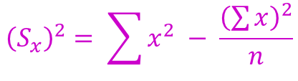


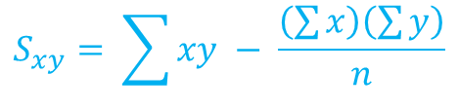


Use the least square regression formula to find the equation of the regression line
$y − \overline{y}= \frac{S_{xy}}{{\left(S_{x}\right)}^{2}}\left(x − \overline{x}\right)$
Size
5
12
7
10
10
9
8
11
6
8
Mass
65
97
68
92
78
78
76
88
74
80
We need to find Σxy and Σx²
Σx | Σy | Σxy | Σx²
100
86
796
7027
784
95
90
$$S_{xy}= \sum{xy} − \frac{\left(\sum{x}\right)\left(\sum{y}\right)}{n}$$
85
$$S_{xy}=7027 − \frac{\left(86\right)\left(796\right)}{10}$$
80
Mass (kg)
$$S_{xy}=181.4$$
75
70
$${\left(S_{x}\right)}^{2}= \sum{x^{2} − \frac{{\left(\sum{x}\right)}^{2}}{n}}$$
65
60
$${\left(S_{x}\right)}^{2}=784−\frac{7396}{10}$$
4
5
6
7
8
9
10
11
12
13
$${\left(S_{x}\right)}^{2}=44.4$$
Shoe Size

Slide 9










Use the least square regression formula to find the equation of the regression line
$y − \overline{y}= \frac{S_{xy}}{{\left(S_{x}\right)}^{2}}\left(x − \overline{x}\right)$
Size
5
12
7
10
10
9
8
11
6
8
Mass
65
97
68
92
78
78
76
88
74
80
We need to find Σxy and Σx²
Σx | Σy | Σxy | Σx²
100
86
796
7027
784
95
$$S_{xy}=181.4$$
$${\left(S_{x}\right)}^{2}=44.4$$
90
$y − \overline{y}= \frac{S_{xy}}{{\left(S_{x}\right)}^{2}}\left(x − \overline{x}\right)$
85
80
$$\overline{x}= \frac{86}{10}$$
$$\overline{y}= \frac{796}{10}$$
$$=8.6$$
$$=79.6$$
Mass (kg)
75
70
$y −79.6= \frac{181.4}{44.4}\left(x −8.6\right)$
65
$$y −79.6=4.09x −35.14$$
60
$$y=4.09x+44.5$$
4
5
6
7
8
9
10
11
12
13
Shoe Size
You should use your GDC to find the equation of the regression line in examinations

Slide 10
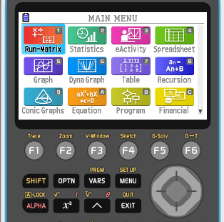
Use the least square regression formula to find the equation of the regression line
Size
5
12
7
10
10
9
8
11
6
8
Mass
65
97
68
92
78
78
76
88
74
80
We are going to use the GDC to find the equation of the regression line
100
95
Turn on the GDC
Press 2
Statistics
90
85
80
Mass (kg)
75
70
65
60
4
5
6
7
8
9
10
11
12
13
Shoe Size

Slide 11
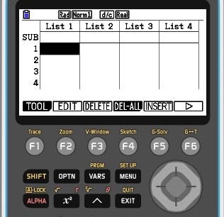
Use the least square regression formula to find the equation of the regression line
Size
5
12
7
10
10
9
8
11
6
8
Mass
65
97
68
92
78
78
76
88
74
80
We are going to use the GDC to find the equation of the regression line
100
Type the values of size in the list 1
95
Type the values of mass in the list 2
90
85
80
Mass (kg)
75
70
65
60
4
5
6
7
8
9
10
11
12
13
Shoe Size

Slide 12
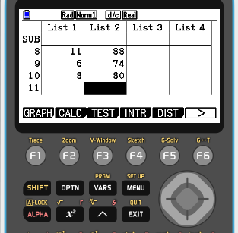
Use the least square regression formula to find the equation of the regression line
Size
5
12
7
10
10
9
8
11
6
8
Mass
65
97
68
92
78
78
76
88
74
80
We are going to use the GDC to find the equation of the regression line
100
95
F2
CALC
90
85
80
Mass (kg)
75
70
65
60
4
5
6
7
8
9
10
11
12
13
Shoe Size

Slide 13
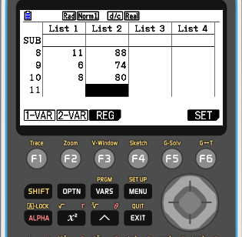
Use the least square regression formula to find the equation of the regression line
Size
5
12
7
10
10
9
8
11
6
8
Mass
65
97
68
92
78
78
76
88
74
80
We are going to use the GDC to find the equation of the regression line
100
95
F3
REG
90
85
80
Mass (kg)
75
70
65
60
4
5
6
7
8
9
10
11
12
13
Shoe Size

Slide 14
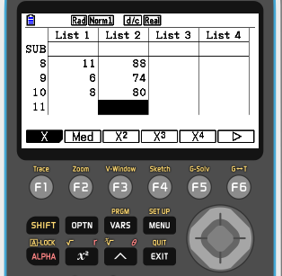
Use the least square regression formula to find the equation of the regression line
Size
5
12
7
10
10
9
8
11
6
8
Mass
65
97
68
92
78
78
76
88
74
80
We are going to use the GDC to find the equation of the regression line
100
95
F1
X
90
85
80
Mass (kg)
75
70
65
60
4
5
6
7
8
9
10
11
12
13
Shoe Size

Slide 15
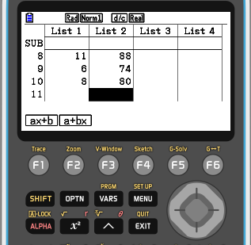
Use the least square regression formula to find the equation of the regression line
Size
5
12
7
10
10
9
8
11
6
8
Mass
65
97
68
92
78
78
76
88
74
80
We are going to use the GDC to find the equation of the regression line
100
95
F1
ax + b
90
85
80
Mass (kg)
75
70
65
60
4
5
6
7
8
9
10
11
12
13
Shoe Size

Slide 16
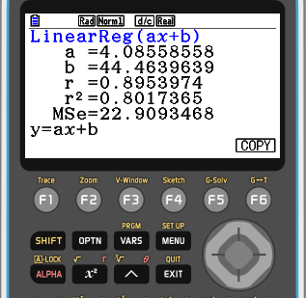

Use the least square regression formula to find the equation of the regression line
Size
5
12
7
10
10
9
8
11
6
8
Mass
65
97
68
92
78
78
76
88
74
80
We are going to use the GDC to find the equation of the regression line
100
y = ax + b
95
a = 4.09
$$y=4.09x+44.5$$
b = 44.5
90
85
80
Mass (kg)
75
70
65
60
4
5
6
7
8
9
10
11
12
13
Shoe Size

Slide 17
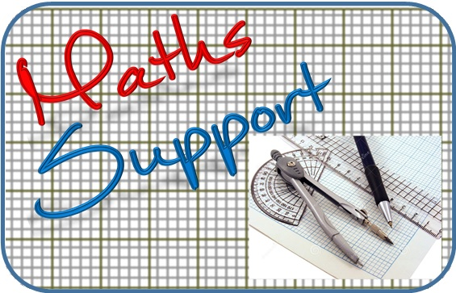
Thank you for using resources from
For more resources visit our website
https://www.mathssupport.org
If you have a special request, drop us an email
info@mathssupport.org

