Slide 1
Pearson product-moment correlation coefficient (r)
LO: Calculate the Pearson product-moment correlation coefficient using the formulae and using the GDC

Slide 2
Correlation.
Up to this point we have used the scatter diagram to see if there is a relationship between two variables.
We have stated that direction is important to determine the correlation.
We have seen that the strength is important when it comes to the correlation.

Slide 3
Direction
Negative Correlation:-
For a generally downward trend, we say that the correlation is negative.
When the independent variable increases, the dependent variable decreases
Positive Correlation:-
For a generally upward trend, we say that the correlation is positive.
An increase in the independent variable means that the dependant variable generally increases.
No correlation:-
For randomly scattered points, with no upward or downward trend, we say there is no correlation.
No apparent link between the variables.

Slide 4
Strength
The strength of correlation is usually described as either strong, moderate or weak
Strong positive
Moderate positive
Weak positive
Strong negative
Moderate negative
Weak negative

Slide 5
Correlation
We have found the equation of the regression line of y on x and used the line for prediction purposes
Now we are going to seek to classify the strength of the correlation numerically
There are several scales in use; we will study a correlation coefficient developed by Karl Pearson
The Pearson product-moment correlation coefficient denoted by r, is a measure of the correlation between two variables x and y, giving a value between -1 and +1 inclusive.
It is widely used in the sciences as a measure of the strength of linear dependence between two variables

Slide 6
Strength
The PMCC or regression coefficient is used to determine how nearly the points fall on a straight line, or how nearly linear they are.
A perfect correlation will have a regression coefficient of r = ± 1
If there is no correlation we will have a regression coefficient of r = 0
Perfect positive linear correlation
Perfect negative linear correlation
No correlation
r = 1
r = -1
r = 0

Slide 7
Strength
A quick way to interpret the r-value is
r-value | Correlation
0 < |r| < 0.5
Very weak
Very Weak
Weak
0.5 ≤ |r| < 0.7
Weak
0.7 ≤ |r| < 0.87
Moderate
0.87 ≤ |r| < 0.95
Strong
0.95 ≤ |r| < 1
Very Strong
|r| = 1
Perfect
Moderate
Strong

Slide 8
Calculating the Pearson’s correlation coefficient (r)
We use the following formulas:-
$$r=\frac{S_{xy}}{S_{x}S_{y}}$$
Notes:-
DON’T PANIC – the formulas are not that bad to use!
There are other versions of these formulas that you may see in books, but the ones here are the easiest to use.
x is the independent variable
y is the dependent variable
n is how many pairs of data you have.
$$S_{xy}=\sum{xy − \frac{\left(\sum{x}\right)\left(\sum{y}\right)}{n}}$$
$$S_{x}= \sqrt{\sum{x^{2}}− \frac{{\left(\sum{x}\right)}^{2}}{n}}$$
$$S_{y}=\sqrt{\sum{y^{2}}− \frac{{\left(\sum{y}\right)}^{2}}{n}}$$
Let us see how to use them in an example

Slide 9
Example. The cost, c, (in pence) of a number of paperback books with total number of pages, p, is recorded, as follows :-
No. of pages (x): 150 200 300 350 450
Cost (y): 500 580 660 820 900
Calculate the PMCC, r, for this data and interpret the relationship.
$$S_{xy}=\sum{xy − \frac{\left(\sum{x}\right)\left(\sum{y}\right)}{n}}$$
$$S_{xy}=1081000−\frac{\left(1450\right)\left(3460\right)}{5}$$
$$S_{xy}=77600$$
$$S_{x}= \sqrt{\sum{x^{2}}− \frac{{\left(\sum{x}\right)}^{2}}{n}}$$
x
150
200
300
350
450
y
500
580
660
820
900
xy
75000
116000
198000
287000
405000
x²
22500
40000
90000
122500
202500
y²
250000
336400
435600
672400
810000
$$S_{x}= \sqrt{477500− \frac{{\left(1450\right)}^{2}}{5}}$$
$$S_{x}=238.75$$
$$S_{y}= \sqrt{\sum{y^{2}}− \frac{{\left(\sum{y}\right)}^{2}}{n}}$$
1450
3460
1081000
477500
2504400
$$S_{y}= \sqrt{2504400− \frac{{\left(3460\right)}^{2}}{5}}$$
$$r=\frac{S_{xy}}{S_{x}S_{y}}$$
$$=\frac{77600}{\left(238.75\right)\left(331.78\right)}$$
$$=0.9796$$
$S_{y}=331.7$8
The value 0.9796 indicates positive Very Strong correlation

Slide 10
Correlation coefficient
The following table is a guide for describing the strength of linear association using the correlation coefficient.
Value | Strength of association
r = 0 | No correlation
0 < r < 0.50 | Very weak correlation
0.50 ≤ r < 0.70 | Weak correlation
0.70 ≤ r < 0.87 | Moderate correlation
0.87 ≤ r < 0.95 | Strong correlation
0.95 ≤ r < 1 | Very strong correlation
r = 1 | Perfect correlation
You should use your GDC to find the Correlation coefficient (r)

Slide 11
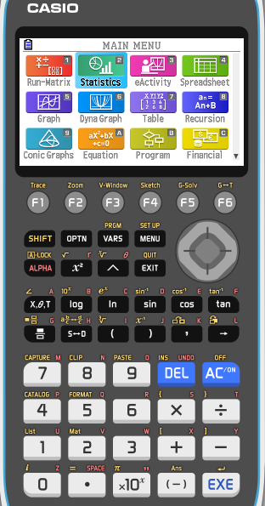
Example. The cost, c, (in pence) of a number of paperback books with total number of pages, p, is recorded, as follows :-
No. of pages (x): 150 200 300 350 450
Cost (y): 500 580 660 820 900
Use the GDC to Calculate the PMCC, r, for this data and interpret the relationship.
Turn on the GDC
Press 2
Statistics

Slide 12
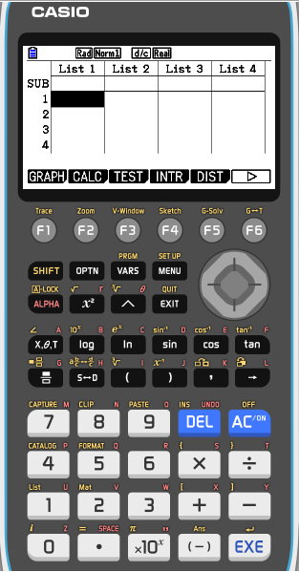
Example. The cost, c, (in pence) of a number of paperback books with total number of pages, p, is recorded, as follows :-
No. of pages (x): 150 200 300 350 450
Cost (y): 500 580 660 820 900
Use the GDC to Calculate the PMCC, r, for this data and interpret the relationship.
Turn on the GDC
Press 2
Statistics
Type the values of No. of pages in the list 1
Type the values of Cost in the list 2

Slide 13
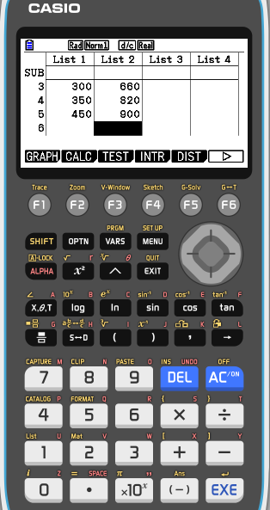
Example. The cost, c, (in pence) of a number of paperback books with total number of pages, p, is recorded, as follows :-
No. of pages (x): 150 200 300 350 450
Cost (y): 500 580 660 820 900
Use the GDC to Calculate the PMCC, r, for this data and interpret the relationship.
Turn on the GDC
Press 2
Statistics
Type the values of No. of pages in the list 1
Type the values of Cost in the list 2
F2
CALC

Slide 14
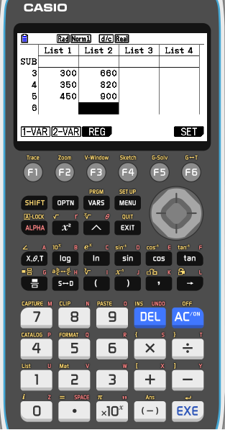
Example. The cost, c, (in pence) of a number of paperback books with total number of pages, p, is recorded, as follows :-
No. of pages (x): 150 200 300 350 450
Cost (y): 500 580 660 820 900
Use the GDC to Calculate the PMCC, r, for this data and interpret the relationship.
Turn on the GDC
Press 2
Statistics
Type the values of No. of pages in the list 1
Type the values of Cost in the list 2
F2
CALC
F3
REG

Slide 15
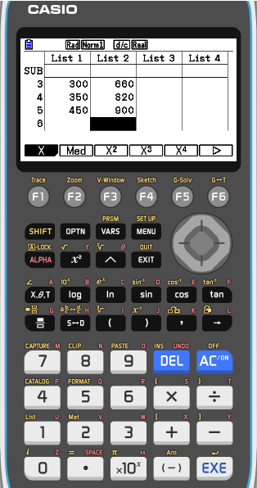
Example. The cost, c, (in pence) of a number of paperback books with total number of pages, p, is recorded, as follows :-
No. of pages (x): 150 200 300 350 450
Cost (y): 500 580 660 820 900
Use the GDC to Calculate the PMCC, r, for this data and interpret the relationship.
Turn on the GDC
Press 2
Statistics
Type the values of No. of pages in the list 1
Type the values of Cost in the list 2
F2
CALC
F3
REG
F1
X

Slide 16
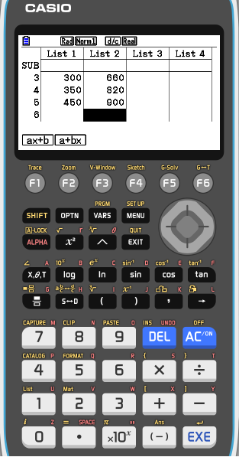
Example. The cost, c, (in pence) of a number of paperback books with total number of pages, p, is recorded, as follows :-
No. of pages (x): 150 200 300 350 450
Cost (y): 500 580 660 820 900
Use the GDC to Calculate the PMCC, r, for this data and interpret the relationship.
Turn on the GDC
Press 2
Statistics
Type the values of No. of pages in the list 1
Type the values of Cost in the list 2
F2
CALC
F3
REG
F1
X
F1
ax + b

Slide 17
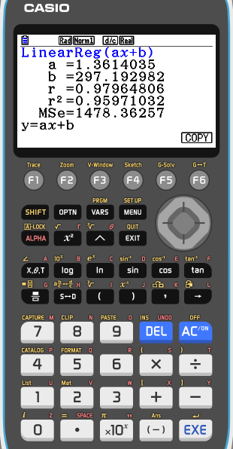
Example. The cost, c, (in pence) of a number of paperback books with total number of pages, p, is recorded, as follows :-
No. of pages (x): 150 200 300 350 450
Cost (y): 500 580 660 820 900
Use the GDC to Calculate the PMCC, r, for this data and interpret the relationship.
Turn on the GDC
Press 2
Statistics
Type the values of No. of pages in the list 1
Type the values of Cost in the list 2
F2
CALC
F3
REG
F1
X
F1
ax + b
r = 0.97964806
The value 0.9796 indicates positive Very Strong correlation

Slide 18
Thank you for using resources from
For more resources visit our website
https://www.mathssupport.org
If you have a special request, drop us an email
info@mathssupport.org

