Slide 1
Variance and Standard deviation
8 August 2023
LO: To understand and calculate Variance and standard deviation.

Slide 2
Variance.
The range and interquartile range are good measures of spread, but they are calculated from only two data values.
The variance combines all the values in a data set to produce a measure of spread
The variance is the arithmetic mean of the squared differences between each value and the mean value.
$$\sum_{i=1}^{k}{{f_{i}\left(x_{i}−μ\right)}^{2}}$$
$$n=\sum_{i=1}^{k}{f_{i}}$$
$$σ^{2}=\frac{ }{n}$$
, where

Slide 3
Variance.
Squaring the difference between each value and the mean value has at least three advantages:
squaring makes each term positive so that values above the mean do not cancel values below the mean
squaring adds more weighting to the larger differences.
The mathematics is relatively manageable when using this measure in subsequent statistical calculations.

Slide 4
Variance.
We can do some algebraic manipulation to deduce a simplified form of this formula
$$\sum_{i=1}^{k}{{\left(x_{i}−μ\right)}^{2}}$$
$$\sum_{i=1}^{k}{\left(x_{i}^{2}−2x_{i}μ+μ^{2}\right)}$$
Expanding the square of the difference
$$σ^{2}=\frac{ }{n}$$
$=\frac{ }{n}$
$$\sum_{i=1}^{k}{x_{i}^{2}}$$
$$\sum_{i=1}^{k}{x_{i}}$$
$$\sum_{i=1}^{k}{1}$$
Using distributive properties.
$=\frac{ }{n}$
$−2μ\frac{ }{n}$
$+μ^{2}\frac{ }{n}$
$$\sum_{i=1}^{k}{x_{i}^{2}}$$
Using the definition of mean and simplifying the third sum
$=\frac{ }{n}$
$$−2μ\left(μ\right)$$
$+μ^{2}\frac{ n }{n}$
$$\sum_{i=1}^{k}{x_{i}^{2}}$$
$$\sum_{i=1}^{k}{x_{i}^{2}}$$
$=\frac{ }{n}$
$$−2μ^{2}$$
$$+μ^{2}$$
$σ^{2}=\frac{ }{n}$
$$−μ^{2}$$

Slide 5
Standard Deviation.
$$\sum_{i=1}^{k}{{f_{i}\left(x_{i}−μ\right)}^{2}}$$
$$\sum_{i=1}^{k}{{f_{i}x}_{i}^{2}}$$
$$−μ^{2}$$
$$σ^{2}=\frac{ }{n}$$
$=\frac{ }{n}$
The Standard deviation (σ) is the square root of the variance
$$\sqrt{\begin{aligned}\sum_{i=1}^{k}{f_{i}{\left(x_{i}−μ\right)}^{2}} \\ \frac{ }{n}\end{aligned}}$$
$$\sqrt{\begin{aligned}\sum_{i=1}^{k}{f_{i}x_{i}^{2}} \\ \frac{ }{n} −μ^{2}\end{aligned}}$$
$$σ=$$
$$=$$
f_{i} is every individual frequency
x_{i} is every individual datum
μ is the mean.
n is the quantity of numbers

Slide 6
Standard Deviation.
The Standard deviation of a distribution is
a measure of spread
affected by the size of each data value
a commonly calculated and used statistic
The Standard deviation shows how much variation there is from the mean.
Although you will usually calculate the Standard deviation on the GDC we will see some examples to shows how to calculate the standard deviation step by step using the formula.

Slide 7
All of the exam marks from a group of students:
x 1 3 4 5 8 9
Calculate the variance and standard deviation
Using this formula
$$\sqrt{\begin{aligned}\sum_{i=1}^{k}{{\left(x_{i}−μ\right)}^{2}} \\ \frac{ }{n}\end{aligned}}$$
x - $μ$
(x - $μ$)²
Score (x)
1
3
4
5
8
9
$$σ=$$
1 – 5 =
-4
16
Calculate the mean
3 – 5 =
-2
4
Step 1:
4 – 5 =
-1
1
$$μ$$
1 + 3 + 4 + 5 + 8 + 9
=
30
5 – 5 =
0
0
=
=
5
6
6
8 – 5 =
3
9
Step 2: Find the difference from the mean
9 – 5 =
4
16
Step 3: Square this difference.
Step 5: substitute into the formula for standard deviation.
Step 4: add up this differences.
46

Slide 8
All of the exam marks from a group of students:
x 1 3 4 5 8 9
Calculate the variance and standard deviation
Using this formula
$$\sqrt{\begin{aligned}\sum_{i=1}^{k}{x_{i}^{2}} \\ \frac{ }{n} −μ^{2}\end{aligned}}$$
x²
Score (x)
1
3
4
5
8
9
$$σ=$$
1
9
Step 1:
Calculate the mean
16
$$μ$$
1 + 3 + 4 + 5 + 8 + 9
=
30
25
=
=
5
6
6
64
$${μ }^{2}$$
Step 2: Find the square of x
=
25
81
Step 4: Square the mean.
Step 3: add up this column.
Step 5: substitute into the formula for standard deviation.
196
$$\sqrt{\frac{196}{6}−25}$$
$$σ=$$

Slide 9
Example. Consider the following grouped frequency distribution
f x_{i}
x_{i} ²
f x_{i}²
To calculate the mean we need fx_{i}
X | f
0 ≤ x < 100 | 8
100 ≤ x < 200 | 11
200 ≤ x < 400 | 24
400 ≤ x < 600 | 15
600 ≤ x < 1000 | 14
MP (x_{i})
50
400
2500
20 000
150
1650
22 500
247 500
7200
90 000
2 160 000
$$μ$$
27 950
300
=
3 750 000
72
500
7500
250 000
$$μ$$
=
388.2
800
11 200
640 000
8 960 000
72
27 950
15 137 500
$$μ2$$
=
150694.9
If we have a population summarised in a grouped frequency distribution, then work out the mid points.
Using the formula for
$$\sqrt{\begin{aligned}\sum_{i=1}^{k}{f_{i}x_{i}^{2}} \\ \frac{ }{n} −μ^{2}\end{aligned}}$$
$$\sum_{i=1}^{k}{{f_{i}x}_{i}^{2}}$$
Variance $=σ^{2}=$
$\frac{ }{n}$
$$−μ^{2}$$
Standard deviation $=σ=$
$$σ^{2}=$$
$$\frac{15 137 500}{72}−150 694.9$$
Standard deviation $=σ=$
$$\sqrt{σ^{2}}$$
$$σ^{2}=$$
59 548.16
$$σ=$$
244.02

Slide 10
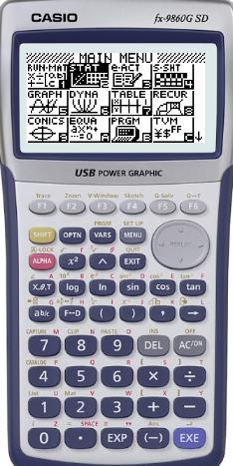
Example. Consider the following grouped frequency distribution
X | f
0 ≤ x < 100 | 8
100 ≤ x < 200 | 11
200 ≤ x < 400 | 24
400 ≤ x < 600 | 15
600 ≤ x < 1000 | 14
MP (x_{i})
Turn on the GDC
50
150
MENU
2
STAT
300
500
800
72
If we are going to use the GDC, then we have to work out the mid points.

Slide 11
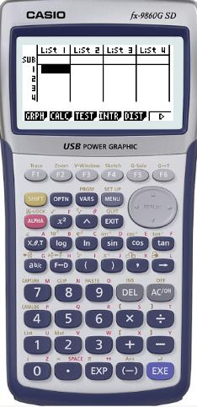
Example. Consider the following grouped frequency distribution
X | f
0 ≤ x < 100 | 8
100 ≤ x < 200 | 11
200 ≤ x < 400 | 24
400 ≤ x < 600 | 15
600 ≤ x < 1000 | 14
MP (x_{i})
Turn on the GDC
50
150
MENU
2
STAT
300
Type in the values of MP in list 1 and the values of frequency in list 2
500
800
72
If we are going to use the GDC, then we have to work out the mid points.

Slide 12
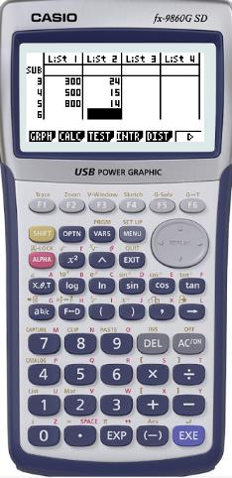
Example. Consider the following grouped frequency distribution
X | f
0 ≤ x < 100 | 8
100 ≤ x < 200 | 11
200 ≤ x < 400 | 24
400 ≤ x < 600 | 15
600 ≤ x < 1000 | 14
MP (x_{i})
Turn on the GDC
50
150
MENU
2
STAT
300
Type in the values of MP in list 1 and the values of frequency in list 2
500
800
72
If we are going to use the GDC, then we have to work out the mid points.
F2
CALC

Slide 13
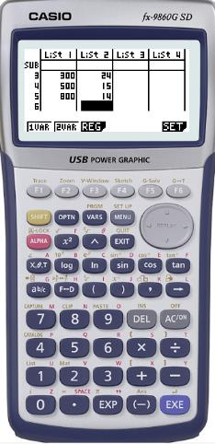
Example. Consider the following grouped frequency distribution
X | f
0 ≤ x < 100 | 8
100 ≤ x < 200 | 11
200 ≤ x < 400 | 24
400 ≤ x < 600 | 15
600 ≤ x < 1000 | 14
MP (x_{i})
Turn on the GDC
50
150
MENU
2
STAT
300
Type in the values of MP in list 1 and the values of frequency in list 2
500
800
72
If we are going to use the GDC, then we have to work out the mid points.
F2
CALC
F6
SET

Slide 14
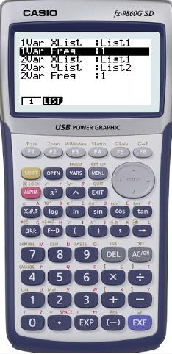
Example. Consider the following grouped frequency distribution
X | f
0 ≤ x < 100 | 8
100 ≤ x < 200 | 11
200 ≤ x < 400 | 24
400 ≤ x < 600 | 15
600 ≤ x < 1000 | 14
MP (x_{i})
Turn on the GDC
50
150
MENU
2
STAT
300
Type in the values of MP in list 1 and the values of frequency in list 2
500
800
72
If we are going to use the GDC, then we have to work out the mid points.
F2
CALC
F6
SET
Scroll down to 1 Var Freq and press F2 2
EXE
EXIT

Slide 15
Example. Consider the following grouped frequency distribution
X | f
0 ≤ x < 100 | 8
100 ≤ x < 200 | 11
200 ≤ x < 400 | 24
400 ≤ x < 600 | 15
600 ≤ x < 1000 | 14
MP (x_{i})
Turn on the GDC
50
150
MENU
2
STAT
300
Type in the values of MP in list 1 and the values of frequency in list 2
500
800
72
If we are going to use the GDC, then we have to work out the mid points.
F2
CALC
F6
SET
Scroll down to 1 Var Freq and press F2 2
EXE
EXIT
F1
1 VAR

Slide 16
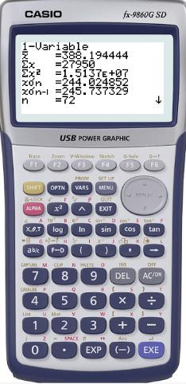
Example. Consider the following grouped frequency distribution
X | f
0 ≤ x < 100 | 8
100 ≤ x < 200 | 11
200 ≤ x < 400 | 24
400 ≤ x < 600 | 15
600 ≤ x < 1000 | 14
MP (x_{i})
Turn on the GDC
50
150
MENU
2
STAT
300
Type in the values of MP in list 1 and the values of frequency in list 2
500
800
72
If we are going to use the GDC, then we have to work out the mid points.
F2
CALC
F6
SET
Scroll down to 1 Var Freq and press F2 2
EXE
EXIT
F1
1 VAR
$$xσn=$$
244.02

Slide 17
Thank you for using resources from
For more resources visit our website
https://www.mathssupport.org
If you have a special request, drop us an email
info@mathssupport.org

