Slide 1
The t-test.
LO: To use a GDC to perform a t-test to determine if there is a significant difference between the means of two groups.

Slide 2

The t-test
A t-test is a type of inferential statistic used to determine if there is a significant difference between the means of two groups, which may be related in certain features.
The t-test is one of many tests used for the purpose of hypothesis testing in statistics.
Calculating a t-test requires three key data values.
They include:
the difference between the mean values from each data set (called the mean difference),
the standard deviation of each group
and the number of data values of each group.

Slide 3
The t-test
In order to perform a t-test there are some assumptions we have to make:
The first assumption made regarding t-tests concerns the scale of measurement. The assumption for a t-test is that the scale of measurement applied to the data collected follows a continuous or ordinal scale
The second assumption made is that of a simple random sample, that the data is collected from a representative, randomly selected portion of the total population.
The third assumption is the data, when plotted, results in a normal distribution, bell-shaped distribution curve.
The final assumption is the homogeneity of variance. Homogeneous, or equal, variance exists when the standard deviations of samples are approximately equal.

Slide 4
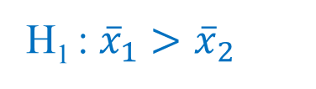
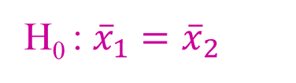
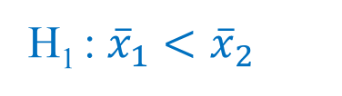

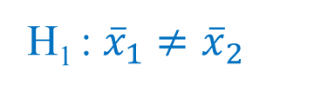
The t-test
There is a formula that is used to calculate it, but you won’t need to use it as your GDC will do the work for you.
First of all you need to set up your null and alternative hypotheses.
Null hypothesis (H₀)
The null hypothesis is that the two means are equal
H₀ : ${\overline{x}}_{1}={\overline{x}}_{2}$
Alternative hypothesis (H₁)
The alternative hypothesis is that the two means are not equal.
For a two tailed test this just means checking that ${\overline{x}}_{1}≠{\overline{x}}_{2}$.
H₁ : ${\overline{x}}_{1}≠{\overline{x}}_{2}$
For a one tailed test it means checking either that ${\overline{x}}_{1}$is less than ${\overline{x}}_{2}$or that it is greater than ${\overline{x}}_{2}$.
H₁ : ${\overline{x}}_{1}<{\overline{x}}_{2}$
H₁ : ${\overline{x}}_{1}>{\overline{x}}_{2}$
or

Slide 5
The t-test
After setting up the null and alternative hypotheses we use the GDC typing in the list of data and calculate the t-statistic and the p-value.
Once you have found the p-value you can compare it with the significance level.
If the p-value is greater than the significance level, then you accept the null hypothesis.
If the p-value is smaller than the significance level, then you do not accept the null hypothesis.
The t-test is mainly conducted at the 5% significance level, it can also be conducted at the 1% or 10% significance levels.

Slide 6


The t-test
Mr. Orlando and Mr. Simon gave the same test to the two top set groups in Year 9. They want to find out whether there is any difference between the achievement levels of the two groups.
The results are:
S | 38 | 38 | 38 | 36 | 38 | 36 | 37 | 38 | 40 | 40 | 39 | 36 | 38 | 40 | 39 | 38 | 37 | 37 | 38 | 39 | 38
O | 39 | 37 | 36 | 39 | 39 | 35 | 38 | 36 | 38 | 38 | 33 | 38 | 35 | 38 | 36 | 36 | 39 | 38 | 24
(a) Write down the null and alternative hypotheses.
H₀ : ${\overline{x}}_{1}={\overline{x}}_{2}$
There is no difference between the grades in Mr. Simon’s and Mr. Orlando’s group.
H₁ : ${\overline{x}}_{1}≠{\overline{x}}_{2}$
There is a difference between the grades in Mr. Simon’s and Mr. Orlando’s group.

Slide 7
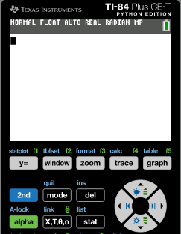
The t-test
Mr. Orlando and Mr. Simon gave the same test to the two top set groups in Year 9. They want to find out whether there is any difference between the achievement levels of the two groups.
The results are:
S | 38 | 38 | 38 | 36 | 38 | 36 | 37 | 38 | 40 | 40 | 39 | 36 | 38 | 40 | 39 | 38 | 37 | 37 | 38 | 39 | 38
O | 39 | 37 | 36 | 39 | 39 | 35 | 38 | 36 | 38 | 38 | 33 | 38 | 35 | 38 | 36 | 36 | 39 | 38 | 24
(b) Find the t-value and p-value for a t-test at the 5% significance level.
We are going to use the GCD
Turn it ON
Click
STAT

Slide 8
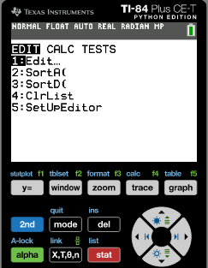
The t-test
Mr. Orlando and Mr. Simon gave the same test to the two top set groups in Year 9. They want to find out whether there is any difference between the achievement levels of the two groups.
The results are:
S | 38 | 38 | 38 | 36 | 38 | 36 | 37 | 38 | 40 | 40 | 39 | 36 | 38 | 40 | 39 | 38 | 37 | 37 | 38 | 39 | 38
O | 39 | 37 | 36 | 39 | 39 | 35 | 38 | 36 | 38 | 38 | 33 | 38 | 35 | 38 | 36 | 36 | 39 | 38 | 24
(b) Find the t-value and p-value for a t-test at the 5% significance level.
We are going to use the GCD
Turn it ON
Click
STAT
Click
1: Edit

Slide 9
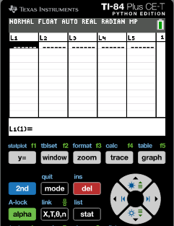
The t-test
Mr. Orlando and Mr. Simon gave the same test to the two top set groups in Year 9. They want to find out whether there is any difference between the achievement levels of the two groups.
The results are:
S | 38 | 38 | 38 | 36 | 38 | 36 | 37 | 38 | 40 | 40 | 39 | 36 | 38 | 40 | 39 | 38 | 37 | 37 | 38 | 39 | 38
O | 39 | 37 | 36 | 39 | 39 | 35 | 38 | 36 | 38 | 38 | 33 | 38 | 35 | 38 | 36 | 36 | 39 | 38 | 24
(b) Find the t-value and p-value for a t-test at the 5% significance level.
We are going to use the GCD
Turn it ON
Click
STAT
Click
1: Edit
Type in the S-values in List 1; O-values List 2

Slide 10
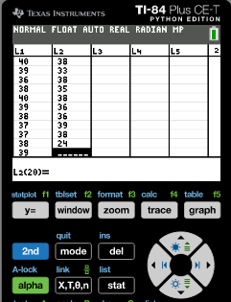
The t-test
Mr. Orlando and Mr. Simon gave the same test to the two top set groups in Year 9. They want to find out whether there is any difference between the achievement levels of the two groups.
The results are:
S | 38 | 38 | 38 | 36 | 38 | 36 | 37 | 38 | 40 | 40 | 39 | 36 | 38 | 40 | 39 | 38 | 37 | 37 | 38 | 39 | 38
O | 39 | 37 | 36 | 39 | 39 | 35 | 38 | 36 | 38 | 38 | 33 | 38 | 35 | 38 | 36 | 36 | 39 | 38 | 24
(b) Find the t-value and p-value for a t-test at the 5% significance level.
We are going to use the GCD
Turn it ON
Click
STAT
Click
1: Edit
Type in the S-values in List 1; O-values List 2
Click Stat

Slide 11

The t-test
Mr. Orlando and Mr. Simon gave the same test to the two top set groups in Year 9. They want to find out whether there is any difference between the achievement levels of the two groups.
The results are:
S | 38 | 38 | 38 | 36 | 38 | 36 | 37 | 38 | 40 | 40 | 39 | 36 | 38 | 40 | 39 | 38 | 37 | 37 | 38 | 39 | 38
O | 39 | 37 | 36 | 39 | 39 | 35 | 38 | 36 | 38 | 38 | 33 | 38 | 35 | 38 | 36 | 36 | 39 | 38 | 24
(b) Find the t-value and p-value for a t-test at the 5% significance level.
We are going to use the GCD
Turn it ON
Click
STAT
Click
1: Edit
Type in the S-values in List 1; O-values List 2
Click Stat
Scroll over to TESTS

Slide 12
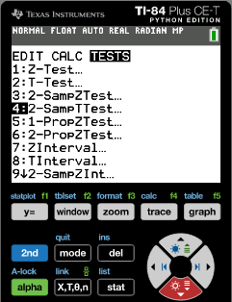
The t-test
Mr. Orlando and Mr. Simon gave the same test to the two top set groups in Year 9. They want to find out whether there is any difference between the achievement levels of the two groups.
The results are:
S | 38 | 38 | 38 | 36 | 38 | 36 | 37 | 38 | 40 | 40 | 39 | 36 | 38 | 40 | 39 | 38 | 37 | 37 | 38 | 39 | 38
O | 39 | 37 | 36 | 39 | 39 | 35 | 38 | 36 | 38 | 38 | 33 | 38 | 35 | 38 | 36 | 36 | 39 | 38 | 24
(b) Find the t-value and p-value for a t-test at the 5% significance level.
We are going to use the GCD
Turn it ON
Click
STAT
Click
1: Edit
Type in the S-values in List 1; O-values List 2
Click Stat
Scroll over to TESTS
Scroll down to 4: 2 SampTTest
Enter

Slide 13
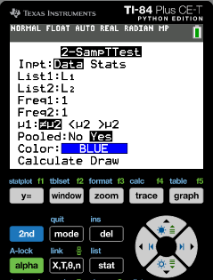
The t-test
Mr. Orlando and Mr. Simon gave the same test to the two top set groups in Year 9. They want to find out whether there is any difference between the achievement levels of the two groups.
The results are:
S | 38 | 38 | 38 | 36 | 38 | 36 | 37 | 38 | 40 | 40 | 39 | 36 | 38 | 40 | 39 | 38 | 37 | 37 | 38 | 39 | 38
O | 39 | 37 | 36 | 39 | 39 | 35 | 38 | 36 | 38 | 38 | 33 | 38 | 35 | 38 | 36 | 36 | 39 | 38 | 24
(b) Find the t-value and p-value for a t-test at the 5% significance level.
We are going to use the GCD
Turn it ON
Click
STAT
Click
1: Edit
Type in the S-values in List 1; O-values List 2
Click Stat
Scroll over to TESTS
Scroll down to 4: 2 SampTTest
Enter
Inpt:Data
List1: L1
List2: L2
Freq1: 1
Freq2: 2
μ1: ≠μ2
Pooled: Yes
Scroll down to Calculate
Enter

Slide 14
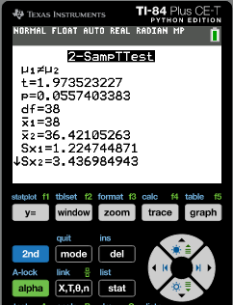
The t-test
Mr. Orlando and Mr. Simon gave the same test to the two top set groups in Year 9. They want to find out whether there is any difference between the achievement levels of the two groups.
The results are:
S | 38 | 38 | 38 | 36 | 38 | 36 | 37 | 38 | 40 | 40 | 39 | 36 | 38 | 40 | 39 | 38 | 37 | 37 | 38 | 39 | 38
O | 39 | 37 | 36 | 39 | 39 | 35 | 38 | 36 | 38 | 38 | 33 | 38 | 35 | 38 | 36 | 36 | 39 | 38 | 24
(b) Find the t-value and p-value for a t-test at the 5% significance level.
We are going to use the GCD
t =
1.97352323
p =
0.05574034

Slide 15


The t-test
Mr. Orlando and Mr. Simon gave the same test to the two top set groups in Year 9. They want to find out whether there is any difference between the achievement levels of the two groups.
t =
1.97352323
The results are:
p =
0.05574034
S | 38 | 38 | 38 | 36 | 38 | 36 | 37 | 38 | 40 | 40 | 39 | 36 | 38 | 40 | 39 | 38 | 37 | 37 | 38 | 39 | 38
O | 39 | 37 | 36 | 39 | 39 | 35 | 38 | 36 | 38 | 38 | 33 | 38 | 35 | 38 | 36 | 36 | 39 | 38 | 24
(c) Write down the conclusion of the test.
H₀ : ${\overline{x}}_{1}={\overline{x}}_{2}$
There is no difference between the grades in Mr. Simon’s and Mr. Orlando’s group.
H₁ : ${\overline{x}}_{1}≠{\overline{x}}_{2}$
There is a difference between the grades in Mr. Simon’s and Mr. Orlando’s group.
We got this values
If the p-value is greater than the significance level, then we accept the null hypothesis.
t =
1.97352323
>
0.05
0.05574034
p =
0.05574034
So, we accept the null hypothesis: there is no significant difference between the two groups.

Slide 16

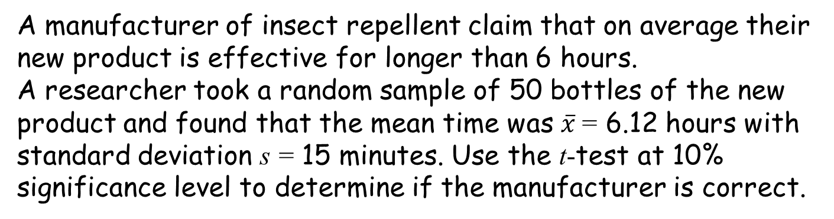

The t-test
Given a sample of size n with sample mean $\overline{x}$ and sample standard deviation s, the test statistic is:
$$t=\frac{\overline{x}−μ_{0}}{\frac{s}{\sqrt{n}}}$$
Example:
A manufacturer of insect repellent claim that on average their new product is effective for longer than 6 hours.
A researcher took a random sample of 50 bottles of the new product and found that the mean time was $\overline{x}$= 6.12 hours with standard deviation s = 15 minutes. Use the t-test at 10% significance level to determine if the manufacturer is correct.
Using the GDC.
H₀ : μ = 6
H₁ : μ > 6

Slide 17
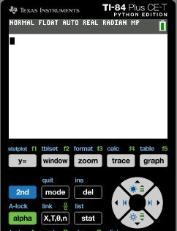
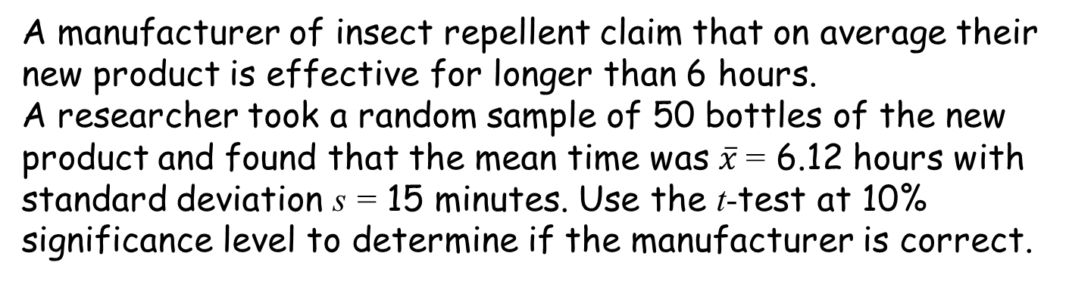
The t-test
Example:
A manufacturer of insect repellent claim that on average their new product is effective for longer than 6 hours.
A researcher took a random sample of 50 bottles of the new product and found that the mean time was $\overline{x}$= 6.12 hours with standard deviation s = 15 minutes. Use the t-test at 10% significance level to determine if the manufacturer is correct.
H₀ : μ = 6
H₁ : μ > 6
We are going to use the GCD
Turn it ON
Click
STAT

Slide 18

The t-test
Example:
A manufacturer of insect repellent claim that on average their new product is effective for longer than 6 hours.
A researcher took a random sample of 50 bottles of the new product and found that the mean time was $\overline{x}$= 6.12 hours with standard deviation s = 15 minutes. Use the t-test at 10% significance level to determine if the manufacturer is correct.
H₀ : μ = 6
H₁ : μ > 6
We are going to use the GCD
Turn it ON
Click
STAT
Scroll over to TESTS

Slide 19
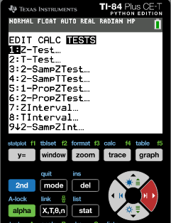
The t-test
Example:
A manufacturer of insect repellent claim that on average their new product is effective for longer than 6 hours.
A researcher took a random sample of 50 bottles of the new product and found that the mean time was $\overline{x}$= 6.12 hours with standard deviation s = 15 minutes. Use the t-test at 10% significance level to determine if the manufacturer is correct.
H₀ : μ = 6
H₁ : μ > 6
We are going to use the GCD
Turn it ON
Click
STAT
Scroll over to TESTS
Scroll down to 2: T-Test
Enter

Slide 20
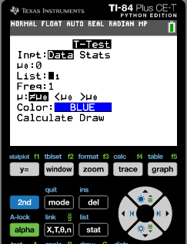
The t-test
Example:
A manufacturer of insect repellent claim that on average their new product is effective for longer than 6 hours.
A researcher took a random sample of 50 bottles of the new product and found that the mean time was $\overline{x}$= 6.12 hours with standard deviation s = 15 minutes. Use the t-test at 10% significance level to determine if the manufacturer is correct.
H₀ : μ = 6
H₁ : μ > 6
We are going to use the GCD
Turn it ON
Click
STAT
Scroll over to TESTS
Scroll down to 2: T-Test
Enter
Inpt: Stats
Enter

Slide 21
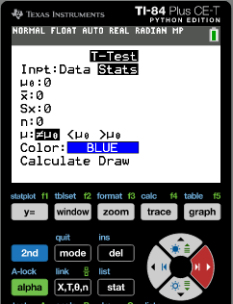

The t-test
Example:
A manufacturer of insect repellent claim that on average their new product is effective for longer than 6 hours.
A researcher took a random sample of 50 bottles of the new product and found that the mean time was $\overline{x}$= 6.12 hours with standard deviation s = 15 minutes. Use the t-test at 10% significance level to determine if the manufacturer is correct.
H₀ : μ = 6
H₁ : μ > 6
We are going to use the GCD
Turn it ON
Click
STAT
Scroll over to TESTS
Scroll down to 2: T-Test
Enter
Inpt: Stats
Enter
Type the values
μ0:
6
$\overline{x}$ :
6.12
sx :
0.25
n :
50
μ :
≠ μ0

Slide 22
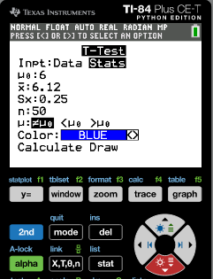
The t-test
Example:
A manufacturer of insect repellent claim that on average their new product is effective for longer than 6 hours.
A researcher took a random sample of 50 bottles of the new product and found that the mean time was $\overline{x}$= 6.12 hours with standard deviation s = 15 minutes. Use the t-test at 10% significance level to determine if the manufacturer is correct.
H₀ : μ = 6
H₁ : μ > 6
We are going to use the GCD
Turn it ON
Click
STAT
Scroll over to TESTS
Scroll down to 2: T-Test
Enter
Inpt: Stats
Enter
Type the values
μ0:
6
$\overline{x}$ :
6.12
sx :
0.25
n :
50
μ :
≠ μ0
Scroll down to Calculate
Enter

Slide 23
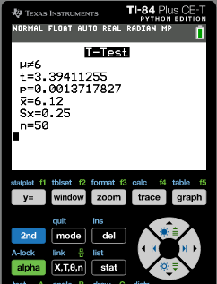
The t-test
Example:
A manufacturer of insect repellent claim that on average their new product is effective for longer than 6 hours.
A researcher took a random sample of 50 bottles of the new product and found that the mean time was $\overline{x}$= 6.12 hours with standard deviation s = 15 minutes. Use the t-test at 10% significance level to determine if the manufacturer is correct.
H₀ : μ = 6
H₁ : μ > 6
We are going to use the GCD
Turn it ON
Click
STAT
Scroll over to TESTS
Scroll down to 2: T-Test
Enter
Inpt: Stats
Enter
Type the values
μ0:
6
$\overline{x}$ :
6.12
sx :
0.25
n :
50
μ :
≠ μ0
Scroll down to Calculate
Enter
t =
3.39
p =
0.00137
= 0.137%
0.137% < 10%
Since the p-value is less than the significance level the researcher has enough evidence to reject H₀

Slide 24
The t-test
Example:
The manager of a restaurant chain goes to a seafood wholesaler and inspects a large catch of over 50 000 prawns. It is known that population is normally distributed. He will buy the catch if the mean weight exceeds 55 grams per prawn.
A random sample of 60 prawns is taken. The sample mean is 56.2 grams with standard deviation 4.2 grams. Use the t-test at 5% significance level to determine whether the manager should purchase the catch.
H₀ : μ = 55
H₁ : μ > 55
We are going to use the GCD
Turn it ON
Click
STAT

Slide 25
The t-test
Example:
The manager of a restaurant chain goes to a seafood wholesaler and inspects a large catch of over 50 000 prawns. It is known that population is normally distributed. He will buy the catch if the mean weight exceeds 55 grams per prawn.
A random sample of 60 prawns is taken. The sample mean is 56.2 grams with standard deviation 4.2 grams. Use the t-test at 5% significance level to determine whether the manager should purchase the catch.
H₀ : μ = 55
H₁ : μ > 55
We are going to use the GCD
Turn it ON
Click
STAT
Scroll over to TESTS

Slide 26
The t-test
Example:
The manager of a restaurant chain goes to a seafood wholesaler and inspects a large catch of over 50 000 prawns. It is known that population is normally distributed. He will buy the catch if the mean weight exceeds 55 grams per prawn.
A random sample of 60 prawns is taken. The sample mean is 56.2 grams with standard deviation 4.2 grams. Use the t-test at 5% significance level to determine whether the manager should purchase the catch.
H₀ : μ = 55
H₁ : μ > 55
We are going to use the GCD
Turn it ON
Click
STAT
Scroll over to TESTS
Scroll down to 2: T-Test
Enter

Slide 27
The t-test
Example:
The manager of a restaurant chain goes to a seafood wholesaler and inspects a large catch of over 50 000 prawns. It is known that population is normally distributed. He will buy the catch if the mean weight exceeds 55 grams per prawn.
A random sample of 60 prawns is taken. The sample mean is 56.2 grams with standard deviation 4.2 grams. Use the t-test at 5% significance level to determine whether the manager should purchase the catch.
H₀ : μ = 55
H₁ : μ > 55
We are going to use the GCD
Turn it ON
Click
STAT
Scroll over to TESTS
Scroll down to 2: T-Test
Enter
Inpt: Stats
Enter

Slide 28
The t-test
Example:
The manager of a restaurant chain goes to a seafood wholesaler and inspects a large catch of over 50 000 prawns. It is known that population is normally distributed. He will buy the catch if the mean weight exceeds 55 grams per prawn.
A random sample of 60 prawns is taken. The sample mean is 56.2 grams with standard deviation 4.2 grams. Use the t-test at 5% significance level to determine whether the manager should purchase the catch.
H₀ : μ = 55
H₁ : μ > 55
We are going to use the GCD
Turn it ON
Click
STAT
Scroll over to TESTS
Scroll down to 2: T-Test
Enter
Inpt: Stats
Enter
Type the values
μ0:
6
$\overline{x}$ :
6.12
sx :
0.25
n :
50
μ :
> μ0

Slide 29
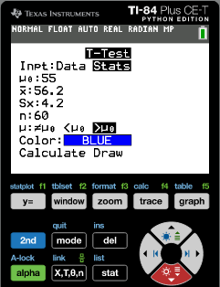
The t-test
Example:
The manager of a restaurant chain goes to a seafood wholesaler and inspects a large catch of over 50 000 prawns. It is known that population is normally distributed. He will buy the catch if the mean weight exceeds 55 grams per prawn.
A random sample of 60 prawns is taken. The sample mean is 56.2 grams with standard deviation 4.2 grams. Use the t-test at 5% significance level to determine whether the manager should purchase the catch.
H₀ : μ = 55
H₁ : μ > 55
We are going to use the GCD
Turn it ON
Click
STAT
Scroll over to TESTS
Scroll down to 2: T-Test
Enter
Inpt: Stats
Enter
Type the values
μ0:
55
$\overline{x}$ :
56.2
sx :
4.2
n :
60
μ :
> μ0
Scroll down to Calculate
Enter

Slide 30
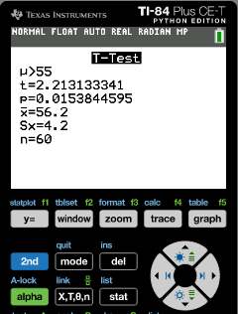
The t-test
Example:
The manager of a restaurant chain goes to a seafood wholesaler and inspects a large catch of over 50 000 prawns. It is known that population is normally distributed. He will buy the catch if the mean weight exceeds 55 grams per prawn.
A random sample of 60 prawns is taken. The sample mean is 56.2 grams with standard deviation 4.2 grams. Use the t-test at 5% significance level to determine whether the manager should purchase the catch.
H₀ : μ = 55
H₁ : μ > 55
We are going to use the GCD
Turn it ON
Click
STAT
Scroll down to 2: T-Test
Enter
Inpt: Stats
Enter
Type the values
μ0:
6
$\overline{x}$ :
6.12
sx :
0.25
n :
50
μ :
> μ0
Scroll down to Calculate
Enter
t =
2.21
p =
0.0154
= 1.54%
1.54% < 10%
Since the p-value is less than the significance level we have enough evidence to reject H₀ and accept H₁ mean weight exceeds 55 grams per prawn

Slide 31

Thank you for using resources from
For more resources visit our website
https://www.mathssupport.org
If you have a special request, drop us an email
info@mathssupport.org

