Slide 1
The Chi-squared (χ²) Goodness of fit test
LO: To conduct the χ² goodness of fit test to accept or reject a hypothesis.

Slide 2
Forming a hypothesis
Suppose you take a die and throw it 120 times so that the number of throws N = 300. If the die is unbiased, you would in theory expect each of the numbers 1 to 6 to appear 50 times.
Number | 1 | 2 | 3 | 4 | 5 | 6
Frequency | 20 | 20 | 20 | 20 | 20 | 20
Since you are taking a sample, it will be surprising if the observed frequency for each number were exactly 20.
Suppose now that the die is biased, then, you would not expect the observed frequency of each number to be exactly 20.
What if you get these results:
Number | 1 | 2 | 3 | 4 | 5 | 6
Frequency | 25 | 23 | 15 | 21 | 18 | 15
How can you tell if the die is biased?
Could these results come from a fair die?

Slide 3
Forming a hypothesis
Taking the results of the experiment with a die, together with the expected frequencies, we get:
Number | 1 | 2 | 3 | 4 | 5 | 6
Expected Frequency ($f_{exp}$) | 20 | 20 | 20 | 20 | 20 | 20
Observed Frequency ($f_{obs}$) | 25 | 23 | 15 | 21 | 18 | 15
We can form a hypothesis that the observed distribution does not differ from a theoretical one, and that any differences are due to natural variations.
Because this statement assumes no difference it is called the null hypothesis. (H₀)
The alternative hypothesis (H₁) is that the observed distribution does differ from the theoretical one and that any differences are due to not only natural variations but the bias of the die as well.
The hypotheses that we could investigate are:
H₀: There is no difference between the observed end the expected frequencies.
H₁: There is a difference between them.

Slide 4
Forming a hypothesis
Taking the results of the experiment with a die, together with the expected frequencies, we get:
Number | 1 | 2 | 3 | 4 | 5 | 6
Expected Frequency ($f_{exp}$) | 20 | 20 | 20 | 20 | 20 | 20
Observed Frequency ($f_{obs}$) | 25 | 23 | 15 | 21 | 18 | 15
We can form a hypothesis that the observed distribution does not differ from a theoretical one, and that any differences are due to natural variations.
Because this statement assumes no difference it is called the null hypothesis. (H₀)
The alternative hypothesis (H₁) is that the observed distribution does differ from the theoretical one and that any differences are due to not only natural variations but the bias of the die as well.
The hypotheses that we could investigate are:
H₀: There is no difference between the observed end the expected frequencies.
H₁: There is a difference between them.

Slide 5
Hypothesis Testing
The hypothesis test we studied before consider a population mean.
We can also consider claims about population proportions.
Example:
Ryan wonders whether the die he was given is fair.
He rolls it 300 times. His results are shown in the table.
Since the frequencies are quite different, Ryan claims that his die is biased.
Number | Frequency
1 | 35
2 | 52
3 | 47
4 | 71
5 | 62
6 | 33
We will study the χ² (chi-squared) Goodness of fit test and see how it can be used to test hypotheses about population proportions

Slide 6
Hypothesis Testing
Example:
Ryan wonders whether the die he was given is fair.
He rolls it 300 times. His results are shown in the table.
Since the frequencies are quite different, Ryan claims that his die is biased.
For Ryan’s die, suppose we let p₁ be the probability of rolling a 1, p₂ be the probability of rolling a 2, and so on
Number | Frequency
1 | 35
2 | 52
3 | 47
4 | 71
5 | 62
6 | 33
Our null hypothesis H₀ is that the die is fair. If this is the case, then each number is equally likely to occur on each roll. We therefore have H₀: p₁ = $\frac{1}{6}$, p₂ = $\frac{1}{6}$, …, p₆ = $\frac{1}{6}$,
Our alternative hypothesis H₀ is that the die is not fair. If this is the case, then at least one outcome has a probability which is different from the others. We therefore have H₁: at least one of p₁, p₂, …, p₆ ≠ $\frac{1}{6}$,

Slide 7
Hypothesis Testing
Example:
Ryan wonders whether the die he was given is fair.
He rolls it 300 times. His results are shown in the table.
We are going to test the hypothesis at a significance level of 5%.
In our study of probability, we calculated the number of times we expect an event to occur given its theoretical probability
Number | Frequency
1 | 35
2 | 52
3 | 47
4 | 71
5 | 62
6 | 33
For example, if Ryan’s die was fair we would expect to see 300 × $\frac{1}{6}$ = 50 of each number
We are therefore interested in how the observed frequencies differ from their expected values
$$x_{calc}^{2}=\sum{\frac{{\left(f_{obs}−f_{exp}\right)}^{2}}{f_{exp}}}$$

Slide 8
Hypothesis Testing
$$x_{calc}^{2}=\sum{\frac{{\left(f_{obs}−f_{exp}\right)}^{2}}{f_{exp}}}$$
Example:
Ryan wonders whether the die he was given is fair.
He rolls it 300 times. His results are shown in the table.
So, to calculate $x_{calc}^{2}$ we will use the table with more columns
Number | f_{obs} | f_{exp} | f_{obs} – f_{exp} | (f_{obs} – f_{exp})² | $\frac{{\left(f_{obs}−f_{exp}\right)}^{2}}{f_{exp}}$
1 | 35
2 | 52
3 | 47
4 | 71
5 | 62
6 | 33
50
-15
225
4.5
50
2
4
0.08
50
-3
9
0.18
50
21
441
8.82
50
12
144
2.88
50
-17
289
5.78
Total
22.24
$x_{calc}^{2}=$ 22.24

Slide 9
Hypothesis Testing
$$x_{calc}^{2}=\sum{\frac{{\left(f_{obs}−f_{exp}\right)}^{2}}{f_{exp}}}$$
Example:
Ryan wonders whether the die he was given is fair.
He rolls it 300 times. His results are shown in the table.
After finding $x_{calc}^{2}$ = 22.24 we have to determine if we accept the null hypothesis that the die is fair
Degrees of freedom
Degrees of freedom (df) | Significance level
 | 10% | 5% | 1%
1 | 2.71 | 3.84 | 6.63
2 | 4.61 | 5.99 | 9.21
3 | 6.25 | 7.81 | 11.34
4 | 7.78 | 9.49 | 13.28
5 | 9.24 | 11.07 | 15.09
6 | 10.64 | 12.59 | 16.81
7 | 12.02 | 14.07 | 18.48
8 | 13.36 | 15.51 | 20.09
9 | 14.68 | 16.92 | 21.67
10 | 15.99 | 18.31 | 23.21
Number | Frequency
1 | 35
2 | 52
3 | 47
4 | 71
5 | 62
6 | 33
df = number of categories - 1
df = 6 – 1 = 5
Significance level (α) = 5%
If
$x_{calc}^{2}$ > $x_{crit}^{2}$
Reject H₀
If
$x_{calc}^{2}$ < $x_{crit}^{2}$
Accept H₀
$22.24$ > $11.07$
Reject H₀
We reject our null hypothesis H₀ is that the die is fair.

Slide 10
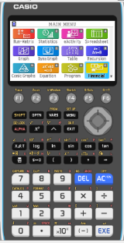
Hypothesis Testing
Now we are going to use the GDC to solve it.
Example:
Ryan wonders whether the die he was given is fair.
He rolls it 300 times. His results are shown in the table.
We are going to use a Graphing display calculator to solve the problem
CASIO
Number | Frequency
1 | 35
2 | 52
3 | 47
4 | 71
5 | 62
6 | 33

Slide 11
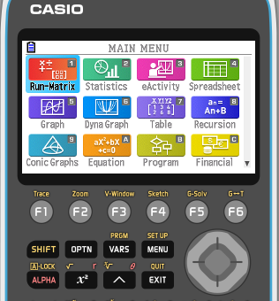
Hypothesis Testing
Now we are going to use the GDC to solve it.
Example:
Ryan wonders whether the die he was given is fair.
He rolls it 300 times. His results are shown in the table.
We need the expected frequency.
Turn on the GDC.
Press 2
Statistics
Number | Frequency | f_{exp}
1 | 35
2 | 52
3 | 47
4 | 71
5 | 62
6 | 33
50
50
50
50
50
50

Slide 12
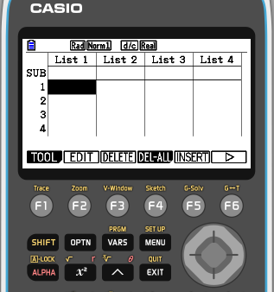
Hypothesis Testing
Now we are going to use the GDC to solve it.
Example:
Ryan wonders whether the die he was given is fair.
He rolls it 300 times. His results are shown in the table.
Type the frequencies in List 1
Type frequencies expected in List 2
Number | Frequency | f_{exp}
1 | 35
2 | 52
3 | 47
4 | 71
5 | 62
6 | 33
50
50
50
50
50
50

Slide 13
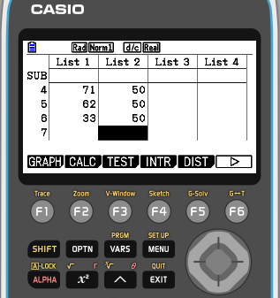
Hypothesis Testing
Now we are going to use the GDC to solve it.
Example:
Ryan wonders whether the die he was given is fair.
He rolls it 300 times. His results are shown in the table.
Press F3
Test
Number | Frequency | f_{exp}
1 | 35
2 | 52
3 | 47
4 | 71
5 | 62
6 | 33
50
50
50
50
50
50

Slide 14
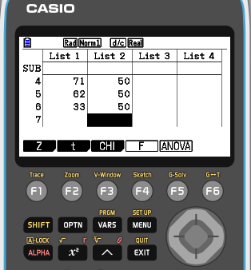
Hypothesis Testing
Now we are going to use the GDC to solve it.
Example:
Ryan wonders whether the die he was given is fair.
He rolls it 300 times. His results are shown in the table.
Press F3
Chi
Number | Frequency | f_{exp}
1 | 35
2 | 52
3 | 47
4 | 71
5 | 62
6 | 33
50
50
50
50
50
50

Slide 15
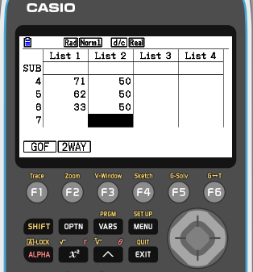
Hypothesis Testing
Now we are going to use the GDC to solve it.
Example:
Ryan wonders whether the die he was given is fair.
He rolls it 300 times. His results are shown in the table.
Press F1
GOF
Number | Frequency | f_{exp}
1 | 35
2 | 52
3 | 47
4 | 71
5 | 62
6 | 33
50
50
50
50
50
50

Slide 16
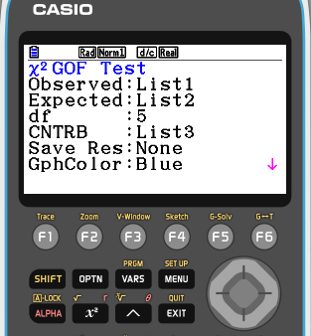
Hypothesis Testing
Now we are going to use the GDC to solve it.
Example:
Ryan wonders whether the die he was given is fair.
He rolls it 300 times. His results are shown in the table.
Make sure that Observed : List 1
Expected: List 2
df = 6 – 1 = 5
Number | Frequency | f_{exp}
1 | 35
2 | 52
3 | 47
4 | 71
5 | 62
6 | 33
EXE
50
50
50
50
50
50

Slide 17
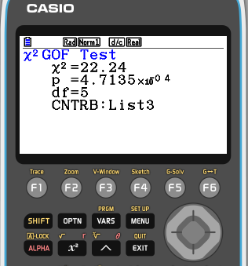
Hypothesis Testing
Now we are going to use the GDC to solve it.
Example:
Ryan wonders whether the die he was given is fair.
He rolls it 300 times. His results are shown in the table.
Number | Frequency | f_{exp}
1 | 35
2 | 52
3 | 47
4 | 71
5 | 62
6 | 33
50
$x_{}^{2}=$ 22.24
50
p = 4.7135×10⁻⁴
50
50
50
50

Slide 18
Hypothesis Testing
Now we are going to use the GDC to solve it.
Example:
Ryan wonders whether the die he was given is fair.
He rolls it 300 times. His results are shown in the table.
Number | Frequency | f_{exp}
1 | 35
2 | 52
3 | 47
4 | 71
5 | 62
6 | 33
50
$x_{}^{2}=$ 22.24
50
p = 4.7135×10⁻⁴
50
Using the p-value.
50
$p$< $α$
If
Reject H₀
50
If
$p$>$α$
Accept H₀
50

Slide 19
Summary of the χ² (chi-squared) Goodness of fit test
χ² Goodness of fit test procedure with critical values
Step 1:
State the null hypothesis H₀ and the alternative hypothesis H₁.
Step 2:
State the significance level α.
Step 3:
Calculate the value of the test statistic $x_{calc}^{2}=\sum{\frac{{\left(f_{obs}−f_{exp}\right)}^{2}}{f_{exp}}}$
Step 4:
Find the degrees of freedom
df = number of categories – 1
Step 5:
Using df and α find the critical value $x_{crit}^{2}$.
Step 6:
Reject H₀ if $x_{calc}^{2}$ ≥ $x_{crit}^{2}$
Step 7:
Take your decision in the context of the problem. Write the conclusion in a sentence

Slide 20
Summary of the χ² (chi-squared) Goodness of fit test
χ² Goodness of fit test procedure with p-values
Step 1:
State the null hypothesis H₀ and the alternative hypothesis H₁.
Step 2:
State the significance level α.
Step 3:
Calculate the value of the test statistic $x_{calc}^{2}=\sum{\frac{{\left(f_{obs}−f_{exp}\right)}^{2}}{f_{exp}}}$
Step 4:
Find the degrees of freedom
df = number of categories – 1
Step 5:
Use the GDC to find the p-value.
Step 6:
Reject H₀ if p-value ≤ α
Step 7:
Take your decision in the context of the problem. Write the conclusion in a sentence

Slide 21
Thank you for using resources from
For more resources visit our website
https://www.mathssupport.org
If you have a special request, drop us an email
info@mathssupport.org

