Slide 1
The Chi-squared test (χ²)
LO: To perform the χ² test of independence to accept or reject a hypothesis.

Slide 2
Hypothesis Testing
You may be interested in finding out whether or not certain sets of data are independent.
Suppose that you are interested in how the variables gender and favourite season are related.
One way to do this is to perform a chi-squared test (c²) of independence.
When two variables are independent one does not affect the other.
This are the results you obtained from the survey.
8 male like summer
12 female like summer
11 male like autumn
17 female like autumn
6 male like winter
10 female like winter
20 male like spring
16 female like spring

Slide 3
Chi-squared test (χ²)
To perform a chi-squared test (χ²) there are six main steps.
Step 1.
Make a conjecture (assumption) about the two data sets.
A conjecture must be stated in two parts:
The null hypothesis (H₀) – states that the data sets are independent.
The alternative hypothesis (H₁) states that the data sets are not independent.
For example, the hypothesis for favourite season and gender could be:
H₀: Favourite season is independent of gender.
H₁: Favourite season is not independent of gender.

Slide 4
Chi-squared test (χ²)
To perform a chi-squared test (χ²) there are six main steps.
Step 2.
Put the data into a contingency table.
A contingency table shows the frequency of two variables.
The elements in the table are the observed values.
For our example about favourite season and gender the contingency table is:
Gender | Summer | Autumn | Winter | Spring | Total
Male | 8 | 11 | 6 | 20 | 45
Female | 12 | 17 | 10 | 16 | 55
Sum | 20 | 28 | 16 | 36 | 100

Slide 5
Chi-squared test (χ²)
To perform a chi-squared test (χ²) there are six main steps.
Step 3.
From the observed values calculate the expected values.
If gender and favourite season were independent, then
P(male ∩ summer) =
$$\frac{45}{100}$$
$$\frac{20}{100}$$
P(male)
×
P(summer)
=
×
In a sample of 100 persons, we would expect
$$100×\left(\frac{45}{100}×\frac{20}{100}\right)$$
= 9
Gender | Summer | Autumn | Winter | Spring | Total
Male |  |  |  |  | 45
Female |  |  |  |  | 55
Sum | 20 | 28 | 16 | 36 | 100
9

Slide 6
Chi-squared test (χ²)
To perform a chi-squared test (χ²) there are six main steps.
Step 3.
From the observed values calculate the expected values.
If gender and favourite season were independent, then
P(male ∩ autumn) =
×
$$\frac{45}{100}$$
×
$$\frac{28}{100}$$
P(male)
P(autumn)
=
In a sample of 100 persons, we would expect
$$100×\left(\frac{45}{100}×\frac{28}{100}\right)$$
= 12.6
Gender | Summer | Autumn | Winter | Spring | Total
Male |  |  |  |  | 45
Female |  |  |  |  | 55
Sum | 20 | 28 | 16 | 36 | 100
9
12.6

Slide 7
Chi-squared test (χ²)
To perform a chi-squared test (χ²) there are six main steps.
Step 3.
From the observed values calculate the expected values.
If gender and favourite season were independent, then
P(male ∩ winter) =
×
$$\frac{45}{100}$$
×
$$\frac{16}{100}$$
P(male)
P(winter)
=
In a sample of 100 persons, we would expect
$$100×\left(\frac{45}{100}×\frac{16}{100}\right)$$
= 7.2
Gender | Summer | Autumn | Winter | Spring | Total
Male |  |  |  |  | 45
Female |  |  |  |  | 55
Sum | 20 | 28 | 16 | 36 | 100
9
12.6
7.2

Slide 8
Chi-squared test (χ²)
To perform a chi-squared test (χ²) there are six main steps.
Step 3.
From the observed values calculate the expected values.
If gender and favourite season were independent, then
P(male ∩ spring) =
×
$$\frac{45}{100}$$
$$\frac{36}{100}$$
P(male)
P(spring)
=
×
In a sample of 100 persons, we would expect
$$100×\left(\frac{45}{100}×\frac{36}{100}\right)$$
= 16.2
Gender | Summer | Autumn | Winter | Spring | Total
Male |  |  |  |  | 45
Female |  |  |  |  | 55
Sum | 20 | 28 | 16 | 36 | 100
9
12.6
7.2
16.2

Slide 9
Chi-squared test (χ²)
To perform a chi-squared test (χ²) there are six main steps.
Step 3.
From the observed values calculate the expected values.
If gender and favourite season were independent, then
P(female ∩ summer) =
×
$$\frac{55}{100}$$
$$\frac{20}{100}$$
P(female)
P(summer)
=
×
In a sample of 100 persons, we would expect
$$100×\left(\frac{55}{100}×\frac{20}{100}\right)$$
= 11
Gender | Summer | Autumn | Winter | Spring | Total
Male |  |  |  |  | 45
Female |  |  |  |  | 55
Sum | 20 | 28 | 16 | 36 | 100
9
12.6
7.2
16.2
11

Slide 10
Chi-squared test (χ²)
To perform a chi-squared test (χ²) there are six main steps.
Step 3.
From the observed values calculate the expected values.
If gender and favourite season were independent, then
P(female ∩ autumn) =
$$\frac{55}{100}$$
×
$$\frac{28}{100}$$
P(female)
P(autumn)
=
×
In a sample of 100 persons, we would expect
$$100×\left(\frac{55}{100}×\frac{28}{100}\right)$$
= 15.4
Gender | Summer | Autumn | Winter | Spring | Total
Male |  |  |  |  | 45
Female |  |  |  |  | 55
Sum | 20 | 28 | 16 | 36 | 100
9
12.6
7.2
16.2
11
15.4

Slide 11
Chi-squared test (χ²)
To perform a chi-squared test (χ²) there are six main steps.
Step 3.
From the observed values calculate the expected values.
If gender and favourite season were independent, then
P(female ∩ winter) =
×
$$\frac{55}{100}$$
×
$$\frac{16}{100}$$
P(female)
P(winter)
=
In a sample of 100 persons, we would expect
$$100×\left(\frac{55}{100}×\frac{16}{100}\right)$$
= 8.8
Gender | Summer | Autumn | Winter | Spring | Total
Male |  |  |  |  | 45
Female |  |  |  |  | 55
Sum | 20 | 28 | 16 | 36 | 100
9
12.6
7.2
16.2
11
15.4
8.8

Slide 12
Chi-squared test (χ²)
To perform a chi-squared test (χ²) there are six main steps.
Step 3.
From the observed values calculate the expected values.
If gender and favourite season were independent, then
P(female ∩ spring) =
×
$$\frac{55}{100}$$
×
$$\frac{36}{100}$$
P(female)
P(spring)
=
In a sample of 100 persons, we would expect
$$100×\left(\frac{55}{100}×\frac{36}{100}\right)$$
= 19.8
Gender | Summer | Autumn | Winter | Spring | Total
Male |  |  |  |  | 45
Female |  |  |  |  | 55
Sum | 20 | 28 | 16 | 36 | 100
9
12.6
7.2
16.2
11
15.4
8.8
19.8

Slide 13
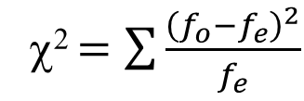
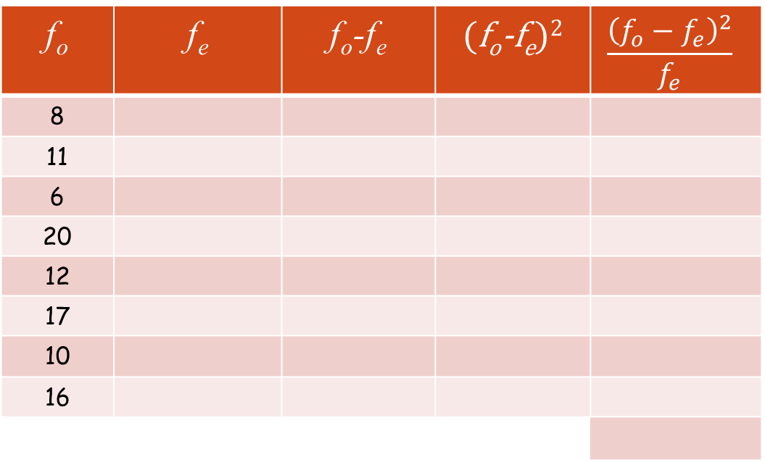
Chi-squared test (χ²)
To perform a chi-squared test (χ²) there are six main steps.
Step 4.
Calculate the chi-squared (c²) value.
To calculate the chi-squared (c²) value use the formula
f_{o} | f_{e} | f_{o}-f_{e} | (f_{o}-f_{e})² | $$\frac{{\left(f_{o}−f_{e}\right)}^{2}}{f_{e}}$$
8
11
6
20
12
17
10
16
χ² $=\sum{\frac{{\left(f_{o}−f_{e}\right)}^{2}}{f_{e}}}$
9
-1
1
0.11111
Where
12.6
-1.6
2.56
0.2031746
fo is observed frequency
7.2
-1.2
1.44
0.2
16.2
3.8
14.44
0.891358
11
1
1
0.090909
fe is expected frequency
15.4
1.6
2.56
0.166234
8.8
1.2
1.44
0.1636363
19.8
-3.8
14.44
0.7292929
Total (χ²)
2.56 (3sf)

Slide 14
Chi-squared test (χ²)
To perform a chi-squared test (χ²) there are six main steps.
Step 5.
Calculate the critical value.
First note the level of significance
The significance level indicates the minimum acceptable probability that the variables are independent.
We usually use either 10%, 5% or 1% for significance level
In our example we are going to use 1%
Now we need to calculate the number of degrees of freedom
To find the degrees of freedom, use the formula base on the contingency table
df = (number of rows – 1)(number of columns – 1)

Slide 15
Chi-squared test (χ²)
To perform a chi-squared test (χ²) there are six main steps.
Step 5.
Calculate the critical value.
The level of significance our example = 1%
df = (number of rows – 1)(number of columns – 1)
Degrees of freedom (df) | Significance level
 | 10% | 5% | 1%
1 | 2.71 | 3.84 | 6.63
2 | 4.61 | 5.99 | 9.21
3 | 6.25 | 7.81 | 11.34
4 | 7.78 | 9.49 | 13.28
5 | 9.24 | 11.07 | 15.09
6 | 10.64 | 12.59 | 16.81
7 | 12.02 | 14.07 | 18.48
8 | 13.36 | 15.51 | 20.09
9 | 14.68 | 16.92 | 21.67
10 | 15.99 | 18.31 | 23.21
df = (2 - 1)(4– 1)
df = 3
We can obtain the critical value from tables
We find the critical value
Critical value is 11.34
In examination it will be given

Slide 16
Chi-squared test (χ²)
To perform a chi-squared test (χ²) there are six main steps.
Step 6.
Compare χ²_{calc} against the critical value.
If χ²_{calc} is less than the critical value, then do not reject the null hypothesis
If χ²_{calc} is more than the critical value, then reject the null hypothesis
In our example
At 1% level
χ²_{calc} = 2.56
Critical value is 11.34
2.56 < 11.34
We do not reject the null hypothesis
We accept that Favourite season is independent of gender.

Slide 17
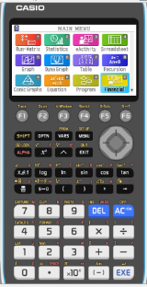
Chi-square (χ²) test by GDC
The Chi-square test itself is quite straight forward, your GDC can do it in few steps but you also must know the formula and be able to do it by hand
We are going to use a Graphing display calculator to solve the problem
CASIO

Slide 18
Chi-square (χ²) test by GDC
The Chi-square test itself is quite straight forward, your GDC can do it in few steps but you also must know the formula and be able to do it by hand
Example 2.
 | Weight
 | light | medium | heavy
Diabetic | 11 | 19 | 26
Non-diabetic | 79 | 68 | 69
This contingency table shows the responses of a randomly sample of adults regarding the person’s weight and whether they have diabetes,
Test at 5% significance level whether there is a link between weight and suffering diabetes.
Turn on
Press 2
Statistics
H₀: having diabetes is independent of weight.
H₁: having diabetes is not independent of weight.

Slide 19
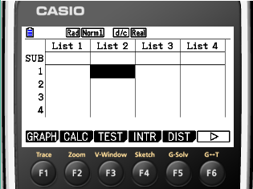
Chi-square (χ²) test by GDC
The Chi-square test itself is quite straight forward, your GDC can do it in few steps but you also must know the formula and be able to do it by hand
Example 2.
 | Weight
 | light | medium | heavy
Diabetic | 11 | 19 | 26
Non-diabetic | 79 | 68 | 69
This contingency table shows the responses of a randomly sample of adults regarding the person’s weight and whether they have diabetes,
Test at 5% significance level whether there is a link between weight and suffering diabetes.
F3
TEST
H₀: having diabetes is independent of weight.
H₁: having diabetes is not independent of weight.

Slide 20
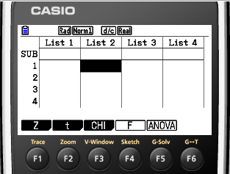
Chi-square (χ²) test by GDC
The Chi-square test itself is quite straight forward, your GDC can do it in few steps but you also must know the formula and be able to do it by hand
Example 2.
 | Weight
 | light | medium | heavy
Diabetic | 11 | 19 | 26
Non-diabetic | 79 | 68 | 69
This contingency table shows the responses of a randomly sample of adults regarding the person’s weight and whether they have diabetes,
Test at 5% significance level whether there is a link between weight and suffering diabetes.
F3
CHI
H₀: having diabetes is independent of weight.
H₁: having diabetes is not independent of weight.

Slide 21
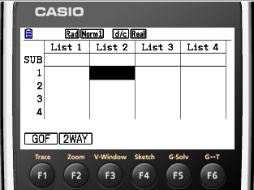
Chi-square (χ²) test by GDC
The Chi-square test itself is quite straight forward, your GDC can do it in few steps but you also must know the formula and be able to do it by hand
Example 2.
 | Weight
 | light | medium | heavy
Diabetic | 11 | 19 | 26
Non-diabetic | 79 | 68 | 69
This contingency table shows the responses of a randomly sample of adults regarding the person’s weight and whether they have diabetes,
Test at 5% significance level whether there is a link between weight and suffering diabetes.
F2
2 WAY
H₀: having diabetes is independent of weight.
H₁: having diabetes is not independent of weight.

Slide 22
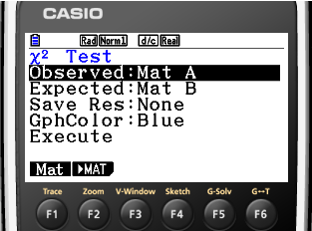
Chi-square (χ²) test by GDC
The Chi-square test itself is quite straight forward, your GDC can do it in few steps but you also must know the formula and be able to do it by hand
Example 2.
 | Weight
 | light | medium | heavy
Diabetic | 11 | 19 | 26
Non-diabetic | 79 | 68 | 69
This contingency table shows the responses of a randomly sample of adults regarding the person’s weight and whether they have diabetes,
Test at 5% significance level whether there is a link between weight and suffering diabetes.
F2
MAT
H₀: having diabetes is independent of weight.
H₁: having diabetes is not independent of weight.

Slide 23
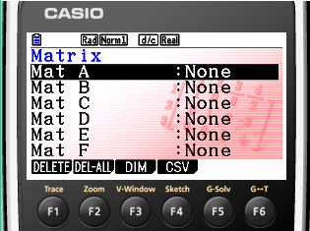
Chi-square (χ²) test by GDC
The Chi-square test itself is quite straight forward, your GDC can do it in few steps but you also must know the formula and be able to do it by hand
Example 2.
 | Weight
 | light | medium | heavy
Diabetic | 11 | 19 | 26
Non-diabetic | 79 | 68 | 69
This contingency table shows the responses of a randomly sample of adults regarding the person’s weight and whether they have diabetes,
Test at 5% significance level whether there is a link between weight and suffering diabetes.
F3
DIM
H₀: having diabetes is independent of weight.
H₁: having diabetes is not independent of weight.

Slide 24
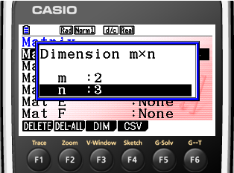
Chi-square (χ²) test by GDC
The Chi-square test itself is quite straight forward, your GDC can do it in few steps but you also must know the formula and be able to do it by hand
Example 2.
 | Weight
 | light | medium | heavy
Diabetic | 11 | 19 | 26
Non-diabetic | 79 | 68 | 69
This contingency table shows the responses of a randomly sample of adults regarding the person’s weight and whether they have diabetes,
Test at 5% significance level whether there is a link between weight and suffering diabetes.
2
EXE
3
EXE
EXE
H₀: having diabetes is independent of weight.
H₁: having diabetes is not independent of weight.

Slide 25
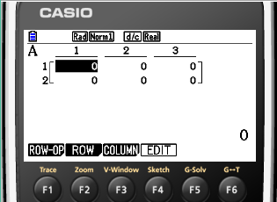
Chi-square (χ²) test by GDC
The Chi-square test itself is quite straight forward, your GDC can do it in few steps but you also must know the formula and be able to do it by hand
Example 2.
 | Weight
 | light | medium | heavy
Diabetic | 11 | 19 | 26
Non-diabetic | 79 | 68 | 69
This contingency table shows the responses of a randomly sample of adults regarding the person’s weight and whether they have diabetes,
Test at 5% significance level whether there is a link between weight and suffering diabetes.
type
EXE
11
19
EXE
26
EXE
79
EXE
68
EXE
69
EXE
H₀: having diabetes is independent of weight.
H₁: having diabetes is not independent of weight.

Slide 26
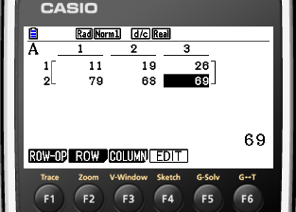
Chi-square (χ²) test by GDC
The Chi-square test itself is quite straight forward, your GDC can do it in few steps but you also must know the formula and be able to do it by hand
Example 2.
 | Weight
 | light | medium | heavy
Diabetic | 11 | 19 | 26
Non-diabetic | 79 | 68 | 69
This contingency table shows the responses of a randomly sample of adults regarding the person’s weight and whether they have diabetes,
Test at 5% significance level whether there is a link between weight and suffering diabetes.
Press
EXIT
EXIT
H₀: having diabetes is independent of weight.
H₁: having diabetes is not independent of weight.

Slide 27
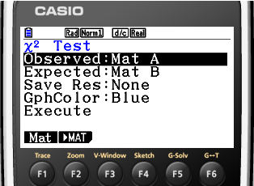
Chi-square (χ²) test by GDC
The Chi-square test itself is quite straight forward, your GDC can do it in few steps but you also must know the formula and be able to do it by hand
Example 2.
 | Weight
 | light | medium | heavy
Diabetic | 11 | 19 | 26
Non-diabetic | 79 | 68 | 69
This contingency table shows the responses of a randomly sample of adults regarding the person’s weight and whether they have diabetes,
Test at 5% significance level whether there is a link between weight and suffering diabetes.
Scroll down
Execute
F1
H₀: having diabetes is independent of weight.
H₁: having diabetes is not independent of weight.

Slide 28
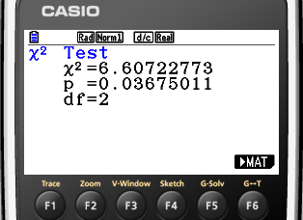
Chi-square (χ²) test by GDC
The Chi-square test itself is quite straight forward, your GDC can do it in few steps but you also must know the formula and be able to do it by hand
Example 2.
 | Weight
 | light | medium | heavy
Diabetic | 11 | 19 | 26
Non-diabetic | 79 | 68 | 69
This contingency table shows the responses of a randomly sample of adults regarding the person’s weight and whether they have diabetes,
Test at 5% significance level whether there is a link between weight and suffering diabetes.
χ²=6.61
At 5% significance level the critical value of χ² = 5.99
H₀: having diabetes is independent of weight.
H₁: having diabetes is not independent of weight.

Slide 29
Chi-square (χ²) test by GDC
The Chi-square test itself is quite straight forward, your GDC can do it in few steps but you also must know the formula and be able to do it by hand
Example 2.
 | Weight
 | light | medium | heavy
Diabetic | 11 | 19 | 26
Non-diabetic | 79 | 68 | 69
This contingency table shows the responses of a randomly sample of adults regarding the person’s weight and whether they have diabetes,
Test at 5% significance level whether there is a link between weight and suffering diabetes.
χ²=6.61
As χ²_{calc} > 5.99, we reject H₀, and conclude that the variables weight and suffering diabetes are not independent.
At 5% significance level the critical value of χ² = 5.99

Slide 30
Formal Test for independence
The p-value
When finding χ² on your calculator, a p-value is also provided. This can be used, together with the χ² value and the critical value, to determine whether or not accept that the variables are independent
If the p-value is smaller than the significance level, then it is sufficiently unlikely that we would have obtained the observed results if the variables had been independent
For example, at 5% significance level:
if p < 0.05, we reject H₀
if p > 0.05, we do not reject H₀
As p < 0.05, we reject H₀, and conclude that the variables weight and suffering diabetes are not independent.

Slide 31
Thank you for using resources from
For more resources visit our website
https://www.mathssupport.org
If you have a special request, drop us an email
info@mathssupport.org

