Slide 1
Introduction to probabilities
LO: Understand and use the vocabulary of probability.

Slide 2
Introduction to probability
The probability of an event is a measure of the chance that it will occur.
Probabilities can be given as percentages from 0% to 100%, or decimal numbers between 0 and 1 or proper fractions.
An impossible event has 0% chance of happening and is assigned the probability 0.
A certain event has 100% chance of happening and is assigned the probability 1.
An even chance event has 50% chance of happening and is assigned the probability 0.5.
All other events are assigned a probability between 0 and 1.
Slightly less than equal chance
Slightly more than equal chance
Very likely to happen
Very unlikely to happen
impossible
certain
0
0.5
1
Not likely to happen
Equal chance of happening as not happening
likely to happen

Slide 3
Introduction to probability
In probability we can use capital letters to represent events, for example
The event that tomorrow Ahmed scores a goal in the next football match, we may call it the event A.
The probability that the event A occurs is written P(A), which is the probability that Ahmed scores a goal.
If P(A) = 0.25, what phrase describes this probability?
Complementary events
Two events are complementary if exactly one of they must occur.
The probabilities of complementary events sum to 1
The complement of event A is denoted A’. It is the event that A does not occur.

Slide 4
Introduction to probability
For any event A with complementary event A’,
P(A) + P(A’) = 1
P(A’) = 1 – P(A)
If A is the event that Ahmed scores a goal in the next football match
A’ is the event that Ahmed does not score a goal in the next football match
Therefore
P(A’) = 1 – P(A)
P(A’) = 1 – 0.25
P(A’) = 0.75

Slide 5

How could you estimate the probability that a train will be late?
Will the train be late today?
You could keep a record of the number of times that the train arrives late over a period of 10 days, and then use these results to estimate the probability that it will be late in the future.
The experiment here is observing the train, and the outcome you record is the train being late.
The results enable you to find the experimental probability of the train being late.

Slide 6
In experiments involving chance, we use the following terms to describe what we are doing and the results we are obtaining.
Is the total number of times the experiment is repeated.
Number of trials
are the different results possible for one trial of the experiment.
Outcomes
of a particular outcome is the number of times that this outcome is observed.
Frequency
of an outcome is the frequency of that outcome expressed as a fraction or percentage of the total number of trials
Relative frequency
frequency
Relative frequency =
Number of trials
The experimental probability is the Relative frequency of the outcome

Slide 7
A marketing company surveys 80 randomly selected people to discover what brand of shoe cleaner they use
The results are shown in this table
Brand | Frequency | Relative frequency
Shine | 27
Brite | 22
Cleano | 20
No Scuff | 11
0.3375
0.2750
0.2500
0.1375
80
Based on these results, estimate the probability that a randomly selected person uses Brite
We start by calculating the relative frequency of each brand
frequency
27
Relative frequency =
=
= 0.3375
Number of trials
80

Slide 8
A marketing company surveys 80 randomly selected people to discover what brand of shoe cleaner they use
The results are shown in this table
Brand | Frequency | Relative frequency
Shine | 27
Brite | 22
Cleano | 20
No Scuff | 11
0.3375
0.2750
0.2500
0.1375
80
Based on these results, estimate the probability that a randomly selected person uses Cleano
From the table we know that the probability is 0.25

Slide 9
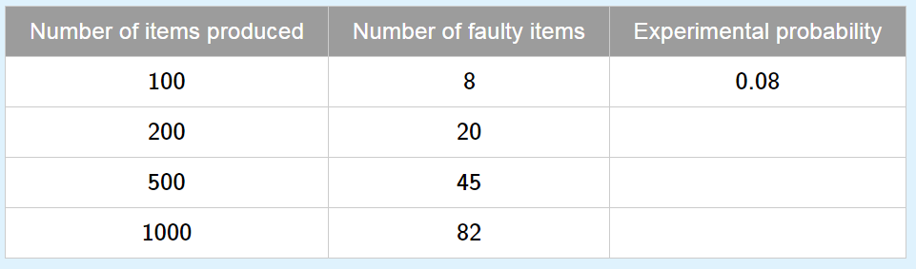
A company manufactures items for computers.
The number of faulty items is recorded in this table
0.1
0.09
0.082
Complete the table.
Which is the best estimate of the probability of an item being faulty?
The best estimate is the last result 0.082
Explain your answer.
As the relative frequency is based on more results.

Slide 10

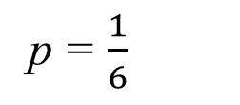
Expected value
If there are n trial of an experiment, and the probability of an event occurring in each trial is p, then the expectation of the occurrence of that event is np.
For example:
How many times I expect to get a 2 if I roll a dice 120 times?
n = 120
Expected value =
120 × $\frac{1}{6}$
p = $\frac{1}{6}$
= 20
We expect 20 times the dice lands in a 2

Slide 11
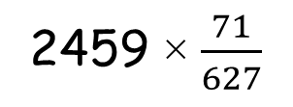
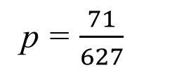
Expected value
In one week, 71 out of 627 trains were late to the station at Waterloo. In the next month, 2459 trains are scheduled to pass through the station. How many of these would you expect to be late?.
n = 2459
2459 × $\frac{71}{627}$
Expected value =
p = $\frac{71}{627}$
We expect trains in the next month to be late.
≈ 278

Slide 12
Sample space diagrams
A sample space diagram is a way of showing all possible equally likely outcomes of an experiment.
There are a variety of ways of representing sample spaces:
Lists
2-dimensional grids
Tree diagrams
Tables of outcomes
Venn diagrams

Slide 13


Listing outcomes
Example:
One coin is tossed and a die is rolled at the same time, list all the possible outcomes.
We can write a list of all the possible outcomes in the experiment.
H, 1
T, 1
H, 2
T, 2
H, 3
T, 3
H, 4
T, 4
H, 5
T, 5
H, 6
T, 6

Slide 14
2-Dimensional grids
Example:
One coin is tossed and a die is rolled at the same time, list all the possible outcomes.
A grid is often more efficient to show all the possible outcomes.
Each point on the grid represents one of the outcomes
T
Coin
H
1
2
3
4
5
6
Die

Slide 15
Tree diagrams
Example:
One coin is tossed and a die is rolled at the same time, list all the possible outcomes.
We can use a tree diagram to illustrate the sample space.
H
1
T
H
2
T
H
3
T
H
4
T
H
5
T
H
6
T

Slide 16
Table of outcomes
Example:
One coin is tossed and a die is rolled at the same time, list all the possible outcomes.
We can use a two-dimensional grid to write all the possible outcomes of the experiment.
Die
 | 1 | 2 | 3 | 4 | 5 | 6
H
T
Coin
H, 1
H, 2
H, 3
H, 4
H, 5
H, 6
T, 1
T, 2
T, 3
T, 4
T, 5
T,6

Slide 17

Sample space
Example
A red and a blue dice are rolled together.
Calculate the probability that:
The total score is 7
6
5
P(total score 7) =
4
red dice
3
2
1
1
2
3
4
5
6
blue dice

Slide 18
Sample space
Example
A red and a blue dice are rolled together.
Calculate the probability that:
The same number comes up on both dice.
6
5
4
P(same number) =
red dice
3
2
1
1
2
3
4
5
6
blue dice

Slide 19
Sample space
Example
A red and a blue dice are rolled together.
Calculate the probability that:
The difference between the scores is 1.
6
5
P(the difference between the scores is 1) =
4
red dice
3
2
1
1
2
3
4
5
6
blue dice

Slide 20
Sample space
Example
A red and a blue dice are rolled together.
Calculate the probability that:
The score on the red dice is less than the score on the blue dice.
6
P(the score on the red dice is less than the score on the blue dice ) =
5
4
red dice
3
2
1
1
2
3
4
5
6
blue dice

Slide 21
Sample space
Example
A red and a blue dice are rolled together.
Calculate the probability that:
The total score is a prime number.
6
P(the total score is a prime number) =
5
4
red dice
3
2
1
1
2
3
4
5
6
blue dice

Slide 22

Thank you for using resources from
For more resources visit our website
https://www.mathssupport.org
If you have a special request, drop us an email
info@mathssupport.org

