Slide 1
Voronoi diagrams
LO: Using the vocabulary for Voronoi diagrams.

Slide 2
Voronoi diagrams
Voronoi diagram
Is a partition of a plane into regions close to each of a given set of objects.
Sites
In this course, these object are just points in the plane called sites.
Voronoi edges
The Voronoi edges (boundaries) are the lines separating the regions.
B
Voronoi Cells
A
C
For each site there is a corresponding region, called a Voronoi cell consisting of all points of the plane closer to that site than to any other.
E
D
Voronoi vertices
The Voronoi vertices are the points at which cells boundaries meet and is equidistant to three (or more) surrounding sites.

Slide 3
Voronoi diagrams
Example 1
A town has the coffee shops identified as A, B,C and D located on the places shown on the grid.
How many cells does the diagram contain?
How many vertices does the diagram contain?
Identify the site(s) closest to:
(i) (2, -1), (ii) (1, 4), (iii) (-1, -2), (iv) vertex Q
(a) The diagram contains 4 cells, one for each site
A
P
(b) The diagram contains 3 vertices
R
(iii) (-1, -2)
(iv)
Is the vertex Q, so it is equally closest to B, C and D
B
(c)
(ii) (1, 4)
it is closest to site A
(i) (2, -1)
lies on the edge adjacent to sites B and D, so it is equally closest to B and D.
it is closest to site C
C
D
Q

Slide 4
Voronoi diagrams
Example 2
Consider the Voronoi diagram for the sites A, B, and C.
State the number of: (i) cells (ii) edges (iii) vertices
Find the equation of each of the boundaries.
Find the coordinates of any vertex
(a)
(i) The diagram contains 3 cells, one for each site
B
(ii) The diagram contains 3 edges
V
(iii) The diagram contains 1 vertex
A
C

Slide 5
Voronoi diagrams
Example 2
Consider the Voronoi diagram for the sites A, B, and C.
State the number of: (i) cells (ii) edges (iii) vertices
Find the equation of each of the boundaries.
Find the coordinates of any vertex
(b)
We are going to find the equation of the red edge.
y = – x
B
The red edge is the perpendicular bisector of A(-3, -2) and B(2, 3)
V
x₁
y₁
x₂
y₂
= $\frac{3+2}{2+3}$
m = $\frac{y_{2}−y_{1}}{x_{2}−x_{1}}$
= 1
Finding the gradient AB
A
C
The gradient of the perpendicular to AB
m_{P(AB)} = –1
The midpoint AB
= ( $\frac{x_{1}−x_{2}}{2}$ , $\frac{y_{1}+y_{2}}{2}$ )
The equation of the perpendicular bisector is
= ( $\frac{−3+2}{2}$ , $\frac{−2+3}{2}$ )
(x + )
y
$$\frac{1}{2}$$
$$\frac{1}{2}$$
–
=
–1
= ( $−\frac{1}{2}$ , $\frac{1}{2}$ )
y
=
–x

Slide 6
Voronoi diagrams
Example 2
Consider the Voronoi diagram for the sites A, B, and C.
State the number of: (i) cells (ii) edges (iii) vertices
Find the equation of each of the boundaries.
Find the coordinates of any vertex
(b)
We are going to find the equation of the blue edge.
y = – x
B
The blue edge is the perpendicular bisector of B(2, 3) and C(1, –3)
y = $−\frac{1}{6}$x $+\frac{1}{4}$
V
x₁
y₁
x₂
y₂
= $\frac{−3−3}{1−2}$
m = $\frac{y_{2}−y_{1}}{x_{2}−x_{1}}$
= 6
Finding the gradient BC
A
C
The gradient of the perpendicular to BC
m_{P(BC)} = $−\frac{1}{6}$
The midpoint BC
= ( $\frac{x_{1}−x_{2}}{2}$ , $\frac{y_{1}+y_{2}}{2}$ )
The equation of the perpendicular bisector is
= ( $\frac{2+1}{2}$ , $\frac{3−3}{2}$ )
(x – )
y
$$−\frac{1}{6}$$
$$\frac{3}{2}$$
–
0
=
= ( $\frac{3}{2}$ , 0)
y
=
$−\frac{1}{6}$x $+\frac{1}{4}$

Slide 7
Voronoi diagrams
Example 2
Consider the Voronoi diagram for the sites A, B, and C.
State the number of: (i) cells (ii) edges (iii) vertices
Find the equation of each of the boundaries.
Find the coordinates of any vertex
(b)
We are going to find the equation of the yellow edge.
y = – x
B
The yellow edge is the perpendicular bisector of A(–3, –2) and C(1, –3)
y = $−\frac{1}{6}$x $+\frac{1}{4}$
V
x₁
y₁
x₂
y₂
y = 4x $+\frac{3}{2}$
m = $\frac{y_{2}−y_{1}}{x_{2}−x_{1}}$
= $\frac{−3+2}{1+3}$
= $−\frac{1}{4}$
Finding the gradient AC
A
C
The gradient of the perpendicular to BC
m_{P(BC)} = 4
The midpoint AC
= ( $\frac{x_{1}−x_{2}}{2}$ , $\frac{y_{1}+y_{2}}{2}$ )
The equation of the perpendicular bisector is
= ( $\frac{−3+1}{2}$ , $\frac{−2−3}{2}$ )
y
$$\frac{5}{2}$$
(x + )
+
=
4
1
= (-1, $−\frac{5}{2}$)
y
=
4x $+\frac{3}{2}$

Slide 8
Voronoi diagrams
Example 2
Consider the Voronoi diagram for the sites A, B, and C.
State the number of: (i) cells (ii) edges (iii) vertices
Find the equation of each of the boundaries.
Find the coordinates of any vertex
(c)
Find the coordinates of any vertex.
y = – x
There is only one vertex, the intersecting point of the three boundaries.
B
y = $−\frac{1}{6}$x $+\frac{1}{4}$
y = – x
①
We are going to use the GDC to find the intersecting point.
V
y = 4x $+\frac{3}{2}$
y = $−\frac{1}{6}$x $+\frac{1}{4}$
②
A
C
y = 4x $+\frac{3}{2}$
③
We have to write the equations in general form.
y + x = 0
①
–8x + 2y = 3
②
2x + 12y = 3
③

Slide 9
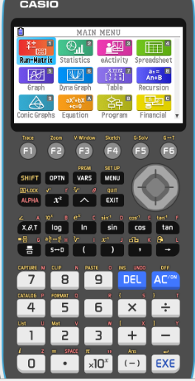
Voronoi diagrams
Example 2
Consider the Voronoi diagram for the sites A, B, and C.
State the number of: (i) cells (ii) edges (iii) vertices
Find the equation of each of the boundaries.
Find the coordinates of any vertex
(c)
Find the coordinates of any vertex.
y = – x
y + x = 0
①
B
–8x + 2y = 3
y = $−\frac{1}{6}$x $+\frac{1}{4}$
②
V
2x + 12y = 3
③
y = 4x $+\frac{3}{2}$
A
Turn on the GDC
A
Equation
C

Slide 10
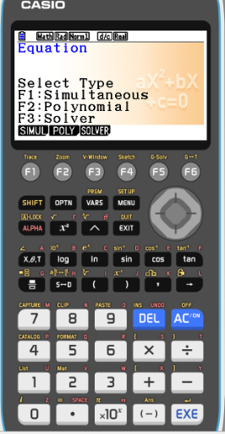
Voronoi diagrams
Example 2
Consider the Voronoi diagram for the sites A, B, and C.
State the number of: (i) cells (ii) edges (iii) vertices
Find the equation of each of the boundaries.
Find the coordinates of any vertex
(c)
Find the coordinates of any vertex.
y = – x
y + x = 0
①
B
–8x + 2y = 3
y = $−\frac{1}{6}$x $+\frac{1}{4}$
②
V
2x + 12y = 3
③
y = 4x $+\frac{3}{2}$
A
Turn on the GDC
A
Equation
C
F1
Simultaneous

Slide 11
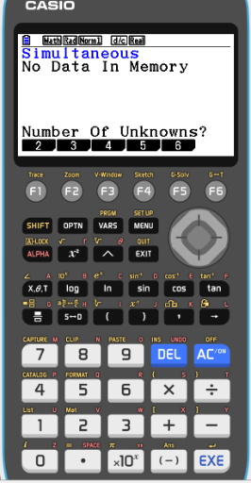
Voronoi diagrams
Example 2
Consider the Voronoi diagram for the sites A, B, and C.
State the number of: (i) cells (ii) edges (iii) vertices
Find the equation of each of the boundaries.
Find the coordinates of any vertex
(c)
Find the coordinates of any vertex.
y = – x
y + x = 0
①
B
–8x + 2y = 3
y = $−\frac{1}{6}$x $+\frac{1}{4}$
②
V
2x + 12y = 3
③
y = 4x $+\frac{3}{2}$
A
Turn on the GDC
A
Equation
C
F1
Simultaneous
F1
Number of unknowns 2

Slide 12
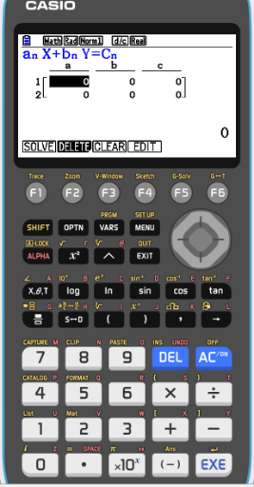
Voronoi diagrams
Example 2
Consider the Voronoi diagram for the sites A, B, and C.
State the number of: (i) cells (ii) edges (iii) vertices
Find the equation of each of the boundaries.
Find the coordinates of any vertex
(c)
Find the coordinates of any vertex.
y = – x
y + x = 0
①
B
–8x + 2y = 3
y = $−\frac{1}{6}$x $+\frac{1}{4}$
②
V
2x + 12y = 3
③
y = 4x $+\frac{3}{2}$
A
Turn on the GDC
A
Equation
C
F1
Simultaneous
F1
Number of unknowns 2
We will select two equations to solve. ① and ②
Type in the coefficients
1
1
0
–8
2
3

Slide 13
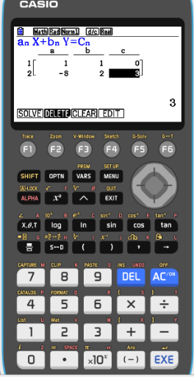
Voronoi diagrams
Example 2
Consider the Voronoi diagram for the sites A, B, and C.
State the number of: (i) cells (ii) edges (iii) vertices
Find the equation of each of the boundaries.
Find the coordinates of any vertex
(c)
Find the coordinates of any vertex.
y = – x
y + x = 0
①
B
–8x + 2y = 3
y = $−\frac{1}{6}$x $+\frac{1}{4}$
②
V
2x + 12y = 3
③
y = 4x $+\frac{3}{2}$
A
Turn on the GDC
A
Equation
C
F1
Simultaneous
F1
Number of unknowns 2
We will select two equations to solve. ① and ②
Type in the coefficients
1
1
0
–8
2
3
F1
Solve

Slide 14
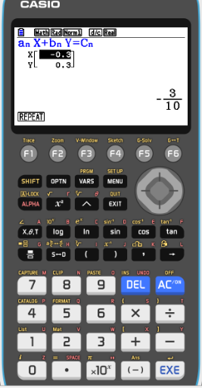
Voronoi diagrams
Example 2
Consider the Voronoi diagram for the sites A, B, and C.
State the number of: (i) cells (ii) edges (iii) vertices
Find the equation of each of the boundaries.
Find the coordinates of any vertex
(c)
Find the coordinates of any vertex.
y = – x
y + x = 0
①
B
–8x + 2y = 3
y = $−\frac{1}{6}$x $+\frac{1}{4}$
②
V
2x + 12y = 3
③
y = 4x $+\frac{3}{2}$
A
Turn on the GDC
A
Equation
C
F1
Simultaneous
F1
Number of unknowns 2
We will select two equations to solve. ① and ②
Type in the coefficients
1
1
0
x = –0.3
–8
2
3
F1
Solve
y = 0.3
Coordinates of vertex (–0.3, 0.3)

Slide 15
Voronoi diagrams
Example 2
Consider the Voronoi diagram for the sites A, B, and C.
State the number of: (i) cells (ii) edges (iii) vertices
Find the equation of each of the boundaries.
Find the coordinates of any vertex
(c)
Find the coordinates of any vertex.
y = – x
y + x = 0
①
B
–8x + 2y = 3
y = $−\frac{1}{6}$x $+\frac{1}{4}$
②
V
2x + 12y = 3
③
y = 4x $+\frac{3}{2}$
A
Turn on the GDC
A
Equation
C
F1
Simultaneous
F1
Number of unknowns 2
We will select other two equations to solve. ② and ③
Type in the coefficients
–8
2
3
x = –0.3
2
12
3
F1
Solve
y = 0.3
Coordinates of vertex (–0.3, 0.3)

Slide 16
Thank you for using resources from
For more resources visit our website
https://www.mathssupport.org
If you have a special request, drop us an email
info@mathssupport.org
Get 20% off in your next purchase from our website, just use this code when checkout: MSUPPORT_20

