Slide 1
Equations of perpendicular bisectors
LO: Find the equation of perpendicular bisector.

Slide 2

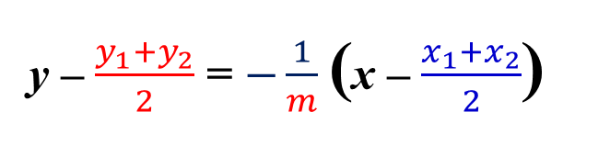
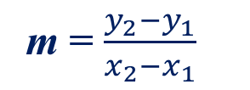

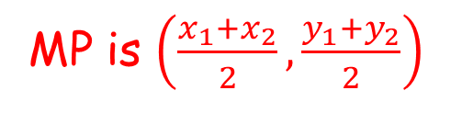
Equation of the perpendicular bisector of a line
Perpendicular bisector
The perpendicular bisector of a line segment joining two points
is the line that passes through the midpoint of the line segment
and is perpendicular to it.
To calculate the equation of the perpendicular bisector of a line joining A(x₁, y₁) to B(x₂, y₂) we need to know the coordinates of the midpoint,
and the gradient of the line segment [AB].
MP is $\left(\frac{x_{1}+x_{2}}{2},\frac{y_{1}+y_{2}}{2}\right)$
The gradient of [AB] is
m = $\frac{y_{2}−y_{1}}{x_{2}−x_{1}}$
the gradient of the perpendicular to AB is the negative reciprocal of m.
B(x₂, y₂)
$$−\frac{1}{m}$$
MP$\left(\frac{x_{1}+x_{2}}{2},\frac{y_{1}+y_{2}}{2}\right)$
Using the gradient-point form of the equation of the straight line.
y – $\frac{y_{1}+y_{2}}{2}$ = $−\frac{1}{m}$ (x – $\frac{x_{1}+x_{2}}{2}$)
A(x₁, y₁)

Slide 3
Equation of the perpendicular bisector of a line
Perpendicular bisector
The perpendicular bisector of a line segment joining two points
is the line that passes through the midpoint of the line segment
and is perpendicular to it.
All points on the perpendicular bisector are equidistant from A and B.
The shortest distance from a point to a straight line is the perpendicular distance
The perpendicular bisector divides the plane into two regions.
d₁
B(x₂, y₂)
On one side of the line are points that are closer to A than to B.
d₂
d₃
d
d₁
d₂
On the other side of the line are points that are closer to B than to A.
d
d₃
A(x₁, y₁)

Slide 4
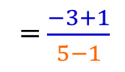


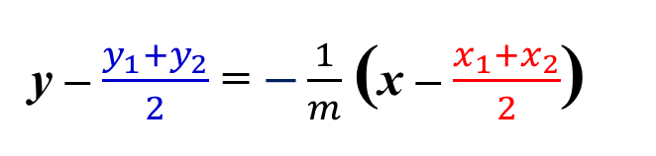
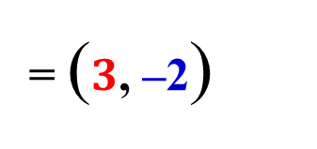
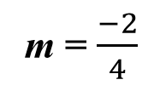
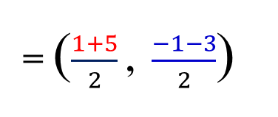

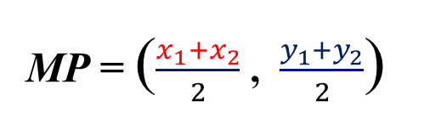

Perpendicular bisector of a line
Example 1
Find the equation of the perpendicular bisector of the line segment whose endpoints are A(1, –1) and B(5, –3) .
x₁
y₁
x₂
y₂
Finding the midpoint [AB]
MP = ($\frac{x_{1}+x_{2}}{2}$ , $\frac{y_{1}+y_{2}}{2}$)
Finding the gradient [AB]
m = $\frac{y_{2}−y_{1}}{x_{2}−x_{1}}$
= $\frac{−3+1}{5−1}$
= ($\frac{1+5}{2}$ , $\frac{−1−3}{2}$)
m = $\frac{−2}{4}$
= $−\frac{1}{2}$
= ($3$, –2)
The gradient of the perpendicular to [AB]
$$−\frac{1}{m}$$
y – $\frac{y_{1}+y_{2}}{2}$ = $−\frac{1}{m}$ (x – $\frac{x_{1}+x_{2}}{2}$)
m_{P(AB)} =
$$= 2$$
(x – )
y
(–2)
=
2
3
Substituting
–
y
2
=
2x
– 6
+
y
=
2x
– 8
The equation of the perpendicular bisector of AB is
y = 2x – 8

Slide 5

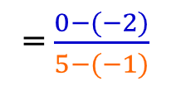


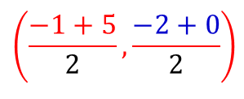
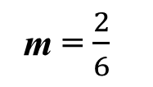
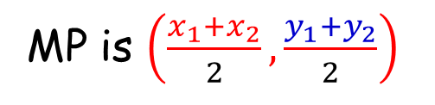

Perpendicular bisector of a line
Example 2
Draw the line that is perpendicular bisector to the points A(– 1, –2) and B(5, 0)
x₁
y₁
x₂
y₂
Finding the midpoint AB
MP is $\left(\frac{x_{1}+x_{2}}{2},\frac{y_{1}+y_{2}}{2}\right)$
$$\left(\frac{−1+5}{2},\frac{−2+0}{2}\right)$$
(2, –1)
Finding the gradient [AB]
m = $\frac{y_{2}−y_{1}}{x_{2}−x_{1}}$
= $\frac{0−(−2)}{5−(−1)}$
m = $\frac{2}{6}$
= $\frac{1}{3}$
B
The gradient of the perpendicular to [AB]
MP
A
$$−\frac{1}{m}$$
m_{P(AB)} =
$$=−3$$

Slide 6
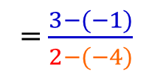

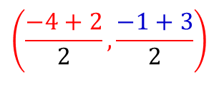


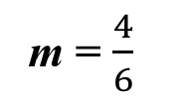
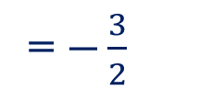

Perpendicular bisector of a line
Example 3
Shade the region of all the points closer to the point A(–4, –1) than to the point B(2, 3)
x₁
y₁
x₂
y₂
Finding the midpoint AB
Finding the gradient [AB]
MP is $\left(\frac{x_{1}+x_{2}}{2},\frac{y_{1}+y_{2}}{2}\right)$
= $\frac{3−(−1)}{2−(−4)}$
m = $\frac{y_{2}−y_{1}}{x_{2}−x_{1}}$
$$\left(\frac{−4+2}{2},\frac{−1+3}{2}\right)$$
m = $\frac{4}{6}$
= $\frac{2}{3}$
(–1, 1)
The gradient of the perpendicular to [AB]
The points on the line are equidistant to A and B
B
MP
$$−\frac{1}{m}$$
A
m_{P(AB)} =
The points to the left of the line are closer to A than to B
= $−\frac{3}{2}$

Slide 7
Perpendicular bisector of a line
Example 4
Two towns are located at points A(2, 18) and point B(12, 22), and a nearby road R is a straight line with equation y = x + 2. They want to build a road from A to B connecting to R at a point T so that the distance from A to B passing through T is shortest. Find the coordinates of T.
Draw a perpendicular from B to line R
26
Mark the intersecting point C of the road and the perpendicular through B
24
B
22
20
18
A
C
Find D on BC on the other side of R, such that BC = CD
16
D
14
E
12
The shortest distance from A to D is the straight line AD
10
8
6
The line AD intersects R at point E
4
R: y = x + 2
2
ED = EB
0
2
4
6
8
10
12
14
16
18
20
22

Slide 8
Perpendicular bisector of a line
Example 4
Two towns are located at points A(2, 18) and point B(12, 22), and a nearby road R is a straight line with equation y = x + 2. They want to build a road from A to B connecting to R at a point T so that the distance from A to B passing through T is shortest. Find the coordinates of T.
ED = EB
since R is the perpendicular bisector of BD
26
24
B
22
∴ AE + ED = AE + EB
20
18
A
C
If we plot another point F anywhere on R
16
D
FD
∴ AF + FD = AF + FB
E
= FB
14
T
12
F
AF + FB > AE + EB
10
8
So E will be the called point T
6
4
R: y = x + 2
From the graph the coordinates of T
2
0
2
4
6
8
10
12
14
16
18
20
22
(13.5,
15.5)

Slide 9

Thank you for using resources from
For more resources visit our website
https://www.mathssupport.org
If you have a special request, drop us an email
info@mathssupport.org
Get 20% off in your next purchase from our website, just use this code when checkout: MSUPPORT_20

