Slide 1
Area of a sector
LO: Calculate the area of a sector where the angle is given in degrees

Slide 2
Naming the parts of a circle
A circle is a set of points equidistant from a fixed point called the centre.
The distance around the entire circle boundary is called the circumference.
diameter
The radius is any line segment joining its centre to any point on the circumference.
radius
centre
The diameter is a line segment passing through the centre.
Note that the diameter of a circle is twice its radius
circumference

Slide 3
Naming the parts of a circle
A chord is any line segment that joins two points on the circle.
tangent
Therefore, a diameter is an example of a chord. It is the longest possible chord.
diameter
The line that touches the circumference in exactly one point is called a tangent or a tangent line.
centre
chord
The point where the tangent touches the circle is called the point of contact or point of tangency.

Slide 4
Naming the parts of a circle
The region of a circle enclosed by
a chord
and an arc
is called
a Segment
diameter
Any chord encloses two segments, which have different areas.
semicircle
chord
Major segment
semicircle
If the segment is enclosed by the
segment
diameter
it is called
a semicircle
Minor segment

Slide 5
Arcs and sectors
arc
An arc is any continuous part of the circumference.

Slide 6
Arcs and sectors
Minor arc
B
Minor arc AB is the shortest distance between two points A and B on the circumference of a circle.
A
Major arc AB is the longer distance around the circumference from A to B
Major arc

Slide 7
Arcs and sectors
a sector is formed.
When an arc is bounded by two radii
arc
A sector is the region enclosed by two radii and an arc.
sector

Slide 8
Arcs and sectors
a sector is formed.
When an arc is bounded by two radii
B
arc
Minor sector
A
A sector is the region enclosed by two radii and an arc.
sector
α
O
The sector AOC enclosed with the smallest angle α is the minor sector.
β
Major sector
The sector AOC enclosed with the largest angle β is the major sector.

Slide 9
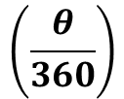
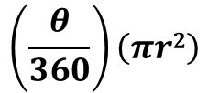

Area of a sector
Any central angle in a circle is a fraction of 360º
$$\left(\frac{θ}{360}\right)$$
The formula for the area of a circle is
Area = π r²
The area of a sector with a central angle θ will be a fraction of the area of the circle.
Area of a sector=
$$\left(\frac{θ}{360}\right)\left(πr2\right)$$
O
r
$$=\frac{θπr^{2}}{360}$$
θ
r
B
Where r is the radius and θ is the central angle measured in degrees
A

Slide 10
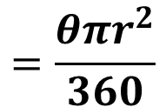

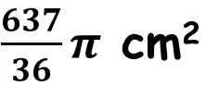
Area of a sector
Find the area of the sector of the arc which subtends a central angle of 130º in a circle of radius 7 cm.
$$=\frac{θπr^{2}}{360}$$
Area of a sector
θ =
130º
B
r =
7 cm
Area of a sector=
$$\frac{130×π×7^{2}}{360}$$
θ = 130º
A
Area of a sector=
$\frac{637}{36}π$ cm²
O
r = 7cm
Area of a sector=
55.6 cm²

Slide 11


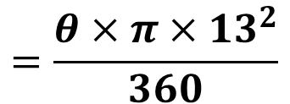
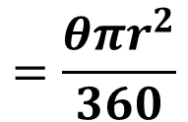
Area of a sector
The area of a sector BAC with radius 13 cm is 30π cm² Find θ, the size of a central angle of sector BAC.
$$=\frac{θπr^{2}}{360}$$
Area of a sector =
30π
Area of a sector
r =
13 cm
$$=\frac{θ×π{×13}^{2}}{360}$$
30π
$θ=\frac{360×30π}{169π}$
$$θ≈63.9°$$

Slide 12

Thank you for using resources from
For more resources visit our website
https://www.mathssupport.org
If you have a special request, drop us an email
info@mathssupport.org
Get 20% off in your next purchase from our website, just use this code when checkout: MSUPPORT_20

