Slide 1
True bearings
LO: Use trigonometric ratios to solve problems involving bearings

Slide 2
Compass points
45° between north and west
N
45° between North and east
NW
NE
W
E
SW
SE
45° between south and west
45° between south and east
S

Slide 3
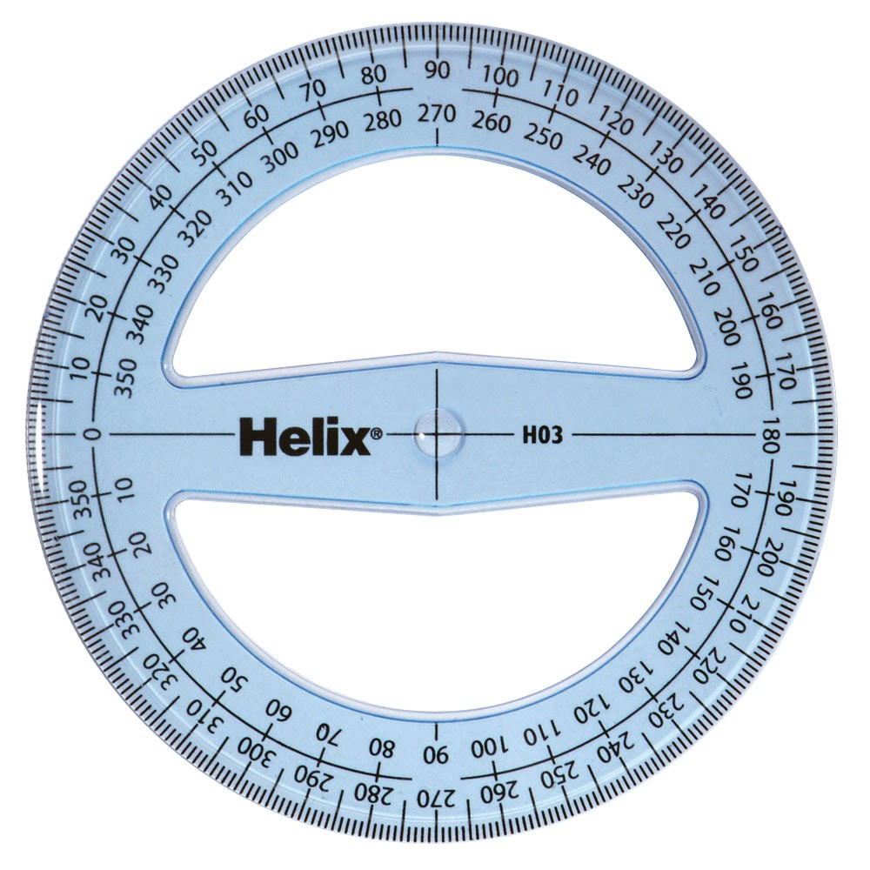
Compass points
When using Compass points for direction, you will see notation such as.
N 35° E
N 35° E
N
Which means 35° east of North
35°
W
E
S

Slide 4
Compass points
When using Compass points for direction, you will see notation such as.
W 25° S
N
Which means 25° south of west
W
E
25°
W 25° S
S

Slide 5
Bearings
Bearings are a measure of direction taken from North.
If you were travelling North you would be travelling on a bearing of 000°.
If you were travelling from the point P in the direction shown by the arrow then you would be travelling on a bearing of 000°.
If you were travelling from the point P in the direction shown by the arrow then you would be travelling on a bearing of 075°.
N
Bearings are always measured clockwise from North and are written as three figures.
75°
P

Slide 6
Bearings
The bearing from point A to point B is 105º.
What is the bearing from point B to point A?
N
The angle from B to A is
105º + 180º =
N
285º
105º
A
This is called a back bearing.
?
105º
B
180°

Slide 7
Bearings
An airplane departs from A and flies on a 138º course for 342 km. It then changes direction to a 228º course and flies a further 482 km to town C.
(a) Find the distance of C from A.
(b) Find the bearing of C from A.
Sketch a fully labelled diagram
N
With this information we can calculate the angle ABC
138º
A
The airplane turns 228º – 138º
= 90º
N
∴ angle ABC = 90º
342km
B
591km
We use Pythagoras theorem to Find AC
228º
AC² =
AB² + BC²
482km
= 342² + 482²
C
AC =
591 km

Slide 8
Bearings
An airplane departs from A and flies on a 138º course for 342 km. It then changes direction to a 228º course and flies a further 485 km to town C.
(a) Find the distance of C from A.
(b) Find the bearing of C from A.
Sketch a diagram
To find the bearing of C from A we need the angle measured from the north to the line AC.
N
138º
A
To find this angle we need the angle BAC named θ
θ
342km
N
B
485
591km
Find θ
tan⁻¹ =
θ
228º
342
θ ≈
54.8º
485km
The required angle is
138 + 54.8 ≈ 192.8
C
The bearing of C from A is about 192.8.

Slide 9
Bearings
A rally driver travels on a bearing of 145° for 2.85 km.
How far east of the starting position is the rally driver?
Sketch a diagram
You need to find the distance east the driver is
N
, the length AB.
145°
x km
B
This form a right angled triangle
Start
We know the angle inside the triangle at A
A
55º
Find AB
x
2.85 km
cos 55º =
2.85
x =
2.85
cos 55º
finish
C
x ≈
1.63
The driver is about 1.63 km east of his starting point

Slide 10
Bearings
A small airplane depart city A and flies on a 143° course for 368 km landing at B. After delivered cargo, it departs on a 233° course and flies a further 472 km to city C. Find:
the distance of C from A
the bearing of C from A
Sketch a diagram
You’ll find the distance between A and C.
N
Find the angle $A\hat{B}N$
co-interior angles
A
143°
180° - 143°
= 37°
Find the angle $A\hat{B}C$
angles at a point
368 km
360°-37°-233°
= 90°
N
37°
Using Pythagoras’ theorem
x km
x² = 368² + 472²
B
233°
x = $\sqrt{{368}^{2}+{472}^{2}}$
472 km
x ≈ 598.5 km
C
So, C is about 598.5 km from A.

Slide 11
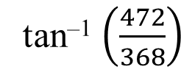
Bearings
A small airplane depart city A and flies on a 143° course for 368 km landing at B. After delivered cargo, it departs on a 233° course and flies a further 472 km to city C. Find:
the distance of C from A
the bearing of C from A
Sketch a diagram
To find the bearing of C from A we need the angle $B\hat{A}C$ (θ).
N
A
143°
To find the angle $B\hat{A}C$ we will use tangent
368 km
opposite
θ
N
tan θ =
37°
adjacent
x km
$$\frac{472}{368}$$
B
tan θ =
233°
tan^{–1} $\left(\frac{472}{368}\right)$
≈ 52.1°
θ =
472 km
C
The bearing of C from A is
143°
+ 52.1°
≈ 195°

Slide 12
Thank you for using resources from
For more resources visit our website
https://www.mathssupport.org
If you have a special request, drop us an email
info@mathssupport.org
Get 20% off in your next purchase from our website, just use this code when checkout: MSUPPORT_20

