Slide 1
Volume and surface area of pyramid, right cone, sphere and hemisphere.
LO: Calculate volume and surface area of 3-D solids.

Slide 2
Square-Based Pyramid
A pyramid is a solid figure that has a base, which can be any polygon, and the rest of the faces are triangles that meet at a point called the apex.
apex
base
Key Feature
Faces
5
A shape with a square base and triangular sides that meet at a point.
Corners
5
Edges
8
Planes of Symmetry?
Four

Slide 3

Volume of a pyramid
A pyramid is a solid figure that has a base, which can be any polygon, and the rest of the faces are triangles that meet at a point called the apex.
It is named for its base
The apex is vertically above the centre of the base
apex
Slant height (l)
Height (h)
base
Square-based pyramid
Triangular-based pyramid
Pentagonal-based pyramid
The formula to calculate the volume of any pyramid is:
V = $\frac{1}{3}$
(base area
x height)

Slide 4


Volume of a pyramid
Find the volume of a square-based pyramid if the perimeter of the base is 20 cm and the height is 12 cm.
Solution:
If the perimeter is 20 cm, and is a square, each side is 5 cm long
12 cm
The height is 12 cm
5 cm
The formula to calculate the volume of any pyramid is:
V = $\frac{1}{3}$
(base area
x height)
V = $\frac{1}{3}$
x 12)
(5²
V = 100 cm³

Slide 5
Volume of a pyramid
What is the volume of this rectangle-based pyramid?
Area of the base = 5 × 3
= 15 cm²
8 cm
1
Volume of pyramid = Ah
3
3 cm
1
= × 15 × 8
3
5 cm
= 40 cm³

Slide 6
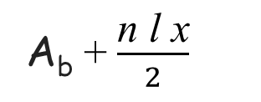

Surface area of a pyramid
The surface area of a pyramid is the sum of the areas of all of its faces.
The square-based pyramid has a total of five faces, one square and four isosceles triangles.
To calculate the surface area we need the area of the base
Slant height (l)
l
x
A_{b}
and the
area of one triangular face
base
and multiply by
Square-based pyramid
the number of triangular faces,
A_{b} = Area of the base
SA =
A_{b}
+ $\frac{1}{2}$ l x
× n
x = length of a side of the base
SA =
A_{b} + $\frac{\text{n} \text{l} \text{x}}{2}$
l = Slant height
n = Number of sides of the base

Slide 7

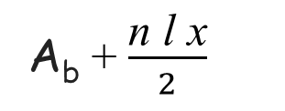
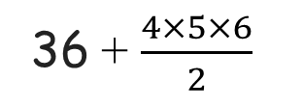
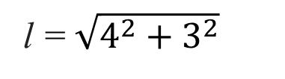
Surface area of a pyramid
Find the surface area of the following pyramid
To calculate the surface are we need the area of the base
Slant height (l)
h = 4cm
A_{b} = 6²
A_{b} = 36
6 cm
We need the slant height (l)
l = $\sqrt{4^{2}+3^{2}}$
l
h = 4cm
l = 5
$$\frac{6}{2}$$
A_{b} + $\frac{\text{n} \text{l} \text{x}}{2}$
SA =
SA =
36 + $\frac{4×5×6}{2}$
SA =
96cm²

Slide 8
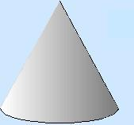
Cone
The cone is a special type of a pyramid with a circular base, so it does not have triangular faces.
Key Feature
The point of the cone is directly above the centre of the circular base.
Faces, Corners and Edges
The normal definitions of faces, corners and edges are not appropriate for a cone.
Planes of Symmetry?
Infinite

Slide 9


Volume of a cone
The cone is a special type of a pyramid with a circular base, so it does not have triangular faces.
apex
Slant height (l)
Height (h)
radius (r)
The formula to calculate the volume of the cone is the same as of any pyramid:
V = $\frac{1}{3}$
(base area
x height)
Since we know that the base will always be a circle, the are of the base is πr²
The formula to calculate the volume of the cone is
V = $\frac{1}{3}$
πr²h

Slide 10
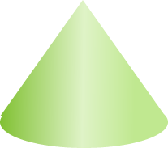
Worked examples
Calculate the volume of the cone.
7cm
3cm
1
V = πr²h
3
1
V = × π × 3² × 7
3
V = 21π cm³
≈ 66.0 cm³ (3sf)

Slide 11
Worked examples
The sector bellow is assembled to form a cone as shown.
l = 9cm
θ =150º
l = 9cm
a) Calculate the base circumference of the cone.
r cm
The base circumference of the cone is equal to the arc length of the sector.
θ
Arc length = × 2π × l
360
150
Arc length = × 2π × 9
= 7.5π
360
So the base circumference is 23.6 cm (3sf)

Slide 12
Worked examples
The sector bellow is assembled to form a cone as shown.
l = 9cm
θ =150º
l = 9cm
r cm
b) Calculate the base radius of the cone.
C = 23.6 cm
The base of the cone is circular, therefore:
C = 2π × r
C
23.6
≈ 3.75 cm
r =
=
2π
2π
So the radius is 3.75 cm to 3sf

Slide 13

Worked examples
The sector bellow is assembled to form a cone as shown.
l = 9cm
θ =150º
l = 9cm
h
c) Calculate the vertical height of the cone.
r = 3.75 cm
C = 23.6 cm
The vertical height of the cone can be calculated using Pythagoras’ theorem on the right angled triangle enclosed by the base radius, vertical height and the slant height:
h² = 9² – 3.75²
$$h= \sqrt{9^{2} − {3.75}^{2}}≈8.18$$
So the vertical height is 8.18 cm (3sf)

Slide 14
Surface area of a cone
The surface area of a cone is the sum of the area of the circular base (A_{b})
and the curved side of the cone (A_{s}).
apex
Slant height (l)
l
r
Height (h)
A_{s}
A_{b}
radius (r)
SA = A_{b} + A_{s}
The area of the circular base A_{b}
is πr²
The curved side is a sector of the circle with radius l
πrl
SA = πr² +
The area of the whole circle is πl²
The circumference of the whole circle is 2πl
The length of the arc of the sector is 2πr
The ratio of the area of the sector
to the area of the whole circle
is the same as the ratio of the length of the arc
to the circumference
of the whole circle
A_{s}
2πr
A_{s}
πrl
=
⇒
=
πl²
2πl

Slide 15
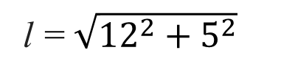

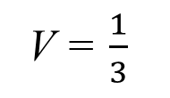
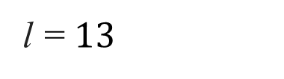
Surface area of a cone
Given the cone, find (a) The volume, (b) The curved surface area and (c) the total surface area.
Solution:
(a) The volume
V = $\frac{1}{3}$
πr²h
12 cm
V = $\frac{1}{3}$
π × 5² ×12
5 cm
V = 100π cm³
≈ 314 cm³
(b) The curved surface area
r = 5
Curved surface area = πrl
h = 12
= π × 5 ×13
l = ?
= 65π
≈ 204 cm²
l = $\sqrt{{12}^{2}+5^{2}}$
(c) the total surface area
SA = πr² +
πrl
l = $13$
SA = π × 5² +
65π
SA = 90π
≈ 283 cm²

Slide 16
Sphere
A sphere is a 3-D shape in which the surface is always the same distance from the centre. This fixed distance is the radius of the sphere.
Key Feature
r
Every point on the surface of the sphere is the same distance from the centre.
Faces, Edges and Corners
The normal definitions of faces, corners and edges are not appropriate for a sphere.
Planes of Symmetry?
Infinite

Slide 17

Volume and surface area of a sphere
For a sphere of radius r:
4
r
Volume = πr³
3
Surface area = 4πr²
r
For a hemisphere of radius r.
2
Volume = πr³
3
For a hollow hemisphere of radius r.
Surface area of the curve side = 2πr²
r
For a solid hemisphere of radius r.
Surface area of the solid hemisphere = 3πr²
Notes:
A sphere can be described as the 3-D locus of the points that are a fixed distance from a point.
These formulae will usually be given in an examination and it is not necessary for pupils to learn or derive them.

Slide 18
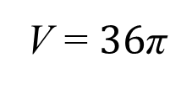


Volume of a sphere
For a sphere of radius r:
4
V = πr³
3
r
= 3 cm
Calculate the volume of the sphere, giving your answer to 3 sf.
$$\frac{4}{3}$$
V = πr³
$$\frac{4}{3}$$
V = × π × 3³
V = $36$π
V ≈ 113 cm³
Notes:
A sphere can be described as the 3-D locus of the points that are a fixed distance from a point.
These formulae will usually be given in an examination and it is not necessary for pupils to learn or derive them.

Slide 19

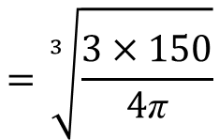
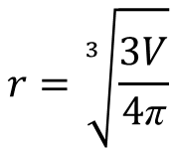

Volume of a sphere
Given that the volume of the sphere is 150 cm³, calculate its radius to 3 sf.
For a sphere of radius r:
4
V = πr³
r
3
Making r the subject:
3V = 4πr³
r³ =
$$\frac{3V}{\text{4}\text{π}}$$
$$r=\sqrt[3]{\frac{3V}{4\text{π}}}$$
$$=\sqrt[3]{\frac{3×150}{4\text{π}}}$$
$$r=\sqrt[3]{35.8098622}$$
r ≈ 3.30 cm
Notes:
A sphere can be described as the 3-D locus of the points that are a fixed distance from a point.
These formulae will usually be given in an examination and it is not necessary for pupils to learn or derive them.

Slide 20
Surface area of a sphere
For a sphere of radius r:
Surface area = 4πr²
r
= 5 cm
Calculate the surface area of the sphere, giving your answer to 3 sf.
SA = 4πr²
SA = 4 × π × 5²
SA ≈ 314 cm²
Notes:
A sphere can be described as the 3-D locus of the points that are a fixed distance from a point.
These formulae will usually be given in an examination and it is not necessary for pupils to learn or derive them.

Slide 21
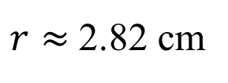

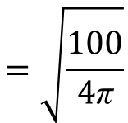

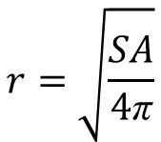
Surface area of a sphere
Given that the surface area of the sphere is 100 cm², calculate its radius to 3 sf.
For a sphere of radius r:
r
SA = 4πr²
Making r the subject:
$$\frac{SA}{4\text{π}}$$
= r²
$$r=\sqrt{\frac{SA}{4\text{π}}}$$
$$=\sqrt{\frac{100}{4\text{π}}}$$
$$r=\sqrt{7.957747}$$
$r≈$ 2.82 cm
Notes:
A sphere can be described as the 3-D locus of the points that are a fixed distance from a point.
These formulae will usually be given in an examination and it is not necessary for pupils to learn or derive them.

Slide 22
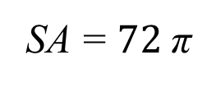
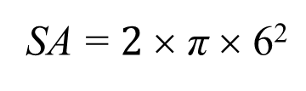
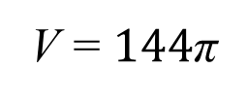
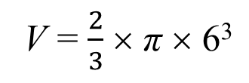
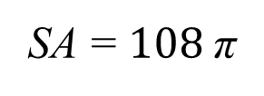
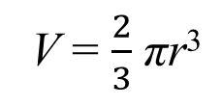
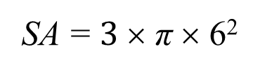
Volume and Surface area of a hemisphere
For this hemisphere, find:
(a) the volume
(b) the curved surface area
(c) the total surface area
Give the answers rounded to 3 sf
(b) the curved surface area
6cm
SA = 2πr²
SA = $2$× π × 6²
SA = $72$π
≈ 226 cm² (3sf)
(a) the volume
(c) the total surface area
SA = 3πr²
V = $\frac{2}{3}$ πr³
SA = $3$× π × 6²
V = $\frac{2}{3}$ × π × 6³
SA = $108$π
≈ 339 cm² (3sf)
V = $144$π
≈ 452 cm³ (3sf)
Notes:
A sphere can be described as the 3-D locus of the points that are a fixed distance from a point.
These formulae will usually be given in an examination and it is not necessary for pupils to learn or derive them.

Slide 23

Thank you for using resources from
For more resources visit our website
https://www.mathssupport.org
If you have a special request, drop us an email
info@mathssupport.org
Get 20% off in your next purchase from our website, just use this code when checkout: MSUPPORT_20

