Slide 1
Constructing Voronoi diagrams
LO: Using an algorithm to construct a Voronoi diagram.

Slide 2
Constructing Voronoi diagrams
Let us first consider the simplest case for a Voronoi diagram,.
It is a diagram for only one site, S which consists of a single point
In this case the Voronoi region for this point is the entire plane
S

Slide 3
Constructing Voronoi diagrams
Now, consider a Voronoi diagram for a set of two points.
It is a diagram for two sites, S₁ and S₂
In this case there are two Voronoi regions delimited by the perpendicular bisector of the segment S₁ S₂
First draw a soft line segment S₁ S₂
S₁
Find the midpoint of the line segment S₁ S₂
Draw the perpendicular bisector of the line segment S₁ S₂
S₂
Note that the two regions are not disjoint but overlap at the set of points equidistant from both points on the ray.

Slide 4
Constructing Voronoi diagrams
Now, consider a Voronoi diagram for a set of three points.
It is a diagram for three sites, S₁, S₂ and S₃
In this case there are three Voronoi regions delimited by the perpendicular bisectors of the segment [S₁S₂], [S₂S₃] and [S₁S₃]
Draw the perpendicular bisector of the line segment S₁ S₂
Draw the perpendicular bisector of the line segment S₂ S₃
S₂
Draw the perpendicular bisector of the line segment S₁ S₃
S₁
Provided S₁, S₂ and S₃ are not collinear, these lines will meet at a single point, this point is a vertex of the Voronoi diagram
S₃
This point is equidistant from S₁, S₂ and S₃
Notice that the Voronoi edges should not be far from the vertex

Slide 5
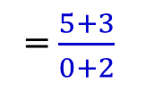

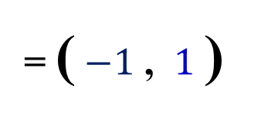
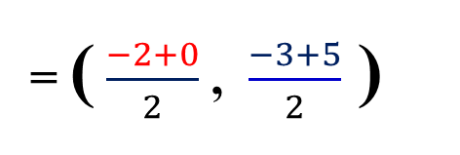

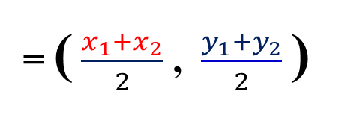

Constructing Voronoi diagrams
Construct a Voronoi Diagram for the sites A(-2, -3) and B(0, 5)
x₁
y₁
x₂
y₂
The midpoint AB
= ( $\frac{x_{1}+x_{2}}{2}$ , $\frac{y_{1}+y_{2}}{2}$ )
= ( $\frac{−2+0}{2}$ , $\frac{−3+5}{2}$ )
= ( $−1$ , $1$ )
B
m = $\frac{y_{2}−y_{1}}{x_{2}−x_{1}}$
Finding the gradient AB
M
= $\frac{5+3}{0+2}$
m = 4
A
The gradient of the perpendicular to AB
$$\frac{1}{4}$$
m_{P(AB)} = –
So, the edge passes through the point (–1 , 1)
And has a gradient $−\frac{1}{4}$

Slide 6
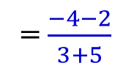

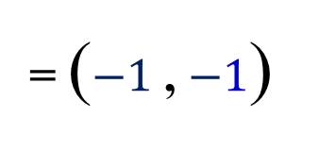

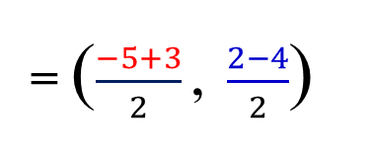

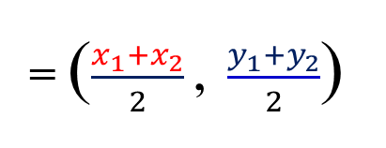
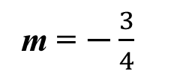
Constructing Voronoi diagrams
Construct a Voronoi Diagram for the sites A(-5, 2), B(3, -4) and C(-3, -2)
x₁
y₁
x₂
y₂
The midpoint [AB]
= ($\frac{x_{1}+x_{2}}{2}$ , $\frac{y_{1}+y_{2}}{2}$)
= ($\frac{−5+3}{2}$ , $\frac{2−4}{2}$)
= ($−1$ , $−1$)
Finding the gradient [AB]
m = $\frac{y_{2}−y_{1}}{x_{2}−x_{1}}$
= $\frac{−4−2}{3+5}$
m = $−\frac{3}{4}$
A
The gradient of the perpendicular to [AB]
M₁
$$\frac{4}{3}$$
m_{P(AB)} =
C
So, the edge passes through the point (–1 , –1)
B
And has a gradient $\frac{4}{3}$

Slide 7
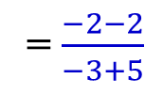

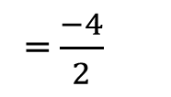
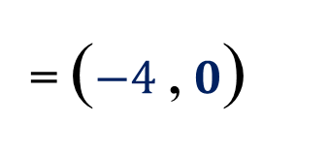

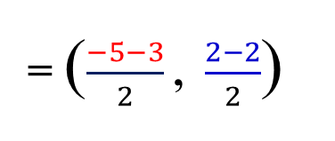

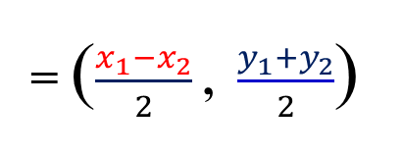

Constructing Voronoi diagrams
Construct a Voronoi Diagram for the sites A(-5, 2), B(3, -4) and C(-3, -2)
x₁
y₁
x₂
y₂
The midpoint [AC]
= ($\frac{x_{1}−x_{2}}{2}$ , $\frac{y_{1}+y_{2}}{2}$)
= ($\frac{−5−3}{2}$ , $\frac{2−2}{2}$)
= ($−4$ , $0$)
Finding the gradient [AC]
m = $\frac{y_{2}−y_{1}}{x_{2}−x_{1}}$
= $\frac{−2−2}{−3+5}$
= $\frac{−4}{2}$
A
m = $−2$
M₂
M₁
The gradient of the perpendicular to [AC]
$$\frac{1}{2}$$
C
m_{P(AC)} =
So, the edge passes through the point (–4 , 0)
B
And has a gradient $\frac{1}{2}$

Slide 8
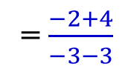

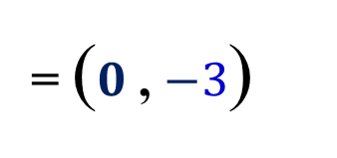
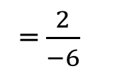
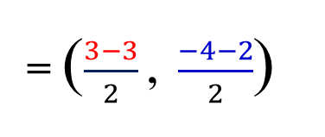

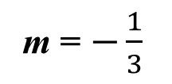
Constructing Voronoi diagrams
Construct a Voronoi Diagram for the sites A(-5, 2), B(3, -4) and C(-3, -2)
x₁
y₁
x₂
y₂
The midpoint [BC]
= ($\frac{x_{1}−x_{2}}{2}$ , $\frac{y_{1}+y_{2}}{2}$)
= ($\frac{3−3}{2}$ , $\frac{−4−2}{2}$)
= ($0$ , $−3$)
Finding the gradient [BC]
m = $\frac{y_{2}−y_{1}}{x_{2}−x_{1}}$
= $\frac{−2+4}{−3−3}$
= $\frac{2}{−6}$
m = $−\frac{1}{3}$
A
M₂
M₁
The gradient of the perpendicular to [BC]
m_{P(BC)} = 3
C
M₃
So, the edge passes through the point (0, –3)
B
And has a gradient $3$

Slide 9
Constructing Voronoi diagrams
Construct a Voronoi Diagram for the sites A(-5, 2), B(3, -4) and C(-3, -2)
We have drawn the perpendicular bisectors as dashed lines
Now we make solid only the parts which form the Voronoi edges.
And delete the non used lines
If you have trouble determining which part of the perpendicular bisector to include as an edge, remember that all the edges surrounding a cell are perpendicular bisectors involving the corresponding site
For cell C the boundaries are:
A
Perpendicular bisector of [AC]
M₂
M₁
Perpendicular bisector of [BC]
C
M₃
We delete them from the vertex
B
The perpendicular bisector of [AB] is not part of the cell C

Slide 10
Constructing Voronoi diagrams
Construct a Voronoi Diagram for the sites A(-5, 2), B(3, -4) and C(-3, -2)
We have drawn the perpendicular bisectors as dashed lines
Now we make solid only the parts which form the Voronoi edges.
And delete the non used lines
If you have trouble determining which part of the perpendicular bisector to include as an edge, remember that all the edges surrounding a cell are perpendicular bisectors involving the corresponding site
For cell C the boundaries are:
A
Perpendicular bisector of [AC]
M₂
M₁
Perpendicular bisector of [BC]
C
M₃
We delete them from the vertex
B
The perpendicular bisector of [AB] is not part of the cell C
This is the Voronoi diagram

Slide 11

Thank you for using resources from
For more resources visit our website
https://www.mathssupport.org
If you have a special request, drop us an email
info@mathssupport.org
Get 20% off in your next purchase from our website, just use this code when checkout: MSUPPORT_20

