Slide 1
Cubic models
LO: Use cubic functions to model rea-life situations.

Slide 2
Cubic function
Cubic functions are polynomial functions where the highest power of x is three.
In general, the form of a cubic function is:
f(x) = ax³ + bx² + cx + d where a ≠ 0 and a, b, c and d ∈ ℝ
Let’s look at the shape of some cubic functions
y = x³
Does it have a maximum?
y
No
Does it have a minimum?
No
How many roots does it have?
x
1 root (0, 0)
What is the y-intercept?
(0, 0)

Slide 3
Cubic function
Cubic functions are polynomial functions where the highest power of x is three.
In general, the form of a cubic function is:
f(x) = ax³ + bx² + cx + d where a ≠ 0 and a, b, c and d ∈ ℝ
Let’s look at the shape of some cubic functions
y = x³ – 4x
Does it have a maximum?
y
Yes, (˗1.15, 3.08)
Does it have a minimum?
Yes, (1.15, ˗3.08)
How many roots does it have?
x
3 roots (˗2, 0), (0, 0), (2, 0),
What is the y-intercept?
(0, 0)

Slide 4
Cubic function
Cubic functions are polynomial functions where the highest power of x is three.
In general, the form of a cubic function is:
f(x) = ax³ + bx² + cx + d where a ≠ 0 and a, b, c and d ∈ ℝ
Let’s look at the shape of some cubic functions
y = x³ + 2x²
Does it have a maximum?
y
Yes, (˗1.33, 1.19)
Does it have a minimum?
Yes, (0, 0)
How many roots does it have?
x
2 roots (˗2, 0), (0, 0)
What is the y-intercept?
(0, 0)

Slide 5
Cubic function
Cubic functions are polynomial functions where the highest power of x is three.
In general, the form of a cubic function is:
f(x) = ax³ + bx² + cx + d where a ≠ 0 and a, b, c and d ∈ ℝ
Let’s look at the shape of some cubic functions
y = -x³ – 3x²
Does it have a maximum?
y
Yes, (0, 0)
Does it have a minimum?
Yes, (˗2, ˗4)
How many roots does it have?
x
2 roots (˗3, 0), (0, 0)
y = x³
What is the y-intercept?
(0, 0)

Slide 6
Cubic function
Cubic functions are polynomial functions where the highest power of x is three.
In general, the form of a cubic function is:
f(x) = ax³ + bx² + cx + d where a ≠ 0 and a, b, c and d ∈ ℝ
Let’s look at the shape of some cubic functions
y = x³ – 2x² + 3
Does it have a maximum?
y
Yes, (0, 3)
Does it have a minimum?
Yes, (1.33, 1.81)
How many roots does it have?
x
1 roots (˗1, 0)
y = x³
What is the y-intercept?
(0, 3)

Slide 7
Cubic function
Cubic functions are polynomial functions where the highest power of x is three.
In general, the form of a cubic function is:
f(x) = ax³ + bx² + cx + d where a ≠ 0 and a, b, c and d ∈ ℝ
Let’s look at the shape of some cubic functions
y = 2x³ – 3x² – x + 3
Does it have a maximum?
y
Yes, (˗0.145, 1.08)
Does it have a minimum?
Yes, (1.15, ˗1.08)
How many roots does it have?
x
3 roots (˗0.618, 0), (0.5, 0), (1.62, 0)
y = x³
What is the y-intercept?
(0, 1)

Slide 8
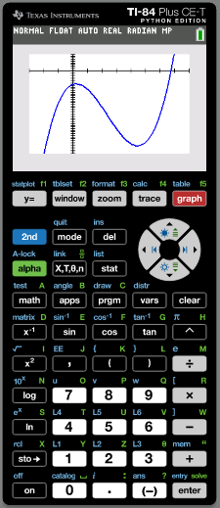
Sketching the graph of a cubic function
You need to be careful when copying the graph from your GDC onto paper.
Sketch the graph of
f(x) = x³ – 7x² + 3x – 8
˗3 ≤ x ≤ 8
˗50 ≤ y ≤ 10
Draw your axes and label them
10
(6.73, 0)
˗3
(0.225, ˗7.67)
8
Make sure that any x- and y-intercepts are in the correct place.
(0, ˗8)
Also, the maximum and minimum should be in the correct place.
˗50
(4.44, ˗45.1)

Slide 9
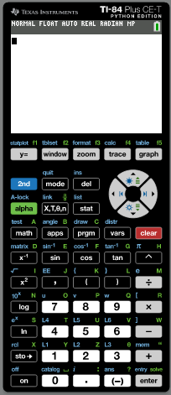
Modelling with a cubic function
Cubic functions can be used to model real world data.
The data in the following table list natural gas consumption (in trillion cubic feet) in the United States.
Year | 2000 | 2005 | 2010 | 2015 | 2020
Consumption | 23.33 | 22.01 | 24.09 | 27.24 | 30.48
Find a polynomial function of degree 3 that models the data
Turn on the calculator.
Click STAT (Statistics)

Slide 10
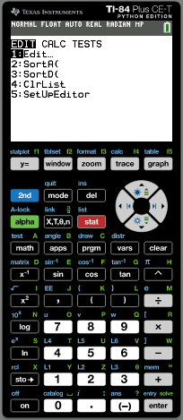
Modelling with a cubic function
Cubic functions can be used to model real world data.
The data in the following table list natural gas consumption (in trillion cubic feet) in the United States.
Year | 2000 | 2005 | 2010 | 2015 | 2020
Consumption | 23.33 | 22.01 | 24.09 | 27.24 | 30.48
Find a polynomial function of degree 3 that models the data
Turn on the calculator.
Press STAT (Statistics)
Press 1 (Edit)

Slide 11
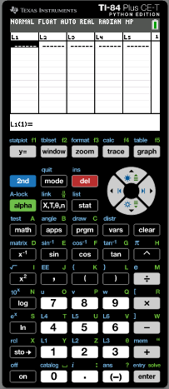
Modelling with a cubic function
Cubic functions can be used to model real world data.
The data in the following table list natural gas consumption (in trillion cubic feet) in the United States.
Year | 2000 | 2005 | 2010 | 2015 | 2020
Consumption | 23.33 | 22.01 | 24.09 | 27.24 | 30.48
Find a polynomial function of degree 3 that models the data
Turn on the calculator.
Press STAT (Statistics)
Press 1 (Edit)
Type the data for Year in List 1 and Consumption in List 2

Slide 12
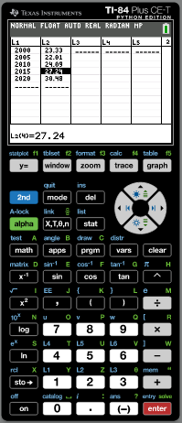
Modelling with a cubic function
Cubic functions can be used to model real world data.
The data in the following table list natural gas consumption (in trillion cubic feet) in the United States.
Year | 2000 | 2005 | 2010 | 2015 | 2020
Consumption | 23.33 | 22.01 | 24.09 | 27.24 | 30.48
Find a polynomial function of degree 3 that models the data
Turn on the calculator.
Press STAT (Statistics)
Press 1 (Edit)
Type the data for Year in List 1 and Consumption in List 2
Press 2nd
statplot

Slide 13
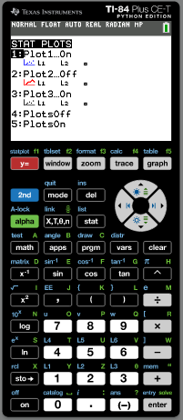
Modelling with a cubic function
Cubic functions can be used to model real world data.
The data in the following table list natural gas consumption (in trillion cubic feet) in the United States.
Year | 2000 | 2005 | 2010 | 2015 | 2020
Consumption | 23.33 | 22.01 | 24.09 | 27.24 | 30.48
Find a polynomial function of degree 3 that models the data
Turn on the calculator.
Press STAT (Statistics)
Press 1 (Edit)
Type the data for Year in List 1 and Consumption in List 2
Press 2nd
statplot
Press 1

Slide 14
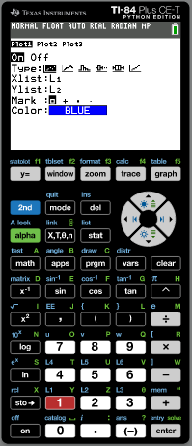
Modelling with a cubic function
Cubic functions can be used to model real world data.
The data in the following table list natural gas consumption (in trillion cubic feet) in the United States.
Year | 2000 | 2005 | 2010 | 2015 | 2020
Consumption | 23.33 | 22.01 | 24.09 | 27.24 | 30.48
Find a polynomial function of degree 3 that models the data
Turn on the calculator.
Press STAT (Statistics)
Press 1 (Edit)
Type the data for Year in List 1 and Consumption in List 2
Press 2nd
statplot
Press 1
Plot1 ON
Xlist: L1
Ylist: L2
ZOOM
9ZoomStat

Slide 15
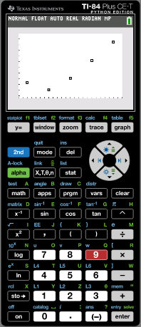
Modelling with a cubic function
Cubic functions can be used to model real world data.
The data in the following table list natural gas consumption (in trillion cubic feet) in the United States.
Year | 2000 | 2005 | 2010 | 2015 | 2020
Consumption | 23.33 | 22.01 | 24.09 | 27.24 | 30.48
Find a polynomial function of degree 3 that models the data
Press MODE.

Slide 16
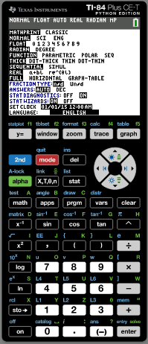
Modelling with a cubic function
Cubic functions can be used to model real world data.
The data in the following table list natural gas consumption (in trillion cubic feet) in the United States.
Year | 2000 | 2005 | 2010 | 2015 | 2020
Consumption | 23.33 | 22.01 | 24.09 | 27.24 | 30.48
Find a polynomial function of degree 3 that models the data
Press MODE.
Use the arrow to highlight STAT DIAGNOSIS
ON
Press STAT

Slide 17
Modelling with a cubic function
Cubic functions can be used to model real world data.
The data in the following table list natural gas consumption (in trillion cubic feet) in the United States.
Year | 2000 | 2005 | 2010 | 2015 | 2020
Consumption | 23.33 | 22.01 | 24.09 | 27.24 | 30.48
Find a polynomial function of degree 3 that models the data
Press MODE.
Use the arrow to highlight STAT DIAGNOSIS
ON
Press STAT

CALC
Scroll down
6:CubicReg

Slide 18
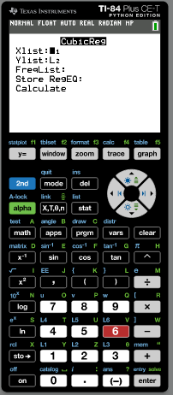
Modelling with a cubic function
Cubic functions can be used to model real world data.
The data in the following table list natural gas consumption (in trillion cubic feet) in the United States.
Year | 2000 | 2005 | 2010 | 2015 | 2020
Consumption | 23.33 | 22.01 | 24.09 | 27.24 | 30.48
Find a polynomial function of degree 3 that models the data
Press MODE.
Use the arrow to highlight STAT DIAGNOSIS
ON
Press STAT

CALC
Scroll down
6:CubicReg
Xlist: L1
Ylist: L2
Store RegEq
Press Vars
 Y-VARS
1-Function
1-Y1
Scroll down
Calculate
ENTER

Slide 19
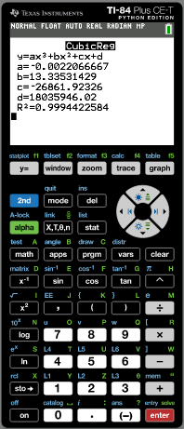
Modelling with a cubic function
Cubic functions can be used to model real world data.
The data in the following table list natural gas consumption (in trillion cubic feet) in the United States.
Year | 2000 | 2005 | 2010 | 2015 | 2020
Consumption | 23.33 | 22.01 | 24.09 | 27.24 | 30.48
The general cubic function is:
y = ax³ + bx² + cx + d.
a = –0.002206667
From the GDC we get
b = 13.3353
c = –26861.923
d = 18035946
The data can be modelled with the function
y = –0.002207x³ + 13.3x² – 26861.9x + 18035946.
The coefficient of determination R² reveals that 99.9% of the data fit the regression model
Drawing the graph
ZOOM
9ZoomStat

Slide 20
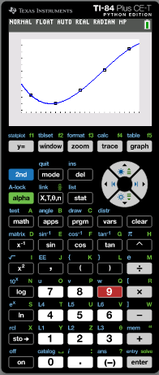
Modelling with a cubic function
Cubic functions can be used to model real world data.
The data in the following table list natural gas consumption (in trillion cubic feet) in the United States.
Year | 2000 | 2005 | 2010 | 2015 | 2020
Consumption | 23.33 | 22.01 | 24.09 | 27.24 | 30.48
Estimate the natural gas consumption in 2018.
CALC
2nd
TRACE
1:Value
Type
2018

Slide 21
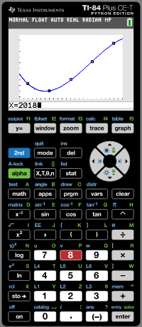
Modelling with a cubic function
Cubic functions can be used to model real world data.
The data in the following table list natural gas consumption (in trillion cubic feet) in the United States.
Year | 2000 | 2005 | 2010 | 2015 | 2020
Consumption | 23.33 | 22.01 | 24.09 | 27.24 | 30.48
Estimate the natural gas consumption in 2018.
CALC
2nd
TRACE
1:Value
Type
2018
ENTER

Slide 22
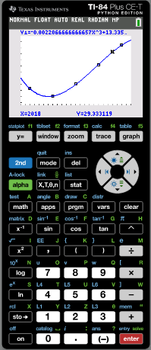
Modelling with a cubic function
Cubic functions can be used to model real world data.
The data in the following table list natural gas consumption (in trillion cubic feet) in the United States.
Year | 2000 | 2005 | 2010 | 2015 | 2020
Consumption | 23.33 | 22.01 | 24.09 | 27.24 | 30.48
Estimate the natural gas consumption in 2018.
CALC
2nd
TRACE
1:Value
Type
2018
ENTER
y = 29.3
The natural gas consumption in 2018.
Approximately 29.3 trillion cubic feet

Slide 23
Thank you for using resources from
For more resources visit our website
https://www.mathssupport.org
If you have a special request, drop us an email
info@mathssupport.org

