Slide 1
Direct and inverse variation
Friday, 11 August 2023
LO: To understand the idea of direct variation.
To understand the idea of inverse variation.
To solve problems involving direct or inverse variation

Slide 2
Direct and inverse variation
When two quantities are related by a proportion, we say they are proportional to each other.
Another way to express this relation is to talk about the variation of the two quantities.
Is talking about how one number changes relative to another number.
Variation could be either direct or inverse variation.
In direct variation, as one number increases, so does the other. This is also called direct proportion.
In inverse variation, it's exactly the opposite: as one number increases, the other decreases. This is also called inverse proportion.

Slide 3
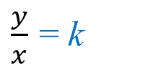
Direct variation
stands for ‘is proportional to’.
∝
The symbol for variation is:
(not to be confused with the Greek letter α (alpha))
Two quantities x and y are said to be in direct proportion
Writing the proportionality
y ∝ x
To change the proportion into an equation we replace ∝ by “= k ×” (equals k multiplied by) where k is the proportionality constant also called the constant of variation or constant of proportionality
Writing the equation
y = k x
Rearranging for k
$\frac{y}{x}$ = k
Two quantities x and y are said to be in direct proportion if they increase or decrease together in such a manner that the ratio of their corresponding values remains constant

Slide 4
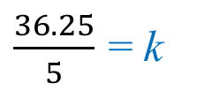
Direct variation
Example 1
The wages, (w) earned are proportional to the time (t) worked. If Peter worked 5 hours, he earned $36.25.
(a) Write an equation for w in terms of t.
(b) Find the wages after 40 hours of work.
The first step is always to write the statement as a proportion using the variation symbol
Writing the proportionality
w ∝ t
The second step is changing the proportion into an equation
Writing the equation
w = k t
The equation for w in terms of t is
Substituting the given values to find k
Replacing w and t
36.25 = k (5)
$\frac{36.25}{5}$ = k
w = 7.25t
Rearranging for k
Solving for k
k = 7.25

Slide 5
Direct variation
Example 1
The wages, (w) earned are proportional to the time (t) worked. If Peter worked 5 hours, he earned $36.25.
(a) Write an equation for w in terms of t.
(b) Find the wages after 40 hours of work.
We use the formula found.
w = 7.25t
Knowing that t = 40
Substituting into the equation
w = 7.25 (40)
Solving
w = 290

Slide 6
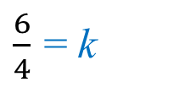
Direct variation
Example 2
The distance, d metres, that a rock falls varied directly with the square of the time taken, t seconds. If the rock falls 6 metres in 2 seconds:
(a) Write an equation for d in terms of t.
(b) Find the distance the rock has fallen after 5 seconds.
The first step is always to write the statement as a proportion using the variation symbol
Writing the proportionality
d ∝ t²
The second step is changing the proportion into an equation
Writing the equation
d = k t²
The equation for d in terms of t is
Substituting the given values to find k
Replacing d and t
6 = k (2²)
$\frac{6}{4}$ = k
d = 1.5t²
Rearranging for k
Solving for k
k = 1.5

Slide 7
Direct variation
Example 2
The distance, d metres, that a rock falls varied directly with the square of the time taken, t seconds. If the rock falls 6 metres in 2 seconds:
(a) Write an equation for d in terms of t.
(b) Find the distance the rock has fallen after 5 seconds.
We use the formula found.
d = 1.5t²
Knowing that t = 5
Substituting into the equation
d = 1.5 (5)²
Solving
d = 37.5metres

Slide 8
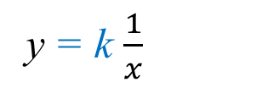
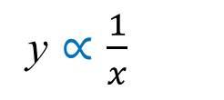
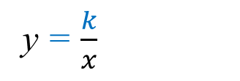
Inverse variation
In an inverse variation, as we stated before, as one number increases, the other decreases. This is also called inverse proportion.
∝
The symbol for variation is the same:
Which stands for ‘is proportional to’.
Two quantities x and y are said to be in inverse proportion
Writing the proportionality
y ∝ $\frac{1}{x}$
We read y is “proportional to” the inverse (reciprocal) of x
To change the proportion into an equation we replace ∝ by “= k ×” (equals k multiplied by)
y = k $\frac{1}{x}$
Writing the equation
y = $\frac{k}{x}$
Rearranging for k
k = xy

Slide 9
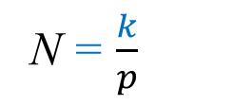
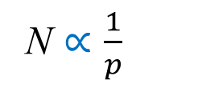
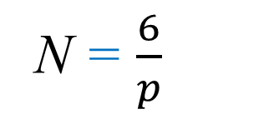
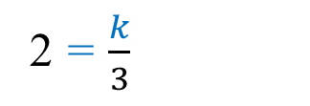
Inverse variation
Example 3
The number of hours (N) taken to build a wall varies inversely with the number of people (p) who are working on it. If 3 people are working building the wall, takes 2 hours to build.
(a) Write an equation for N in terms of p.
(b) Find the time it takes to build the wall if 4 people are working.
(c) Given it takes 3 hours to build the wall, state how many people worked on it?
The first step is always to write the statement as a proportion using the variation symbol
Writing the proportionality
N ∝ $\frac{1}{p}$
The second step is changing the proportion into an equation
Writing the equation
N = $\frac{k}{p}$
The equation for N in terms of p is
Substituting the given values to find k
Replacing N and p
2 = $\frac{k}{3}$
N = $\frac{6}{p}$
Rearranging and solving for k
k = (2)(3) = 6

Slide 10
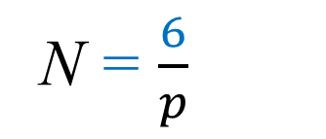
Inverse variation
Example 3
The number of hours (N) taken to build a wall varies inversely with the number of people (p) who are working on it. If 3 people are working building the wall, takes 2 hours to build.
(a) Write an equation for N in terms of p.
(b) Find the time it takes to build the wall if 4 people are working.
(c) Given it takes 3 hours to build the wall, state how many people worked on it?
N = $\frac{6}{p}$
We use the formula found.
Knowing that p = 4
Substituting into the equation
N = $\frac{6}{4}$
Solving
N = 1.5
It takes 1.5 hours to build the wall when 4 people work on it

Slide 11
Inverse variation
Example 3
The number of hours (N) taken to build a wall varies inversely with the number of people (p) who are working on it. If 3 people are working building the wall, takes 2 hours to build.
(a) Write an equation for N in terms of p.
(b) Find the time it takes to build the wall if 4 people are working.
(c) Given it takes 3 hours to build the wall, state how many people worked on it?
N = $\frac{6}{p}$
We use the formula found.
Knowing that N = 3
Substituting into the equation
3 = $\frac{6}{p}$
Solving
p = 2
2 people work on it.

Slide 12
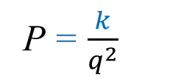
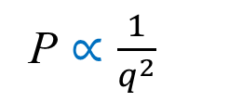
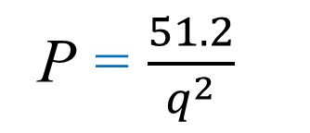
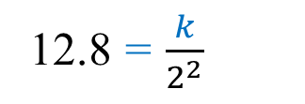
Inverse variation
Example 4
P is inversely proportional to the square of q.
When q = 2, P = 12.8
(a) Write an equation for P in terms of q.
(b) Find the value of P when q = 8
The first step is always to write the statement as a proportion using the variation symbol
Writing the proportionality
P ∝ $\frac{1}{q^{2}}$
The second step is changing the proportion into an equation
Writing the equation
P = $\frac{k}{q^{2}}$
The equation for P in terms of q is
Substituting the given values to find k
Replacing P and q
12.8 = $\frac{k}{2^{2}}$
P = $\frac{51.2}{q^{2}}$
Rearranging and solving for k
k = (12.8)(4)
k = 51.2

Slide 13
Inverse variation
Example 4
P is inversely proportional to the square of q.
When q = 2, P = 12.8
(a) Write an equation for P in terms of q.
(b) Find the value of P when q = 8
P = $\frac{51.2}{q^{2}}$
We use the formula found.
Knowing that q = 8
P = $\frac{51.2}{8^{2}}$
Substituting into the equation
Solving
P = 3.925

Slide 14
Thank you for using resources from
For more resources visit our website
https://www.mathssupport.org
If you have a special request, drop us an email
info@mathssupport.org

