Slide 1
Models
LO: To represent real life situation using mathematical models.

Slide 2
Modelling
We can apply mathematics to real-world problems to help understand the world around us.
A mathematical model is a simplified description of a real system using mathematical concepts and language
The process of developing this model is called mathematical modelling
In mathematical modelling we simplify the problem by making assumptions and removing less important details.
This allows us to construct a mathematical description of the problem which is simple enough for us to work with, and which we can solve to approximate the real-world situation.
Mathematical models are developed using a modelling cycle.

Slide 3
Modelling cycle
Step 1:
Pose a real-world problem. Make assumptions which simplify the problem without missing key features.
Step 2:
Develop a model which represents the problem with mathematics. This may involve a formula or an equation. The model should consider constraints such as the range of possible values each variable can take in the real world.
Step 3:
Test the model by comparing its predictions with known data. If the model is unsatisfactory, return to step 2.
Step 4:
Reflect on your model and apply it to your original problem, interpreting the solution in its real-world context.
Step 5:
If appropriate, extend your model to make it more general or accurate as needed.

Slide 4
Modelling cycle
Extend the model
Reflect on and apply the model.
reject
Test the model
accept
Develop a model
Pose a real-world problem.

Slide 5
Modelling
Example:
A cylindrical can of cat food has volume V = 500 cm³.
The radius of the can is r cm and the height is h cm.
(a) Explain why π r²h = 500
(b) Rearrange the equation from part (a) to make h the subject.
(c) Find an expression for the total surface area S of the can.
(d) Substitute your expression for h from part (b) into your expression for S from part (c) and hence show that $S=2πr^{2}+\frac{1000}{r}$.
(e) Plot the graph of this equation
(f) Find the minimum surface area of the can and the value of r for which this occurs.

Slide 6
Modelling
Example:
A cylindrical can of cat food has volume V = 500 cm³.
The radius of the can is r cm and the height is h cm.
(a) Explain why π r²h = 500
If the can is cylindrical, the volume of a cylinder is given by
$$V=πr^{2}h$$
Since we are told that V = 500
it follows that
π r²h = 500

Slide 7
Modelling
Example:
A cylindrical can of cat food has volume V = 500 cm³.
The radius of the can is r cm and the height is h cm.
(b) Rearrange the equation from part (a) to make h the subject.
the equation from part (a)
π r²h = 500
$$h=\frac{500}{{πr}^{2}}$$
Dividing both sides by π r²

Slide 8
Modelling
Example:
A cylindrical can of cat food has volume V = 500 cm³.
The radius of the can is r cm and the height is h cm.
(c) Find an expression for the total surface area S of the can.
$$πr^{2}$$
r cm
$$S=2πr^{2}$$
$+$ $2πrh$
$$2πrh$$
h cm
$$πr^{2}$$

Slide 9
Modelling
Example:
A cylindrical can of cat food has volume V = 500 cm³.
The radius of the can is r cm and the height is h cm.
(d) Substitute your expression for h from part (b) into your expression for S from part (c) and hence show that $S=2πr^{2}+\frac{1000}{r}$.
$$h=\frac{500}{{πr}^{2}}$$
Form part (b)
Form part (c)
$S=2πr^{2}+$ $2πrh$
$S=2πr^{2}+$ $2πr\frac{500}{{πr}^{2}}$
Substituting h
$$S=2πr^{2}+\frac{1000}{r}$$

Slide 10
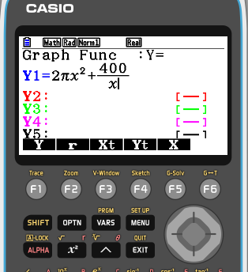
Modelling
Example:
A cylindrical can of cat food has volume V = 500 cm³.
The radius of the can is r cm and the height is h cm.
(e) Plot the graph of this equation
$$S=2πr^{2}+\frac{1000}{r}$$

Slide 11
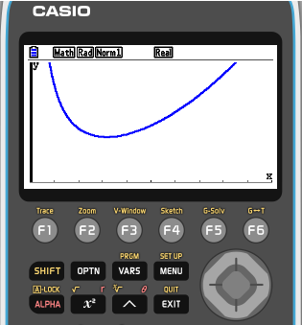
Modelling
Example:
A cylindrical can of cat food has volume V = 500 cm³.
The radius of the can is r cm and the height is h cm.
(e) Plot the graph of this equation
$$S=2πr^{2}+\frac{1000}{r}$$
Using a suitable scale
0 ≤ x ≤ 15
0 ≤ y ≤ 800

Slide 12
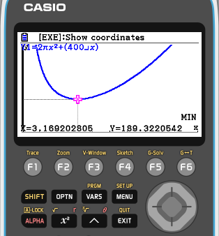
Modelling
Example:
A cylindrical can of cat food has volume V = 500 cm³.
The radius of the can is r cm and the height is h cm.
(f) Find the minimum surface area of the can and the value of r for which this occurs.
The minimum surface area is 348.7 cm²
This occurs when r = 4.3 cm

Slide 13
Thank you for using resources from
For more resources visit our website
https://www.mathssupport.org
If you have a special request, drop us an email
info@mathssupport.org

