Slide 1
The graph of a function, its equation y = f(x)
LO: To draw the graph of a function given its equation.

Slide 2
The graph of a function
Every function has a particular behaviour and is identified by a specific shape.
There are two ways to represent the graph of a function.
Drawing its graph.
Sketching its graph.
In this lesson we will be working on Drawing the graph of a function
If you are asked to draw the graph of a function is to represent by means of a labelled, accurate diagram or graph, using a pencil. A ruler (straight edge) should be used for straight lines.
Graphs should have points correctly plotted (if appropriate) and joined in a straight line or smooth curve.

Slide 3
The graph of a function
Draw the graph of f(x) = 2x + 1 for – 3 ≤ x ≤ 3.
We can create a table of values that combines the inputs and outputs
10
y
9
x
y = f(x)
(x, y)
-3
-2
-1
0
1
2
3
8
-5
-3
-1
1
3
5
7
7
(-3,-5)
(-2,-3)
(-1,-1)
(0, 1)
(1, 3)
(2, 5)
(3, 7)
6
5
We will use values from -3 through 3 for x and from them, we will evaluate the function to find the corresponding value of y
4
3
f(x) = 2x + 1
2
1
x
Plot the points accurately.
–6 –5 –4 –3 –2 –1
1 2 3 4 5 6
⁻1
Use a ruler to join the points.
⁻2
⁻3
⁻4
⁻5

Slide 4
The graph of a function
Draw the graph of f(x) = x² – 1 for – 3 ≤ x ≤ 3.
We can create a table of values that combines the inputs and outputs
10
y
9
f(x) = x² – 1
x
y = f(x)
(x, y)
-3
-2
-1
0
1
2
3
8
8
3
0
-1
0
3
8
7
(-3,8)
(-2,3)
(-1,0)
(0, -1)
(1, 0)
(2, 3)
(3, 8)
6
5
We will use values from -3 through 3 for x and from them, we will evaluate the function to find the corresponding value of y
4
3
2
1
x
Plot the points accurately.
–6 –5 –4 –3 –2 –1
1 2 3 4 5 6
⁻1
Draw a smooth curve joining the points.
⁻2
⁻3
⁻4
⁻5

Slide 5
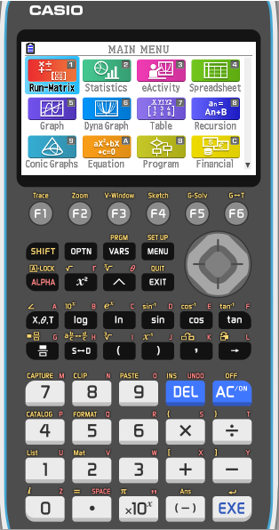
The graph of a function
Draw the graph of f(x) = x³ – x² – 7x –1 for – 2 ≤ x ≤ 3.
We can create a table of values that combines the inputs and outputs
x
y = f(x)
(x, y)
-2
-1
0
1
2
3
We will use values from – 2 through 3 for x and from them, we will evaluate the function to find the corresponding value of y
Now we are going to use the GDC to construct a table of values for – 2 ≤ x ≤ 3
.
Turn on the GDC.
Press 7
Table

Slide 6
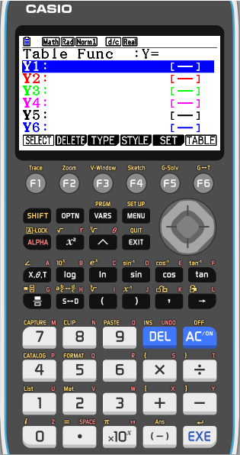
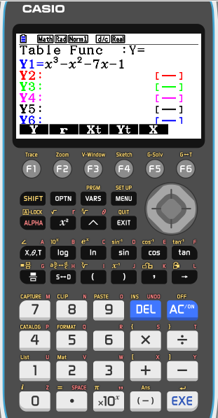
The graph of a function
Draw the graph of f(x) = x³ – x² – 7x –1 for – 2 ≤ x ≤ 3.
We can create a table of values that combines the inputs and outputs
x
y = f(x)
(x, y)
-2
-1
0
1
2
3
Type in the function
x³ – x² – 7x – 1
EXE

Slide 7
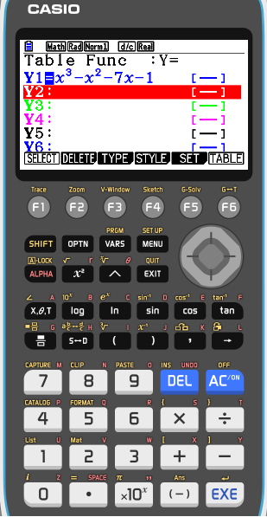
The graph of a function
Draw the graph of f(x) = x³ – x² – 7x –1 for – 2 ≤ x ≤ 3.
We can create a table of values that combines the inputs and outputs
x
y = f(x)
(x, y)
-2
-1
0
1
2
3
Type in the function
x³ – x² – 7x – 1
EXE
Press F5
Set

Slide 8
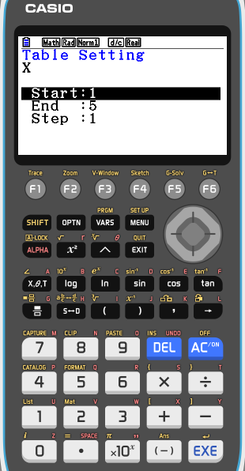
The graph of a function
Draw the graph of f(x) = x³ – x² – 7x –1 for – 2 ≤ x ≤ 3.
We can create a table of values that combines the inputs and outputs
x
y = f(x)
(x, y)
-2
-1
0
1
2
3
Type in the function
x³ – x² – 7x – 1
EXE
Press F5
Set
Set the boundaries
Start -2
EXE
End 3
EXE
Step 1
EXE

Slide 9
The graph of a function
Draw the graph of f(x) = x³ – x² – 7x –1 for – 2 ≤ x ≤ 3.
We can create a table of values that combines the inputs and outputs
x
y = f(x)
(x, y)
-2
-1
0
1
2
3
Type in the function
x³ – x² – 7x – 1
EXE
Press F5
Set
Set the boundaries
Start -2
EXE
End 3
EXE
Step 1
EXE
Press F6
Table

Slide 10
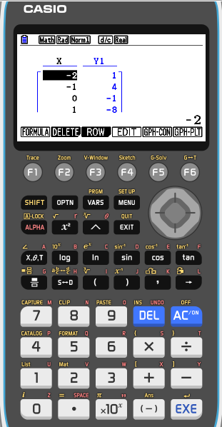
The graph of a function
Draw the graph of f(x) = x³ – x² – 7x –1 for – 2 ≤ x ≤ 3.
We can create a table of values that combines the inputs and outputs
x
y = f(x)
(x, y)
-2
-1
0
1
2
3
1
4
-1
-8
-11
-4
(-2,1)
(-1,4)
(0, -1)
(1,-8)
(2,-11)
(3,-4)
Type in the function
x³ – x² – 7x – 1
EXE
Press F5
Set
Set the boundaries
Start -2
EXE
End 3
EXE
Step 1
EXE
Press F6
Table
Scroll down and fill in the table

Slide 11
The graph of a function
Draw the graph of f(x) = x³ – x² – 7x –1 for – 2 ≤ x ≤ 3.
We can create a table of values that combines the inputs and outputs
5
y
f(x) = x³ – x² – 7x – 1
4
x
y = f(x)
(x, y)
3
-2
-1
0
1
2
3
2
1
4
-1
-8
-11
-4
1
x
(-2,1)
(-1,4)
(0, -1)
(1,-8)
(2,-11)
(3,-4)
–3 –2 –1
1 2 3
-1
Plot the points accurately.
-2
Draw a smooth curve joining the points.
-3
-4
-5
⁻-6
-7
-8
-9
-10
-11

Slide 12
Thank you for using resources from
For more resources visit our website
https://www.mathssupport.org
If you have a special request, drop us an email
info@mathssupport.org

