Slide 1
Systems of three equations using GDC
LO: Solve simultaneous equations using the GDC.

Slide 2
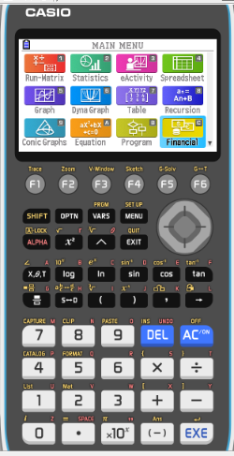
Solving systems of three equations using the GDC
We are going to use Graphing display calculator to solve Systems of Simultaneous equations with three unknowns using the Equation solver
CASIO

Slide 3
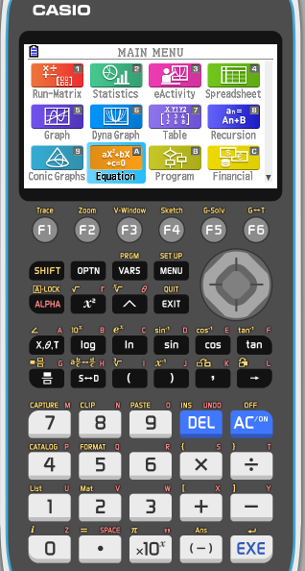
Solving simultaneous equations using the GDC
We will use the CASIO GDC to solve this equations.
7x + 5y – 3z = 16
3x – 5y + 2z = –8
5x + 3y – 7z = 0
Select EQUA from the main MENU

Slide 4
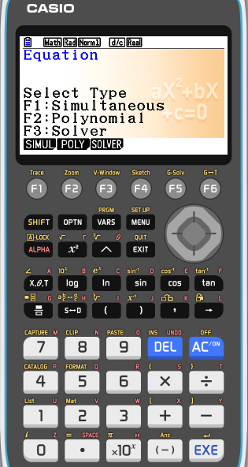
Solving simultaneous equations using the GDC
We will use the CASIO GDC to solve this equations.
7x + 5y – 3z = 16
3x – 5y + 2z = –8
5x + 3y – 7z = 0
Select EQUA from the main MENU
Then press F1 (SIML)

Slide 5
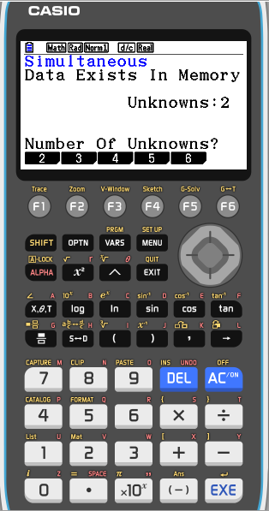
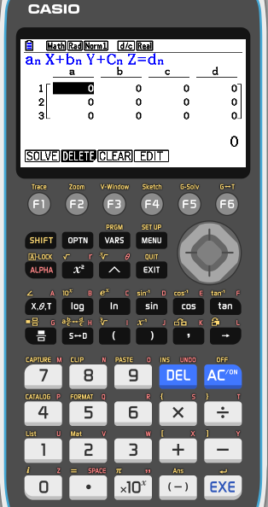
Solving simultaneous equations using the GDC
We will use the CASIO GDC to solve this equations.
7x + 5y – 3z = 16
3x – 5y + 2z = –8
5x + 3y – 7z = 0
Select EQUA from the main MENU
Then press F1 (SIML)
We have three unknowns in our equations so, press F2 (3)
Enter the coefficients of the equations as shown, pressing EXE after each entry.

Slide 6
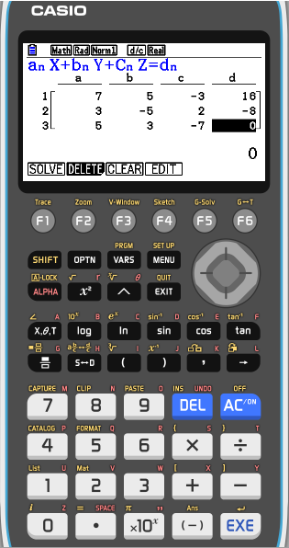
Solving simultaneous equations using the GDC
We will use the CASIO GDC to solve this equations.
7x + 5y – 3z = 16
3x – 5y + 2z = –8
5x + 3y – 7z = 0
Select EQUA from the main MENU
Then press F1 (SIML)
We have three unknowns in our equations so, press F2 (3)
Enter the coefficients of the equations as shown, pressing EXE after each entry.
Press F1 (SOLV) to solve the system

Slide 7
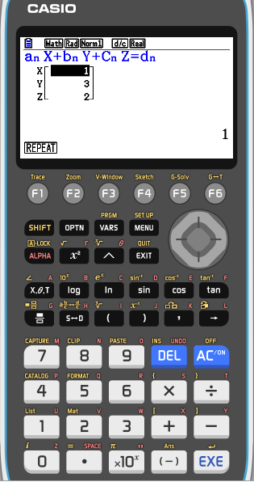
Solving simultaneous equations using the GDC
We will use the CASIO GDC to solve this equations.
7x + 5y – 3z = 16
3x – 5y + 2z = –8
5x + 3y – 7z = 0
Select EQUA from the main MENU
Then press F1 (SIML)
We have three unknowns in our equations so, press F2 (3)
Enter the coefficients of the equations as shown, pressing EXE after each entry.
Press F1 (SOLV) to solve the system
x = 1
y = 3
z = 2

Slide 8
Thank you for using resources from
For more resources visit our website
https://www.mathssupport.org
If you have a special request, drop us an email
info@mathssupport.org

