Slide 1
Solving simultaneous equations using the Equation solver
LO: To solve simultaneous equations using the Equation solver in the GDC

Slide 2
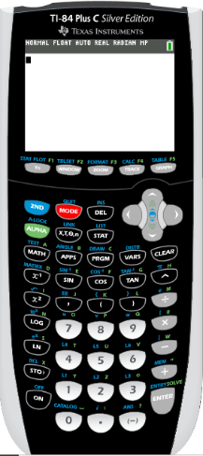
We are going to use Graphing display calculator to solve the Simultaneous equations using the Equation solver
Texas Instruments

Slide 3
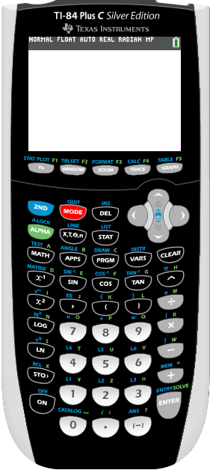
Solving simultaneous equations using the GDC
Use your TI – 84 Plus C to solve.
2x - 3y = 4
3x + 2y = 19
Click on APPS

Slide 4
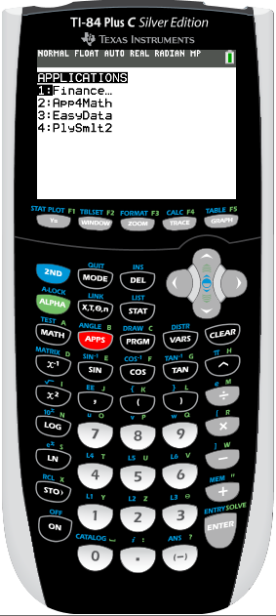
Solving simultaneous equations using the GDC
Use your TI – 84 Plus C to solve.
2x - 3y = 4
3x + 2y = 19
Click on APPS
Click on 4
PlySmlt2

Slide 5
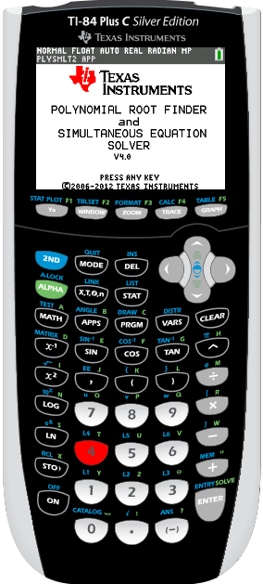
Solving simultaneous equations using the GDC
Use your TI – 84 Plus C to solve.
2x - 3y = 4
3x + 2y = 19
Click on APPS
Click on 4
PlySmlt2
Then press any key

Slide 6
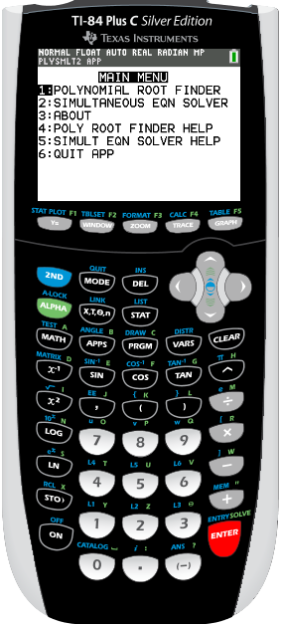
Solving simultaneous equations using the GDC
Use your TI – 84 Plus C to solve.
2x - 3y = 4
3x + 2y = 19
Click on APPS
Click on 4
PlySmlt2
Then press any key
Press 2: Simultaneous EQN SOLVER

Slide 7
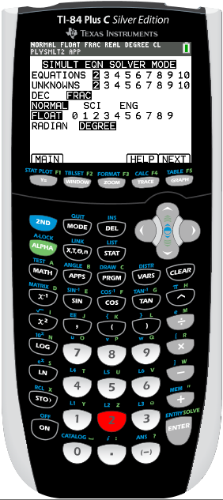
Solving simultaneous equations using the GDC
Use your TI – 84 Plus C to solve.
2x - 3y = 4
3x + 2y = 19
Click on APPS
Click on 4
PlySmlt2
Then press any key
Press 2: Simultaneous EQN SOLVER
Make sure that the setting is:
Equations 2, Unknowns 2.
Press NEXT

Slide 8
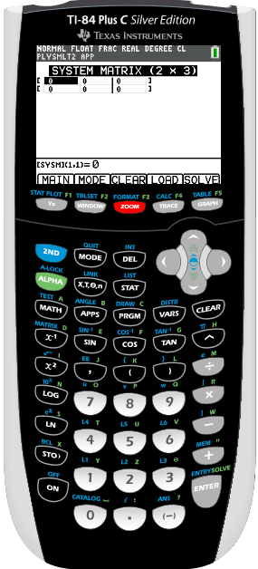
Solving simultaneous equations using the GDC
Use your TI – 84 Plus C to solve.
2x - 3y = 4
3x + 2y = 19
Click on APPS
Click on 4
PlySmlt2
Then press any key
Press 2: Simultaneous EQN SOLVER
Make sure that the setting is:
Equations 2, Unknowns 2.
Press NEXT
Enter the coefficients of the equations as shown, pressing ENTER after each entry.
Press F1 (SOLV) to solve the system

Slide 9
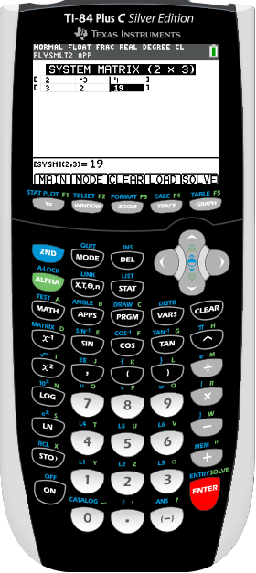
Solving simultaneous equations using the GDC
Use your TI – 84 Plus C to solve.
2x - 3y = 4
3x + 2y = 19
Click on APPS
Click on 4
PlySmlt2
Then press any key
Press 2: Simultaneous EQN SOLVER
Make sure that the setting is:
Equations 2, Unknowns 2.
Press NEXT
Enter the coefficients of the equations as shown, pressing ENTER after each entry.
Press SOLVE

Slide 10
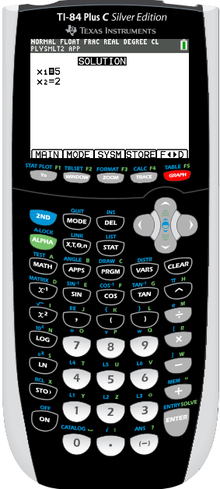
Solving simultaneous equations using the GDC
Use your TI – 84 Plus C to solve.
2x - 3y = 4
3x + 2y = 19
Click on APPS
Click on 4
PlySmlt2
Then press any key
Press 2: Simultaneous EQN SOLVER
Make sure that the setting is:
Equations 2, Unknowns 2.
Press NEXT
Enter the coefficients of the equations as shown, pressing ENTER after each entry.
Press SOLVE
So, the solution is x = 5, y = 2.

Slide 11

Thank you for using resources from
For more resources visit our website
https://www.mathssupport.org
If you have a special request, drop us an email
info@mathssupport.org

