Slide 1
Solving simultaneous equations using the Equation solver
LO: To solve simultaneous equations using the Equation solver in the GDC

Slide 2
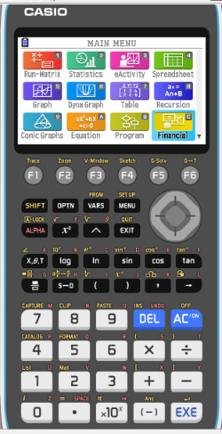
We are going to use Graphing display calculator to solve the Simultaneous equations using the Equation solver
CASIO

Slide 3
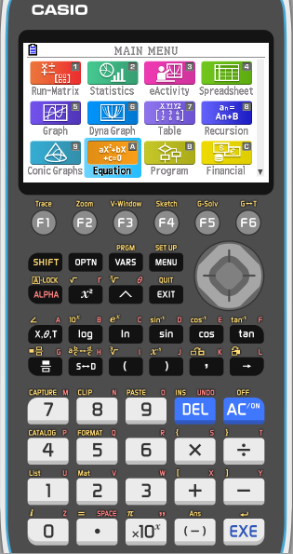
Solving simultaneous equations using the GDC
Use your CASIO Graphing calculator to solve.
2x - 3y = 4
3x + 2y = 19
Select EQUATION from the main MENU

Slide 4
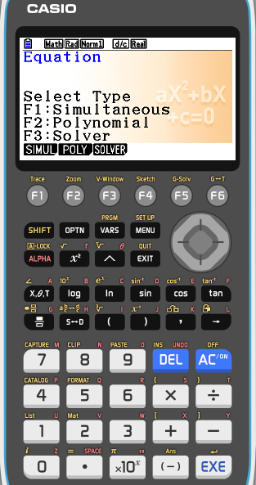
Solving simultaneous equations using the GDC
Use your CASIO Graphing calculator to solve.
2x - 3y = 4
3x + 2y = 19
Select EQUATION from the main MENU
Then press F1 (SIMUL)

Slide 5
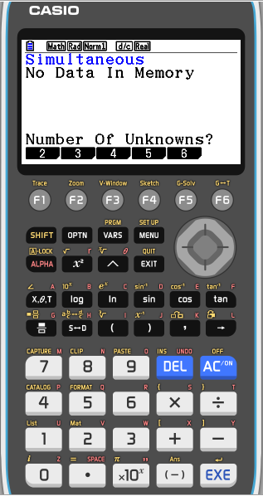
Solving simultaneous equations using the GDC
Use your CASIO Graphing calculator to solve.
2x - 3y = 4
3x + 2y = 19
Select EQUATION from the main MENU
Then press F1 (SIMUL)
We have two unknowns in our equations so, press F1 (2)

Slide 6
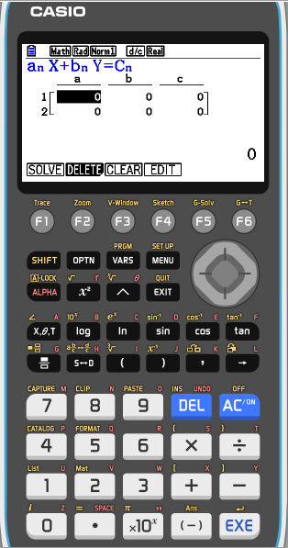
Solving simultaneous equations using the GDC
Use your CASIO Graphing calculator to solve.
2x - 3y = 4
3x + 2y = 19
Select EQUATION from the main MENU
Then press F1 (SIMUL)
We have two unknowns in our equations so, press F1 (2)
Enter the coefficients of the equations pressing EXE after each entry.

Slide 7
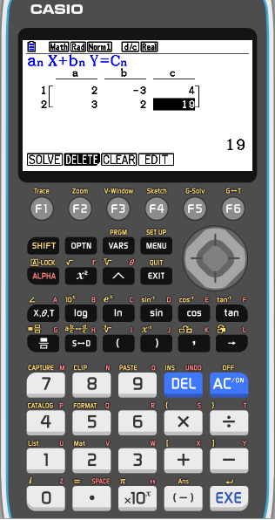
Solving simultaneous equations using the GDC
Use your CASIO Graphing calculator to solve.
2x - 3y = 4
3x + 2y = 19
Select EQUATION from the main MENU
Then press F1 (SIMUL)
We have two unknowns in our equations so, press F1 (2)
Enter the coefficients of the equations pressing EXE after each entry.
Press F1 (SOLV) to solve the system

Slide 8
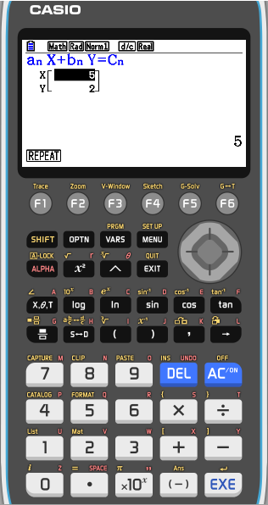
Solving simultaneous equations using the GDC
Use your CASIO Graphing calculator to solve.
2x - 3y = 4
3x + 2y = 19
Select EQUATION from the main MENU
Then press F1 (SIMUL)
We have two unknowns in our equations so, press F1 (2)
Enter the coefficients of the equations pressing EXE after each entry.
Press F1 (SOLV) to solve the system
So, the solution is x = 5, y = 2.

Slide 9
Thank you for using resources from
For more resources visit our website
https://www.mathssupport.org
If you have a special request, drop us an email
info@mathssupport.org

